Slide 1
Characterizing the Transcriptomic Recurrence Signature of Glioblastoma Following Laser Interstitial Thermal Therapy
Gregory J. Schwing, MD, PhD¹ · Tavarekere N. Nagaraja, PhD²
Indrani Datta, DHI² · Ian Y. Lee, MD²
¹ Department of General Surgery, Detroit Medical Center and Wayne State University, Detroit, MI
² Department of Neurosurgery, Hermelin Brain Tumor Center, Henry Ford Health, Detroit, MI
CNS 2026 Annual Meeting, Washington, DC
Presentation SSTU02 (Abstract 418) · Sunrise Science Session, Tumor 2
Monday 2 November 2026, 7:00–7:06 AM
Room 147B, Walter E. Washington Convention Center
Notes:
Good morning. I'm Greg Schwing, from Wayne State and the Detroit Medical Center. I have no disclosures. Dr. Lee consults for Medtronic and Monteris.

Slide 2
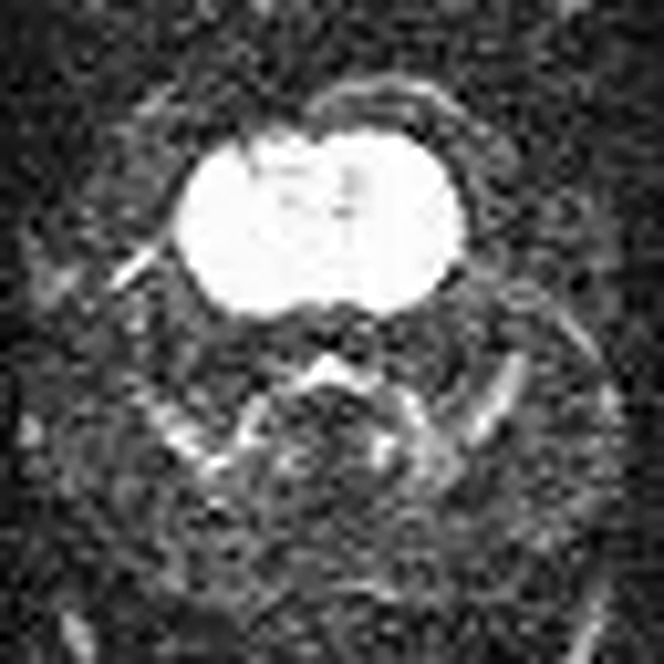
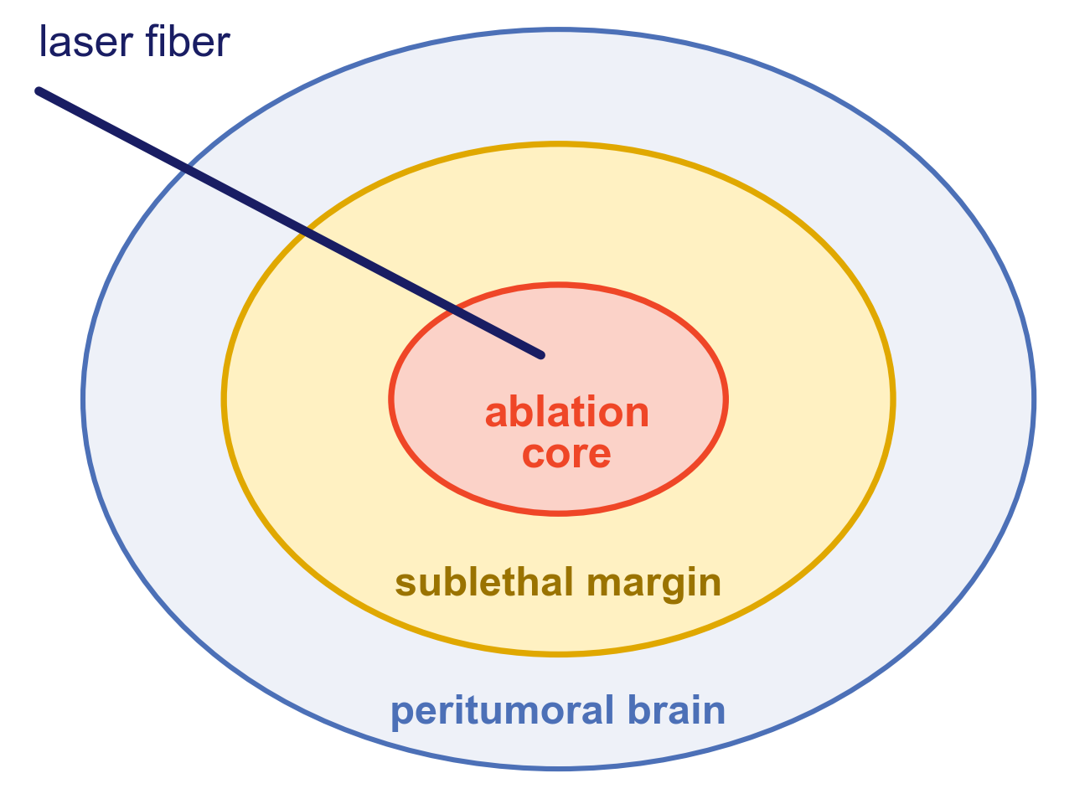
LITT kills the core. What grows back?
What is a regrowing lesion made of, and can tumor be measured away from the implant?
Video: diffusion-weighted MRI during LITT in this rat model, from Nagaraja TN, et al. Acta Neurochir 2021;163:3455-3463; permission pending. Schematic, not to scale. Chen C, et al. J Neurooncol 2021;151:429-442.
Notes:
This is diffusion MRI during LITT in this rat model. We kill the core. Cells in the margin are thought to survive, and tumor comes back. We then sample tumor and brain mixed together. So, two questions. What is a regrowing lesion made of? And can we measure tumor away from the implant?

Slide 3
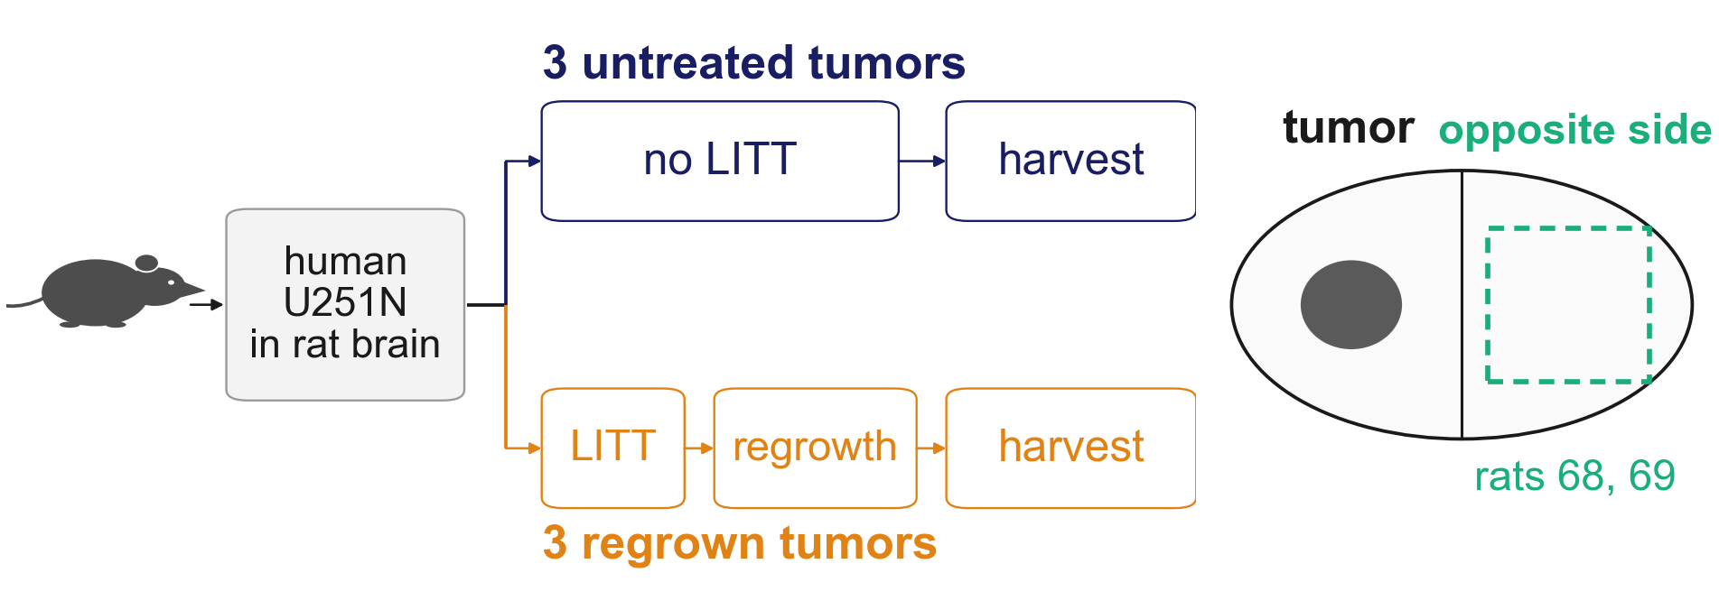
A human tumor in a rat: every read sorted by species
Every read and array probe is assigned to tumor or host by sequence.
Nagaraja TN, et al. J Neurosurg 2026;145:364-377. Eight rats implanted; rat 64's piece held no tumor, rat 65 has no library. Arrays scanned April 2022; harvest dates per animal are not recorded. Orthotopic U251N xenograft in the athymic rat, MRI-guided LITT; n = 3 per arm, one cell line; RNA data GEO GSE338105.
Notes:
Here's the design. Human U251N cells in a rat brain. Three tumors stayed untreated. Three regrew after LITT. In two rats we also took the opposite side. The tumor is human and the brain is rat, so we can sort every read by species. You can't do that in a patient.

Slide 4
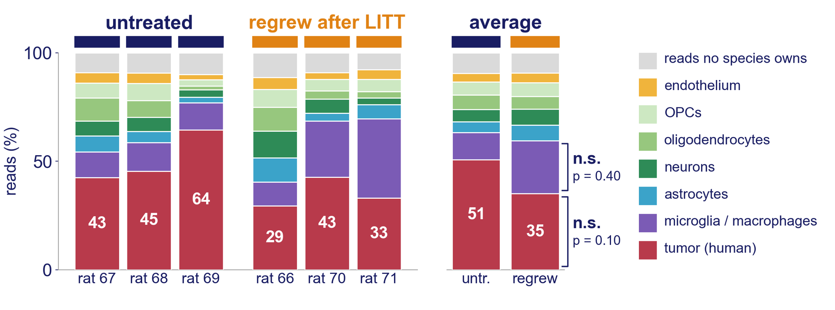
Regrowing lesions hold less tumor
Tumor share: RNA p = 0.10; the methylation array gives the same order, p = 0.05*, the smallest p six animals can give.
Read share by source: human reads by xengsort (k = 25); rat reads split into six cell types (BRETIGEA). Exact test over all 20 ways to split six animals; tumor one-sided as pre-stated, microglia two-sided; * p ≤ 0.05. Layout after Varn FS, et al. Cell 2022;185:2184-2199. Orthotopic U251N xenograft in the athymic rat, MRI-guided LITT; n = 3 per arm, one cell line; RNA data GEO GSE338105.
Notes:
Each column is one lesion, split by where its reads come from. Red is tumor. Purple is microglia and macrophages. Orange regrew after LITT, and its tumor share runs lower: 29 to 43 percent, against 43 to 64. On average, half becomes a third. The methylation array gives the same order. With six animals, p can't go below 0.05, and DNA sits at that floor.

Slide 5
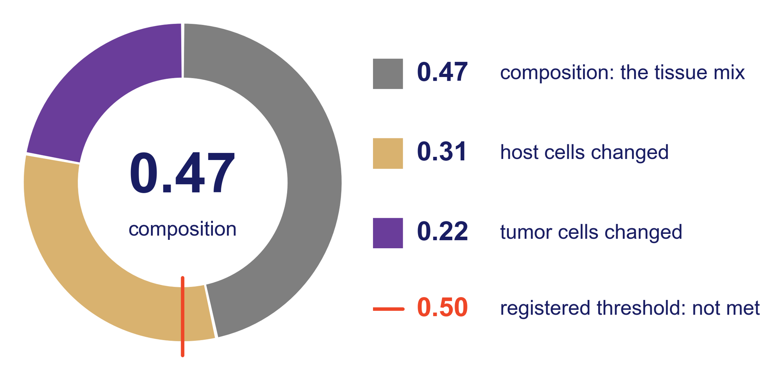
Less tumor explains under half of the change
Of the 133 genes a bulk analysis calls differential, 13 % are composition-dominant.
Shapley split of each gene's bulk fold change, 10,192 one-to-one orthologs; share of summed absolute terms. Shen-Orr SS, et al. Nat Methods 2010;7:287-289 (mixture model). Orthotopic U251N xenograft in the athymic rat, MRI-guided LITT; n = 3 per arm, one cell line; RNA data GEO GSE338105.
Notes:
So is the whole signal just less tumor? Here we can answer exactly. The ring is the change a bulk assay sees, split into three parts. Gray is the tissue mix: 0.47. It's the biggest piece, but we said in advance it had to pass one half, that red mark, and it didn't. The rest is host and tumor cells changing. The mesenchymal score, for one, falls in the tumor cells.

Slide 6
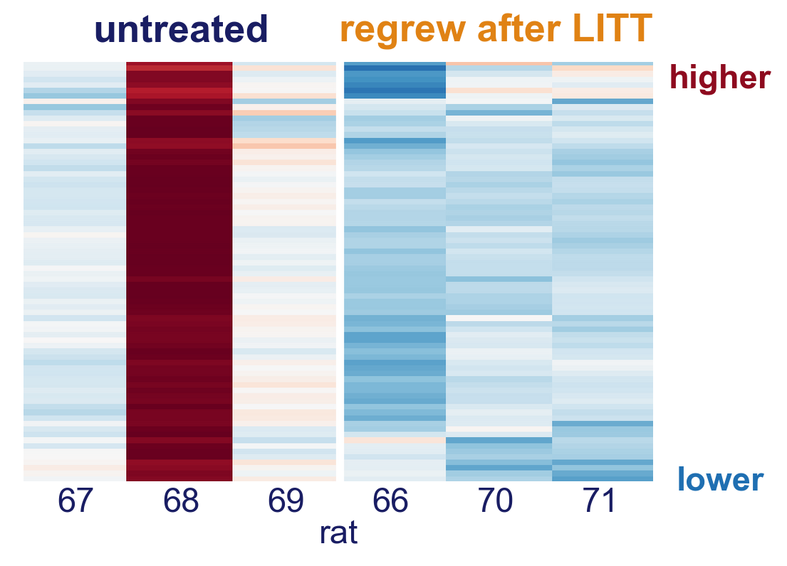
In the tumor cells, ribosomal-protein genes fall
The direction holds with any tumor left out.
One tumor, IL68B, sets the size: −0.40 becomes −0.11 log2 without it.
FDR q is seed-dependent: 0.02 to 0.31.
Tumor content is not separated from it.
Broad GSEA, gene-set permutation; 77 leading-edge ribosomal-protein genes, row z-scores. Subramanian A, et al. Proc Natl Acad Sci USA 2005;102:15545-15550. Orthotopic U251N xenograft in the athymic rat, MRI-guided LITT; n = 3 per arm, one cell line; RNA data GEO GSE338105.
Notes:
These are the tumor cells alone. Each column is a tumor, each row a ribosomal-protein gene. Red is higher, blue is lower. The regrown tumors are blue. These genes fall. Now the cautions. The dark red column is rat 68. That one tumor, IL68B, sets the size: without it, 0.40 shrinks to 0.11 log2. The false discovery rate is seed-dependent, 0.02 to 0.31. And the translational shutdown in your abstract book was a first-pass test. We haven't measured translation.

Slide 7
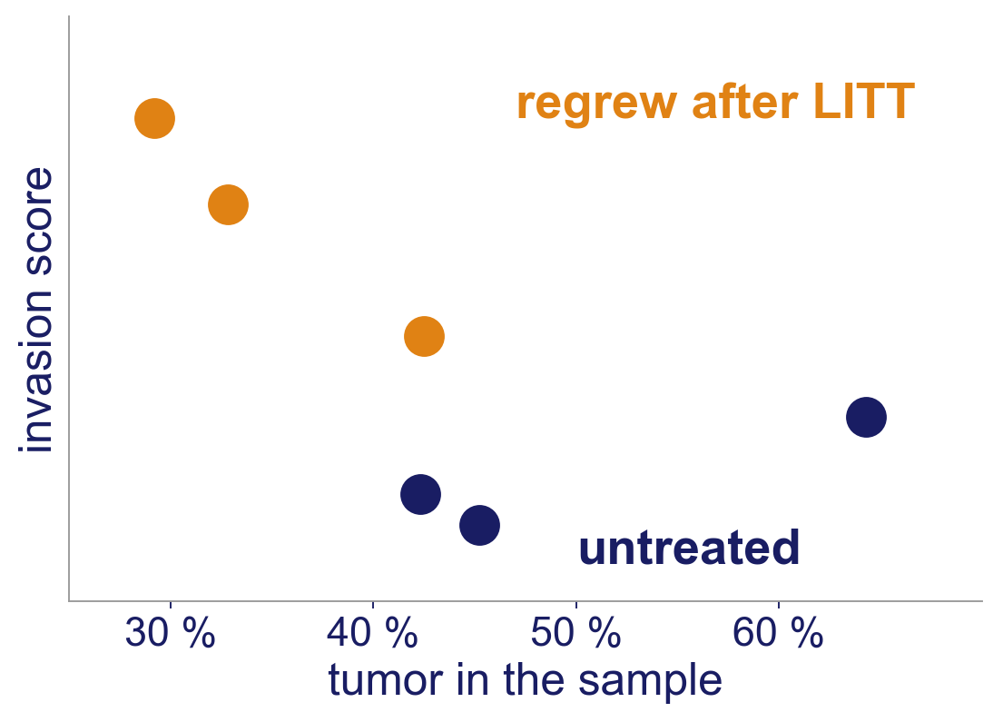
One invasion program stays up after adjustment
First of twenty labellings after adjusting for tumor share.
p = 0.05 is the floor of this design.
Regrown tumors were also harvested later: a hypothesis, not a finding.
Distal-invasion program from Chanoch-Myers R, et al. Nat Commun 2026;17:4079; singscore on floor-corrected human log-CPM; score ~ arm + tumor share. Orthotopic U251N xenograft in the athymic rat, MRI-guided LITT; n = 3 per arm, one cell line; RNA data GEO GSE338105.
Notes:
Now infiltration. Each dot is a tumor. Up is a published distal-invasion score. Orange sits above blue. Adjusted for tumor content, it's first of twenty labellings. That's p of 0.05, the floor here. These animals were also harvested later. So it's a hypothesis, not a finding.

Slide 8
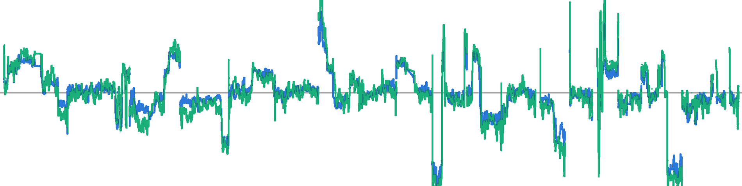
U251N material in the opposite hemisphere
Rat 69, never ablated: its tumor and its opposite hemisphere
4.90 %
56 of 59
0.88
0.55 %
human reads
donor genotype
male Y dose, female rat
rat 68, same site
Copy number along chromosomes 1 to 22, scaled to the parental culture; running medians, bin cloud removed and lines thickened for the slide. Y dose relative to the culture. Two platforms, separate aliquots, one animal. Both opposite-side animals were never ablated.
Notes:
This one surprised us. Rat 69 was never ablated. Each line is copy number along the genome. Blue is its tumor. Green is its opposite hemisphere. They rise and fall together. That's the cell line's fingerprint. That piece read 4.9 percent human, with the donor genotype at 56 of 59 probes and a male Y in a female rat. Rat 68 read 0.55. One animal, never ablated, so nothing here speaks to LITT.

Slide 9
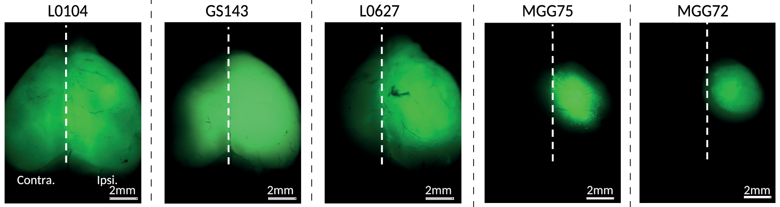
Others have tracked glioblastoma across the midline
crossed
less
did not
Mouse: 4 of 20 patient-derived models reached the far side (single-cell RNA-seq).
Patient: a second GBM in the opposite hemisphere shared the first tumor's changes.
U251N: recovered from the far side in mice by GFP; no sequence-based report found.
Panel: Chanoch-Myers R, et al. Nat Commun 2026;17:4079, Fig. 1f, cropped; green, GFP-labelled tumor; permission pending. van Nifterik KA, et al. J Neurosurg 2006;105:739-744. Johnston AL, et al. PLoS Biol 2007;5:e212. Other models; none settles rat 69.
Notes:
We aren't the first to look. These are mouse brains from a 2026 paper. Green is human tumor. The first three crossed the midline, the next one less, the last one didn't. Four of twenty patient-derived models reached the far side, by single-cell sequencing. In a patient, a second glioblastoma in the opposite hemisphere shared the first tumor's genetic changes. For U251N, we found no sequence-based report. None of this tells us what happened in rat 69.

Slide 10
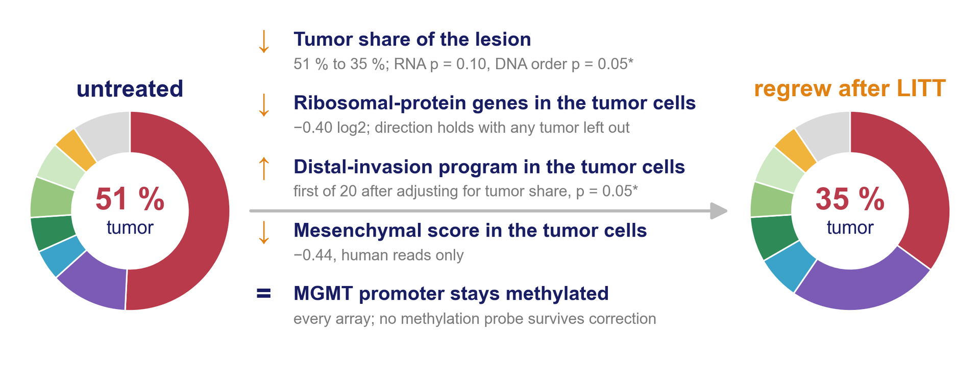
Before and after LITT: the recurrence phenotype
Three tumors per arm, one cell line: each line is a pilot result.
Rings: average read share by source, colours as on slide 4. * p ≤ 0.05 by the exact test over the 20 splits. Layout after Varn FS, et al. Cell 2022;185:2184-2199 (Fig. 7). Orthotopic U251N xenograft in the athymic rat, MRI-guided LITT; n = 3 per arm, one cell line; RNA data GEO GSE338105.
Notes:
Here's the whole picture. Left, untreated. Right, regrown after LITT. Tumor share falls from about half to a third. In the tumor cells, ribosomal-protein genes fall, a distal-invasion program rises, and the mesenchymal score falls. MGMT stays methylated. Each line is a pilot result, three per arm.

Slide 11
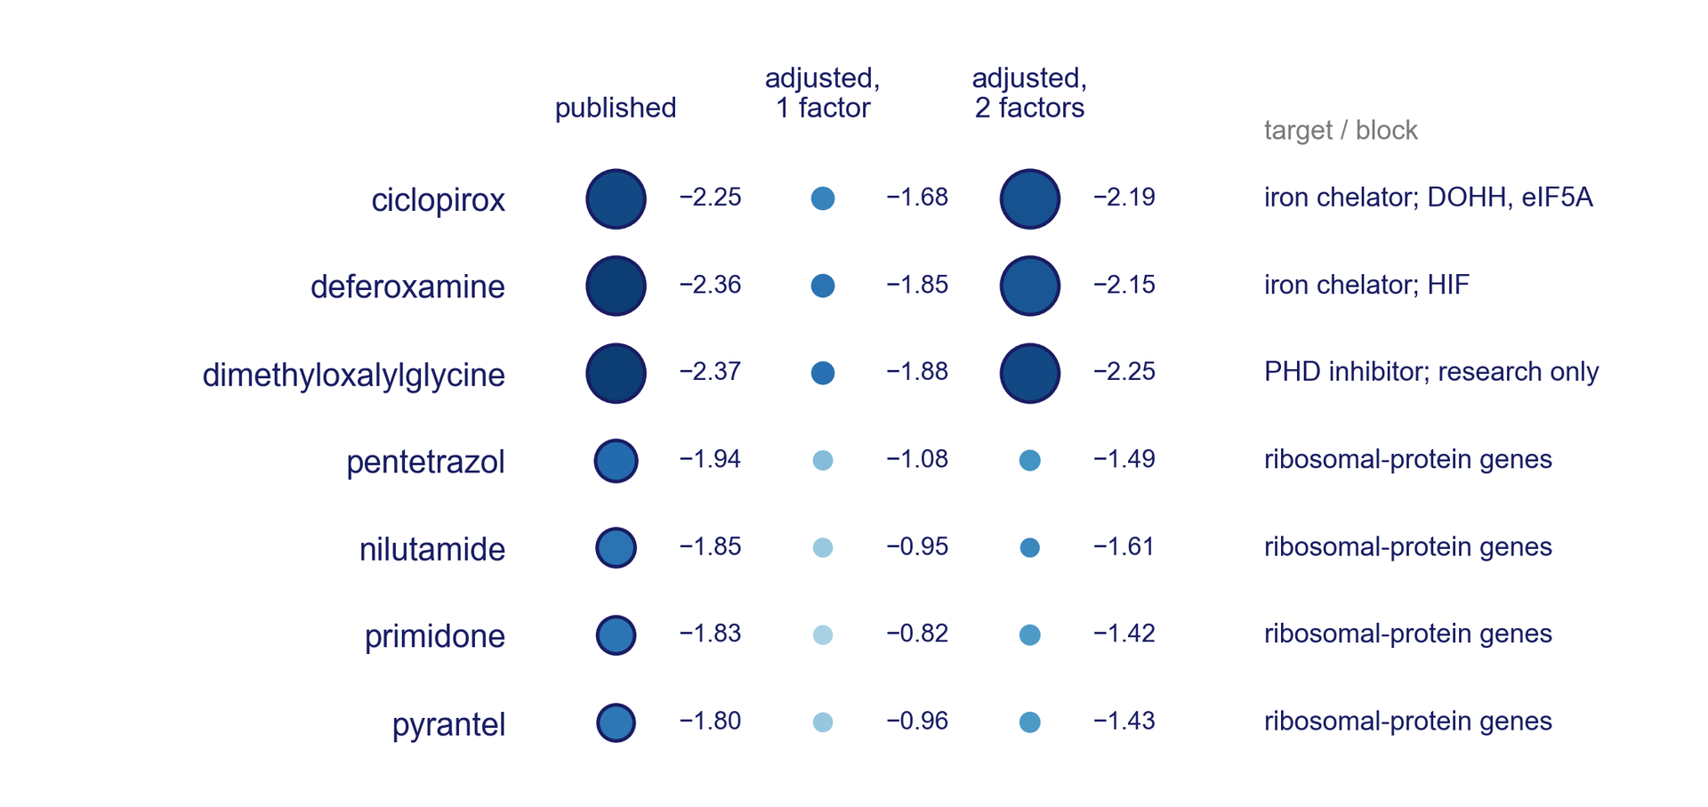
Drug targets after the control-sample adjustment
6 of the 16 published drug signatures hold (q < 0.05), all led by hypoxia genes, among them two iron chelators and an oxygen-sensor inhibitor. The ribosomal-protein drugs fall away (q > 0.8).
DSigDB v1.0 drug signatures, preranked GSEA, 1,000 permutations; blue, the signature opposes the regrown tumors' change; area, -log10 q; ring, q < 0.25. Adjusted: RUVs factors from the three control samples (IL64B, N168B, N269B). Yoo M, et al. Bioinformatics 2015;31:3069-3071. Risso D, et al. Nat Biotechnol 2014;32:896-902. Computational prediction, untested in this model.
Notes:
Now the drug screen. Each dot is a drug signature tested against the regrown tumors. Blue opposes the recurrence change, and a ring passes false-discovery control. The left column is the published screen. The other two first remove the cross-species read signal that our three control samples measure. The ribosomal-protein drugs fall away. What stays is one axis: iron-dependent enzymes. Ciclopirox and deferoxamine are approved drugs. This is a computational prediction, untested in this model.

Slide 12
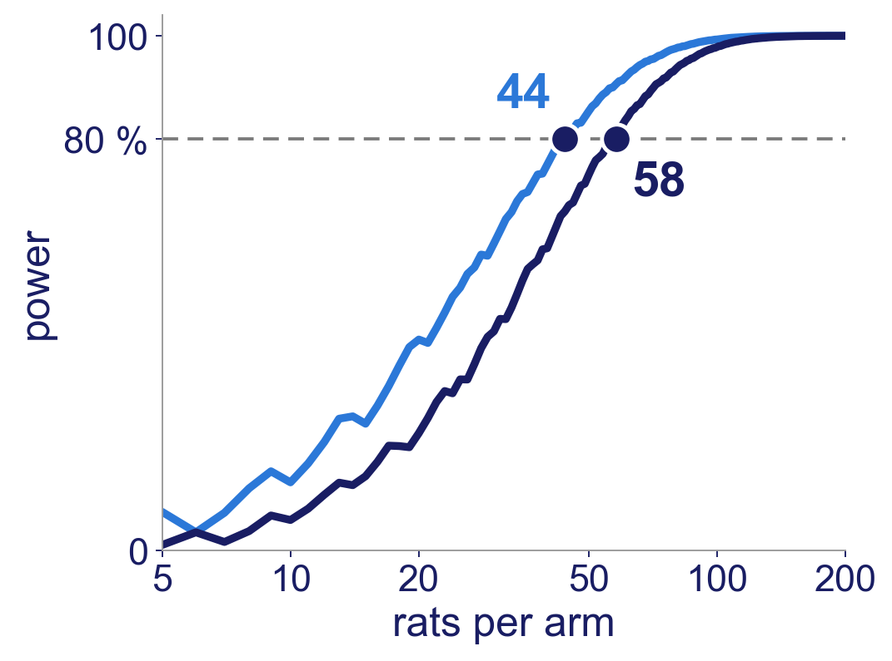
The next experiment, sized in advance
44–58
rats per arm: does LITT change how often remote tumor is found?
9–16
barcoded animals: the clone-level question
Whole design: 141–199 rats.
Power to detect 0.20 against 0.50 by Fisher exact; dashed, 80 %; 44 unadjusted, 58 Holm-adjusted. Whole design: 141 unadjusted, 199 conservative. Targets fixed and hashed before the pilot was read. Browne RH. Stat Med 1995;14:1933-1940.
Notes:
So what's next? The curve is power against rats per arm. 44 to 58 rats per arm tests whether LITT changes how often remote tumor is found. 9 to 16 barcoded animals ask the clone question. The whole design is 141 to 199 rats.

Slide 13
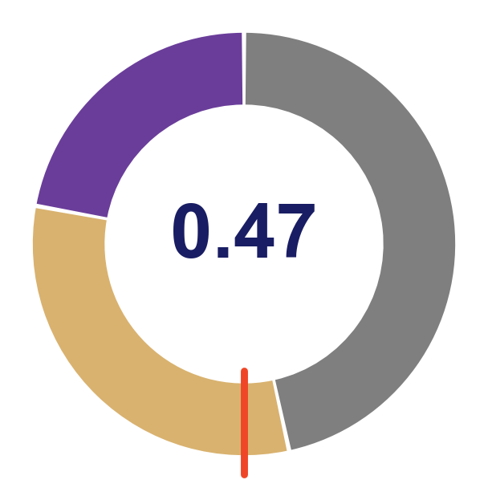
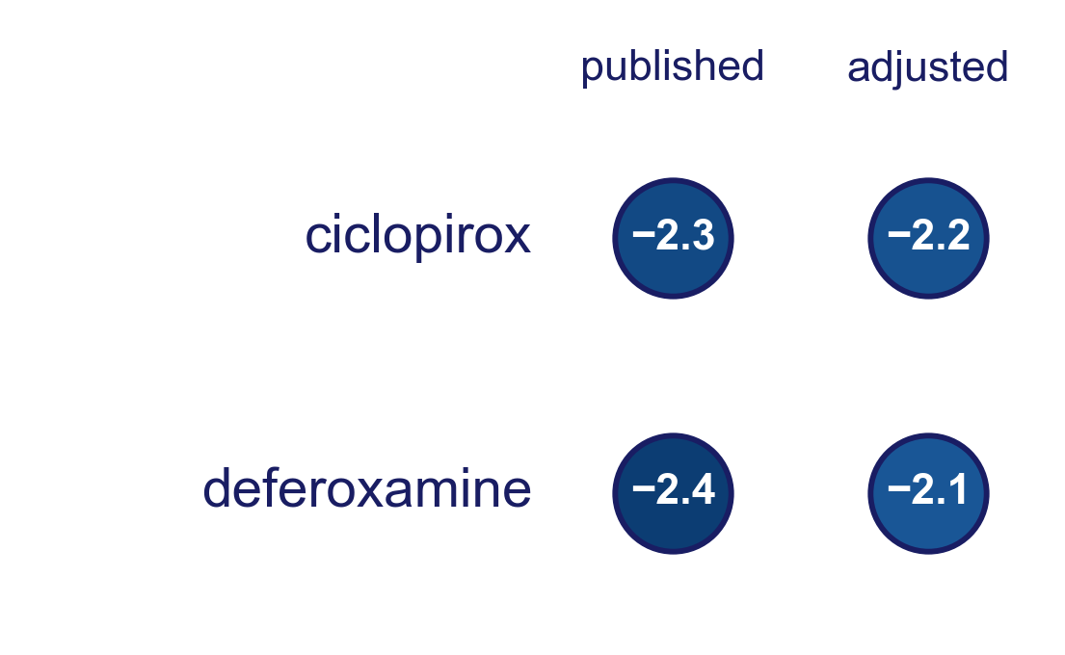
What this means
Less tumor, and that mix explains under half of the signal.
The drug axis that survives the control samples: iron-dependent enzymes.
U251N material is measurable in the opposite hemisphere.
Thanks: Tavarekere N. Nagaraja, PhD, Indrani Datta, DHI, and Ian Y. Lee, MD, Hermelin Brain Tumor Center, Henry Ford Health.
Henry Ford Health Physician Scientist Award A20050 (I.Y.L.). IACUC #1509; ARRIVE. RNA data: GEO GSE338105.
Questions: go2432@wayne.edu
Evidence status: one cell line (U251N) in one rat xenograft model, n = 3 per arm. New and evolving work; no patient data.
Notes:
To close. Regrowing lesions hold less tumor, and that explains under half of the signal. In the tumor cells, the drug screen that survives our control samples points to one axis, iron-dependent enzymes, with ciclopirox first. And U251N material can be measured in the opposite hemisphere. These are pilot results, three tumors per arm in one cell line. Thank you.

Slide 14
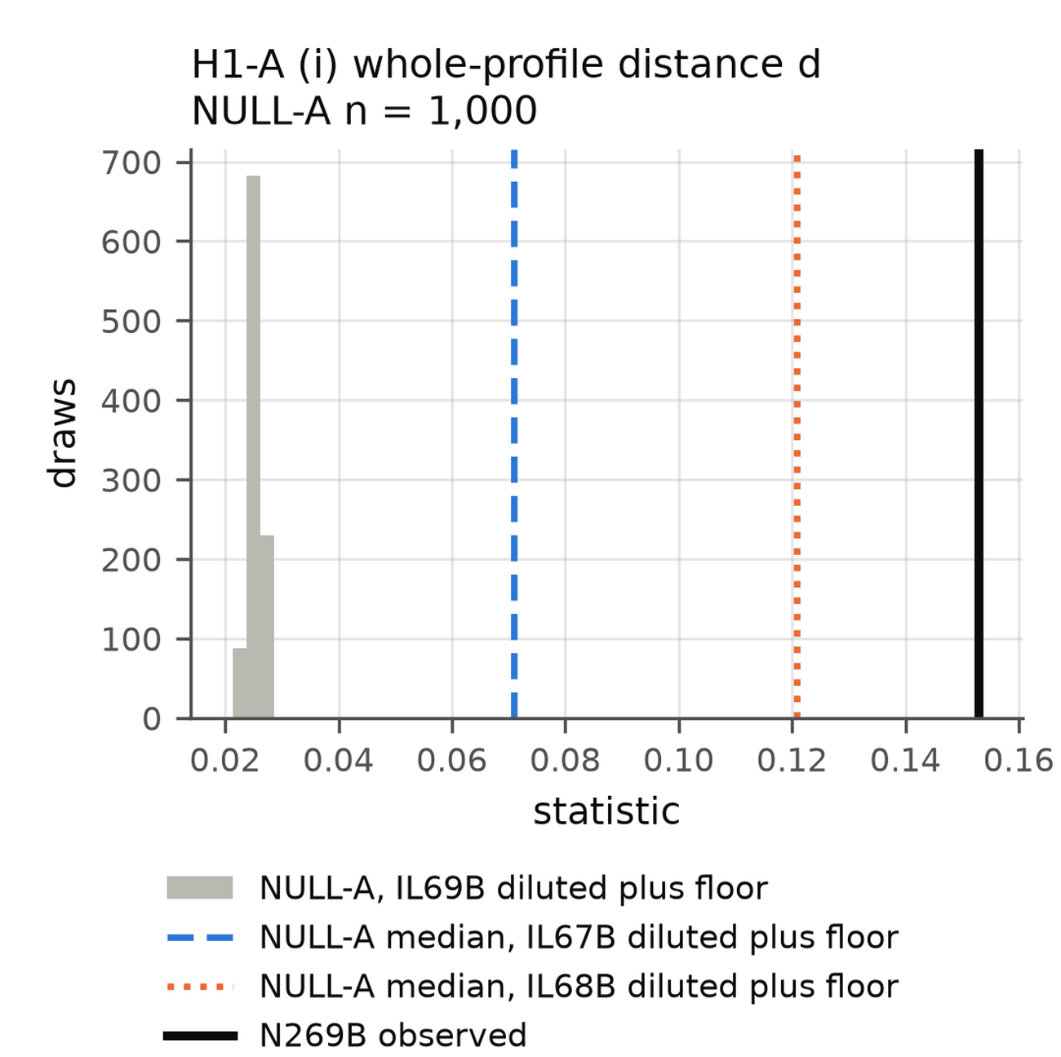
Backup. Not its own core diluted, on two of three tests
Own core thinned to the same depth, plus the floor, 1,000 draws: whole-profile distance 0.153 against a null 99.5th percentile of 0.028.
The statistic with a direction named in advance does not reject (P = 0.56).
Dashed and dotted lines: the same construction from two other animals' tumors. One animal.
Notes:
This asks whether the far-side RNA is just its own tumor, thinned out. Gray is what thinning gives. The black line is what we saw, well outside it. Two of three tests say the same. The third doesn't.

Slide 15
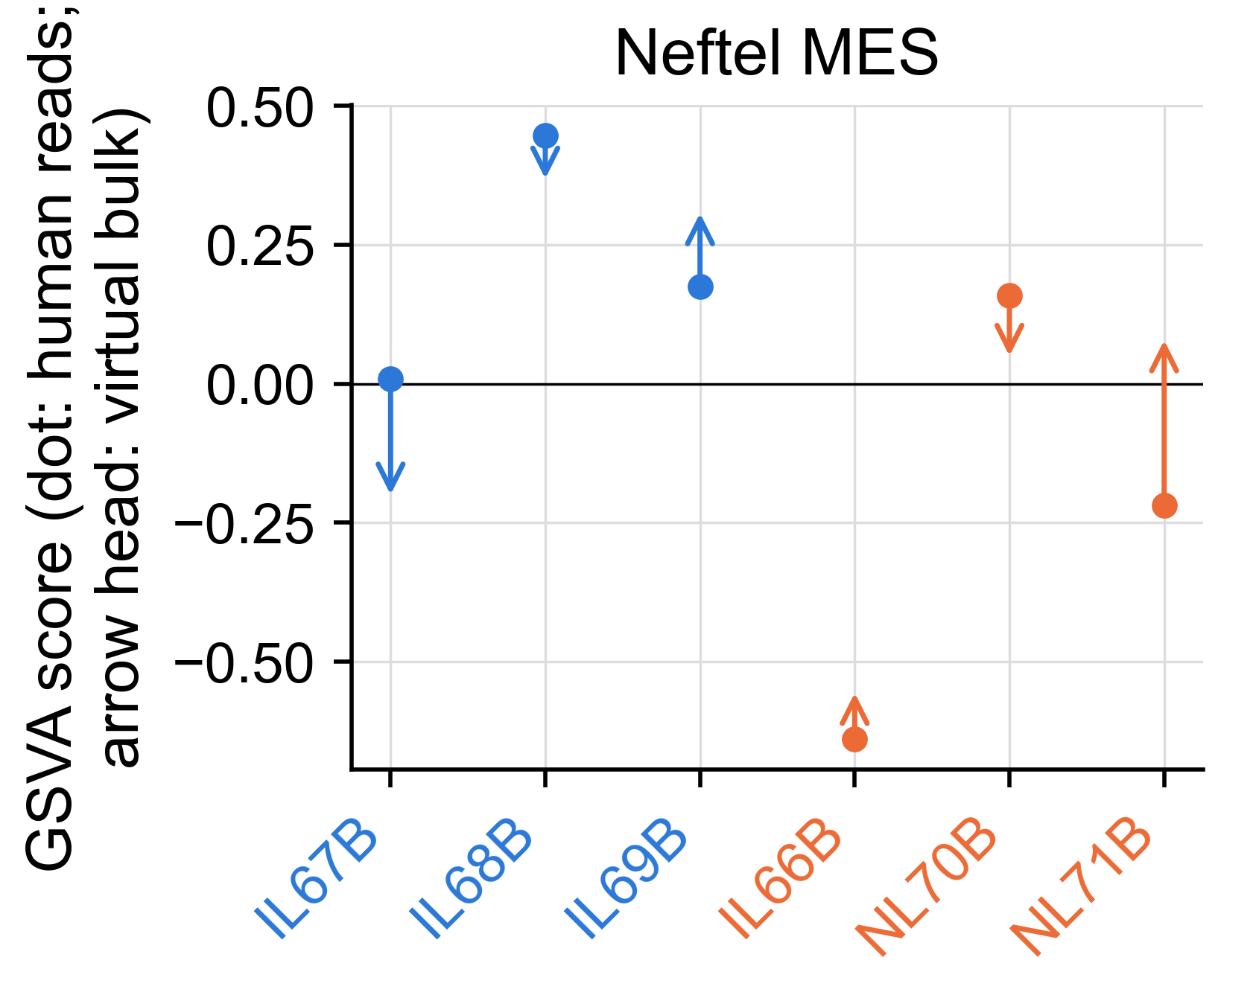
Backup. Mesenchymal score: tumor cells and bulk
Tumor-cell score change −0.44: it falls at recurrence.
Rat-only score tracks myeloid content (Spearman 0.66); the composition-generated shift ranks 5 of 20, so it is not shown at six animals.
Neftel C, et al. Cell 2019;178:835-849. Dot, human reads; arrow head, the same sample read as bulk. GSVA on TMM log-CPM. Orthotopic U251N xenograft in the athymic rat, MRI-guided LITT; n = 3 per arm, one cell line; RNA data GEO GSE338105.
Notes:
Each dot is a tumor's mesenchymal score in the human reads. The arrow shows the same sample read as bulk. The tumor-cell score falls at recurrence. Six animals can't tell us how much of the bulk signal is host.

Slide 16
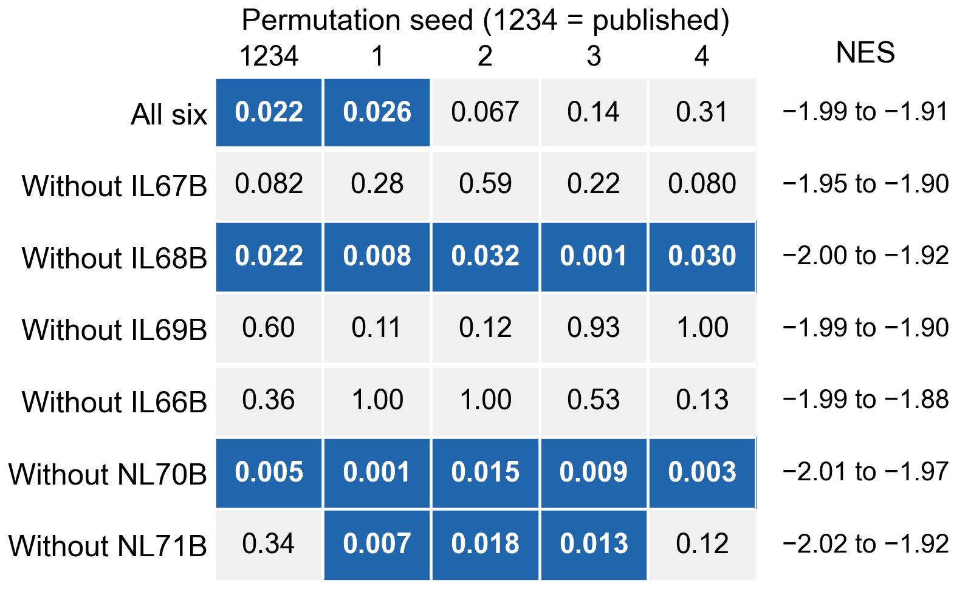
Backup. Leave any tumor out
Every run: NES −1.88 to −2.02, nominal p < 0.002. FDR q < 0.05 in 15 of 35 runs.
The published GSEA command with one tumor removed and the filter re-applied, five permutation seeds; seed 1234 reproduces the published report exactly.
Notes:
Each row leaves one tumor out. Each column is a random seed. Blue means q under 0.05. The direction never changes. The q value does.

Slide 17
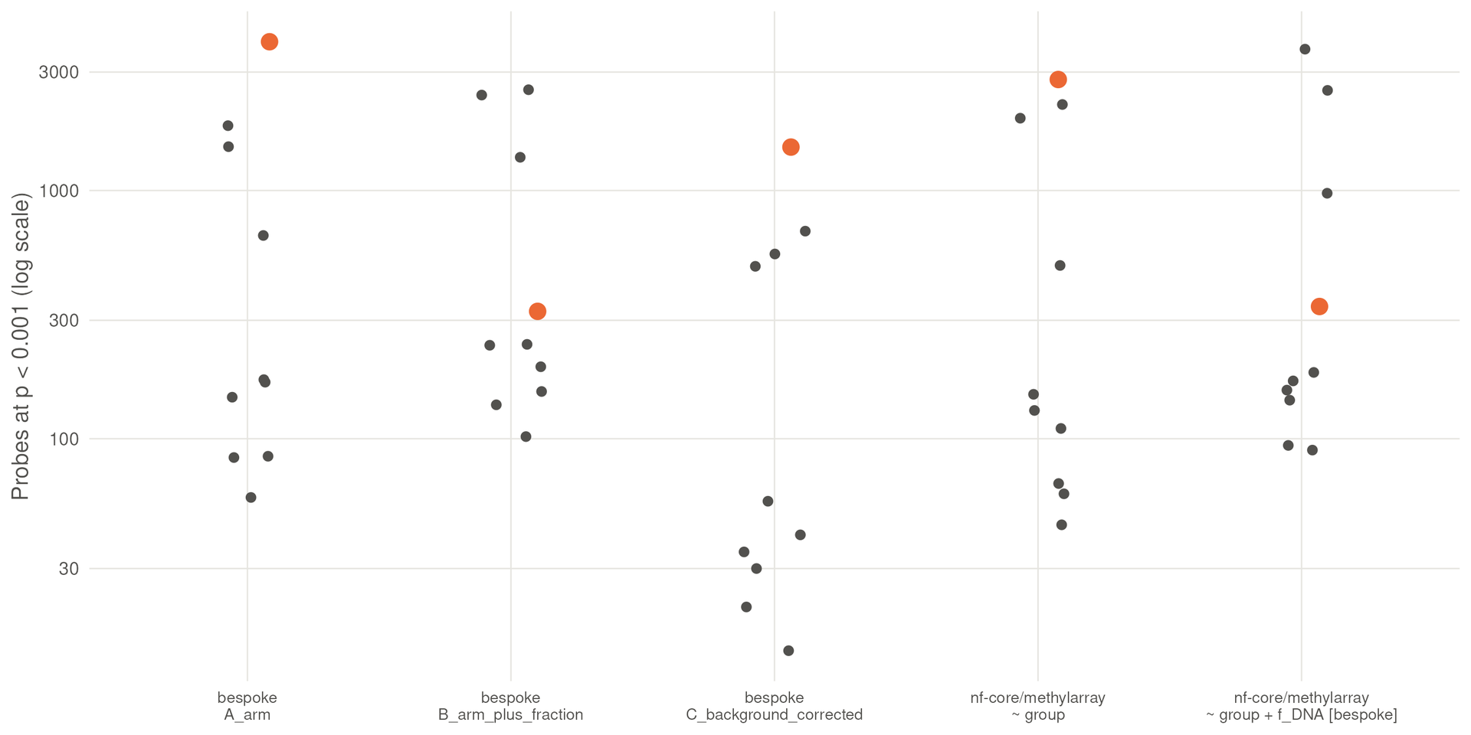
Backup. Methylation: nothing survives correction
No probe reaches FDR < 0.05. The true split ranks 1 of 10 without a fraction covariate and 4 of 10 with it.
That holds in two pipelines and under all 14 published cross-species exclusion lists.
Probes at p < 0.001 for all ten balanced splits, per pipeline and design; the true split is orange. Orthotopic U251N xenograft in the athymic rat, MRI-guided LITT; n = 3 per arm, one cell line; RNA data GEO GSE338105.
Notes:
Each dot is one way of splitting the six tumors. Orange is the real split. No probe survives correction. Adjust for tumor content and the real split drops from first to fourth.

Slide 18
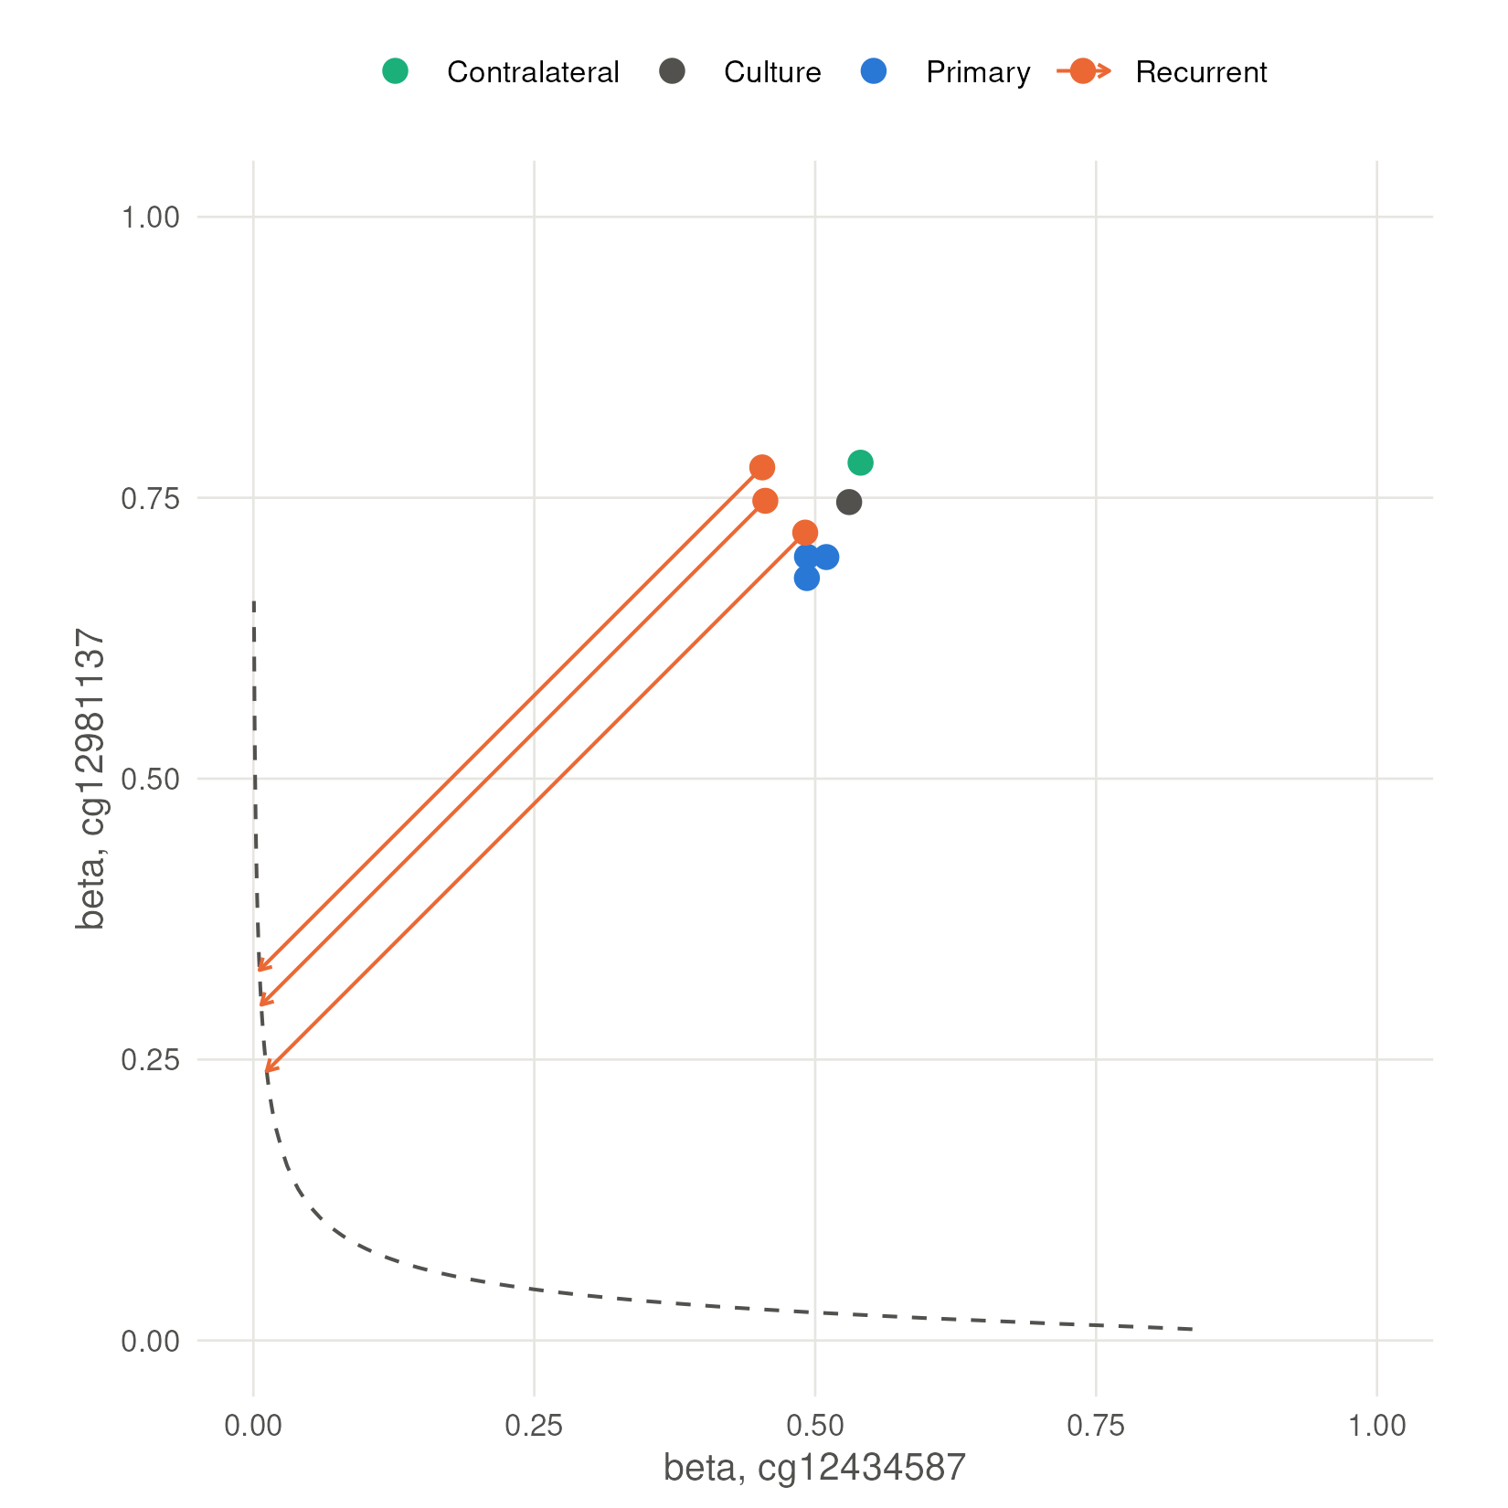
Backup. MGMT status does not move
MGMT-STP27 calls every array methylated (0.995–0.998); a call would need a shift of 0.45–0.48 beta.
No animal received an alkylating agent: a stability readout, not a resistance result.
Bady P, Delorenzi M, Hegi ME. J Mol Diagn 2016;18:350-361. Dashed line, the model's decision boundary. Orthotopic U251N xenograft in the athymic rat, MRI-guided LITT; n = 3 per arm, one cell line; RNA data GEO GSE338105.
Notes:
Every array calls MGMT methylated. The arrows show how far a call would have to move to change. No animal got an alkylating agent, so this is stability, not resistance.

Slide 19
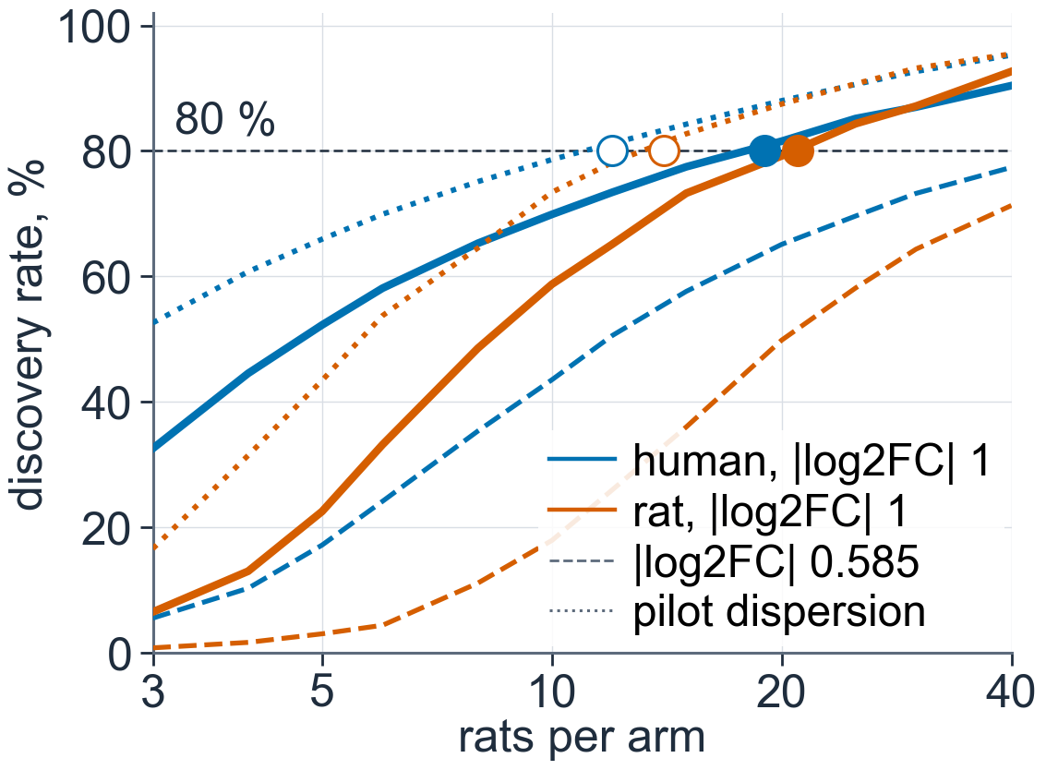
Backup. Genome-wide sizing
Expression, 80 % discovery at |log2FC| 1: 19 human, 21 rat per arm; 63 with the fraction covariate at its worst.
Methylation: Δβ 0.10 misses 80 % at the conservative SD; 39 per arm at the pilot SD.
Filled marks, conservative sizing; open marks, pilot dispersion; dashed curves, |log2FC| 0.585; the host share of DE genes is assumed at 1 %. power.json, job 40483640.
Notes:
This sizes genome-wide expression. The dashed line is 80 percent. That's 19 to 21 rats per arm without the tumor-content covariate, 63 with it at its worst.

Slide 20
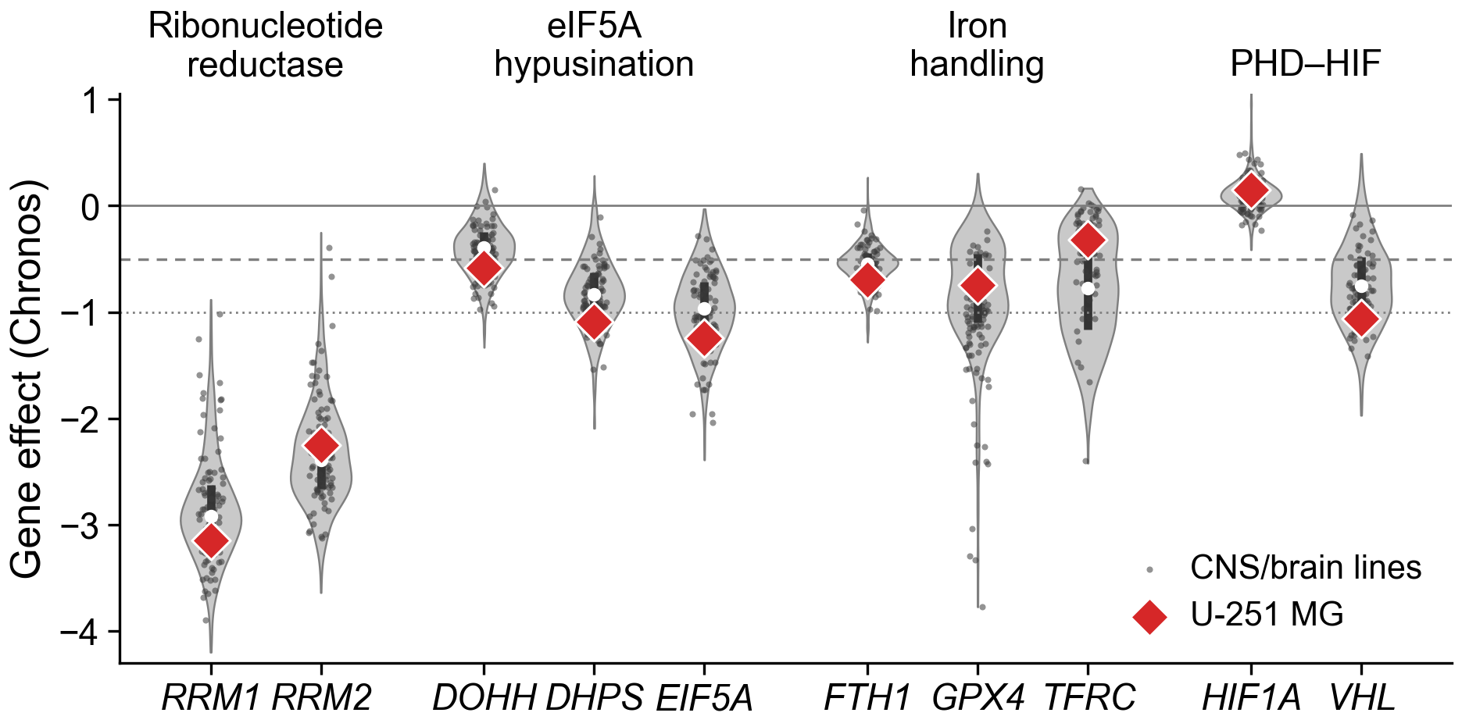
Backup. Why ciclopirox, the abstract's lead candidate
Ciclopirox chelates iron and inhibits DOHH, which activates eIF5A for translation elongation. In DepMap¹⁶, U-251 MG is past the dependency threshold for DOHH (−0.58), more dependent than 69 % of 90 CNS lines (median −0.46).
In mice, LITT opens the barrier around the ablation for one to three weeks¹⁷: a possible delivery window.
16. DepMap 24Q4 (depmap.org), Chronos gene effect, U-251 MG (ACH-000232); Dempster JM, et al. Genome Biol 2021;22:343. 17. Cleary RT, et al. Neuro Oncol 2026;28:1649–1661. Dashed, −0.5; dotted, −1.
Notes:
This is the abstract's lead drug candidate. U-251 sits past the dependency threshold for DOHH, which ciclopirox inhibits. It's a computational prediction, untested in this model.

