Slide 1
Not All Spines Are Created Equal: A Single-Shot CT Segmentation Model For Preoperative Detection Of Lumbar And Thoracic End Anomalies
Gregory J. Schwing, MD, PhD
Department of General Surgery, Detroit Medical Center and Wayne State University, Detroit, MI
CNS 2026 Annual Meeting, Washington, DC
Mini Podium 4, Spine Session 1 (MP4SP1) · Monday 2 November 2026, 5:21–6:00 PM · Podium 4, Ballroom ABC
The paper of the same title is accepted at NeurIPS 2026, Datasets and Benchmarks track

Slide 2

Where this is going
1
Surgeons count vertebrae on the C-arm. On a transitional spine the count is wrong
2
Today's tools map a position on the spine to the preoperative CT to help the surgeon count. Humans still make mistakes
3
SchwingNet reads the level from the shape of the bones in a limited field of view; with the sacrum in view it also counts, and checks the two against each other; from a sweep of overlapping exposures it reconstructs the spine. Nothing is mapped to the CT
A real lateral C-arm exposure; each body named from its shape, with its probability.
4
Tested on real intraoperative C-arm exposures: how often it is right, and when it stops
5
What is missing: enough transitional patients' scans to feed the model

Slide 3

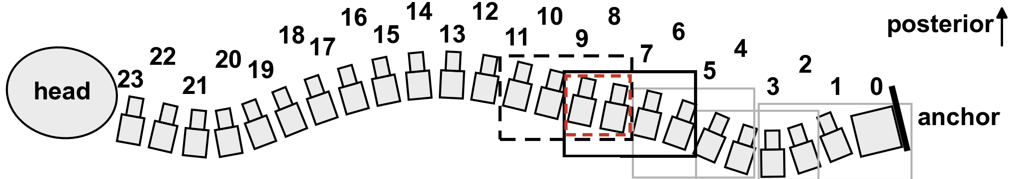
The level is counted, and the count is often wrong
Half of spine surgeons report a wrong-level operation in their career (Mody 2008; Groff 2013)
Registry of 34,544 operations: 0.12 %, thoracic 0.42 % (Furuya 2026)
The first exposed level is wrong in 4–15 % before the check film; verification protocols miss a third (Ammerman 2006; Dablouk 2019; Longo 2012)
The remedy on offer is another count
Strong et al. 2022, Figure 3: intraoperative fluoroscopy, needle at the T10 pedicle, counted from the sacrum. J Neurosurg Spine 36:792 (PMC10193475); permission pending.
A sweep: the C-arm steps up the prone spine, each exposure overlapping the last, and the surgeon counts from the sacrum.
SchwingNet reads the same sweep: a proprietary algorithm reconstructs the spine from the overlapping exposures, so the count is checked at every level in it. Cartoon from the SchwingNet manuscript.
1. Mody MG, et al. Spine 2008;33:194. 2. Groff MW, et al. World Neurosurg 2013;79:585. 3. Furuya M, et al. Bone Joint J 2026;108-B:673. 4. Dablouk MO, et al. Br J Neurosurg 2019. 5. Ammerman JM, et al. Surg Neurol 2006. 6. Longo UG, et al. J Bone Joint Surg Br 2012;94-B:1546.

Slide 4

Transitional anatomy changes the count
Labelled CT, public de-identified records (CTSpinoPelvic1K). Bar, 20 mm.
8.8 % of 3,147 full-length radiographs lack 24 presacral segments (Sabri 2025); in 550 lumbar operations the count was wrong in 38 of 71 patients with a transitional vertebra (Nakagawa 2017)
The truth is on CT. No public radiograph or C-arm frame carries a human-read T13 or Castellvi grade
7. Sabri SA, et al. Neurosurg Focus 2025;58(6):E13. 8. Nakagawa T, et al. 2017. 9. Castellvi AE, et al. Spine 1984;9:493. Figure: SchwingNet manuscript (in preparation), Figure 1.

Slide 5

What a wrong site costs, and what avoiding it costs
Mehtsun WT, et al. Surgery 2013;153:465. Tan et al. Jt Comm J Qual Patient Saf 2023;49:265. Bettis T, et al. Patient Saf Surg 2026. Goodkin R, Laska LL. Surg Neurol 2004;61:323. Mody MG, et al. Spine 2008;33:194. Groff MW, et al. World Neurosurg 2013;79:585. Machin JT, et al. Eur Spine J 2018;27:2693. Harrison WD, et al. Ann R Coll Surg Engl 2015. AJNR Am J Neuroradiol 2023;44:618. Childers CP, Maggard-Gibbons M. JAMA Surg 2018;153:e176233.
Notes:
Every number is from a verified primary source except the four marked derived: the wrong-site share of the NPDB total (one quarter of paid never-event claims are wrong site), the yearly cost of the fiducial series (179 patients over 38.4 months at $34–37 per operating-room minute, 2014 dollars), and the US wrong-level operation and indemnity estimates (the two published per-procedure rates applied to 1.3–1.6 million spine operations a year, with the published litigation and payment fractions).
The $1.3 billion is all surgical never events (retained objects, wrong site, wrong procedure, wrong patient) over 1990–2010; no published wrong-site-only total exists.

Slide 6


The label on the film is only as right as the planning read
Registration scores against the labels it imported. On a transitional spine the label is only as right as the planning read
Nothing published names a level from one exposure alone, and nothing is tested on a transitional spine
Top: De Silva et al. 2016, Figure 1 (Spine; PMC5045321). Bottom: Manbachi et al. 2018, Figure 6, labels on a 13th rib and a lumbarised S1 (Ann Biomed Eng; PMC9107073). Permission pending.
15. Otake Y, et al. Phys Med Biol 2012;57:5485. 16. De Silva T, et al. Spine 2016. 17. Manbachi A, et al. Ann Biomed Eng 2018;46:1548. 18. Peh WCG, et al. 1999. 19. Zhang R, et al. J Xray Sci Technol 2023. 20. Huang Y, et al. Comput Methods Programs Biomed 2022.

Slide 7

The planning read fails where the count fails
An open-source whole-body segmenter, unmodified, on 1,152 public CTs (Wasserthal 2023)
Normal anatomy: L5 Dice 0.94. Lumbarization: every label slides one level, L5 Dice 0.29
L6 emitted: 0 of 1,152. Confident, well formed, one level off, no error signal
Published under this talk's title: Not All Spines Are Created Equal, NeurIPS 2026 Datasets and Benchmarks (accepted)
A lumbarization case with a true L6. Left, ground truth; right, the segmenter's output.
21. Wasserthal J, et al. Radiol Artif Intell 2023;5:e230024. 22. Schwing GJ, et al. Not All Spines Are Created Equal. NeurIPS 2026 Datasets and Benchmarks (accepted; retrospective). 23. CTSpinoPelvic1K, doi.org/10.5281/zenodo.22139642.

Slide 8
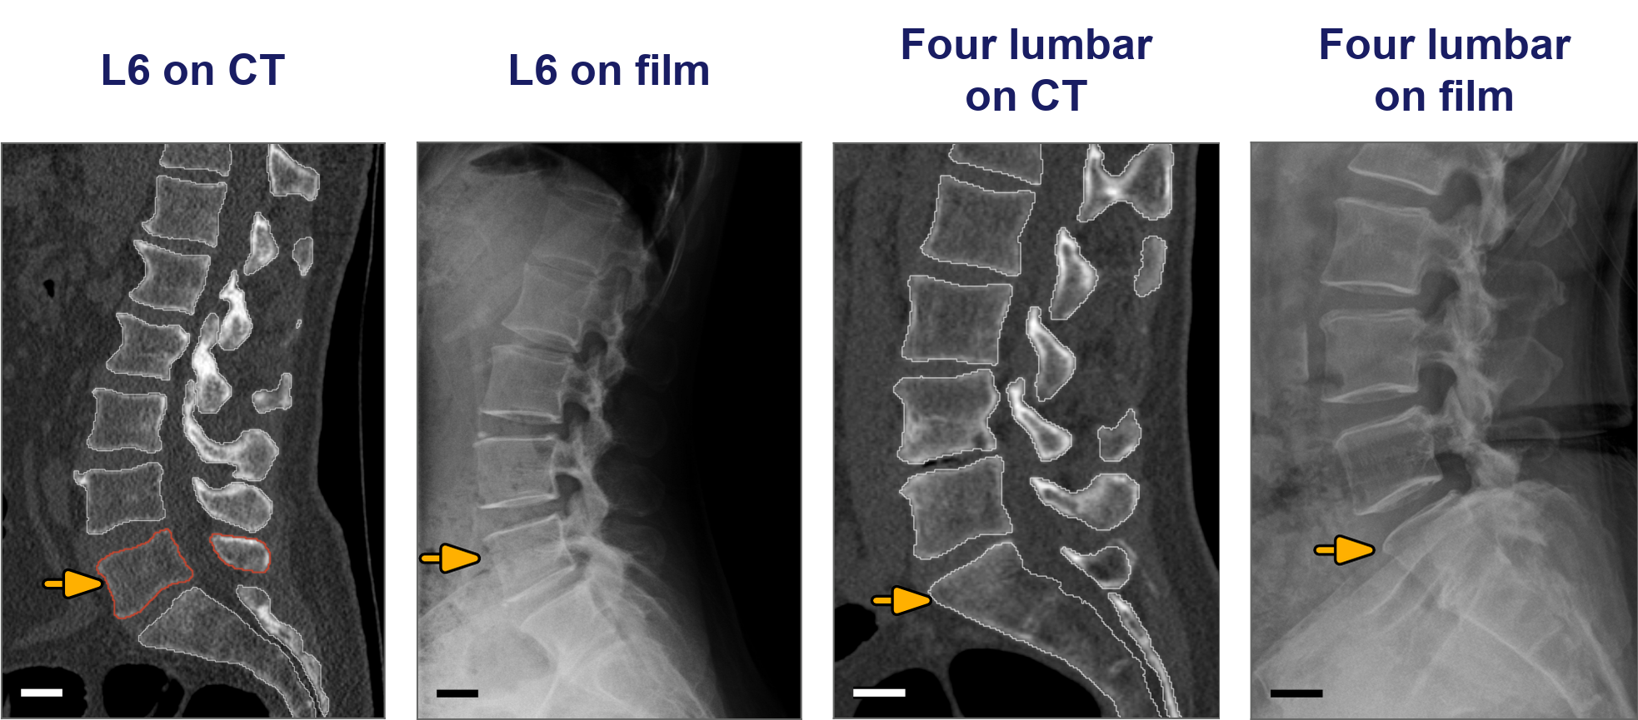
Hypothesis and purpose
A sixth lumbar and a four-lumbar spine on labelled CT and on another patient's real film (SchwingNet manuscript, Figure 1; public, de-identified).
Hypothesis: each transitional vertebra has a local shape a network can learn from labelled CT and find on a film
Purpose: name the level from one exposure, and outperform surgeons using registration at level identification. Targets set before scoring: 90 % naming, 85 % variant sensitivity, 97 % detection
Investigational. Decision support beside the surgeon's count, never a replacement for the check film.

Slide 9
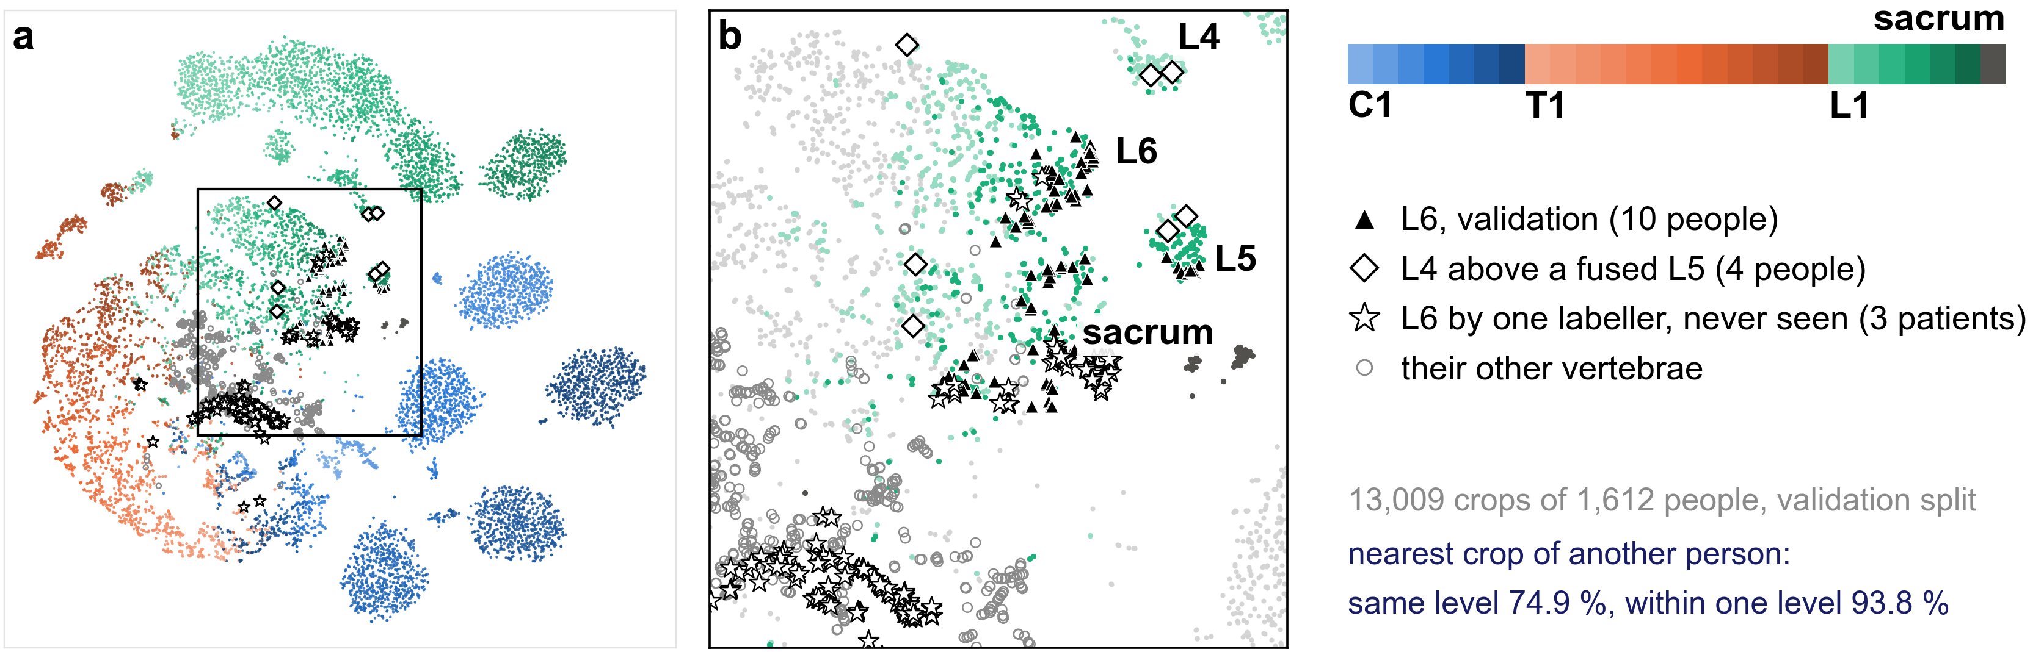
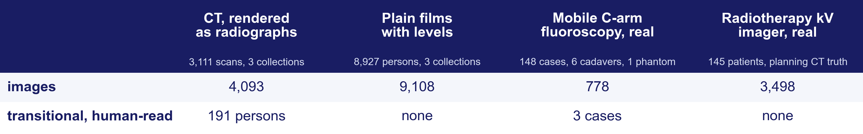
What it learned from public data: one shape per level
Notes:
Top: the level model's embedding of 13,009 crops from 1,612 people, coloured by level (a, C1 to sacrum; b, the lumbosacral window: triangles the validation L6, stars the contested L6 of never-seen patients, diamonds the last free vertebra above a fused L5, rings those patients' other vertebrae). Manuscript Figure 2a–b, rendered from the same map file.
The nearest crop from another person is the same level in 74.9 % and within one level in 93.8 %. L6 separates from L5 (silhouette 0.35) as far as L1 from T12 (0.32); 75 of 98 L6 crops were named L6. Preliminary: ten L6 persons, on the split that chose the checkpoint.
Bottom: the training data by modality. CT rendered as radiographs: 802 + 1,935 + 374 scans from three collections, 191 transitional persons. Plain films with levels: 4,963 + 3,600 + 364 persons, none human-read transitional. Mobile C-arm fluoroscopy: 148 intraoperative cases (cone-beam CT truth), 6 cadaver pelves, 1 phantom, 778 frames, 3 transitional cases. Radiotherapy kV imager: 145 patients, 3,498 frames, planning CT truth, 91 screen calls unread.
All public and de-identified. The transitional truth is on CT; no released film or C-arm frame carries a human-read T13 or Castellvi grade. The intraoperative set (148 cases, 2023) is in no training set. Retrospective, analysed April–September 2026.

Slide 10
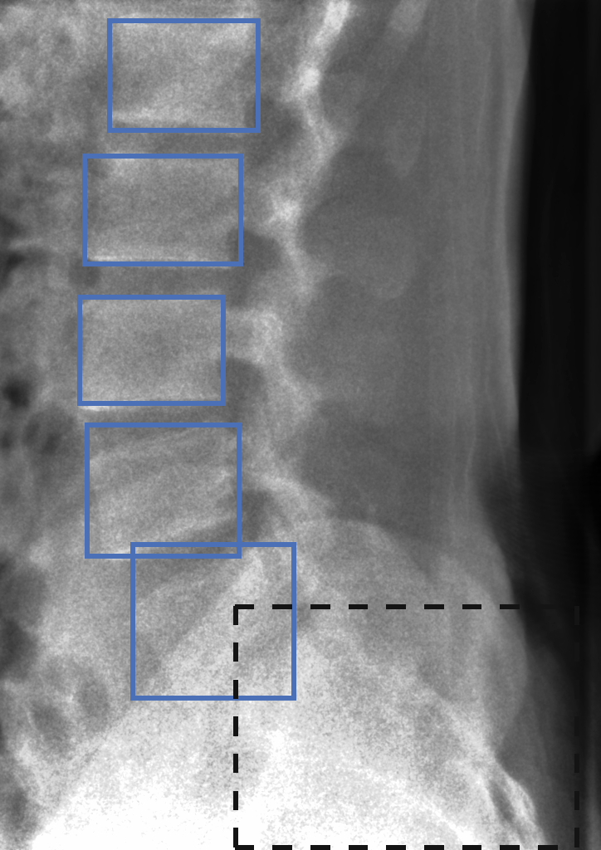
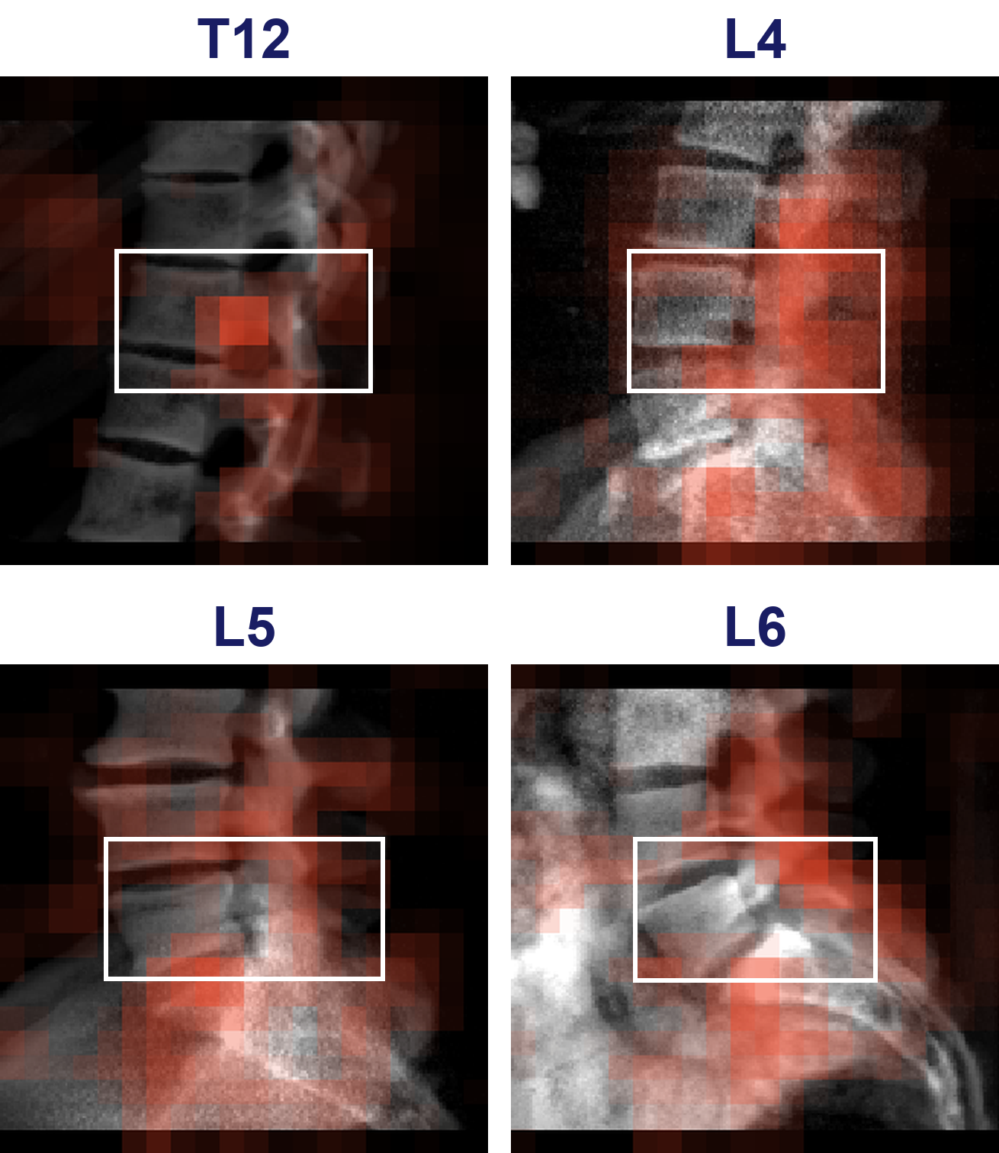
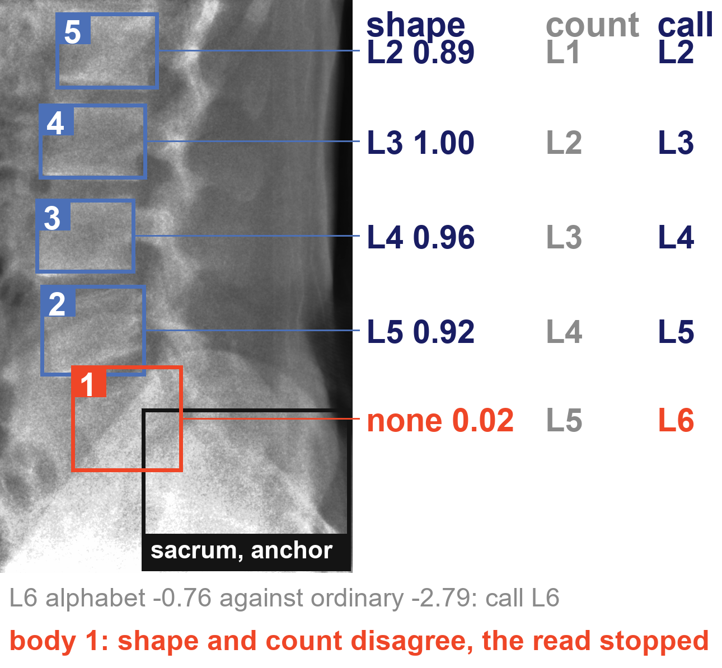
What SchwingNet does: find, name, check
1 · Find
2 · Name
3 · Check
bodies and sacrum boxed, no name yet
named from its shape; red, what the name draws on
shape against the count: where they disagree, the read stops
Notes:
One exposure in. Out, for every body in the field: a level name with its probability; when the sacrum is in the field, the count from it; and a flag when the two disagree. Neither end of the spine is needed, and no label is imported from another study.
Left: the detectors' body boxes (blue) and sacrum box (dashed) on a real lateral frame, no names yet. Middle: occlusion maps for T12, L4, L5, L6 and the sacrum; red, the parts of the crop whose removal changes the name most (manuscript Figure 2d); per unit area the attribution is densest on the target body. Right: the same frame as the left panel with the shape name and its probability, the count from the sacrum and the call on each box; body 1 red, where they disagree and the read stops.
Trained on renders of labelled CT and on annotated radiographs; the intraoperative C-arm is in no training set. The architecture, how the two readings are combined and when the read stops are withheld pending the university invention review. C-ArmLSpine case 42, public, 2023.

Slide 11

How it was tested: real exposures, cone-beam CT truth
Real lateral frames, calls by the cross-validated model; green right, red wrong, orange unscored (the two truth labellers disagree). Needle tip on the named L4. C-ArmLSpine, public, 2023.
Notes:
148 intraoperative cases, public, acquired November–December 2023; truth from each patient's cone-beam CT, read by two automatic labellers; 814 of 910 vertebrae agreed and kept. The set is lumbar: the truth withholds T11 and most of T12.
Three readings of the same frames: never trained on this C-arm; fine-tuned by case-grouped folds; fine-tuned by acquisition-day folds. Limited fields of view were cut from the same frames: five, three or one body, with no sacrum in them.
Scored per detected body as exact level; intervals clustered by case; paired differences with exact sign tests, Holm-adjusted over the comparisons named before scoring. Every number in the paper is read by the build from a result file; a patient-keyed gate swept 563 quoted numbers against checkpoint lineages. Retrospective study of public collections, analysed April–September 2026.

Slide 12
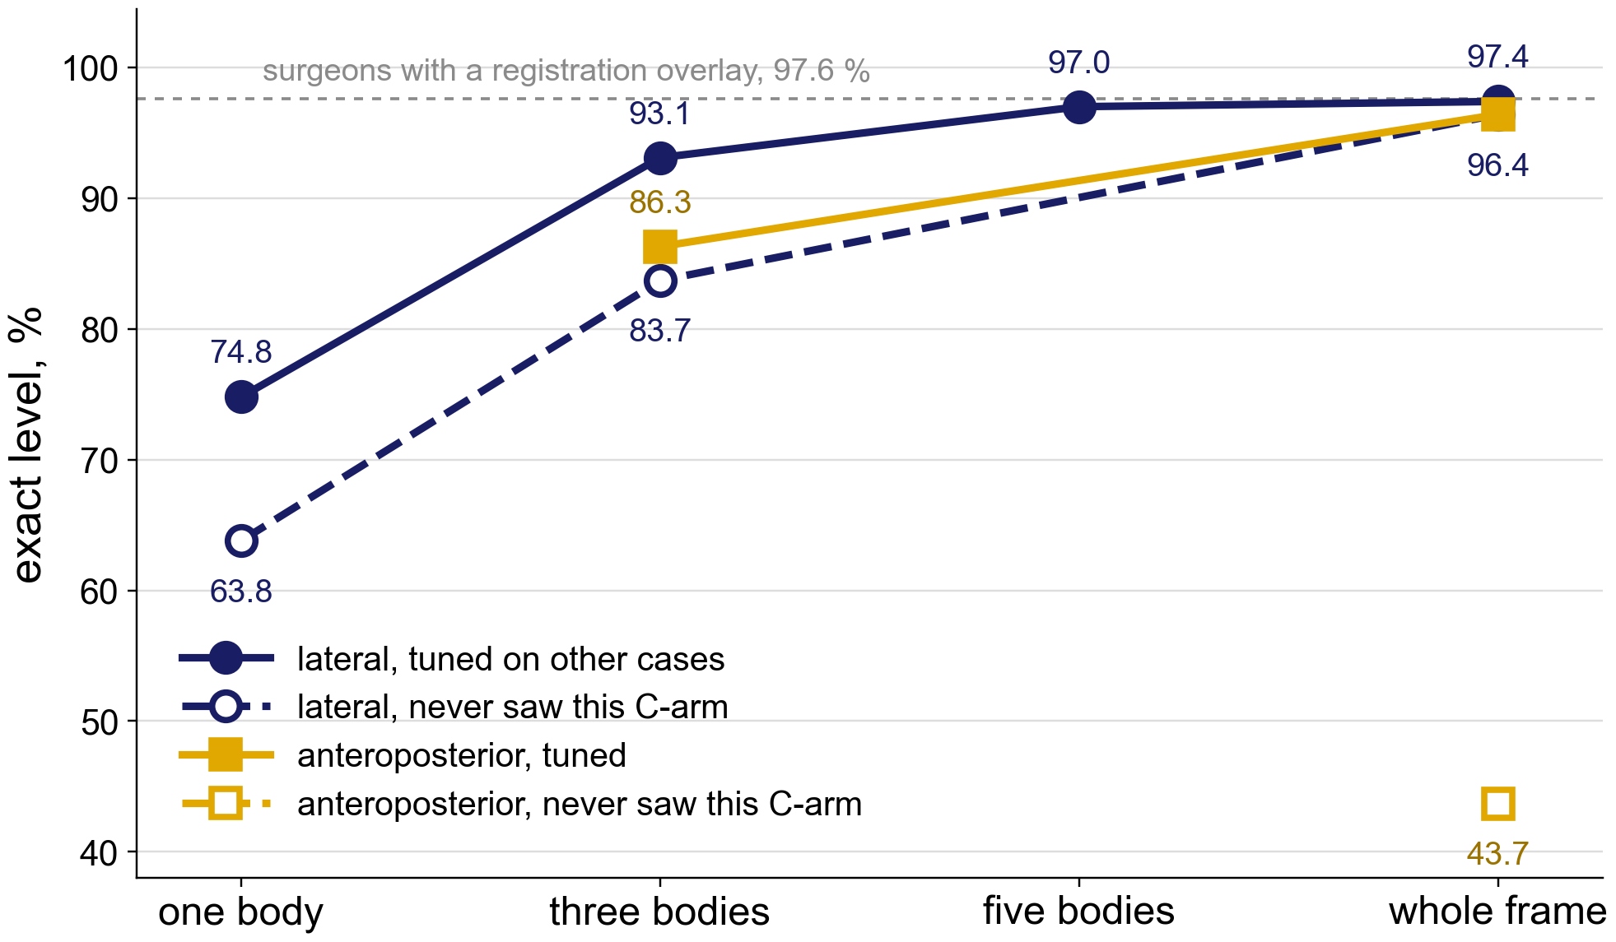
Result 1: no sacrum in view, the shape names the level
Three lumbar bodies and nothing else in the field: 93 of 100 named exactly; one body alone, 75. No count is possible there; the name comes from shape
The whole lateral frame reads 97.4 %, at the level of surgeons reading a registration overlay (97.6 %, dashed)
Never trained on this C-arm the lateral view loses one to eleven points; the anteroposterior view needs the C-arm's own cases (43.7 to 96.4 %)
Exact level per body against what is in the field; no sacrum in the one-, three- and five-body fields. 148 real intraoperative cases, cone-beam CT truth (manuscript Table 3).
Notes:
Case-grouped folds: five bodies in the field 647 of 667 (97.0 %); three bodies 1,079 of 1,159 (93.1 %; 95 % CI 89.2, 96.2); one body 451 of 603 (74.8 %). Never trained on this C-arm: three bodies 970 of 1,159 (83.7 %), one body 385 of 603 (63.8 %). Whole frame, lateral: 601 of 617 fine-tuned (97.4 %), 595 of 617 zero-shot (96.4 %; 92.3, 98.4). Anteroposterior whole frame: 608 of 631 fine-tuned (96.4 %), 276 of 631 zero-shot (43.7 %); three bodies 1,015 of 1,176 (86.3 %).
The published methods, each scored against its own truth (the table that was on the next slide in v9): LevelCheck registration 100 % against the labels it imported from the planning CT; surgeons reading the LevelCheck overlay 97.6 % (Manbachi 2018), the dashed line; registration-free naming Huang 88.3 %, Peh 77.9 to 82.2 %, Zhang 73.3 %. No study is on a transitional spine. Parity with the overlay is suggested, not proven: the paired comparison is a separate study.

Slide 13
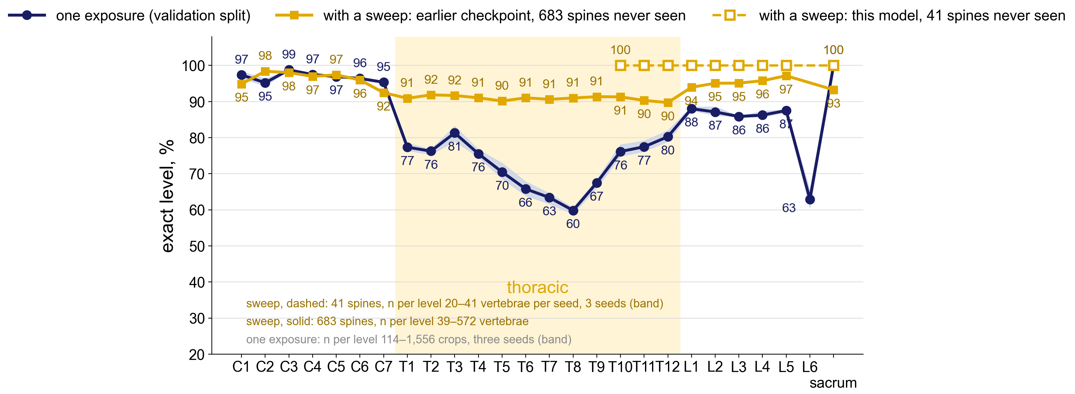
Which levels it names: cervical to sacrum, thoracic included
Navy: one exposure, exact level by level on the level model's development validation split (rendered CT and films, 15,898 crops, bands of two to nine bodies; the split that chose the checkpoint, not held out).
Gold, solid: the same levels read through a sweep of overlapping exposures, simulated from 683 CT renders the encoder never saw (TotalSegmentator bench, an earlier checkpoint): a proprietary algorithm reconstructs the spine from the overlap. Dashed: the model behind the navy curve on the 41 render spines it never saw, T10 to the sacrum. Real C-arm testing is lumbar; thoracic naming on a real C-arm is not yet tested.
Notes:
Navy, per-level exact accuracy, mean of three seeds: C1–C7 95–99 %; T1–T4 75–81 %; T5–T9 60–70 %; T10–T12 76–80 %; L1–L5 86–88 %; L6 63 % (150 crops); sacrum 100 %. Source: results/alpha_0.3_seed*/mixed_allspine_v9 head runs, per_level of the random-band row. A development number, not a held-out test; the film sources have no thoracic annotation, so thoracic accuracy is on renders.
Gold, solid: the sweep on the earlier checkpoint of the encoder (model_r18_ce_v3.pt), 683 TotalSegmentator renders it never saw: 522 swept from the sacrum at overlap 2 and 203 from C2 at overlap 1 (fixed step; 41 spines are in both), every vertebra in the sweep scored exact. Per level (n vertebrae): C1 95 % (39); C2 98 % (248); C3 98 % (253); C4 97 % (264); C5 97 % (268); C6 96 % (298); C7 92 % (411); T1 91 % (483); T2 92 % (478); T3 92 % (468); T4 91 % (457); T5 90 % (426); T6 91 % (390); T7 91 % (383); T8 91 % (410); T9 91 % (462); T10 91 % (505); T11 90 % (526); T12 90 % (544); L1 94 % (545); L2 95 % (547); L3 95 % (572); L4 96 % (567); L5 97 % (559); sacrum 93 % (563). Levels with fewer than 15 swept vertebrae are not drawn. Source: ~/model_night/sweep_v3/ts/ts_ii9_o2_gt_fixed and ts_c2_ii9_o1_gt. Gold, dashed: the same protocol on the encoder and the three heads the navy curve uses (v9, model_rung_1_aug2.pt), on every render spine that encoder never saw (41: 40 TotalSegmentator and 1 CTSpinoPelvic1K; the eval gate found the other 1,100 TS, 801 CTSP and 387 VerSe renders in its training or selection keys), swept from the sacrum at overlap 2 with the end rule (skip, open); every chain complete, every swept vertebra exact on all three seeds; the frame alone on the same spines 69 %. Per level (n vertebrae per seed): T10 100 % (20); T11 100 % (22); T12 100 % (23); L1 100 % (24); L2 100 % (25); L3 100 % (41); L4 100 % (41); L5 100 % (41); sacrum 100 % (41); above T10 fewer than 15 per seed, not drawn. Source: ~/model_night/sweep_v3/cns/sac_o2_s0..2 (job 40454032, 2026-09-25).
The sweep is simulated from CT renders: it has never been run on real C-arm sweeps. The C-ArmLSpine truth removes the thoracolumbar junction, so no real-C-arm thoracic accuracy exists; a thoracic C-arm set, and a real sweep, are the next data need. How the reconstruction is done is withheld pending the university invention review.

Slide 14
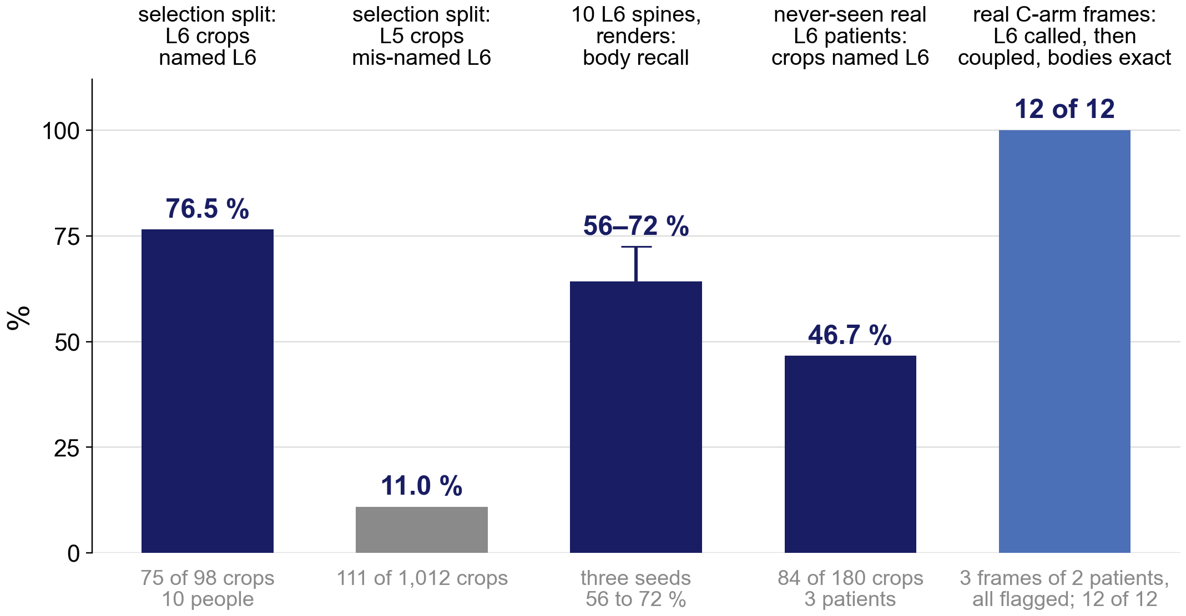
Result 2: the sixth lumbar vertebra, named from shape
On the split that chose the checkpoint, 75 of 98 L6 crops from ten people are named L6, and 111 of 1,012 L5 crops are mis-named L6. Rendered from the CT of three real patients read six-lumbar by one labeller and never seen in training, 84 of 180 crops are named L6 with no label imported from anywhere.
On the real C-arm, L6 was called on three anchored frames of two patients and every call was flagged for the surgeon; shape and count together named all 12 bodies exactly where the count alone named none.
Selection split of the training bank (not held out); CBCT renders of C-ArmLSpine cases 42, 121 and 136 (never seen); real frames, case-grouped folds. A transitional test set does not exist yet: Result 4. Manuscript Figure 2 and Results.
Notes:
Every L6 number the manuscript reports, on one chart. Selection split: 75 of 98 L6 crops named L6 (76.5 %), 111 of 1,012 L5 crops mis-named L6 (11.0 %). Ten L6 spines on renders, three seeds: body-level recall 56.1 to 72.4 % (validation split, seen before the freeze). Three never-seen real L6 patients (C-ArmLSpine 42, 121, 136), CBCT renders under six device cards: 84 of 180 crops named L6 (46.7 %); the two-cluster silhouette of their L6 against L5 is 0.10 to 0.16 against 0.34 for the validation L6. Real C-arm, coupled fold models at confidence 0.74: L6 called on 3 of 233 anchored frames (case 139 AP and lateral, case 44 lateral), all flagged; coupled exact on their 12 bodies 12 of 12, the count 0 of 12.
Say plainly: L6 is the rare class, ten people in training, and every real L6 read is on three patients. That is why Result 4 is about collecting enough transitional scans.

Slide 15

Result 3: when shape and count disagree, it stops
A patient one CT labeller reads six-lumbar, the other five. Shape names bodies 5 to 2 as L2–L5 (0.89–1.00); the count says L1–L4. Body 1: shape none (0.02), count L5
The call is L6 for the column; body 1 is left unnamed and the read stops
Over all anchored frames: count 97.0 %, shape 97.7 %, together 98.2 % (1,009 bodies). Stopped on 23 of 233 frames, holding five of the six errors and all four L6 calls
A disagreement is reported, not hidden
C-ArmLSpine case 42, public; manuscript Figure 4d with the probabilities the system printed on each box; cross-validation fold.
How the two readings are combined and when the read stops are withheld pending the invention review. No accuracy on this slide is a wrong-level surgery rate.

Slide 16

Where the frames sat mattered more than how many
Unseen device: 80.5 % of bodies found; 93.9 % on truth boxes inside the field
Its own frames: a plateau from 24 (c). One view buys that view only
Renders at two poses find 53 % between them; the same count spread over the arc, 77 % (d)
SchwingNet manuscript, Figure 5c–d; render sweep on 40 unseen subjects.

Slide 17

How many people it takes, and which view they were shot in
Film naming rose with training persons: NHANES II 78 → 93 %, BUU-LSPINE 65 → 97 %, CSXA 94 → 99.8 %
C-arm lateral: 93.7 % with no C-arm person. Anteroposterior: 33.8 % with none, 90.8 % with five
Training both views cost neither (98.1 and 97.0 %)
● NHANES II
● BUU-LSPINE
▲ CSXA
● C-arm, lateral
■ C-arm, anteroposterior
○ lateral-trained, read on anteroposterior
✕ both views, all persons
Exact level against training persons; SchwingNet manuscript, Figure 5b.

Slide 18

Result 4: transitional naming is not yet tested; what the census supplies
Wilson 95 % lower bound at the class sums of the whole CT census; green, above the surgeon-assisted overlay's 97.6 %; blue, above the pre-stated 90 %.
Notes:
Scored so far: three L6 patients, in cross-validation only; a description, not a test. Today there are 7 candidates on real exposures, none verified.
n: the transitional persons a screen of every collection in the census should find, from published prevalence (Sun 2025; Hanhivaara 2020; Nardo 2012); a case counts only where a film exists. Each cell: the lowest accuracy the data would still support at 95 % confidence at that share of errors. 157 error-free persons are the fewest that clear 97.6 %.
With 870 L6 persons the network may miss 12 and still sit above the overlay's 97.6 %; with all 2,069 transitional persons, 36; the 322 L6 of the screen running now allow 2. Beating it outright needs the paired comparison on the same persons, a separate study.

Slide 19
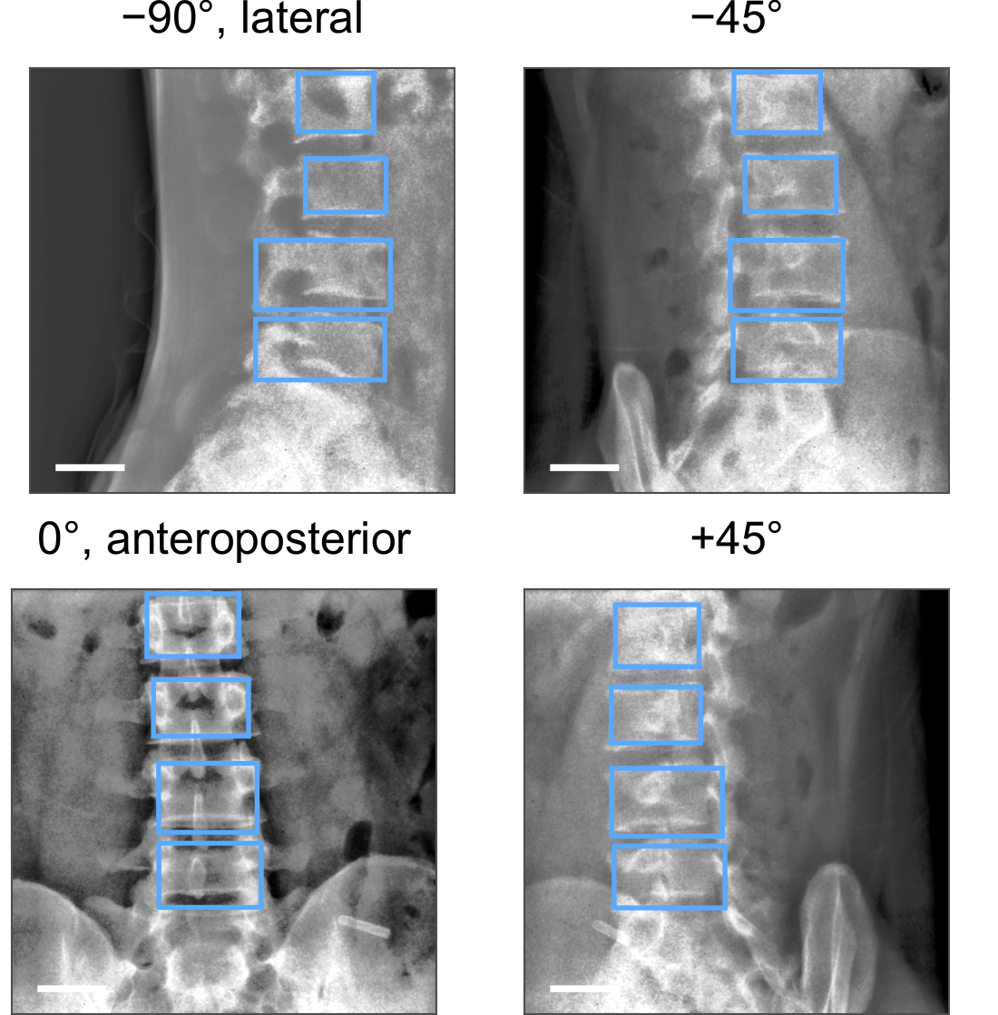
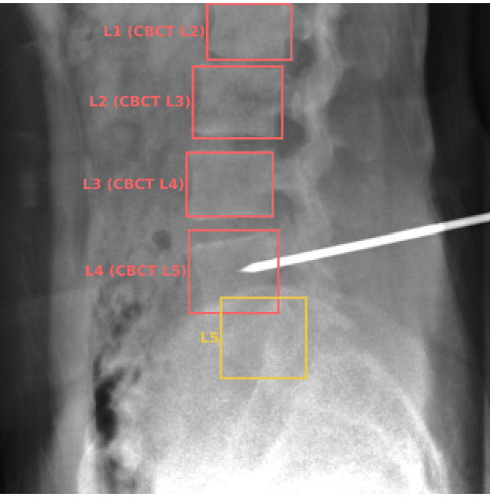
Limitations and next steps
The only real rotational acquisition: one patient, 301 frames from lateral to anteroposterior (supplement Figure S5a; bar, 50 mm). Every other real frame sits at one of two poses.
A frame whose truth the two automatic labellers disagree on (orange): unscored. The test's truth is their agreement, not a human read.
Notes:
Limitations. One intraoperative device, lumbar; its truth is two automatic labellers agreeing, which removes the thoracolumbar junction and cannot settle a transitional count. Whether 148 cases are 148 people cannot be established; every intraoperative interval is too narrow if they are not. Real frames sit at two poses; one patient's rotational acquisition is the only real arc. The posterior is uncalibrated; the per-level chart is a development split. Retrospective, public data; nothing prospective; not a cleared device.
Next steps. Verify the transitional candidates by two human readers and run the pre-stated test: 35 persons, zero errors. A thoracic C-arm set. A second C-arm, with obliques, held out; the paired comparison with registration on verified at-risk persons. Phantom, cadaver, then human series, in that order, before any operating-room use.

Slide 20

Conclusions: three goals, where each stands
Name the level with nothing to count from: met on ordinary lumbar anatomy — 93 % with three bodies in view, 96.4 % zero-shot on the whole frame; thoracic levels named on renders, untested on a real C-arm
Name it on a transitional spine: not yet shown — three cross-validation patients; 35 error-free persons needed; the census should supply about 870 L6
Outperform surgeons using registration: needs the paired study — 98.2 % coupled beside 97.6 % for surgeons with the overlay, on different test sets
Exact level on the unseen C-arm.
A name from shape, checked against the count, with a stop where they disagree
Evidence status: investigational; retrospective, public de-identified data; no prospective evaluation; not a cleared device.

Slide 21
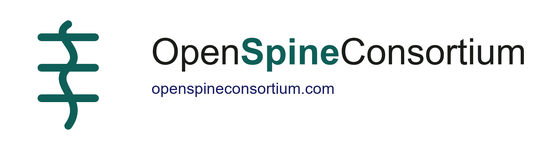
Acknowledgments and data availability
With thanks to Patrick Schwing (LSU Health Sciences Center New Orleans); Miraziz Ismoilov and Nizar Alnabahneh (Radiology) and Loren Schwiebert (Computer Science), Wayne State University; and the annotators Ashley Schehr, Annika Tekumulla, Margret Khoushi, Ryan Christian, Dane Hubers, Faris Mahjoub, Hassan Saad, Mia Sooch, Sathyagopal Siddapureddy, Michael McLellan and Jerick Kim
Data: CTSpinoPelvic1K (doi.org/10.5281/zenodo.22139642) and the public C-arm, radiograph and CT collections under their own licences; all de-identified
Papers: Not All Spines Are Created Equal, NeurIPS 2026 Datasets and Benchmarks (accepted); the CTSpinoPelvic1K dataset article (Medical Physics, submitted); SchwingNet (in preparation)
Funding: NIH NIGMS F30GM147909. No commercial support.
Data, code, weights and the annotator onboarding:
openspineconsortium.com
github.com/OpenSpineConsortium
Questions
gregory.schwing@med.wayne.edu

