Slide 1
SchwingNet: Naming a Vertebral Level From One C-arm Exposure, Without Counting From C2
Gregory J. Schwing, MD, PhD; Patrick Schwing; Miraziz Ismoilov, MD; Nizar Alnabahneh, MD; Loren Schwiebert, PhD; and the OpenSpineConsortium annotators
Department of General Surgery, Detroit Medical Center and Wayne State University, Detroit, MI
Radiology and Computer Science, Wayne State University; LSU Health Sciences Center New Orleans
CNS 2026 Annual Meeting · Washington, DC · [session and date pending]

Slide 2

Where this is going
1
A level is counted, not marked, and the count fails on transitional anatomy
2
Registered labels inherit the planning read, and the planning read fails there too
3
Hypothesis: a transitional vertebra has a shape a network can learn
4
SchwingNet on a C-arm it never saw: name, count, coupled call, stop
A real lateral C-arm exposure; each body named from its shape, with its posterior.
5
What a transitional test needs, and where the persons will come from

Slide 3

A level is counted, not marked, and the count is wrong often
Half of spine surgeons report a wrong-level operation in their career (Mody 2008; Groff 2013)
Registry of 34,544 operations: 0.12 %, thoracic 0.42 % (Furuya 2026)
The first exposed level is wrong in 4–15 % before the check film (Ammerman 2006; Dablouk 2019)
No neurophysiological check between T1 and L2; verification protocols miss a third (Longo 2012)
Strong et al. 2022, Figure 3: intraoperative fluoroscopy, needle at the T10 pedicle, counted from the sacrum. J Neurosurg Spine 36:792 (PMC10193475); permission pending.
The remedy on offer is another count.
1. Mody MG, et al. Spine 2008;33:194. 2. Groff MW, et al. World Neurosurg 2013;79:585. 3. Furuya M, et al. Bone Joint J 2026;108-B:673. 4. Dablouk MO, et al. Br J Neurosurg 2019. 5. Ammerman JM, et al. Surg Neurol 2006. 6. Kirshblum SC, et al. J Spinal Cord Med 2011. 7. Longo UG, et al. J Bone Joint Surg Br 2012;94-B:1546.

Slide 4

Transitional anatomy changes the count
Labelled CT, public de-identified records (CTSpinoPelvic1K). Bar, 20 mm.
8.8 % of 3,147 full-length radiographs lack 24 presacral segments (Sabri 2025)
The count was wrong in 38 of 71 patients with a transitional vertebra (Nakagawa 2017)
The truth is on CT. No public radiograph or C-arm frame carries a human-read T13 or Castellvi grade
8. Sabri SA, et al. Neurosurg Focus 2025;58(6):E13. 9. Nakagawa T, et al. 2017. 10. Castellvi AE, et al. Spine 1984;9:493. Figure: SchwingNet manuscript (in preparation), Figure 1.

Slide 5
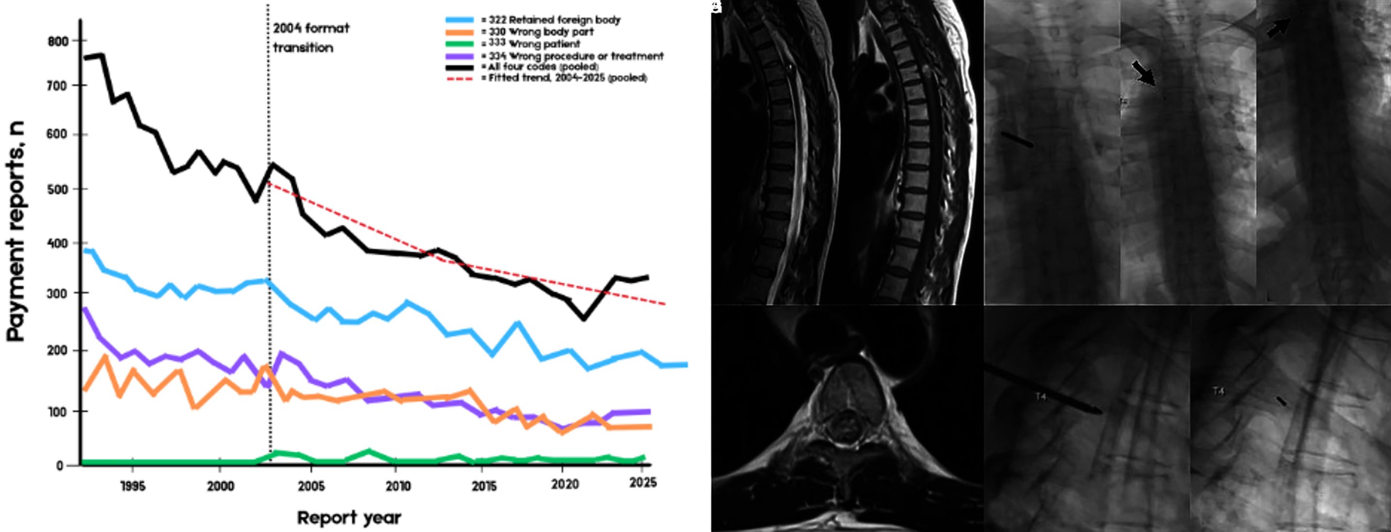
What a wrong level costs, and what avoiding it costs
17 % of events lead to legal action; one in five Spine Section surgeons has been sued (Mody 2008; Groff 2013)
81 % of litigated cases paid; median never-event payment $75,220 (Goodkin 2004; Bettis 2026)
Avoiding it: a gold fiducial, 52 min and 183 mGy per patient, 179 patients at one centre (AJNR 2023)
Left: Bettis et al. 2026, Figure 1, National Practitioner Data Bank never-event payments 1991–2025 (open access). Right: AJNR 2023;44:618, Figure 1, fiducial placed at T4 (PMC10171395). Permission pending.
Derived, unpublished: roughly 420–1,900 US wrong-level operations a year; indemnity alone about $8–37 million.
11. Goodkin R, Laska LL. Surg Neurol 2004;61:323. 12. Bettis T, et al. Patient Saf Surg 2026. 13. Machin JT, et al. Eur Spine J 2018;27:2693. 14. AJNR Am J Neuroradiol 2023;44:618. 15. Childers CP, Maggard-Gibbons M. JAMA Surg 2018;153:e176233.

Slide 6

The label on the film is only as right as the planning read
LevelCheck registers preoperative CT labels onto the film: 100 % placement, 97.6 % surgeon reads (De Silva 2016; Manbachi 2018)
Scored against the imported labels. On a transitional spine the label is only as right as the planning read
Registration-free naming on real C-arm images: 73 % (Zhang 2023); cadaver long-length images 88 % (Huang 2022)
Top: De Silva et al. 2016, Figure 1 (Spine; PMC5045321). Bottom: Manbachi et al. 2018, Figure 6, labels on a 13th rib and a lumbarised S1 (Ann Biomed Eng; PMC9107073). Permission pending.
Nothing published names a level from one exposure alone, and nothing is tested on a transitional spine.
16. Otake Y, et al. Phys Med Biol 2012;57:5485. 17. Lo SFL, et al. Spine 2015. 18. De Silva T, et al. Spine 2016. 19. Manbachi A, et al. Ann Biomed Eng 2018;46:1548. 20. Peh WCG, et al. 1999. 21. Zhang R, et al. J Xray Sci Technol 2023. 22. Huang Y, et al. Comput Methods Programs Biomed 2022.

Slide 7

The planning read fails where the count fails
An open-source whole-body segmenter, unmodified, on 1,152 public CTs (Wasserthal 2023)
Normal anatomy: L5 Dice 0.94. Lumbarization: every label slides one level, L5 Dice 0.29
L6 emitted: 0 of 1,152. Confident, well formed, one level off, no error signal
Not All Spines Are Created Equal, NeurIPS 2026
A lumbarization case with a true L6. Left, ground truth; right, the segmenter's output.
23. Wasserthal J, et al. Radiol Artif Intell 2023;5:e230024. 24. Schwing GJ, et al. Not All Spines Are Created Equal. NeurIPS 2026 Datasets and Benchmarks (accepted; retrospective). 25. CTSpinoPelvic1K, doi.org/10.5281/zenodo.22139642.

Slide 8
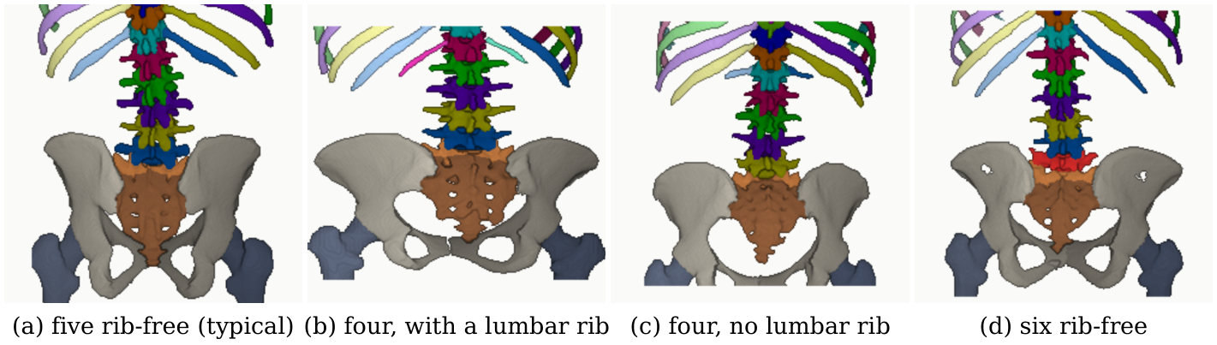
Hypothesis and purpose
Four phenotypes at the lumbar borders, aligned on the sacrum (CTSpinoPelvic1K, public, de-identified).
Hypothesis: each transitional vertebra has local morphology a network reading a few bodies can learn
Purpose: build it, see what it learns, test it on an unseen C-arm, count the transitional persons a test needs
Pre-stated targets: 90 % transitional naming, 85 % variant sensitivity, 97 % detection
Investigational. Decision support beside the surgeon's count, never a replacement for the check film.

Slide 9
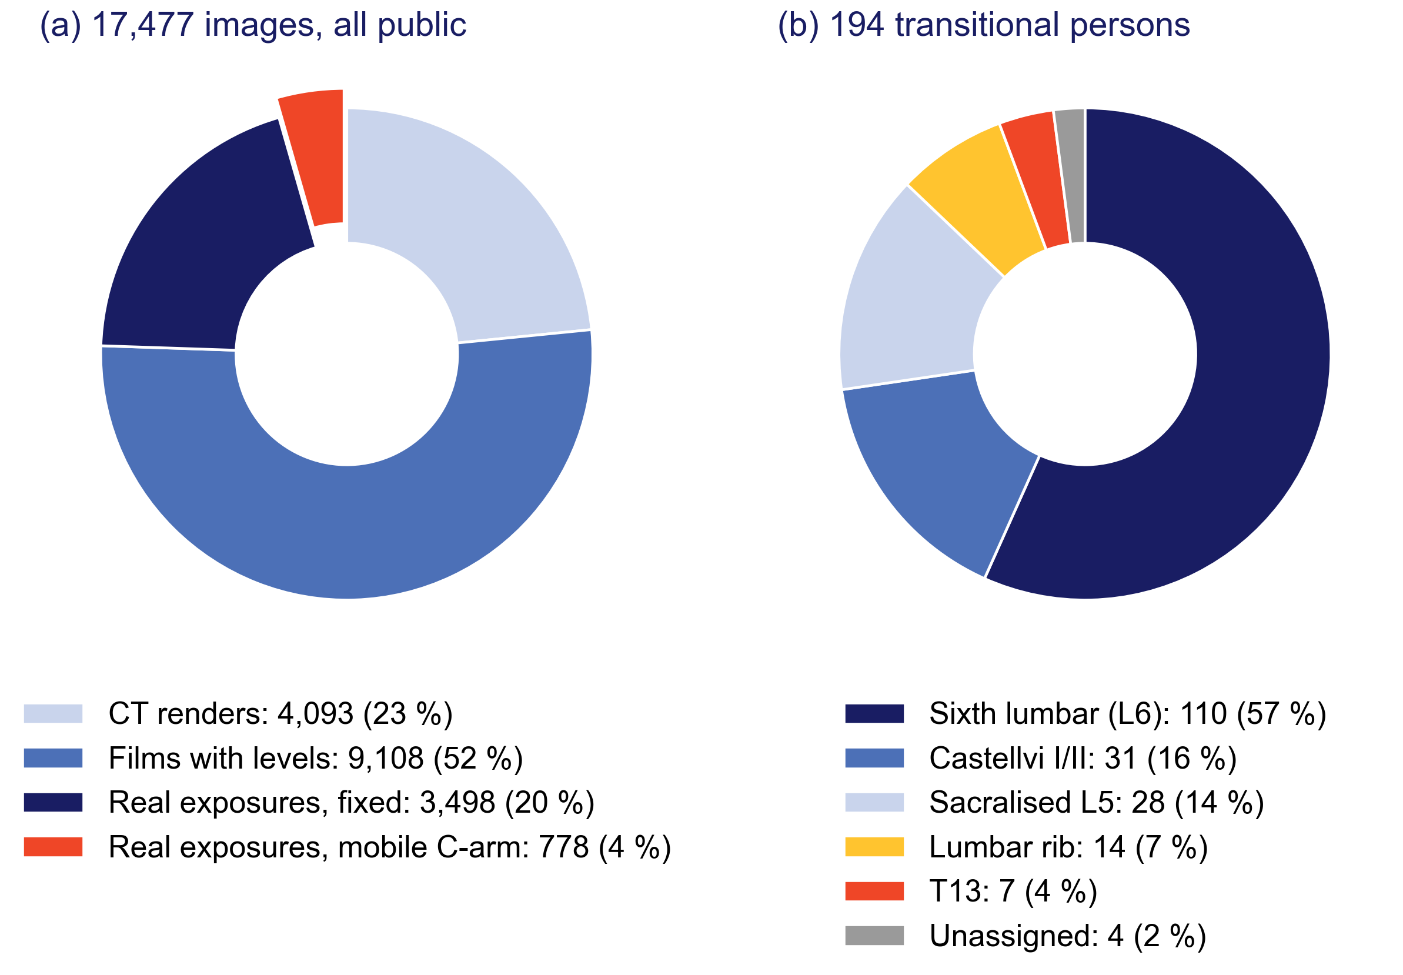
What exists to learn from
Public and de-identified: 4,093 CT renders, 9,108 films with levels, 4,276 real exposures
194 transitional persons. No released film or C-arm frame carries a human-read T13 or Castellvi grade
The intraoperative C-arm set (148 cases, cone-beam CT truth, 2023) is in no training set
(a) Images by source type; (b) transitional persons by phenotype.
Retrospective study of public collections, analysed April–September 2026; sources, licences and download locations per release in the manuscript. VinDr-SpineXR under a PhysioNet data use agreement.

Slide 10
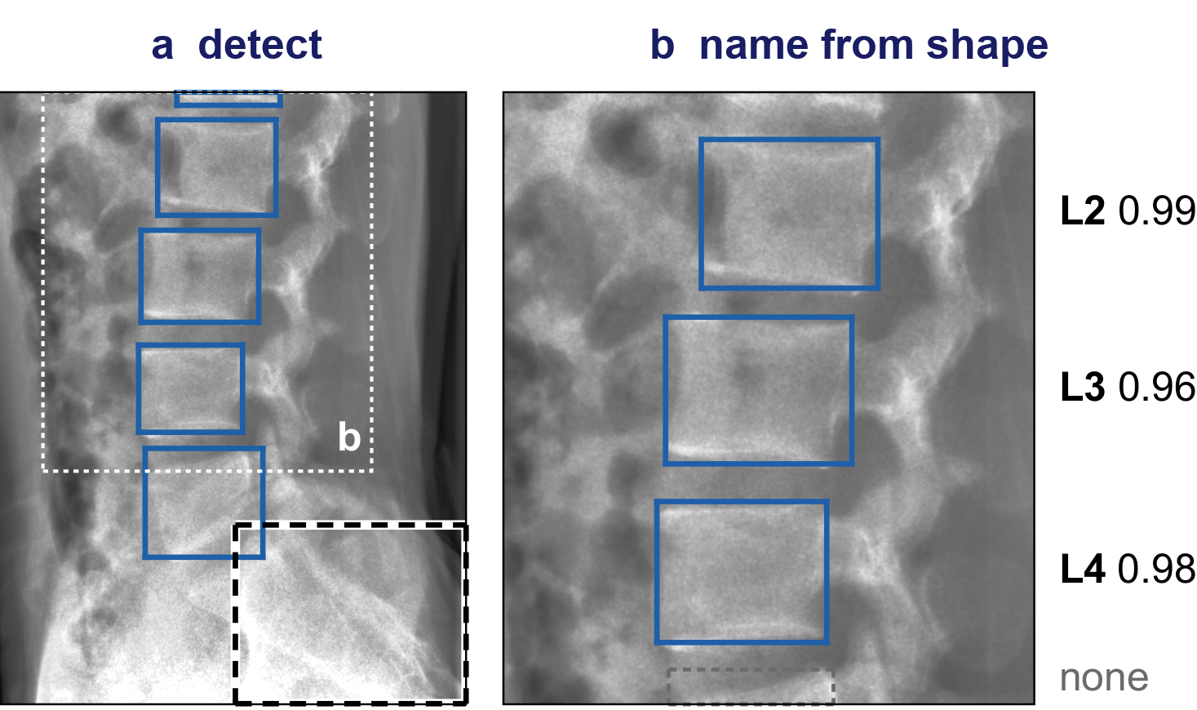
What SchwingNet does: inputs and outputs
1 · Find
2 · Name
3 · Check
bodies and sacrum boxed;
no level name
each body named from its shape,
posterior beside it
against the count from the sacrum:
agree, a name; disagree, a stop
In: one exposure. Out: a name with its posterior for every body, the count from the sacrum, a flag when they disagree
No end of the spine needed; no label imported from another study
Method withheld pending university invention review; weights and code with the paper

Slide 11
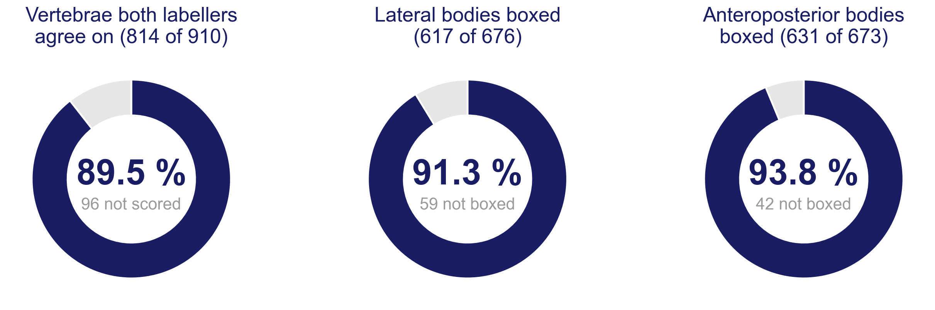
How it was tested
Retrospective, public collections, analysed April–September 2026
Truth: two automatic labellers agreeing on cone-beam CT, 148 cases
Three readings: zero-shot; case-grouped folds; acquisition-day folds
Exact level per detected body; intervals clustered by case; Holm-adjusted paired tests
C-ArmLSpine, public intraoperative exposures, acquired November–December 2023; the dark ring is what was scored.
Every number is read by the build from a result file; a patient-keyed gate swept 563 quoted numbers against checkpoint lineages.

Slide 12
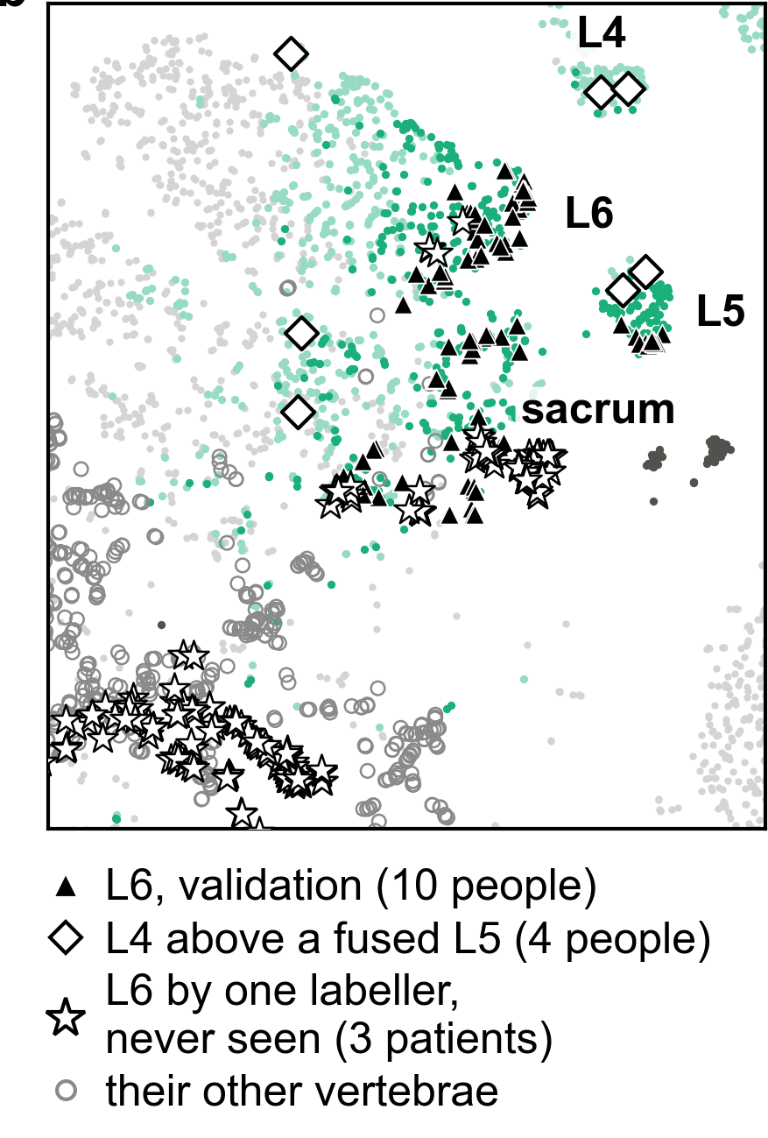
A sixth lumbar vertebra has a shape of its own
13,009 validation crops, 1,612 people: the nearest crop of another person is the same level in 74.9 %
L6 separates from L5 (silhouette 0.35) as far as L1 from T12 (0.32)
75 of 98 L6 crops named L6
Preliminary: ten L6 persons, on the split that chose the checkpoint
The lumbosacral window of the embedding; SchwingNet manuscript, Figure 2b.

Slide 13
One lateral exposure of a C-arm the network never saw
Zero-shot, lateral: 595 of 617 bodies exact (96.4 %; 92.3, 98.4)
Anteroposterior zero-shot 43.7 %; fine-tuned on other cases 96.4 %
Three bodies in view 93.1 %; one body 74.8 %: a name where there is nothing to count
C-ArmLSpine, public intraoperative exposures, 2023; SchwingNet manuscript, Figure 4a–b.

Slide 14
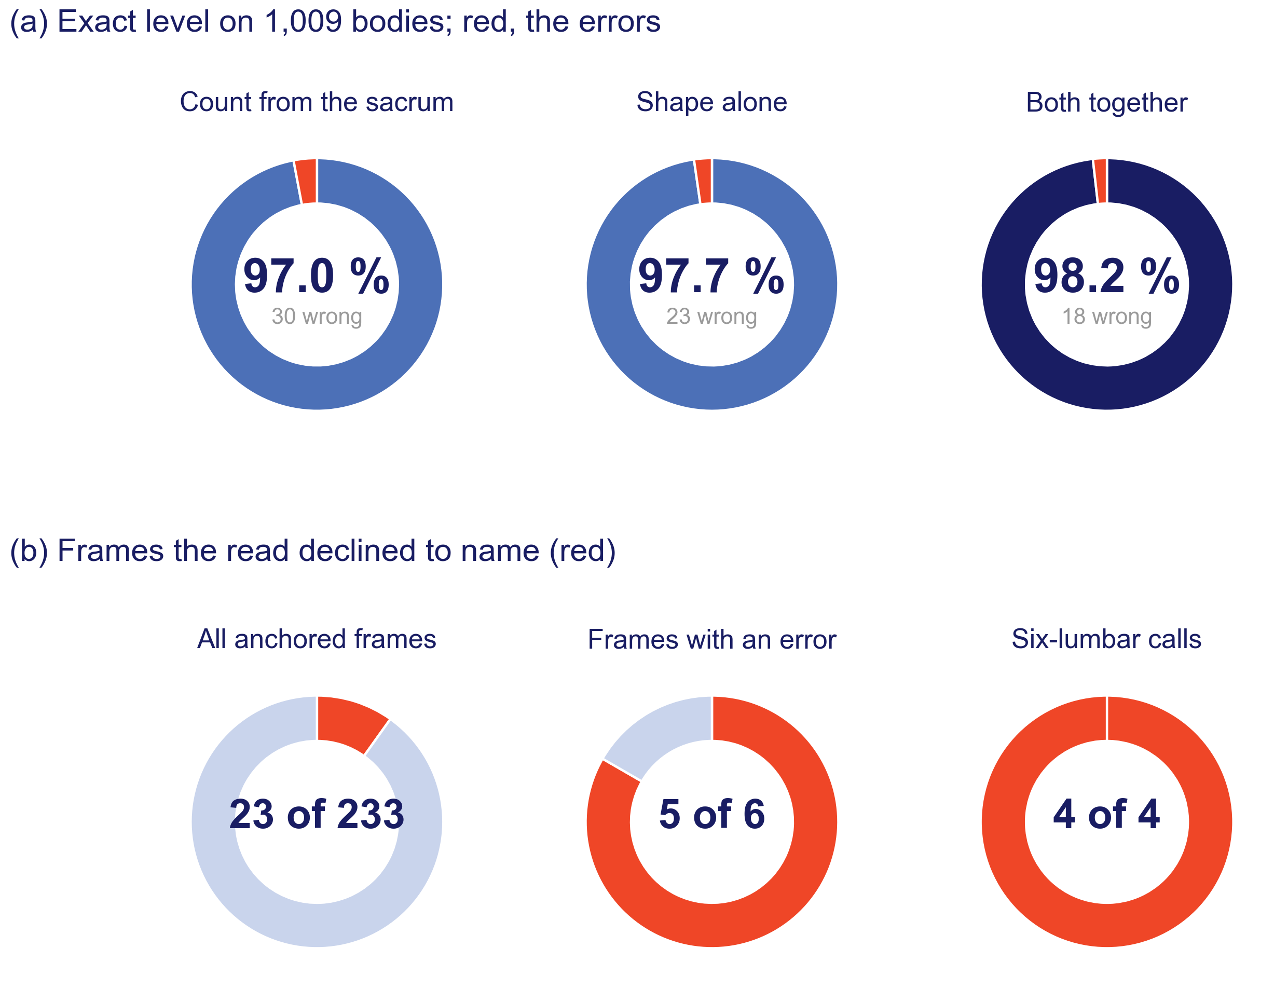
Two readings of one frame, and a stop where they disagree
Count from the sacrum 97.0 %, shape alone 97.7 %, together 98.2 % (1,009 bodies)
Stopped on 23 of 233 frames: five of the six errors and all four L6 calls
A disagreement is reported, not hidden
How the readings are combined and when the read stops are withheld pending the invention review.
C-ArmLSpine, case-grouped folds.

Slide 15

Where the frames sat mattered more than how many
Unseen device: 80.5 % of bodies found; 93.9 % on truth boxes inside the field
Its own frames: a plateau from 24 (c). One view buys that view only
Renders at two poses find 53 % between them; the same count spread over the arc, 77 % (d)
SchwingNet manuscript, Figure 5c–d; render sweep on 40 unseen subjects.

Slide 16

How many people it takes, and which view they were shot in
Film naming rose with training persons: NHANES II 78 → 93 %, BUU-LSPINE 65 → 97 %, CSXA 94 → 99.8 %
C-arm lateral: 93.7 % with no C-arm person. Anteroposterior: 33.8 % with none, 90.8 % with five
Training both views cost neither (98.1 and 97.0 %)
● NHANES II
● BUU-LSPINE
▲ CSXA
● C-arm, lateral
■ C-arm, anteroposterior
○ lateral-trained, read on anteroposterior
✕ both views, all persons
Exact level against training persons; SchwingNet manuscript, Figure 5b.

Slide 17
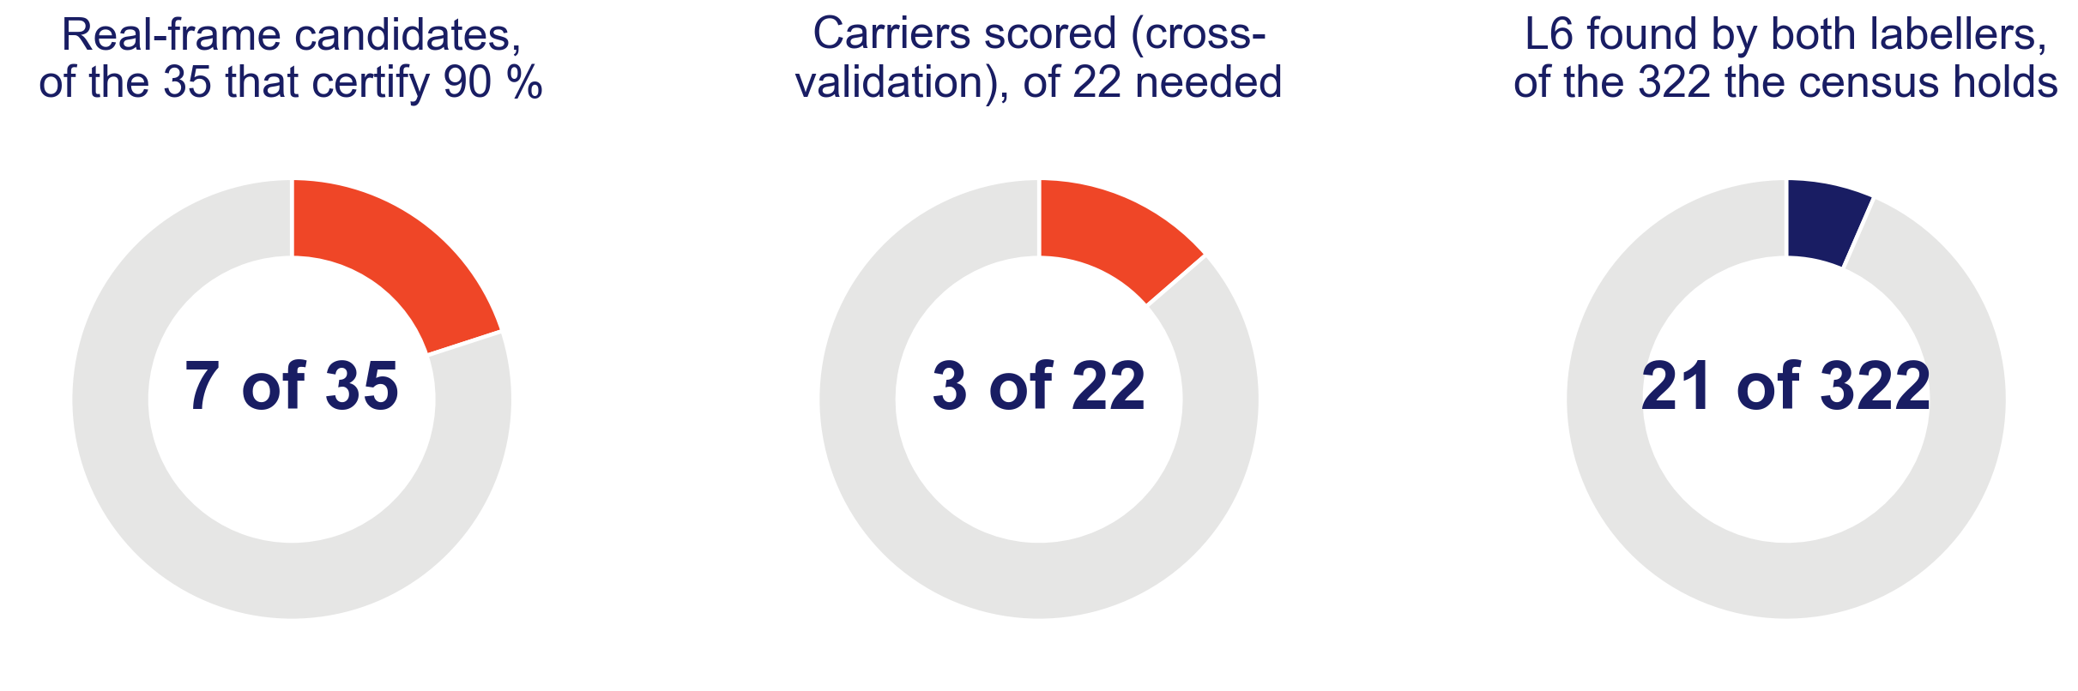
Transitional naming on real exposures: shown and not shown
Scored: three L6 patients, in cross-validation only. A description, not a test
Needed: 35 error-free at-risk persons for 90 %. Seven candidates exist
Census: 22 public CT collections, 18,873 CTs, about 320 L6 expected; 21 found so far
Expected counts from published prevalence (Sun 2025; Hanhivaara 2020; Nardo 2012).
Evidence base absent: transitional naming on real exposures is unverified.
Two-labeller screening of public CT for transitional anatomy: American Association of Clinical Anatomists, June 2026.

Slide 18
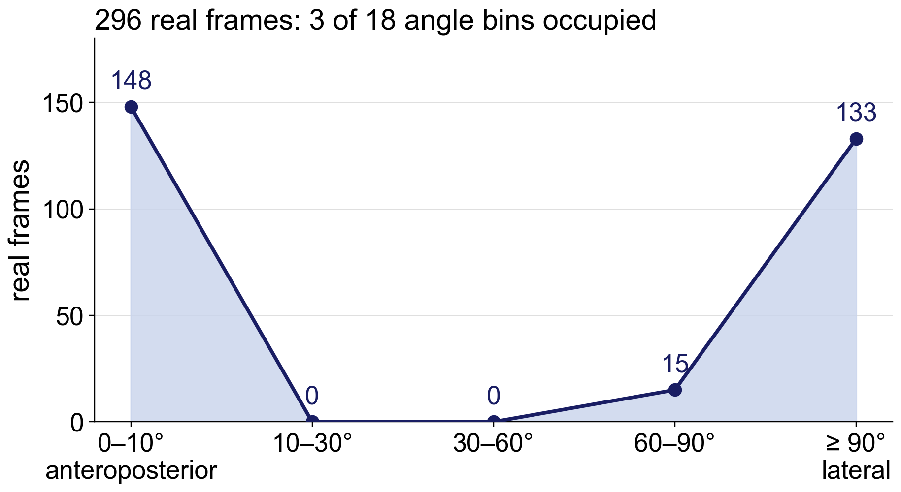
Limitations and next steps
Limitations
One device; its truth is two automatic labellers agreeing
148 cases may not be 148 people; intervals may be too narrow
Posterior uncalibrated; the embedding is of the selection split
Retrospective, public data; nothing prospective; not a cleared device
Next steps
Verify the transitional candidates; run the 35-person, zero-error test
A second C-arm, with obliques, held out
Phantom, cadaver, then human series

Slide 19

Conclusions
The count fails on transitional anatomy; registered labels and CT segmenters inherit the miscount
SchwingNet: 96.4 % zero-shot on the lateral view, 98.2 % coupled, and a stop on 23 of 233 frames holding five of six errors
Transitional naming on real exposures: unverified. 35 persons needed; the census is under way
Exact level on the unseen C-arm.
A name from shape, checked against the count, with a stop where they disagree
Evidence status: investigational; retrospective, public de-identified data; no prospective evaluation; not a cleared device.

Slide 20
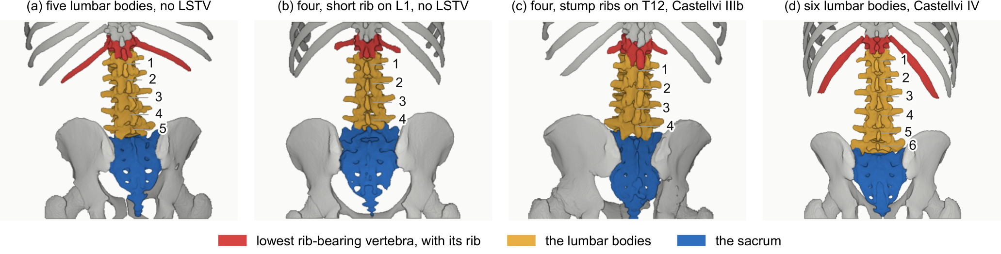
Acknowledgments and data availability
Coauthors and annotators: Patrick Schwing; Miraziz Ismoilov, Nizar Alnabahneh, Loren Schwiebert; Ashley Schehr, Annika Tekumulla, Margret Khoushi, Ryan Christian, Dane Hubers, Faris Mahjoub, Hassan Saad, Mia Sooch, Sathyagopal Siddapureddy, Michael McLellan, Jerick Kim
Data: CTSpinoPelvic1K (doi.org/10.5281/zenodo.22139642) and the public C-arm, radiograph and CT collections under their own licences; all de-identified
Code and weights: github.com/OpenSpineConsortium
Funding: NIH NIGMS F30GM147909. No commercial support.
Questions
gregory.schwing@med.wayne.edu
openspineconsortium.com

