Slide 1
SchwingNet: Naming a Vertebral Level From One C-arm Exposure, Without Counting From C2
Gregory J. Schwing, MD, PhD
Department of General Surgery, Detroit Medical Center and Wayne State University, Detroit, MI
CNS 2026 Annual Meeting · Washington, DC · [session and date pending]

Slide 2

Where this is going
1
Surgeons count vertebrae on the C-arm. On a transitional spine the count is wrong
2
Today's tools map a position on the spine to the preoperative CT to help the surgeon count. Humans still make mistakes
3
SchwingNet reads the level from the shape of the bones in one exposure
4
Tested on real intraoperative C-arm exposures: how often it is right, and when it stops
A real lateral C-arm exposure; each body named from its shape, with its probability.
5
What is missing: enough transitional patients' scans to feed the model

Slide 3

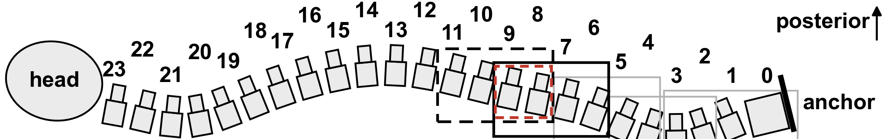
The level is counted, and the count is often wrong
Half of spine surgeons report a wrong-level operation in their career (Mody 2008; Groff 2013)
Registry of 34,544 operations: 0.12 %, thoracic 0.42 % (Furuya 2026)
The first exposed level is wrong in 4–15 % before the check film; verification protocols miss a third (Ammerman 2006; Dablouk 2019; Longo 2012)
The remedy on offer is another count
Strong et al. 2022, Figure 3: intraoperative fluoroscopy, needle at the T10 pedicle, counted from the sacrum. J Neurosurg Spine 36:792 (PMC10193475); permission pending.
The C-arm steps up the prone spine, each exposure overlapping the last, and the level is counted from the sacrum. Cartoon from the SchwingNet manuscript.
1. Mody MG, et al. Spine 2008;33:194. 2. Groff MW, et al. World Neurosurg 2013;79:585. 3. Furuya M, et al. Bone Joint J 2026;108-B:673. 4. Dablouk MO, et al. Br J Neurosurg 2019. 5. Ammerman JM, et al. Surg Neurol 2006. 6. Longo UG, et al. J Bone Joint Surg Br 2012;94-B:1546.

Slide 4

Transitional anatomy changes the count
Labelled CT, public de-identified records (CTSpinoPelvic1K). Bar, 20 mm.
8.8 % of 3,147 full-length radiographs lack 24 presacral segments (Sabri 2025); in 550 lumbar operations the count was wrong in 38 of 71 patients with a transitional vertebra (Nakagawa 2017)
The truth is on CT. No public radiograph or C-arm frame carries a human-read T13 or Castellvi grade
7. Sabri SA, et al. Neurosurg Focus 2025;58(6):E13. 8. Nakagawa T, et al. 2017. 9. Castellvi AE, et al. Spine 1984;9:493. Figure: SchwingNet manuscript (in preparation), Figure 1.

Slide 5
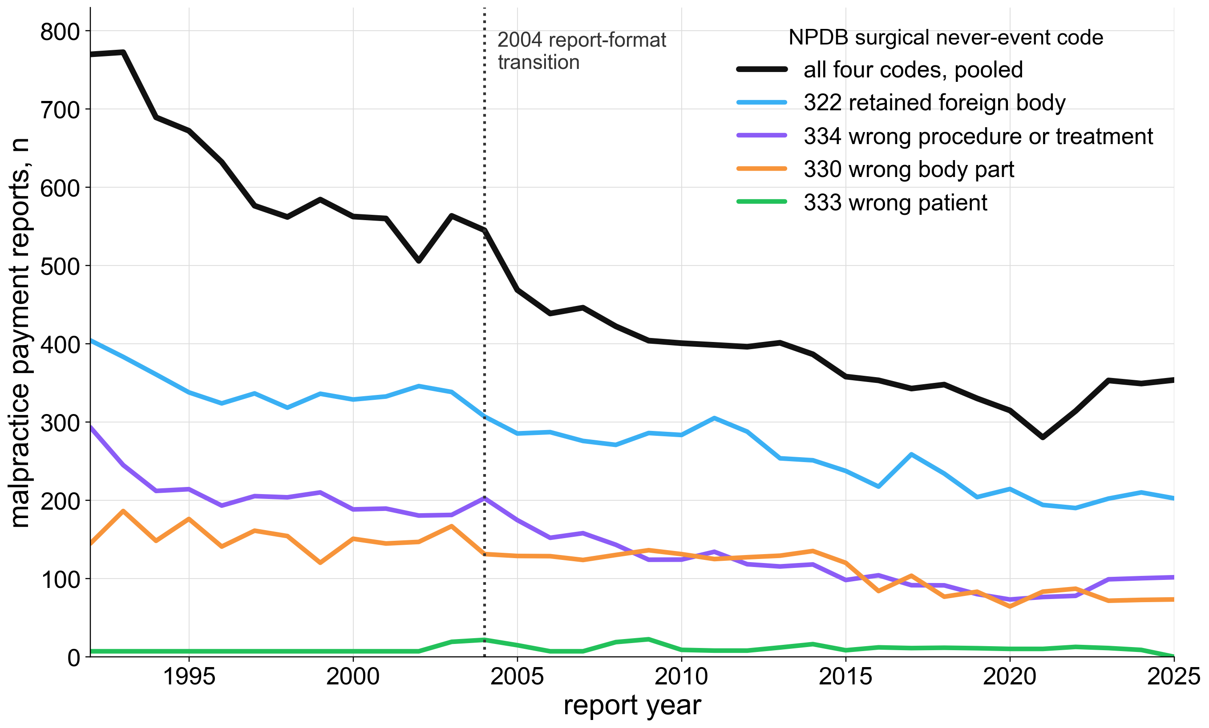
What a wrong level costs, and what avoiding it costs
17 % of events lead to legal action; one in five Spine Section surgeons has been sued (Mody 2008; Groff 2013)
81 % of litigated cases paid; median never-event payment $75,220 (Goodkin 2004; Bettis 2026)
Avoiding it: a gold fiducial placed the day before, 52 min and 183 mGy per patient (AJNR 2023)
Derived, unpublished: roughly 420–1,900 US wrong-level operations a year; indemnity alone about $8–37 million.
Redrawn from Bettis et al. 2026, Figure 1: NPDB malpractice payment reports for surgical never events, 1991–2025; values read from the published figure, fitted trend omitted (Patient Saf Surg, open access; permission pending).
10. Goodkin R, Laska LL. Surg Neurol 2004;61:323. 11. Bettis T, et al. Patient Saf Surg 2026. 12. Machin JT, et al. Eur Spine J 2018;27:2693. 13. AJNR Am J Neuroradiol 2023;44:618. 14. Childers CP, Maggard-Gibbons M. JAMA Surg 2018;153:e176233.

Slide 6

The label on the film is only as right as the planning read
LevelCheck registers preoperative CT labels onto the film: 100 % placement, 97.6 % surgeon reads (De Silva 2016; Manbachi 2018)
Scored against the imported labels. On a transitional spine the label is only as right as the planning read
Registration-free naming on real C-arm images: 73 % (Zhang 2023); cadaver long-length images 88 % (Huang 2022)
Nothing published names a level from one exposure alone, and nothing is tested on a transitional spine.
Top: De Silva et al. 2016, Figure 1 (Spine; PMC5045321). Bottom: Manbachi et al. 2018, Figure 6, labels on a 13th rib and a lumbarised S1 (Ann Biomed Eng; PMC9107073). Permission pending.
15. Otake Y, et al. Phys Med Biol 2012;57:5485. 16. Lo SFL, et al. Spine 2015. 17. De Silva T, et al. Spine 2016. 18. Manbachi A, et al. Ann Biomed Eng 2018;46:1548. 19. Peh WCG, et al. 1999. 20. Zhang R, et al. J Xray Sci Technol 2023. 21. Huang Y, et al. Comput Methods Programs Biomed 2022.

Slide 7

The planning read fails where the count fails
An open-source whole-body segmenter, unmodified, on 1,152 public CTs (Wasserthal 2023)
Normal anatomy: L5 Dice 0.94. Lumbarization: every label slides one level, L5 Dice 0.29
L6 emitted: 0 of 1,152. Confident, well formed, one level off, no error signal
Not All Spines Are Created Equal, NeurIPS 2026
A lumbarization case with a true L6. Left, ground truth; right, the segmenter's output.
22. Wasserthal J, et al. Radiol Artif Intell 2023;5:e230024. 23. Schwing GJ, et al. Not All Spines Are Created Equal. NeurIPS 2026 Datasets and Benchmarks (accepted; retrospective). 24. CTSpinoPelvic1K, doi.org/10.5281/zenodo.22139642.

Slide 8
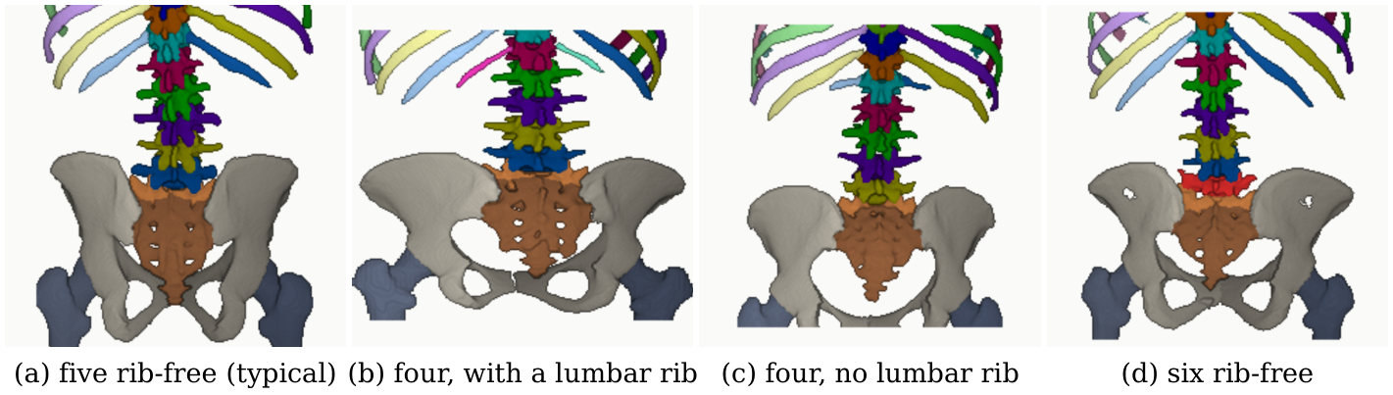
Hypothesis and purpose
Four phenotypes at the lumbar borders, aligned on the sacrum (CTSpinoPelvic1K, public, de-identified).
Hypothesis: each transitional vertebra has a local shape a network reading a few bodies can learn
Purpose: name the level from one exposure, and outperform surgeons using registration at level identification. Targets set before scoring: 90 % naming, 85 % variant sensitivity, 97 % detection
Investigational. Decision support beside the surgeon's count, never a replacement for the check film.

Slide 9
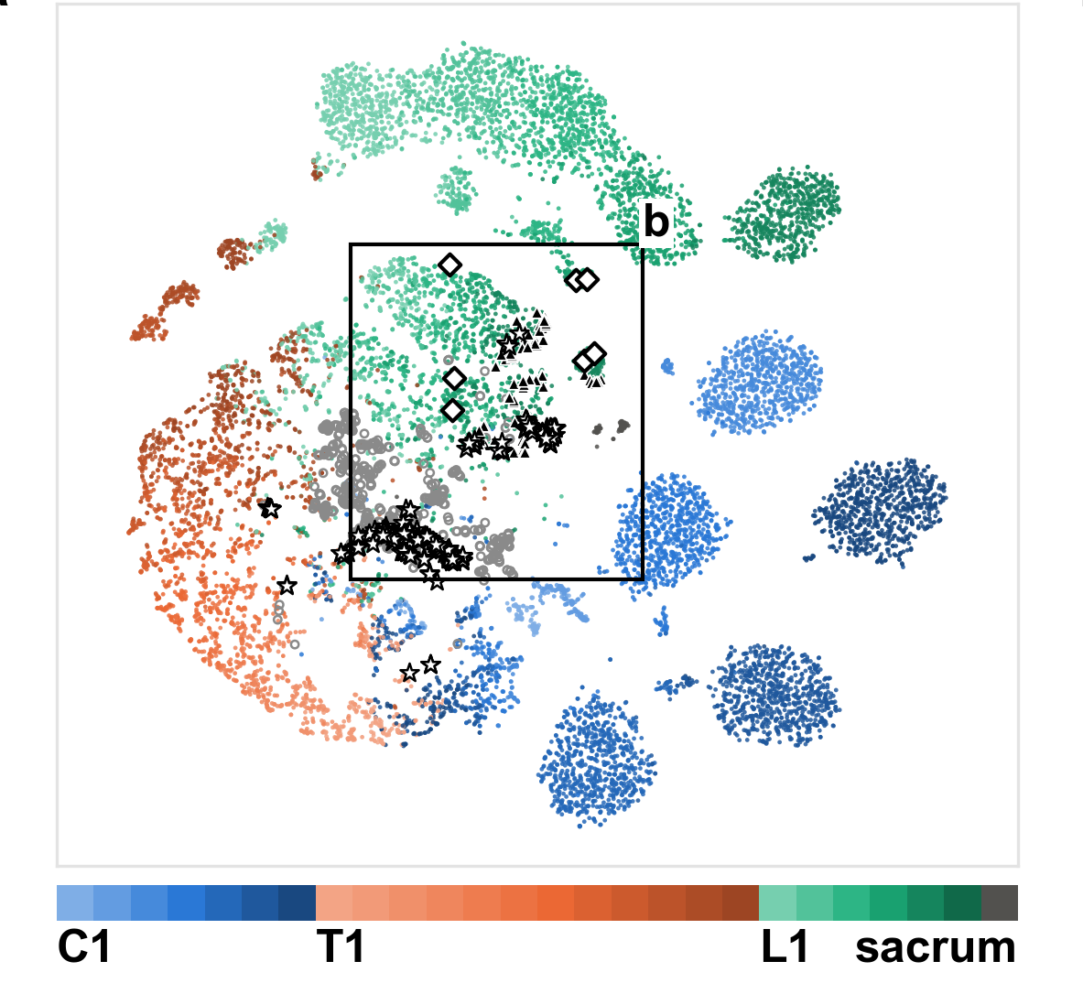
What it learned from public data: one shape per level
Public and de-identified: 4,093 CT renders, 9,108 films with levels, 4,276 real exposures; 194 transitional persons
No released film or C-arm frame carries a human-read T13 or Castellvi grade
The network's map of 13,009 crops from 1,612 people: one cluster per level, C1 to the sacrum. The nearest crop from another person is the same level in 74.9 %
The intraoperative C-arm set (148 cases, cone-beam CT truth, 2023) is in no training set
SchwingNet manuscript, Figure 2a: the level model's embedding, coloured by level (t-SNE). Triangles, L6; stars, the contested L6 of never-seen patients.
Retrospective study of public collections, analysed April–September 2026; sources, licences and download locations per release in the manuscript. VinDr-SpineXR under a PhysioNet data use agreement.

Slide 10
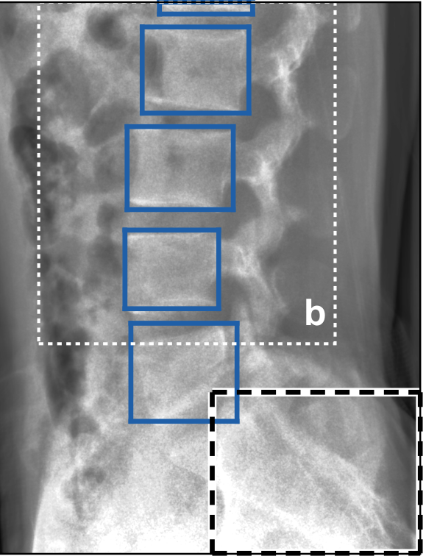
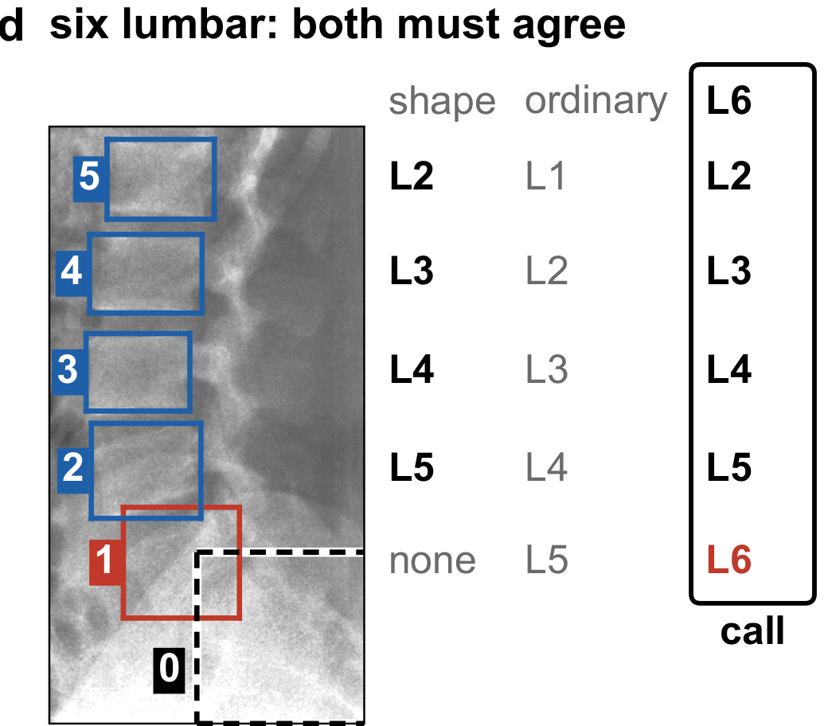
What SchwingNet does: find, name, check
1 · Find
2 · Name
3 · Check
bodies and sacrum boxed;
no level name yet
each body named from its shape,
probability beside it
against the count from the sacrum:
agree, a name; disagree, a stop
Notes:
One exposure in. Out, for every body in the field: a level name with its probability, the count from the sacrum, and a flag when the two disagree. Neither end of the spine is needed, and no label is imported from another study.
Trained on renders of labelled CT and on annotated radiographs; the intraoperative C-arm is in no training set. Fitted image-formation parameters for each device, the trained weights and the code accompany the paper.
The architecture, how the two readings are combined and when the read stops are withheld pending the university invention review. Figures: manuscript Figure 4a, 4b and 4d; C-ArmLSpine, public, 2023.

Slide 11

How it was tested: real exposures, cone-beam CT truth
Real lateral frames, calls by the cross-validated model; green right, red wrong, orange unscored (the two truth labellers disagree). Needle tip on the named L4. C-ArmLSpine, public, 2023.
Notes:
148 intraoperative cases, public, acquired November–December 2023; truth from each patient's cone-beam CT, read by two automatic labellers; 814 of 910 vertebrae agreed and kept.
Three readings of the same frames: never trained on this C-arm; fine-tuned by case-grouped folds; fine-tuned by acquisition-day folds.
Scored per detected body as exact level; intervals clustered by case; paired differences with exact sign tests, Holm-adjusted over the comparisons named before scoring. Every number in the paper is read by the build from a result file; a patient-keyed gate swept 563 quoted numbers against checkpoint lineages.
Retrospective study of public collections, analysed April–September 2026.

Slide 12
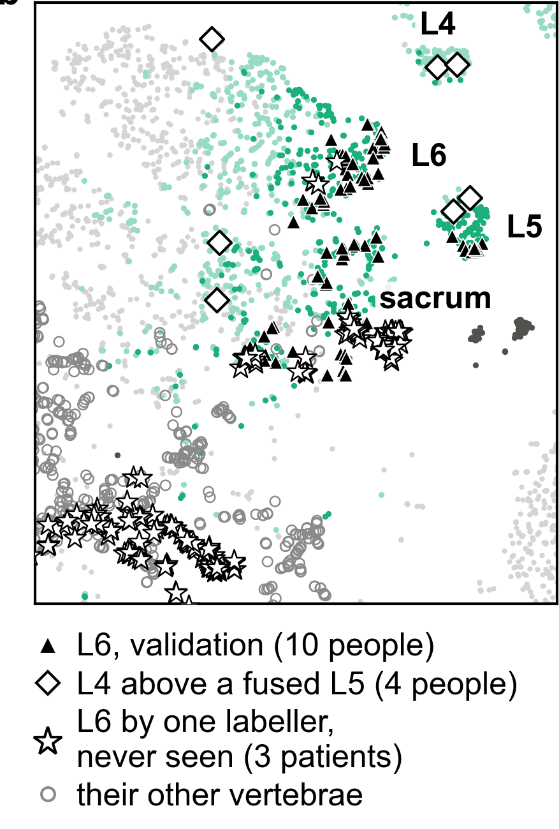
A sixth lumbar vertebra has a shape of its own
The lumbosacral window of the same map
L6 separates from L5 (silhouette 0.35) as far as L1 from T12 (0.32)
75 of 98 L6 crops named L6
Preliminary: ten L6 persons, on the split that chose the checkpoint
SchwingNet manuscript, Figure 2b.

Slide 13
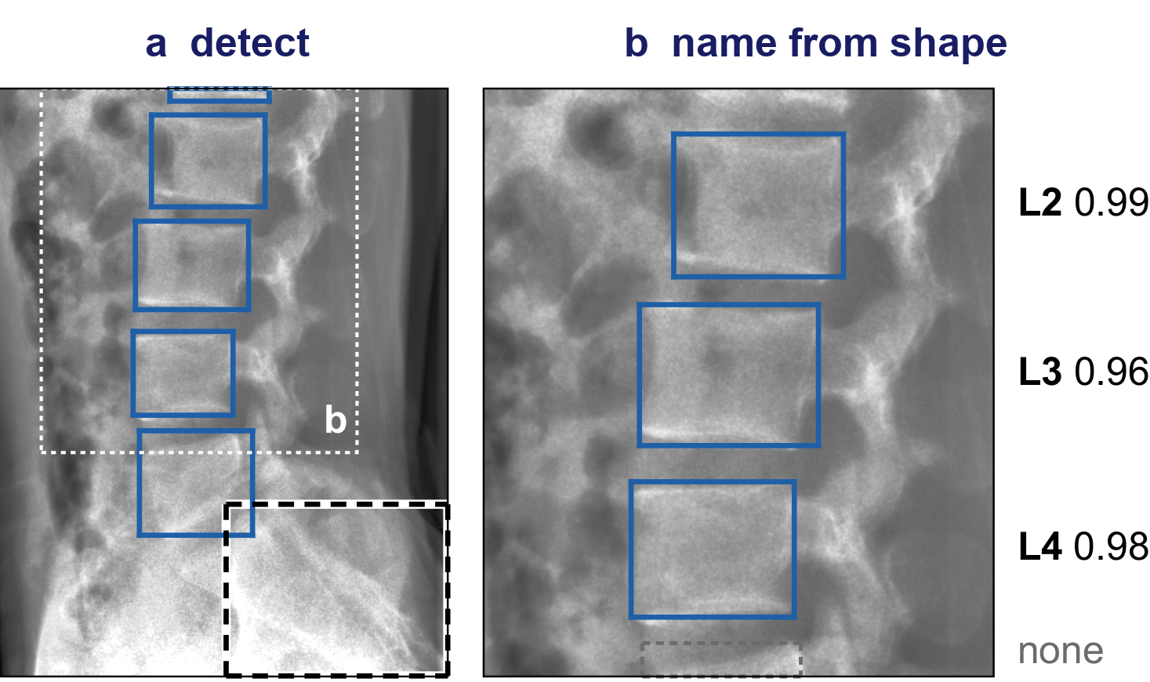
One lateral exposure of a C-arm the network never saw
Zero-shot, lateral: 595 of 617 bodies exact (96.4 %; 92.3, 98.4)
Anteroposterior zero-shot 43.7 %; fine-tuned on other cases 96.4 %
Three bodies in view 93.1 %; one body 74.8 %: a name where there is nothing to count
C-ArmLSpine, public intraoperative exposures, 2023; SchwingNet manuscript, Figure 4a–b.

Slide 14
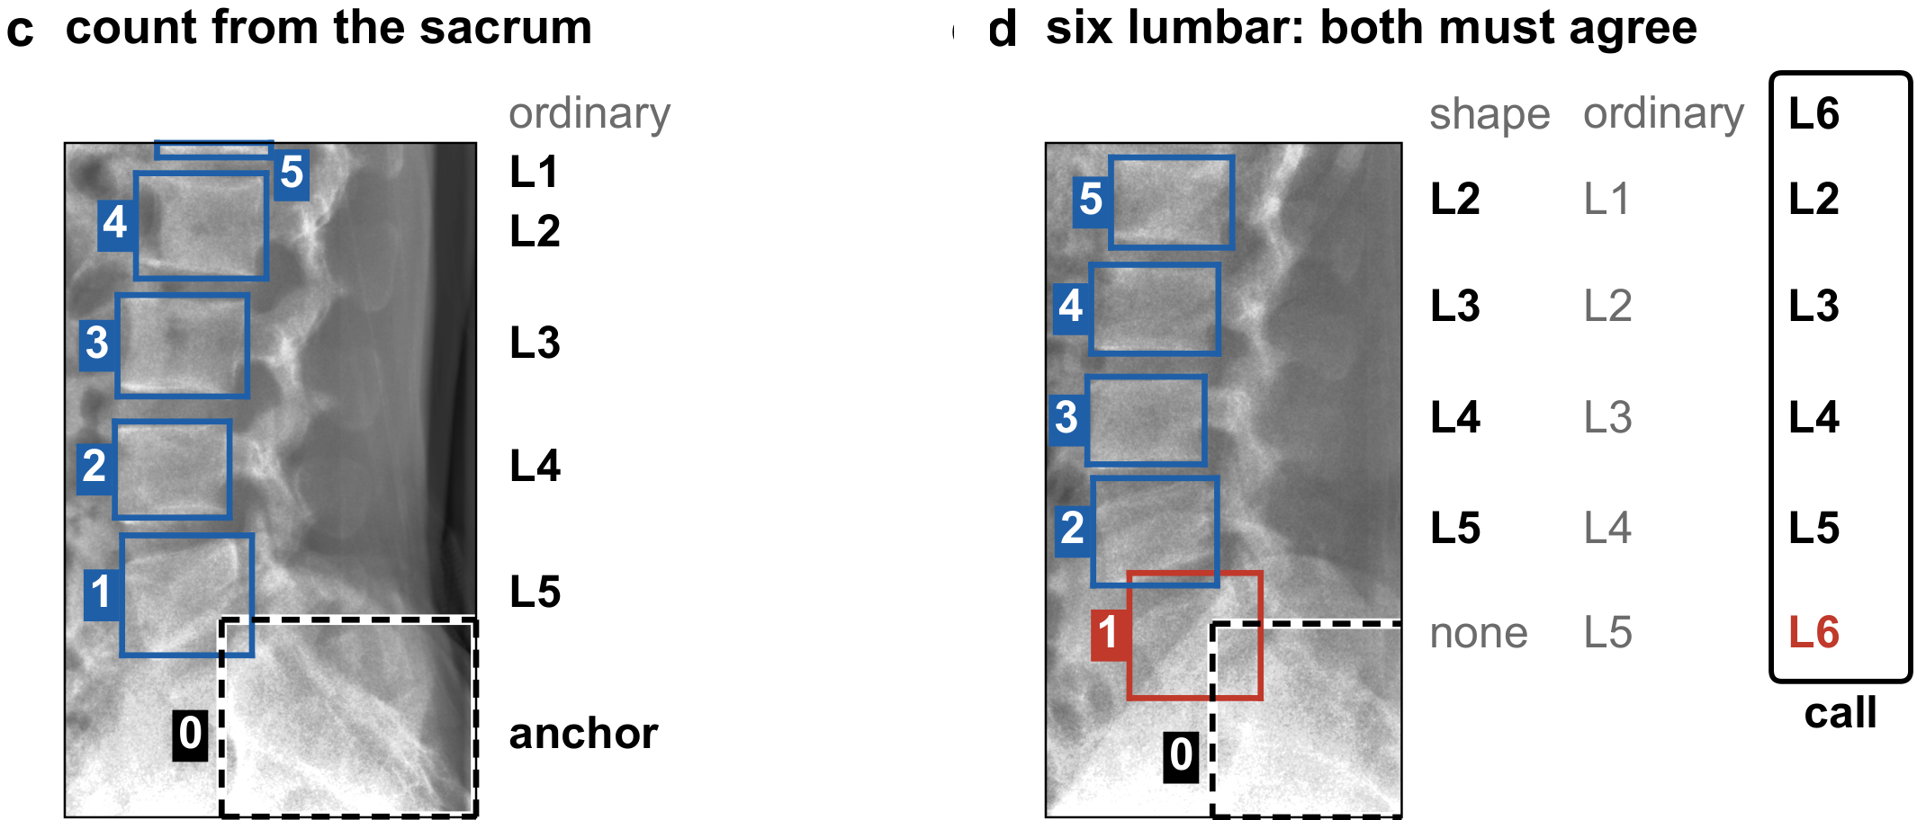
Two readings of one frame, and a stop where they disagree
Count from the sacrum 97.0 %, shape alone 97.7 %, together 98.2 % (1,009 bodies)
Stopped on 23 of 233 frames: five of the six errors and all four L6 calls
A disagreement is reported, not hidden
Same frame. (c) Ordinals from the detected sacrum, named in the ordinary five-lumbar alphabet. (d) A frame one CT labeller reads six-lumbar: shape and count disagree on body 1; the read stops.
How the readings are combined and when the read stops are withheld pending the invention review.

Slide 15

Where the frames sat mattered more than how many
Unseen device: 80.5 % of bodies found; 93.9 % on truth boxes inside the field
Its own frames: a plateau from 24 (c). One view buys that view only
Renders at two poses find 53 % between them; the same count spread over the arc, 77 % (d)
SchwingNet manuscript, Figure 5c–d; render sweep on 40 unseen subjects.

Slide 16

How many people it takes, and which view they were shot in
Film naming rose with training persons: NHANES II 78 → 93 %, BUU-LSPINE 65 → 97 %, CSXA 94 → 99.8 %
C-arm lateral: 93.7 % with no C-arm person. Anteroposterior: 33.8 % with none, 90.8 % with five
Training both views cost neither (98.1 and 97.0 %)
● NHANES II
● BUU-LSPINE
▲ CSXA
● C-arm, lateral
■ C-arm, anteroposterior
○ lateral-trained, read on anteroposterior
✕ both views, all persons
Exact level against training persons; SchwingNet manuscript, Figure 5b.

Slide 17

Transitional naming on a real exposure: the one case
A patient one CT labeller reads six-lumbar, the other five. Lateral frame, cross-validation fold
Shape names bodies 5 to 2 as L2–L5 (0.89–1.00); the count says L1–L4. Body 1: shape none (0.02), count L5
The call is L6 for the column; body 1 is left unnamed and the read stops
Three such patients exist, six frames; scored in cross-validation only. A description, not a test
C-ArmLSpine case 42, public; SchwingNet manuscript, Figure 4d, with the probabilities the system printed on each box.
No accuracy on this slide is a wrong-level surgery rate. Evidence base absent: transitional naming on real exposures is unverified.

Slide 18

What the census would let me claim
n: the transitional persons a screen of every collection in the census should find, from published prevalence; a case counts only where a film exists. Today there are 7 candidates on real exposures, none verified.
Each cell: the lowest accuracy the data would still support at 95 % confidence if the network named those n persons with that share of errors (Wilson bound). 157 error-free persons are the fewest that clear 97.6 %.
97.6 % is what surgeons scored reading 62 difficult films with the LevelCheck overlay (Manbachi 2018). With 870 L6 persons the network may miss 12 and still sit above it; with all 2,069 transitional persons, 36. The 322 L6 of the screen running now allow 2.
Beating it outright needs the paired comparison on the same persons, a separate study; this slide is the size of the claim the census makes possible.

Slide 19
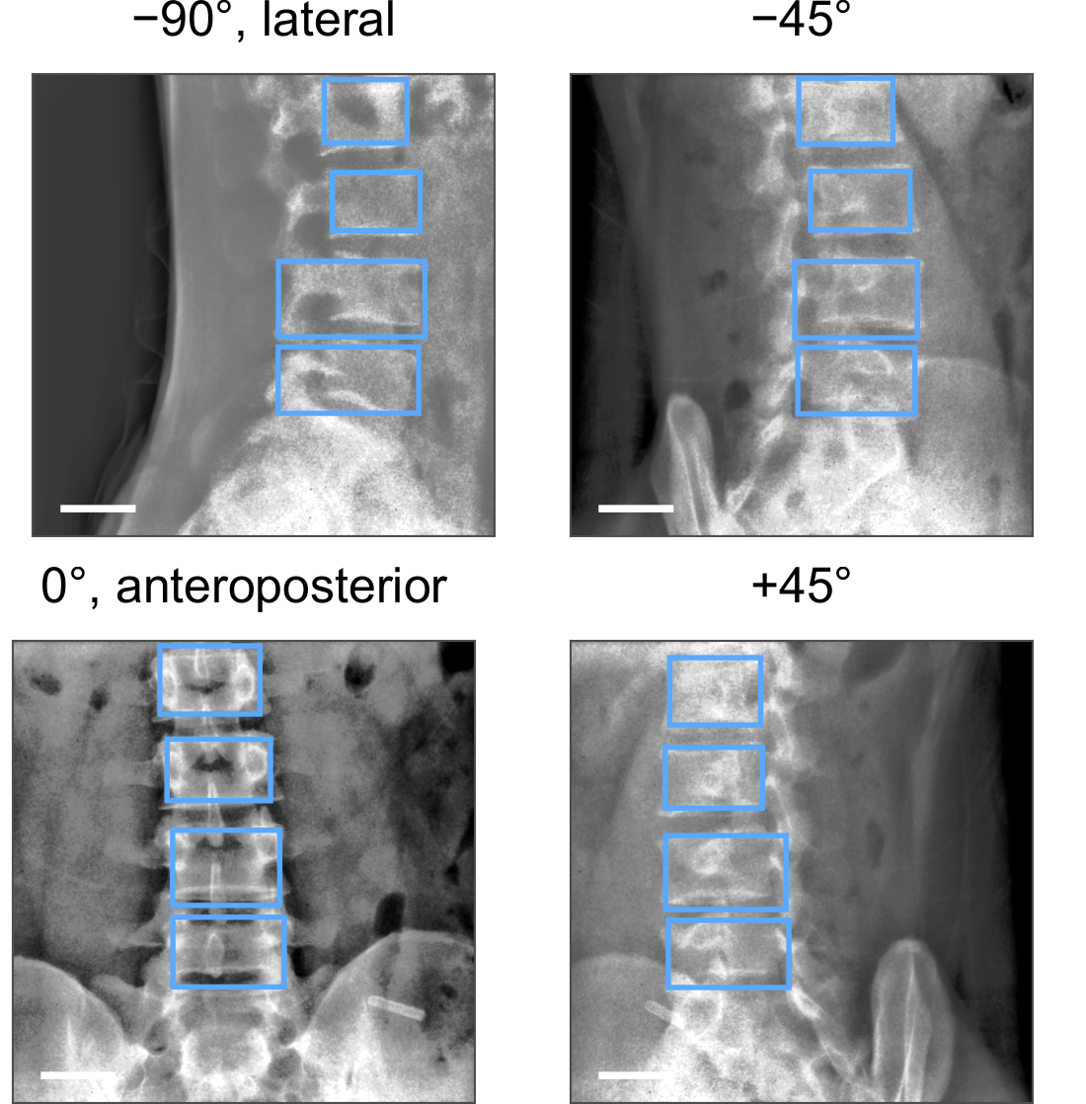
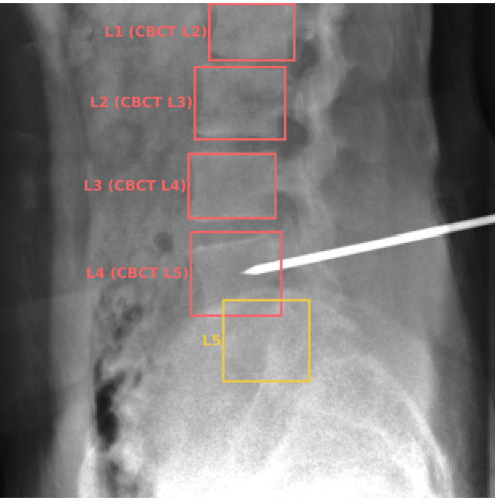
Limitations and next steps
The only real rotational acquisition: one patient, 301 frames from lateral to anteroposterior (supplement Figure S5a; bar, 50 mm). Every other real frame sits at one of two poses.
A frame whose truth the two automatic labellers disagree on (orange): unscored. The test's truth is their agreement, not a human read.
Notes:
Limitations. One intraoperative device; its truth is two automatic labellers agreeing, which removes the thoracolumbar junction and cannot settle a transitional count. Whether 148 cases are 148 people cannot be established; every intraoperative interval is too narrow if they are not. Real frames sit at two poses; one patient's rotational acquisition is the only real arc, and on it the held-out detector found about half the bodies. The posterior is uncalibrated; the embedding is of the selection split. Retrospective, public data; nothing prospective; not a cleared device.
Next steps. Verify the transitional candidates by two human readers and run the pre-stated test: 35 persons, zero errors. A second C-arm, with obliques, added to the corpus and held out; the paired comparison with registration on verified at-risk persons. Phantom, cadaver, then human series, in that order, before any operating-room use.

Slide 20

Conclusions
The count fails on transitional anatomy; registered labels and CT segmenters inherit the miscount
SchwingNet: 96.4 % zero-shot on the lateral view, 98.2 % coupled, and a stop on 23 of 233 frames holding five of six errors
Transitional naming on real exposures: unverified. 35 persons needed; the census is under way
Exact level on the unseen C-arm.
A name from shape, checked against the count, with a stop where they disagree
Evidence status: investigational; retrospective, public de-identified data; no prospective evaluation; not a cleared device.

Slide 21
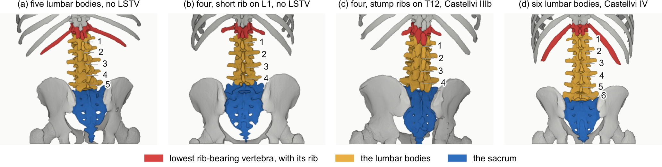
Acknowledgments and data availability
With thanks to Patrick Schwing (LSU Health Sciences Center New Orleans); Miraziz Ismoilov and Nizar Alnabahneh (Radiology) and Loren Schwiebert (Computer Science), Wayne State University; and the annotators Ashley Schehr, Annika Tekumulla, Margret Khoushi, Ryan Christian, Dane Hubers, Faris Mahjoub, Hassan Saad, Mia Sooch, Sathyagopal Siddapureddy, Michael McLellan and Jerick Kim
Data: CTSpinoPelvic1K (doi.org/10.5281/zenodo.22139642) and the public C-arm, radiograph and CT collections under their own licences; all de-identified
Code and weights: github.com/OpenSpineConsortium
Funding: NIH NIGMS F30GM147909. No commercial support.
Questions
gregory.schwing@med.wayne.edu
openspineconsortium.com

