Slide 1
SchwingNet: Naming a Vertebral Level From One C-arm Exposure, Without Counting From C2
Gregory J. Schwing, MD, PhD
Department of General Surgery, Detroit Medical Center and Wayne State University, Detroit, MI
CNS 2026 Annual Meeting · Washington, DC · [session and date pending]

Slide 2

Where this is going
1
Surgeons count vertebrae on the C-arm. On a transitional spine the count is wrong
2
Today's tools map a position on the spine to the preoperative CT to help the surgeon count. Humans still make mistakes
3
SchwingNet reads the level from the shape of the bones in a limited field of view; with the sacrum in view it also counts, and checks the two against each other. Nothing is mapped to the CT
A real lateral C-arm exposure; each body named from its shape, with its probability.
4
Tested on real intraoperative C-arm exposures: how often it is right, and when it stops
5
What is missing: enough transitional patients' scans to feed the model

Slide 3

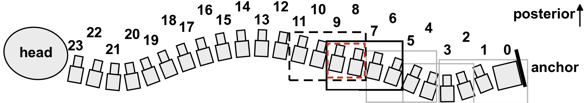
The level is counted, and the count is often wrong
Half of spine surgeons report a wrong-level operation in their career (Mody 2008; Groff 2013)
Registry of 34,544 operations: 0.12 %, thoracic 0.42 % (Furuya 2026)
The first exposed level is wrong in 4–15 % before the check film; verification protocols miss a third (Ammerman 2006; Dablouk 2019; Longo 2012)
The remedy on offer is another count
Strong et al. 2022, Figure 3: intraoperative fluoroscopy, needle at the T10 pedicle, counted from the sacrum. J Neurosurg Spine 36:792 (PMC10193475); permission pending.
The C-arm steps up the prone spine, each exposure overlapping the last, and the level is counted from the sacrum. Cartoon from the SchwingNet manuscript.
1. Mody MG, et al. Spine 2008;33:194. 2. Groff MW, et al. World Neurosurg 2013;79:585. 3. Furuya M, et al. Bone Joint J 2026;108-B:673. 4. Dablouk MO, et al. Br J Neurosurg 2019. 5. Ammerman JM, et al. Surg Neurol 2006. 6. Longo UG, et al. J Bone Joint Surg Br 2012;94-B:1546.

Slide 4

Transitional anatomy changes the count
Labelled CT, public de-identified records (CTSpinoPelvic1K). Bar, 20 mm.
8.8 % of 3,147 full-length radiographs lack 24 presacral segments (Sabri 2025); in 550 lumbar operations the count was wrong in 38 of 71 patients with a transitional vertebra (Nakagawa 2017)
The truth is on CT. No public radiograph or C-arm frame carries a human-read T13 or Castellvi grade
7. Sabri SA, et al. Neurosurg Focus 2025;58(6):E13. 8. Nakagawa T, et al. 2017. 9. Castellvi AE, et al. Spine 1984;9:493. Figure: SchwingNet manuscript (in preparation), Figure 1.

Slide 5
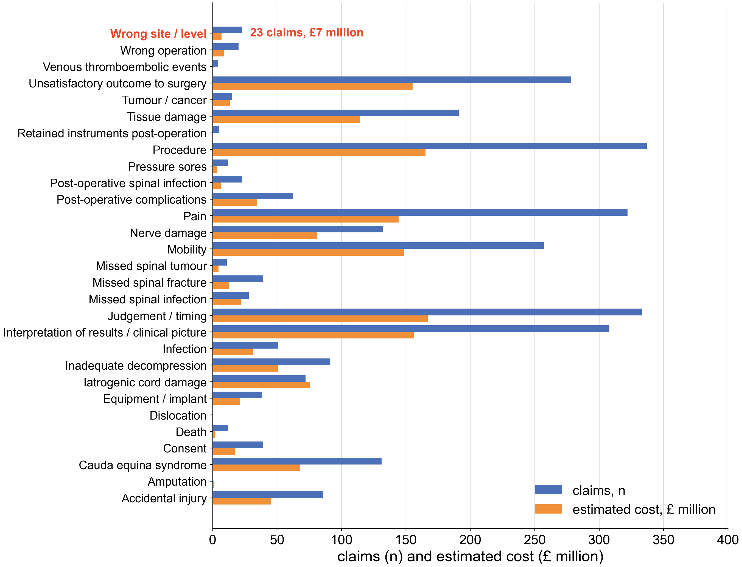
What a wrong level costs, and what avoiding it costs
978 spinal-surgery negligence claims in England over five years, £535.5 million: wrong site or level is a small share of them (Machin 2018)
17 % of self-reported wrong-level events lead to legal action; 81 % of litigated cases are paid; median never-event payment $75,220 (Mody 2008; Goodkin 2004; Bettis 2026)
Avoiding it: a gold fiducial placed the day before, 52 min and 183 mGy per patient (AJNR 2023)
Derived, unpublished: roughly 420–1,900 US wrong-level operations a year; indemnity alone about $8–37 million.
Redrawn from Machin et al. 2018, Figure 2: NHS spinal-surgery negligence claims 2012–2017 by cause, number and estimated cost; values read from the published figure (Eur Spine J, open access).
10. Machin JT, et al. Eur Spine J 2018;27:2693. 11. Goodkin R, Laska LL. Surg Neurol 2004;61:323. 12. Bettis T, et al. Patient Saf Surg 2026. 13. AJNR Am J Neuroradiol 2023;44:618. 14. Childers CP, Maggard-Gibbons M. JAMA Surg 2018;153:e176233.

Slide 6


The label on the film is only as right as the planning read
Registration scores against the labels it imported. On a transitional spine the label is only as right as the planning read
Nothing published names a level from one exposure alone, and nothing is tested on a transitional spine
Top: De Silva et al. 2016, Figure 1 (Spine; PMC5045321). Bottom: Manbachi et al. 2018, Figure 6, labels on a 13th rib and a lumbarised S1 (Ann Biomed Eng; PMC9107073). Permission pending.
15. Otake Y, et al. Phys Med Biol 2012;57:5485. 16. De Silva T, et al. Spine 2016. 17. Manbachi A, et al. Ann Biomed Eng 2018;46:1548. 18. Peh WCG, et al. 1999. 19. Zhang R, et al. J Xray Sci Technol 2023. 20. Huang Y, et al. Comput Methods Programs Biomed 2022.

Slide 7

The planning read fails where the count fails
An open-source whole-body segmenter, unmodified, on 1,152 public CTs (Wasserthal 2023)
Normal anatomy: L5 Dice 0.94. Lumbarization: every label slides one level, L5 Dice 0.29
L6 emitted: 0 of 1,152. Confident, well formed, one level off, no error signal
Not All Spines Are Created Equal, NeurIPS 2026
A lumbarization case with a true L6. Left, ground truth; right, the segmenter's output.
21. Wasserthal J, et al. Radiol Artif Intell 2023;5:e230024. 22. Schwing GJ, et al. Not All Spines Are Created Equal. NeurIPS 2026 Datasets and Benchmarks (accepted; retrospective). 23. CTSpinoPelvic1K, doi.org/10.5281/zenodo.22139642.

Slide 8
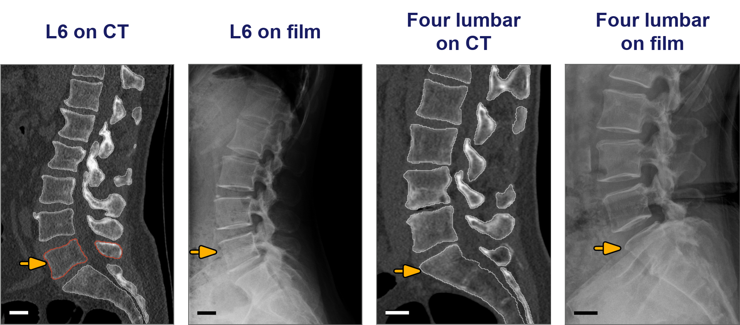
Hypothesis and purpose
A sixth lumbar and a four-lumbar spine on labelled CT and on another patient's real film (SchwingNet manuscript, Figure 1; public, de-identified).
Hypothesis: each transitional vertebra has a local shape a network can learn from labelled CT and find on a film
Purpose: name the level from one exposure, and outperform surgeons using registration at level identification. Targets set before scoring: 90 % naming, 85 % variant sensitivity, 97 % detection
Investigational. Decision support beside the surgeon's count, never a replacement for the check film.

Slide 9
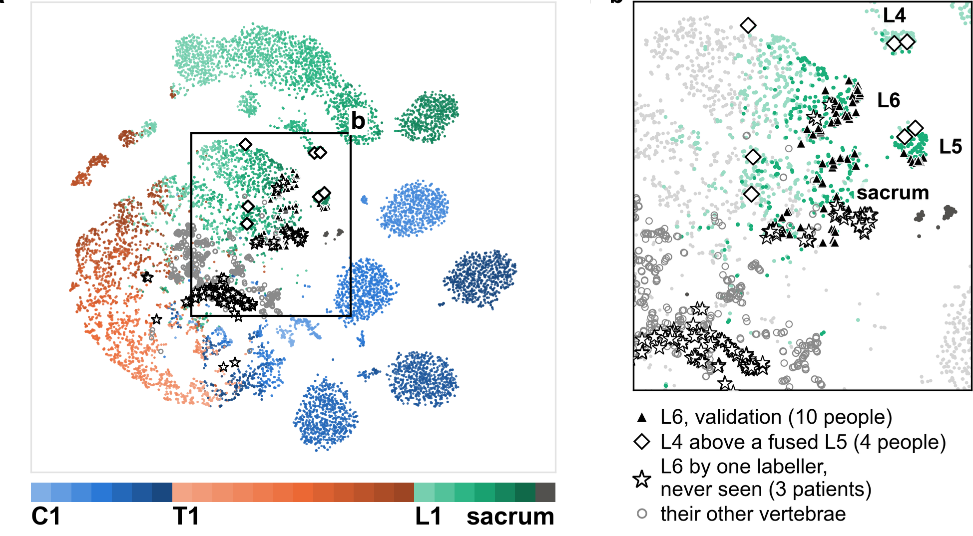
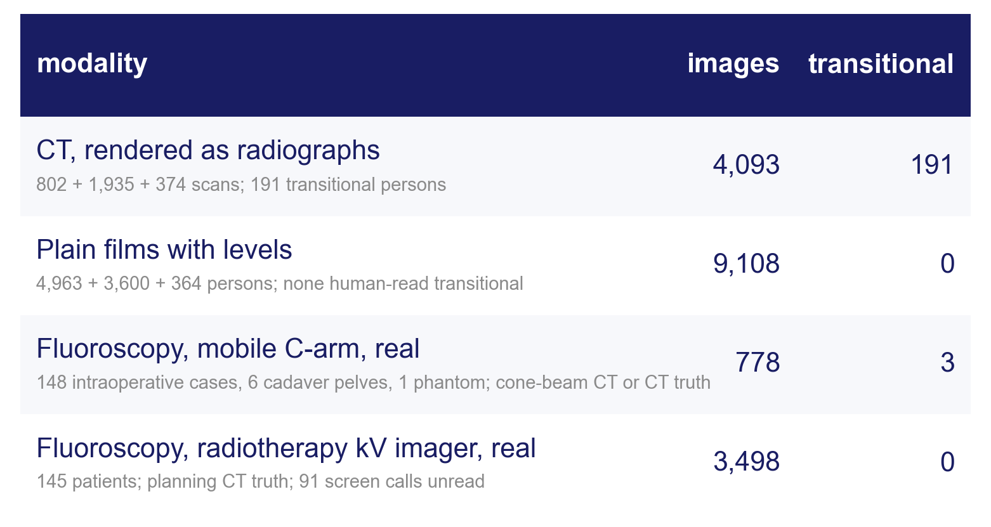
What it learned from public data: one shape per level
All public and de-identified. The transitional truth is on CT; no released film or C-arm frame carries a human-read T13 or Castellvi grade
The intraoperative set (148 cases, cone-beam CT truth, 2023) is in no training set
The level model's embedding of 13,009 crops from 1,612 people, coloured by level (left, C1 to sacrum; right, the lumbosacral window: triangles L6, stars the contested L6 of never-seen patients). Manuscript Figure 2a–b.
Notes:
All public and de-identified; retrospective, analysed April–September 2026. 194 transitional persons across the sources, 191 of them on CT; no released film or C-arm frame carries a human-read T13 or Castellvi grade. The intraoperative C-arm set (148 cases, cone-beam CT truth, 2023) is in no training set.
The nearest crop from another person is the same level in 74.9 % and within one level in 93.8 %. L6 separates from L5 (silhouette 0.35) as far as L1 from T12 (0.32); 75 of 98 L6 crops were named L6. Preliminary: ten L6 persons, on the split that chose the checkpoint.

Slide 10
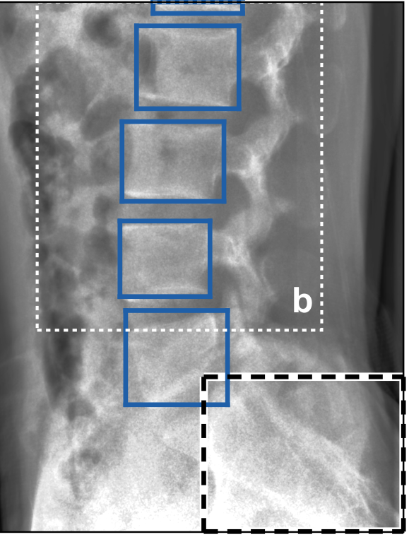
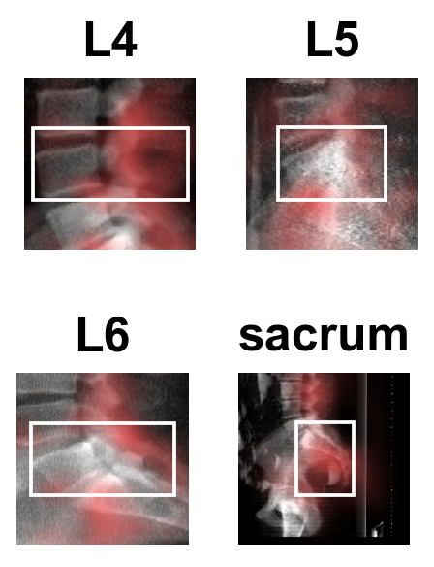
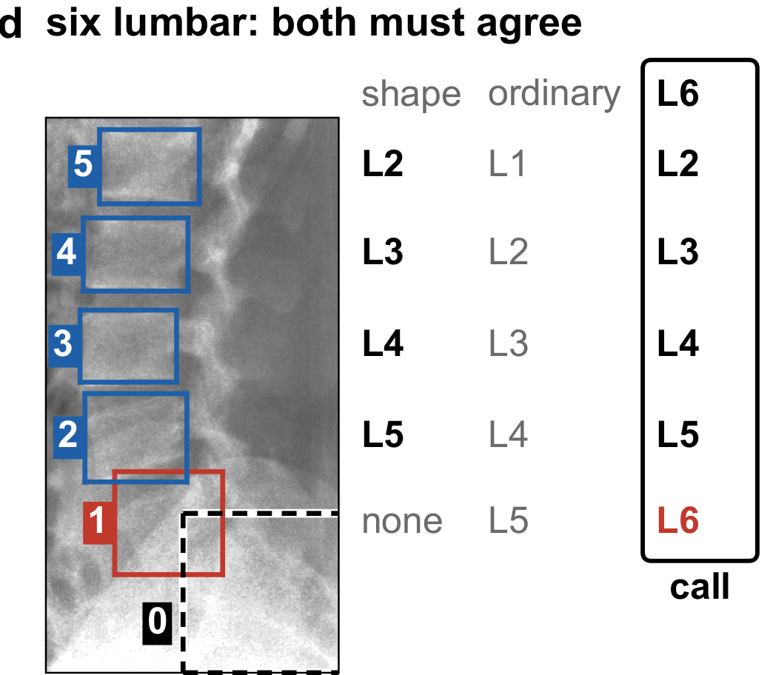
What SchwingNet does: find, name, check
1 · Find
2 · Name
3 · Check
bodies and sacrum boxed;
no level name yet
each body named from its shape;
red, what the name draws on
against the count from the sacrum:
agree, a name; disagree, a stop
Notes:
One exposure in. Out, for every body in the field: a level name with its probability; when the sacrum is in the field, the count from it; and a flag when the two disagree. Neither end of the spine is needed, and no label is imported from another study.
Middle: occlusion maps for L4, L5, L6 and the sacrum; red, the parts of the image whose removal changes the name most (manuscript Figure 2d). Per unit area the attribution is densest on the target body; for L4 to L6 more of it falls on the body below than on the target.
Trained on renders of labelled CT and on annotated radiographs; the intraoperative C-arm is in no training set. The architecture, how the two readings are combined and when the read stops are withheld pending the university invention review. Figures: manuscript Figure 4a, 2d and 4d.

Slide 11

How it was tested: real exposures, cone-beam CT truth
Real lateral frames, calls by the cross-validated model; green right, red wrong, orange unscored (the two truth labellers disagree). Needle tip on the named L4. C-ArmLSpine, public, 2023.
Notes:
148 intraoperative cases, public, acquired November–December 2023; truth from each patient's cone-beam CT, read by two automatic labellers; 814 of 910 vertebrae agreed and kept.
Three readings of the same frames: never trained on this C-arm; fine-tuned by case-grouped folds; fine-tuned by acquisition-day folds.
Scored per detected body as exact level; intervals clustered by case; paired differences with exact sign tests, Holm-adjusted over the comparisons named before scoring. Every number in the paper is read by the build from a result file; a patient-keyed gate swept 563 quoted numbers against checkpoint lineages.
Retrospective study of public collections, analysed April–September 2026.

Slide 12
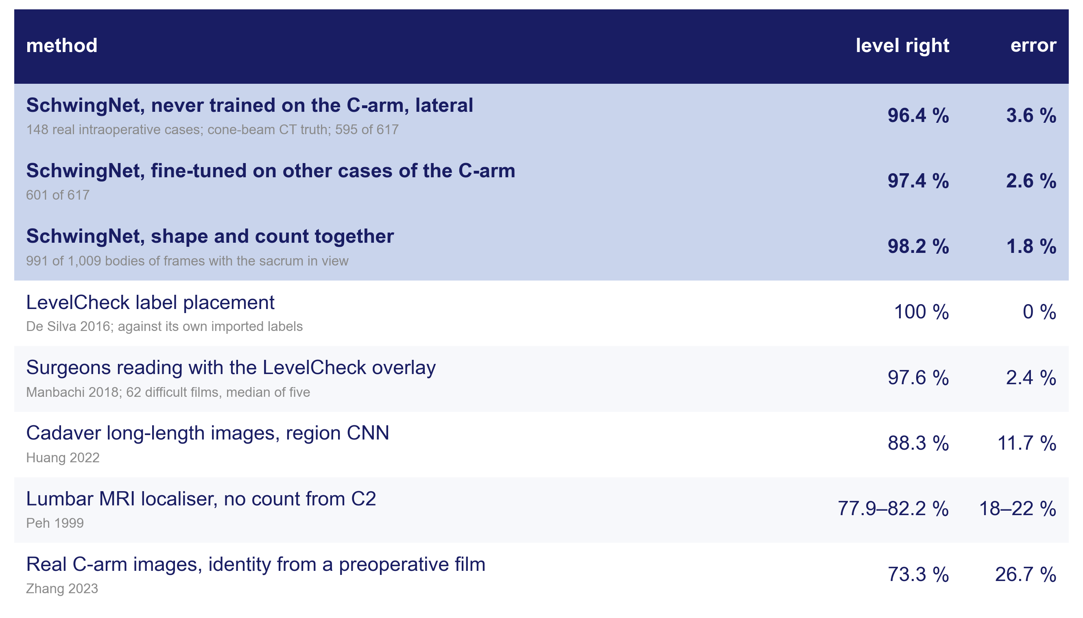
Result 1: it names the level without counting or registration
SchwingNet on 148 real intraoperative cases of a C-arm it never saw, lateral view, scored against cone-beam CT; the published methods on their own test sets. Parity with the overlay is suggested, not proven: the paired comparison is a separate study.
Notes:
Zero-shot lateral: 595 of 617 detected bodies exact (96.4 %; 95 % CI 92.3, 98.4). Anteroposterior zero-shot 43.7 %; fine-tuned on other cases of the same C-arm 96.4 %. With three bodies in view 93.1 %; with one body 74.8 %: a name where there is nothing to count.
The published accuracies are scored against different truths: LevelCheck against the labels it imported from the planning CT; the surgeon reading with the overlay against the same; the registration-free methods against their own test sets. No study is on a transitional spine.

Slide 13

Result 2: when shape and count disagree, it stops
A patient one CT labeller reads six-lumbar, the other five. Shape names bodies 5 to 2 as L2–L5 (0.89–1.00); the count says L1–L4. Body 1: shape none (0.02), count L5
The call is L6 for the column; body 1 is left unnamed and the read stops
Over all anchored frames: count 97.0 %, shape 97.7 %, together 98.2 % (1,009 bodies). Stopped on 23 of 233 frames, holding five of the six errors and all four L6 calls
A disagreement is reported, not hidden
C-ArmLSpine case 42, public; manuscript Figure 4d with the probabilities the system printed on each box; cross-validation fold.
How the two readings are combined and when the read stops are withheld pending the invention review. No accuracy on this slide is a wrong-level surgery rate.

Slide 14

Where the frames sat mattered more than how many
Unseen device: 80.5 % of bodies found; 93.9 % on truth boxes inside the field
Its own frames: a plateau from 24 (c). One view buys that view only
Renders at two poses find 53 % between them; the same count spread over the arc, 77 % (d)
SchwingNet manuscript, Figure 5c–d; render sweep on 40 unseen subjects.

Slide 15

How many people it takes, and which view they were shot in
Film naming rose with training persons: NHANES II 78 → 93 %, BUU-LSPINE 65 → 97 %, CSXA 94 → 99.8 %
C-arm lateral: 93.7 % with no C-arm person. Anteroposterior: 33.8 % with none, 90.8 % with five
Training both views cost neither (98.1 and 97.0 %)
● NHANES II
● BUU-LSPINE
▲ CSXA
● C-arm, lateral
■ C-arm, anteroposterior
○ lateral-trained, read on anteroposterior
✕ both views, all persons
Exact level against training persons; SchwingNet manuscript, Figure 5b.

Slide 16

Result 3: transitional naming is not yet tested; what the census supplies
Scored so far: three L6 patients, in cross-validation only; a description, not a test. Today there are 7 candidates on real exposures, none verified.
n: the transitional persons a screen of every collection in the census should find, from published prevalence; a case counts only where a film exists. Each cell: the lowest accuracy the data would still support at 95 % confidence at that share of errors (Wilson bound).
97.6 % is what surgeons scored with the LevelCheck overlay (Manbachi 2018). With 870 L6 persons the network may miss 12 and still sit above it; with all 2,069 transitional persons, 36; the 322 L6 of the screen running now allow 2.
Beating it outright needs the paired comparison on the same persons, a separate study.

Slide 17
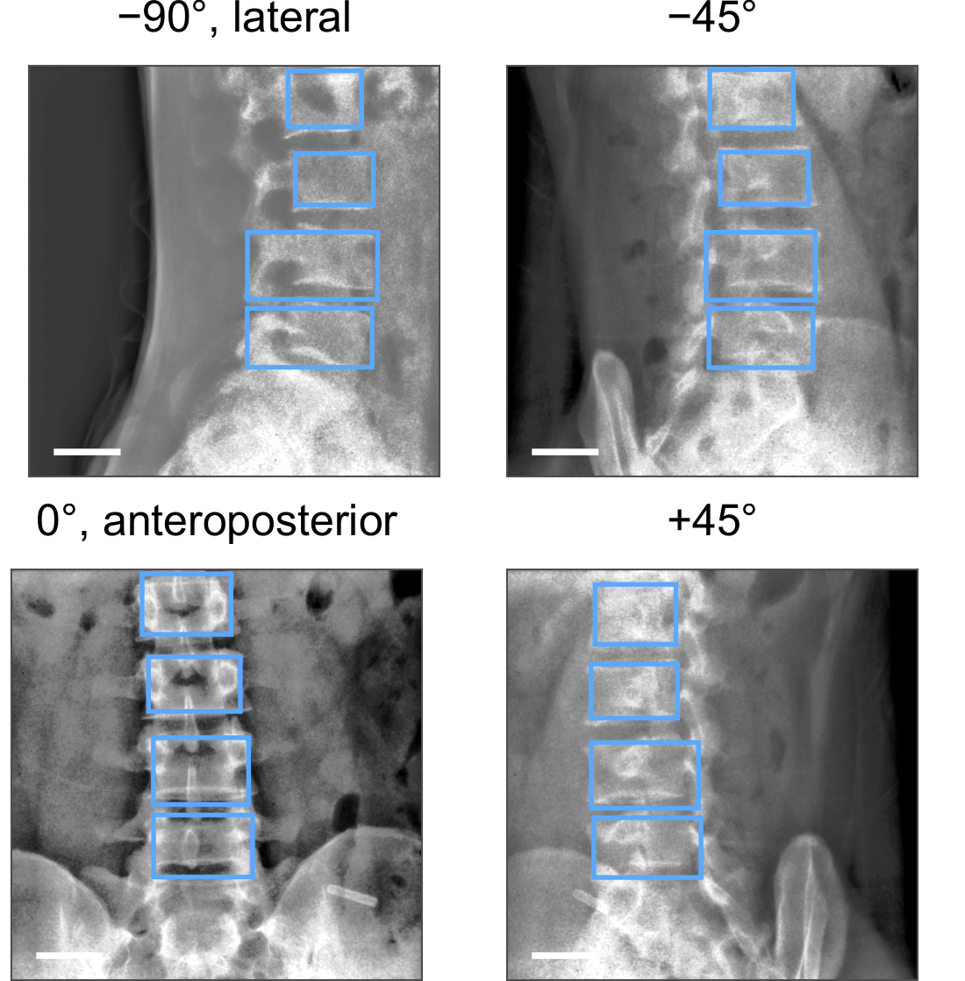
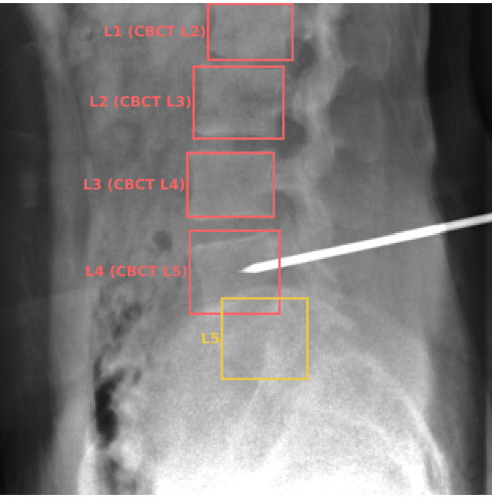
Limitations and next steps
The only real rotational acquisition: one patient, 301 frames from lateral to anteroposterior (supplement Figure S5a; bar, 50 mm). Every other real frame sits at one of two poses.
A frame whose truth the two automatic labellers disagree on (orange): unscored. The test's truth is their agreement, not a human read.
Notes:
Limitations. One intraoperative device; its truth is two automatic labellers agreeing, which removes the thoracolumbar junction and cannot settle a transitional count. Whether 148 cases are 148 people cannot be established; every intraoperative interval is too narrow if they are not. Real frames sit at two poses; one patient's rotational acquisition is the only real arc, and on it the held-out detector found about half the bodies. The posterior is uncalibrated; the embedding is of the selection split. Retrospective, public data; nothing prospective; not a cleared device.
Next steps. Verify the transitional candidates by two human readers and run the pre-stated test: 35 persons, zero errors. A second C-arm, with obliques, added to the corpus and held out; the paired comparison with registration on verified at-risk persons. Phantom, cadaver, then human series, in that order, before any operating-room use.

Slide 18

Conclusions: three goals, where each stands
Name the level from one exposure, no count, no registration: met on ordinary anatomy — 96.4 % zero-shot, 98.2 % coupled, beside 97.6 % for surgeons with the overlay (different test sets)
Name it on a transitional spine: not yet shown — three cross-validation patients; 35 error-free persons needed; the census should supply about 870 L6
Outperform surgeons using registration: needs the paired study — the census makes the size of that claim possible
Exact level on the unseen C-arm.
A name from shape, checked against the count, with a stop where they disagree
Evidence status: investigational; retrospective, public de-identified data; no prospective evaluation; not a cleared device.

Slide 19
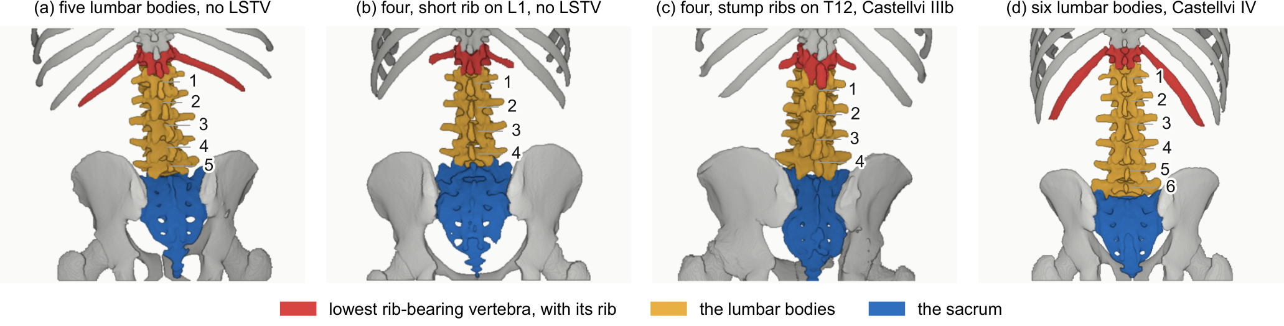
Acknowledgments and data availability
With thanks to Patrick Schwing (LSU Health Sciences Center New Orleans); Miraziz Ismoilov and Nizar Alnabahneh (Radiology) and Loren Schwiebert (Computer Science), Wayne State University; and the annotators Ashley Schehr, Annika Tekumulla, Margret Khoushi, Ryan Christian, Dane Hubers, Faris Mahjoub, Hassan Saad, Mia Sooch, Sathyagopal Siddapureddy, Michael McLellan and Jerick Kim
Data: CTSpinoPelvic1K (doi.org/10.5281/zenodo.22139642) and the public C-arm, radiograph and CT collections under their own licences; all de-identified
Code and weights: github.com/OpenSpineConsortium
Funding: NIH NIGMS F30GM147909. No commercial support.
Questions
gregory.schwing@med.wayne.edu
openspineconsortium.com

