Slide 1

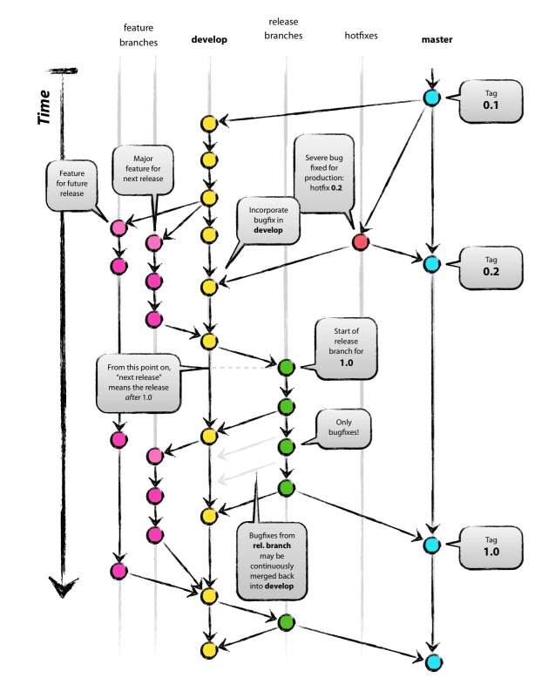
EMM Development Procedure
GOAL:
Avoid Problems - Push Production Ready Changes ONLY
Procedure for Adding Change
On the local repo:
Baseline feature branch from appropriate main or release branch
Change is always committed to a feature branch
Test change with latest commits of all current branches
Push feature branch to GitHub (shared) repo
On GitHub repo:
New change is coordinated, shared, and tested
Merged to main and release oriented branches by team leadership.
Scheduled and tested for prod deployment
Merges only on main, release, and hotfix branches
When problems are encountered:
Pull branch with problem to local repo
Baseline feature branch from problem branch
Follow Procedure for Adding Change above
Change Type Updates:
Production Ready – develop and master
All Types – feature, pre-develop
Fixes and Corrections only pre-master, post-develop
Merge feature branch to release or hotfix branch
Merges only on main, release, and hotfix branches

