Slide 1
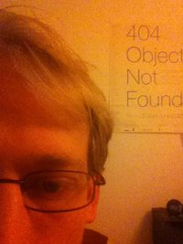
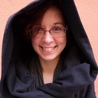
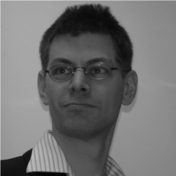

Biopython @ OpenTechSchool
Your coaches tonight are:
?
?
Olga
Amélie
Alexander
Kristian
Stephan
sponsored by
www.academis.eu

Slide 2
Biopython @ OpenTechSchool
Goals tonight:
Make your first steps in Biopython.
Get a feeling for the Rosalind challenges.
Learn how you can learn more.

Slide 3
Biopython @ OpenTechSchool
Workshop material:
URL to material
www.rosalind.info
Ask questions – we are here to help you!

