Slide 1
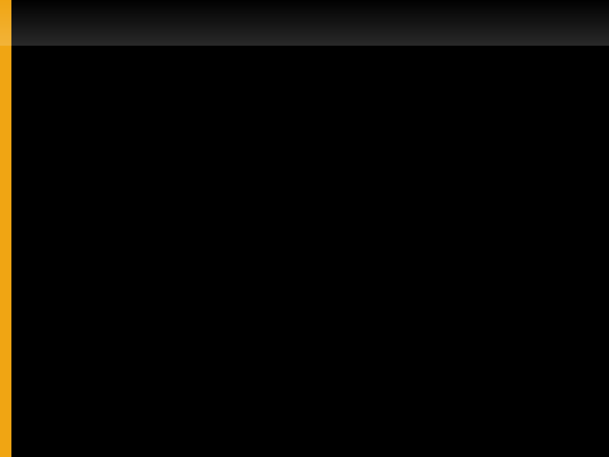
Introduction to Programming
Lets Get Started with Python

Slide 2
Setting Up
First you will need Python
Direct a web browser tohttp://python.org/download
Download Python 3.2.3 Windows x86 MSI Installer if you have Windows
Download Python 3.2.3 Mac OS X 64-bit/32-bit x86-64/i386 Installer if you have Mac OS X
Follow your installation instructions

Slide 3
Basic Tools
We are going to use IDLE for our environment
This provides an editor and a shell
The shell starts first and accepts programming commands one by one
You will see results in the shell right away
IDLE also provides a special text editor
This programming editor can help us by colouring special words differently
It also lets us save our programs for later, unlike the shell

Slide 4
Shell
Lets try out the shell! What happens if you try to talk to the computer like a person:
>>> How much is one plus one?
Oops!
File "<stdin>", line 1
How much is one plus one?
^
SyntaxError: invalid syntax
We need to know the computers special language, or syntax. Instead lets see 1 + 1

Slide 5
Fun with Math
The shell spits the answer back to you!
How would you do multiplication? Division or subtraction?
+ - * / symbols are called operators
The shell is like a simple calculator so it doesn't do order of operations, but you can force it to using parenthesis ie: (3 + 4) / (5 + 5)

Slide 6
Hello World
We can get the shell to say things on the screen, try print 'Hello World'
print is a command or function and 'Hello World' is a string
A string is any text that isn't a command or number
Don't forget the quotes (')! Python needs this to tell the difference between functions, numbers and strings
print could be used to provide context:
print 'The gravity on Mars is:', 9.81 * 0.1

Slide 7
Helping Hands
Python has libraries of special functions that help to do more complicated things
These libraries are called modules
You can try from math import * which gives you tools like sqrt(81) or ceil(0.9).
There are some surprise modules like
import antigravity
Next we're going to have some fun with the turtle module!

