Slide 1
Introduction to OpenTouryo, an Application Framework for .NET
April 23, 2014

Slide 2

Opening
OpenTouryo has been developed by Hitachi Solutions (Formerly Hitachi Systems & Services) in 2007.
In the 7 years up to now, it has been adopted by many projects of this Company. (product development and contract development, and up to large-scale mission-critical systems from small departmental system)
The system that need high quality and high reliability is need development infrastructure which is backed by a proven effective. The know-how that we have accumulated many years from NET application development has been aggregated to OpenTouryo.
Changes in IT technology is intense, and Choice of technology has increased in recent years. On the other hand, the importance of the use of IT is increasing more for the growth of the company. This time, Hitachi Solutions decided to publish as open source under the name OpenTouryo, It had been internal use as .NET application development framework.

Slide 3
Contents
1. Summary
2. Characteristics
3. Communication Control Function
4. D layer Auto-creation Tool Function
5. Dynamic Parameterized Query Function
6. Rich client functionality

Slide 4
Contents
1. Summary
2. Characteristics
3. Communication Control Function
4. D layer Auto-creation Tool Function
5. Dynamic Parameterized Query Function
6. Rich client functionality

Slide 5
1.1 Summary
OpenTouryo is an application framework of the full stack on the premise .NET Framework 3.5 or more.
Corresponding to various system, Allow the application development of high quality.
Web, C/S, batch, RIA, WebAPI, Embedded.etc
document
Use guide, tutorial
English manual for offshore development
license
source : Apache License, Version 2.0
document : Creative Commons - CC BY 2.1 JP

Slide 6
1.2 system requirements
 |  | Product name
Development environment |  | Microsoft Visual Studio 2010 – 2013 Microsoft Visual C# 2010 – 2013 Microsoft Visual Basic 2010 – 2013
Execution environment | Run Time | .NET Framework 3.5 – 4.5.1 ASP.NET2.0, 4.0(+ AJAX Extensions) ASP.NET MVC 4 Windows Azure SDK for .NET Silverlight, Windows store application
 | Data Provider | .NET Framework Data Provider for SQL Server OLEDB.NET Data Provider ODBC.NET Data Provider Oracle Data Provider for .NET IBM DB2.NET Data Provider HiRDB.NET data provider MySQL Connector/NET PostgreSQL Npgsql.NET data provider
 | WWW Browser | Internet Explorer Version 6.0, – 11.0 It is possible to use in other browsers as well if the dialog display function is not used (Support for mobile phone oriented CHTML).
Notes:
5

Slide 7
Contents
1. Summary
2. Characteristics
3. Communication Control Function
4. D layer Auto-creation Tool Function
5. Dynamic Parameterized Query Function
6. Rich client functionality

Slide 8
2.1 Three-tier architecture that satisfy both of customization and versatility
It provides an architecture that rules the process flow of each layer,
By the base class of two-stage, juggle customization and versatility.
ASP.NET
P layer
B(F) layer
D layer
Base class 1
Base class 1
Base class 1
Base class 2
Base class 2
Base class 2
Sub class
Sub class
Sub class
Provide common functionality to be used in base class2 (customization) and base class1 (fixed)
Authentication
Session management
Data access
Transaction management
Exception process
Permission
Message acquisition
Input check
Sub-screen display
Security

Slide 9
2.2 The function of each layer
Layer | Function
P | This structure dosen't spoil the operability of the designer in Visual Studio. Screen transition control, session management Deterrence of illegal operation, input check. Etc
B | Flow Control To control the flow of basic processing(customizable) of the following Start and end processing, exception handling DB connection management, transaction management log output, performance measurement .etc Communication control function Provides remote processing mechanism between servers using various protocols. Compatible with a variety of system configurations, including cloud and Onpure by this.
D | Data access libraries like MyBatis Dynamic parameterized query Dynamic parameterized query definition and verification tool Batch processing for SQL generation parts .etc

Slide 10
2.3 Components, tools
class | Function
Common libraries | String editing, input check function Log output, share information and message management Internationalization Local ⇔ UTC time conversion, CultureInfo support of various messages resources Asynchronous event control, shared memory management
Custom Controls | Corresponding to WindowsForms and WebForm String editing, input check function, Grid display in
Automatic generation tool | D-layer automatic generation tool table CRUD Automatic generation tool of the table maintenance screen

Slide 11
2.4 Promotion of standardization by the OpenTouryo
ASP.NET
P layer
B(F) layer
D layer
Standard provision of common process
ベースクラス１
ベースクラス１
ベースクラス１
Project-wise customizable process
ベースクラス２
ベースクラス２
ベースクラス２
Developer-wise implementation of business logic
サブクラス
サブクラス
サブクラス
Standardization of application architecture using “Touryo”
1. Standardization of all layers across the P/B/D layers, is possible. 2. Base process implementation is divided into base class 1 and 2. ・ Base class 1: Common process (Execution engine) ・ Base class 2: Customized Project-wise(Customer-wise) 3. Hence, developers can concentrate on implementing business logic into the sub class.

Slide 12
2.5 Project Template
Online processing and Batch processing that is customized to fit the architecture of the system of the project is Called “project template”.
Beforehand Prepares project template and deploy to the project, This allow a rapid start-up of development of projects.
template-base is published to facilitate the preparation of the project template. See the "Tutorial_Template_development.doc" for ways to use Template-base.
“Project template” reflecting
project-wise architecture
Customization of customizable layer
Customizable standardization framework
(structure of P/F/D layers and specification of verification points)
Common parts (Communication control, dynamic parameterized query)
All types of documents
・ User guide
・ Tutorials
・ Samples etc.
Runtime framework
(e.g. ASP.NET, WPF, WCF, ADO.NET, Shared components)
Runtime ( .NET CLR )
Notes:
11

Slide 13

2.6 Silverlight Store Application Support
Even if Silverlight store application is selected as UI, it is possible to develop business application using the proven process methods, provided by “Touryo”. Also, it is also possible to implement interoperation between .NET ⇔ non- .NET systems.
Silverlight
Store Application
.NET program
REST or SOAP
TEXT
DBMS
DTO
DTO
・ List acquisition
・ Editing content acquisition and batch update
・ Bind DTO on screen
・ DTO retains list editing content on the screen
TEXT
Windows Forms / WPF
Non- .NET (Java etc.)(*)
TEXT
DBMS
DTO
DataTable
DTO
・ List acquisition
・ Editing content acquisition and batch update
・ Implementation of interchange of DTO and DataTable
・ Conversion of the list editing content on the screen to DTO
(*) It is necessary to create similar DTO components in case of the non- .NET program.
Notes:
12

Slide 14
2.7 Windows Azure (Paas) Support
Windows Platform (On-premises)
Arbitrary ＤＢＭＳ
Windows Ｓｅｒｖｅｒ
Available only for the configuration file changes
Windows Azure Platform
SQL Azure
Web Role
Storage Service
Notes:
13

Slide 15
Contents
1. Summary
2. Characteristics
3. Communication Control Function
4. D layer Auto-creation Tool Function
5. Dynamic Parameterized Query Function
6. Rich client functionality

Slide 16
3.1 Communication Control Function – Summary
Communication control function facilitates the development of complex three-tier system.
Web application
DBMS
Web application system
Web service
C/S system
Complex ３ layer system
By communication control function to hide the cumbersome communication process, Developers can focus on the implementation of the business logic.

Slide 17
3.2 Communication Control Function – Add-in enabled Structure
Communication control function can be added as an add-in to existing development. The distributed object type function is implemented using the Web service protocol.
P layer
Communication Control
B(F) layer
D layer
Base class 1
Base class 1
Base class 1
Base class 2
Base class 2
Base class 2
Sub class
Sub class
Sub class
Call protocol
Name resolution definition
In-process call
Name resolution definition
Supports in-process call as well.

Slide 18

3.3 Communication Control Function – Excellent Scalability
Client application
Server application
In-process
Service gateway/interface components
B/D layer
Location Transparency Implementation of call switching through in-process/NW, change of call destination WAS by definition
Scale Transparency Implementation of scale-out (vertical, horizontal dispersion)
Other Transparency Also possible to connect with different kinds of development technology other than .NET
Implementation as Web service
Web service
In-process
Change of deployment destination
Web service
In-process
Also possible to exceed F/W

Slide 19
Contents
1. Summary
2. Characteristics
3. Communication Control Function
4. D layer Auto-creation Tool Function
5. Dynamic Parameterized Query Function
6. Rich client functionality

Slide 20
4. D layer Auto Creation Tool – Auto Creation
Automatically generates 100% Dao / SQL of CRUD processing for the table view with the schema information. Processing has been generated, it leverages the dynamic parameterized query below. In addition, time stamp optimism exclusive process of Web applications prone to leakage implementation will also be generated.
D layer auto creation function
D layer definition file
D layer
Creation tool
DBMS
Meta data extraction tool
Dao
class
SQL
file
Schema
Extraction function of DB schema information

Slide 21
Contents
1. Summary
2. Characteristics
3. Communication Control Function
4. D layer Auto-creation Tool Function
5. Dynamic Parameterized Query Function
6. Rich client functionality

Slide 22
5.1 Dynamic Parameterized Query – Existing SQL
Previously, character string, character string concatenation, and the accompanying IF statement were scattered in the program that processes dynamic SQL.
Character string
'************************************************************************************
'* SQL文作成
'************************************************************************************
str_Sql = "SELECT COUNT(DISTINCT xxxxx) AS xxxxx FROM xxxxx"
If intXXXXX = 0 Then
str_Work = " WHERE xxxxx = " & strXXXXX & " AND xxxxx LIKE '" & strXXXXX & "%'"
ElseIf intXXXXX = 2 Then
str_Work = " WHERE xxxxx = " & strXXXXX & " AND xxxxx = '" & strXXXXX & "'"
ElseIf intXXXXX = 3 Then
str_Work = " WHERE xxxxx = " & strXXXXX & " AND xxxxx = '" & strXXXXX & "'" & _
" AND xxxxx IN (SELECT xxxxx FROM xxxxx WHERE xxxxx = " & strXXXXX & ")"
Else
str_Work = " WHERE xxxxx = " & strXXXXX & " AND xxxxx LIKE '" & strXXXXX & "%'" & _
" AND xxxxx IN (SELECT xxxxx FROM xxxxx WHERE xxxxx = " & strXXXXX & ")"
End If
Program
Character string concatenation
IF statement
DBMS
Dynamic SQL is,
・ Addition/deletion of WHERE, JOIN statement
・ Addition/deletion of AND, OR operator
・ Setup the parameter of IN statement so that it matches the no. of conditions
・ Potential comprehension of vulnerability issue etc.,
as control is problematic and implementation is difficult.

Slide 23
5.2 Dynamic Parameterized Query – Summary
Program implementation becomes easy due to Dynamic Parameterized Query Function, as there are no character string, character string concatenation, and the accompanying IF statements.
the parameter is set from the API only.
Program
<?xml version="1.0" encoding="shift_jis" ?>
<ROOT>
SELECT
A, B, C, D
FROM T
<WHERE>
WHERE
<IF>AND A = @A</IF>
<IF>AND A LIKE @A_LIKE</IF>
<IF>AND B = @B</IF>
<IF>AND B LIKE @B_LIKE</IF>
<IF>AND C = @C</IF>
<IF>AND C LIKE @C_LIKE</IF>
<IF>AND D = @D</IF>
</WHERE>
ORDER BY <IF name="SEQUENCE">A<ELSE>B</ELSE></IF>
</ROOT>
Framework
Data access
components
XML file
DBMS
Internally process dynamic parameterized query
Dynamic parameterized query can be executed by parameter setting only, and developers are relieved from the control of complex character string concatenation processes. Also, static parameterized query, which does not require description in XML, is also supported.

Slide 24
Contents
1. Summary
2. Characteristics
3. Communication Control Function
4. D layer Auto-creation Tool Function
5. Dynamic Parameterized Query Function
6. Rich client functionality

Slide 25
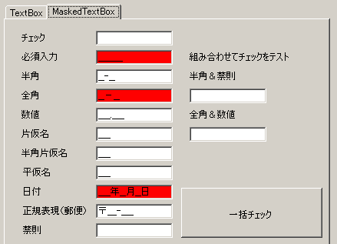
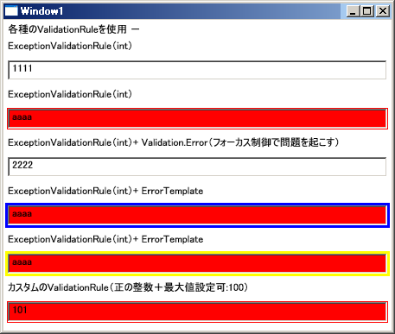
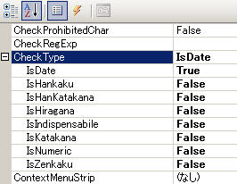
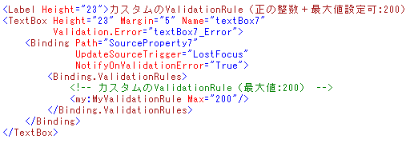
6.1 Custom Control and Validation
Easy implementation of item level check using custom control(WebForm / Windows Forms), and validation framework (WPF). Also, check conditions can be selected from VS designer and XAML based on attributes.
WPF
WebForm/
WindowsForms
Notes:
24

Slide 26
6.2 Rich Client supported P layer Framework
P layer framework for Rich Client
Windows Forms
Synchronous call
Communication control function
Web service
Asynchronous call
Desynchronization framework
Asynchronous call delegate
Progress display call back
DBMS
Supports
Result display
Progress display
Message box display
from the back ground.
Asynchronous call to all types of AP server is also possible.
Result display call back
1.Migrated P layer framework for ASP.NET to rich client.
2.Implement asynchronous request, asynchronous polling using asynchronous framework.
Log component
Log file
Write trace log as needed
Notes:
25

Slide 27

6.3 Rich Client Web Deploy Tool
2. HEAD method
(Update confirmation)
1. Application start command via tool
3. GET method (ZIP acquisition)
(Supports differential download)
4. decompression/deployment/activation of downloaded ZIP file
Deployment manifesto file and ZIP file X n (ZIP file group with compressed program set)
Functions such as of ZIP file/deployment manifesto creation, MD5 hash check, silent mode execution is implemented in deploy tool.
Notes:
26

