Slide 1
GzOS Introduction
Open Trust Group
Update: 09/02/2018

Slide 2
Quick Start Guide
$ curl -s https://raw.githubusercontent.com/OpenTrustGroup/scripts/gzos/bootstrap | bash -s gzos stable
$ cd gzos_stable
$ fx clean-build gztee
$ fx run-qemu (Press ‘c’ to continue booting system)
https://github.com/OpenTrustGroup/docs/blob/master/gzos/getting_started.md

Slide 3
Brief Introduction
An open-source TEE OS developed by Open Trust Group
Licensed with MIT, BSD, Apache, … (non-GPL license)
Derived from Fuchsia (Garnet Layer + Zircon Core Platform)
Supported ARMv8-A TrustZone
Can be developed on QEMU virtual platform
Normal World
Secure World
(TrustZone)
EL0
EL1
Linux
GzOS
(TEE)
S-EL0
S-EL1
EL2
Hypervisor
EL3
ARM Trusted Firmware
S-EL3

Slide 4
Why Fuchsia?
Microkernel architecture + Capability-based security model
A general purpose OS but easy to be tailored for a small system
  Note: The scale of system RAM requirement is MB, not KB
Good software quality
Non-GPL license

Slide 5
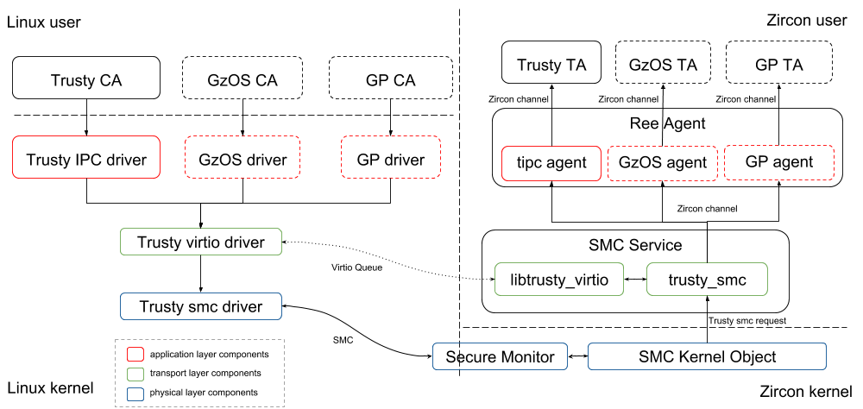
GzOS Software Architecture
https://github.com/OpenTrustGroup/docs/blob/master/gzos/system_arch.md

Slide 6
GzOS Status (ChangeLog)
v0.1.0 released (2018-08-14)
  Supported Trusty API by default
  Supported on-demand TA loading
v0.2.0 (under development)
  Support GzOS proprietary API for CA to TA and TA to TA IPC
  Support loading TA images from REE filesystem

Slide 7
Reference
GitHub
Document
Web Site

