Slide 1
Problem & Solution
Problem: show people where their food comes from
Solution: We made some maps.
Data from DNR, MDA, GardeningMatters.org, and MetroGIS
Names: Andrew, Brad, Jacob, Ben, Justin, Karlie

Slide 2
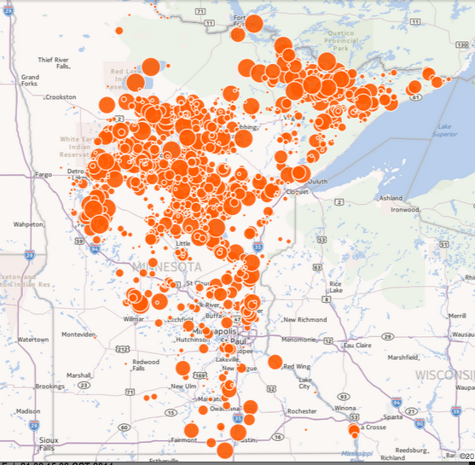
Wild Rice
Wild Rice
in the
Wild!

Slide 3
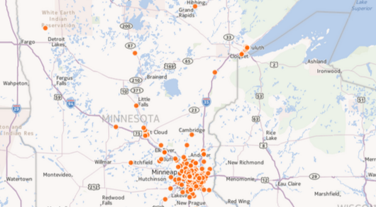
Community Gardens in MINNESOTA!!!

Slide 4
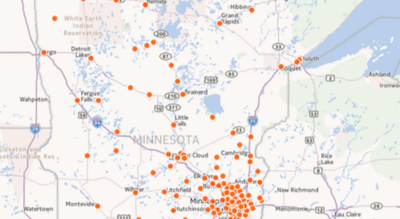
Farmer’s Markets in MINNESOTA!!!

Slide 5
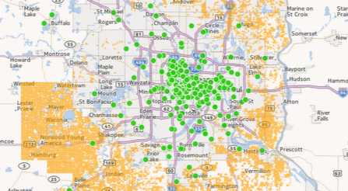
Green = Community Gardens Yellow = Farms All . . . In MINNESOTA

Slide 6
Type
www.TheTrojanHorseRadish.com
For more MINNESOTAN MAPS!!!

