Slide 1

myCiv – Voter Engagement
Eric Margolis - eric.margolis@gmail.com - @margolismn
Eric Christenson/ecSynergy - eric@ecsynergy.com - www.ecsynerger.com
David Radcliffe - dradcliffe@gmail.com - @daveinstpaul - mathblag.wordpress.com
Carla Januska/Smart Hive - cjansuka@gmail.com - @cjanuska
http://smarthive.com

Slide 2
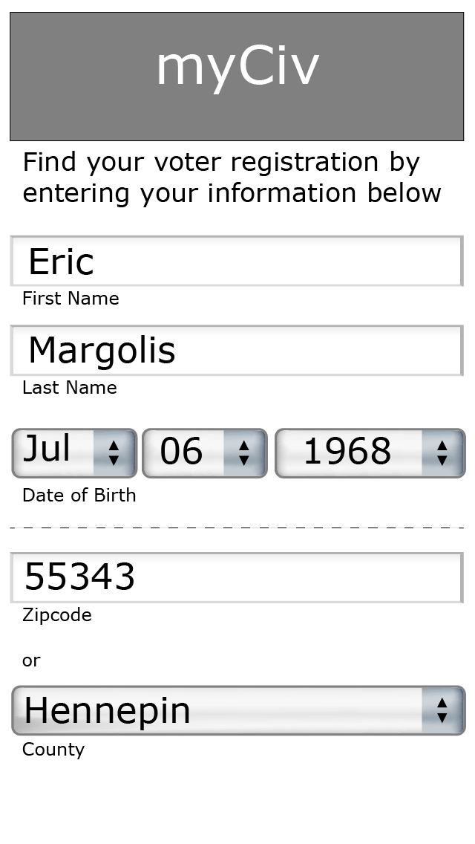
myCiv – vote engagement
the problem being solved;
Giving access to Minnesota citizens on the status of their voter registration. Are they registered or not? And, engaging them in the electoral process by creating a relationship with their data and their representatives.

Slide 3
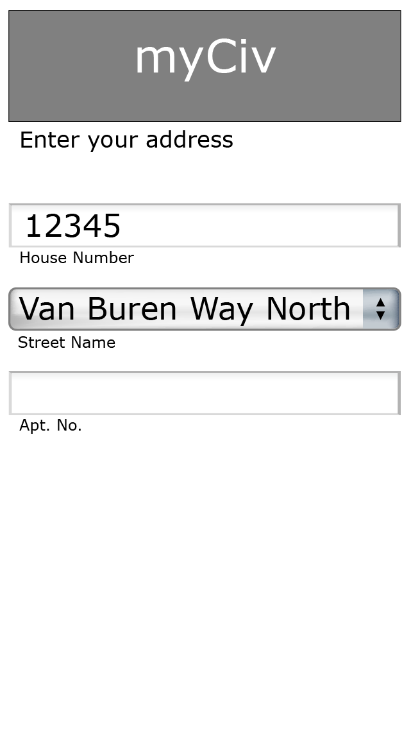
myCiv – vote engagement
the solution being proposed;
A mobile application which allows individual citizens access to their voting registration information. Which is allowed under existing MN Statues and asking only basic limited information which is already on file with the MN SOS Office.

Slide 4

myCiv – vote engagement
the work your team completed;
Our project allows individuals to verify if they are registered and then provides them with access to who represents them and important information about upcoming elections.

Slide 5
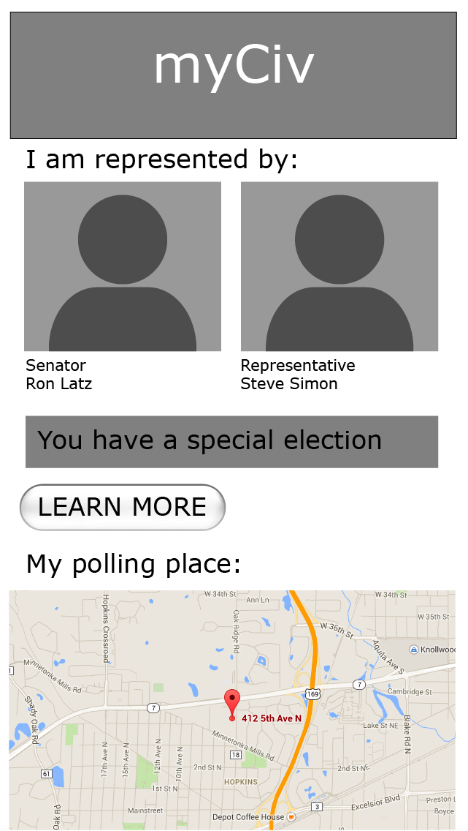
myCiv – vote engagement
the data being used and how it’s being used; We used Polling Place Finder dataset lists information and MN House and MN Senate member data and MN SOS Voter Registration Status lookup and Team 7’s MN Leg Social Media Map

Slide 6
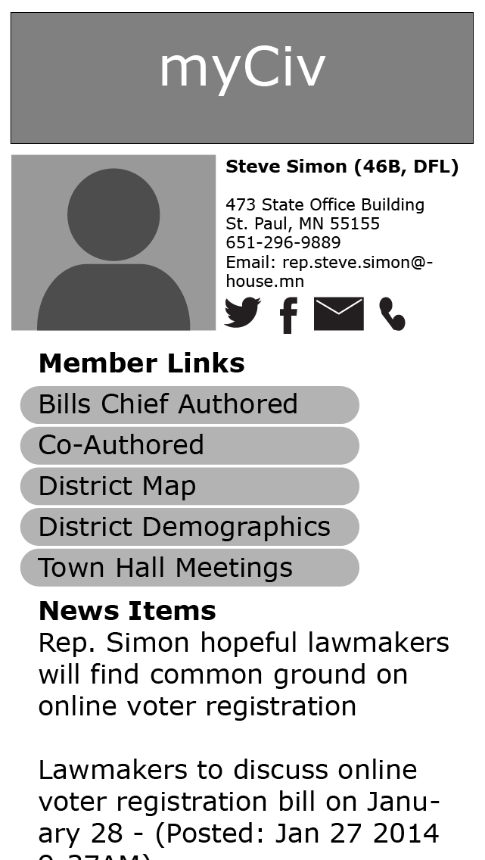
myCiv – vote engagement
myCiv is a prototype application which runs on Android based devices. It puts open data in the hands of Minnesota Citizens and allows them to become more engaged in elections. It also establish a relationship between individual citizens and the MN SOS Office which can be used to send push notifications at election times in a non-partisian manner.

