Slide 1
POC MINNESOTA
Promoting and Supporting People of Color in Business in Minnesota

Slide 2
Problem
The state of Minnesota is projecting growth in several racially diverse areas of the population
The state economy is missing an opportunity to leverage this growth to create new businesses and job opportunities targeted at this demographic
The state doesn’t have a comprehensive resource to attract and retain the talents of these groups for economical development

Slide 3
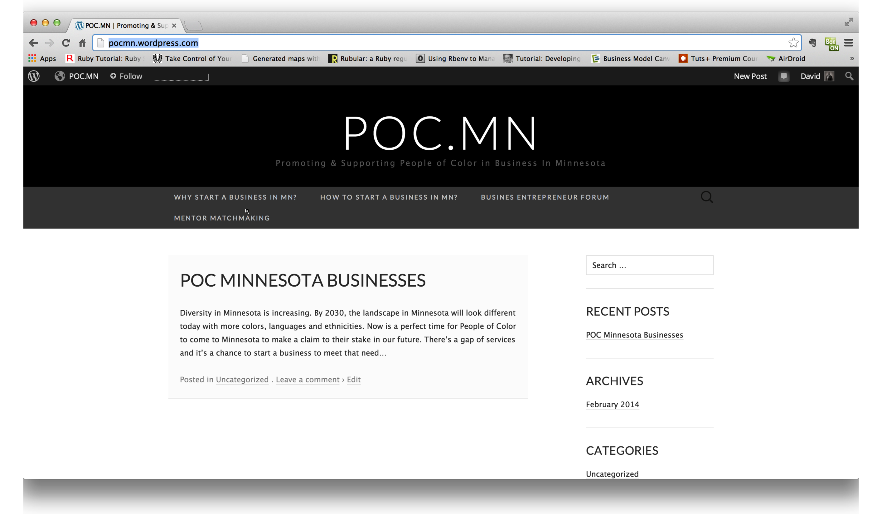
Solution
Develop new online tools for reaching and encouraging the diversity of incoming population
Develop pipeline by matching constituents with economic development opportunities
Create and provide mentoring from resident entrepreneurs and business professional

Slide 4
Work
Defined the business problem
Developed an initial business model using a business model canvas
Mapped out initial partners and resources
Created a storyboard of the experience
Collaborated with a diverse group of people from state and local government on refining the idea
Built a mock-up to start shaping the customer experience

Slide 5
Data
The team used the population projections data from the Admin Minnesota site.
The focus was on the growth of each group to determine the mix of races by 2035
The business filling data was examined but the team found no use for this dataset
New datasets will be required to move the project forward i.e. access to contracting opportunities from the Office of the Secretary of State

Slide 6
Team Bios
David Edgerton Jr.
IT Strategic Business Partner, National Marrow Donor Program
Owner, CelluWorks, LLC
MBA, University of Minnesota
BSEE, North Carolina A&T State University

