Slide 1


James Kauth
Innovation Program Director
Office of the State CIO

Slide 2
Innovation Program Strategy
Engage the public
Create greater efficiencies
Leverage strategic partnerships
Impact specific issue areas
Produce cultural change
Establish innovation processes
External Focus
Internal Focus

Slide 3

“Creativity is thinking up new things. Innovation is doing new things.” Theodore Levitt

Slide 4


Best ideas bubble up!
Comment & Vote
Ideas
Staff
Customers
Citizens
ICAT
COOL STUFF
Awards & recognition
Review Process
The Innovation Cycle
Work Teams

Slide 5
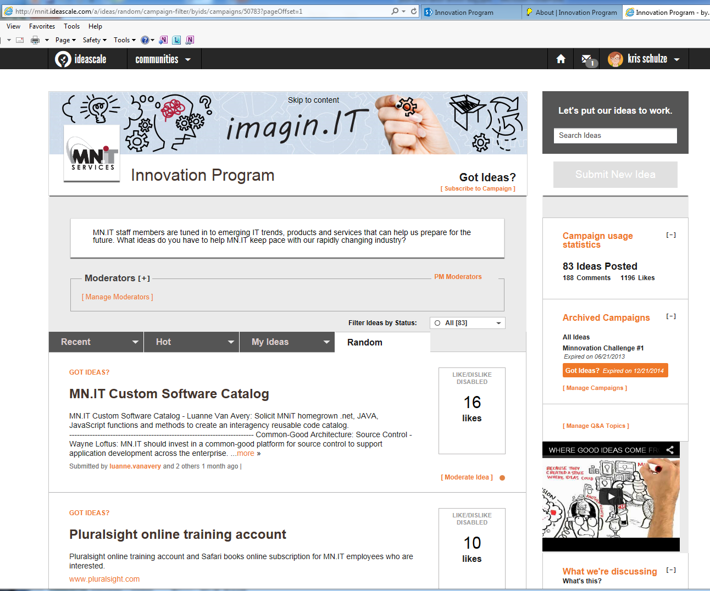
Cloud-based Ideation Tool
Innovation Program online community
Self-registration. like Yammer
Intuitive design: self-taught interface
Mobile enabled: ideas anywhere

Slide 6
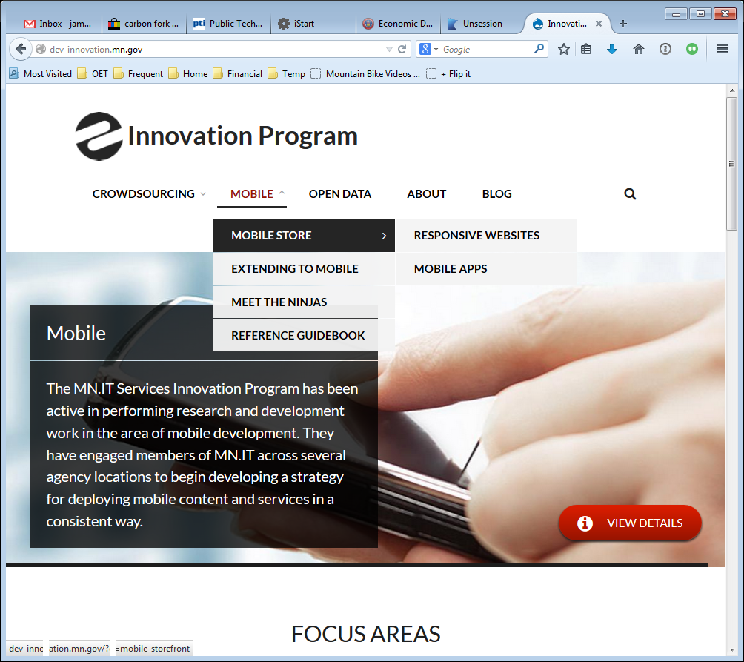
Mobile and Responsive Design
Creation of Mobile Ninjas
Ninja Consulting
Developer licenses: Apple, Android & Microsoft
MN Unplugged
(Mobile App Store)
Mobile Reference Guide
Innovation.mn.gov

Slide 7



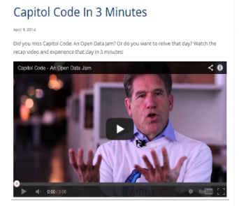




Civic Tech Partnerships
Geo:Code
Hack for MN
Capitol Code
CityCamp MN
MN Data Opener

