Slide 1
Accessibility
Jay Wyant, CIAO
January 31, 2015

Slide 2

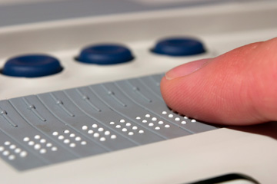

Accessibility Quick Quiz
What is Accessibility?
What is Accommodation?
What is Assistive Technology (AT)?
Notes:
Distinguish between (IT) accessibility and accommodation.
Accessibility is built in, for everyone to use; technology centered, not person centered; proactive.
Some call it an “electronic curb cut”
“curb cut” links to video:
http://www.state.mn.us/mn/forms/oetweb/accessibility/curb-cut-video/Accessibility_Video_Large.html

Slide 3

Who needs accessibility?

Slide 4
Video Demo
Justin is a 16-year old straight-A honor roll high school junior who plans to go to college and wants to be a writer.
He has cerebral palsy, auditory neuropathy and visual tracking difficulties.
He uses an adapted keyboard and joystick mouse to access the computer to do everything from read books, do homework, explore the world on the internet, play games, and write.
He also uses an augmentative communication device for helping him communicate with others.
Fewer mouse movements and simplicity in design makes accessing a computer and information much more efficient for him.
Notes:
He gave us permission to use this video.

Slide 5
“How do I make this ADA-compliant?”
Notes:
A phrase I am trying to eradicate from state lexicon. Possibly the anticipated DOJ ruling will provide some guidance, but even then it won’t be completely prescriptive. Every situation or technology will have its unique aspects.

Slide 6
“How do I make this work for everyone?”
Notes:
Accessibility as a pathway to usability

Slide 7


Guidance v. Checklist
Notes:
Checklists are reminders of key guidance elements. Not an assurance of accessibility.

Slide 8
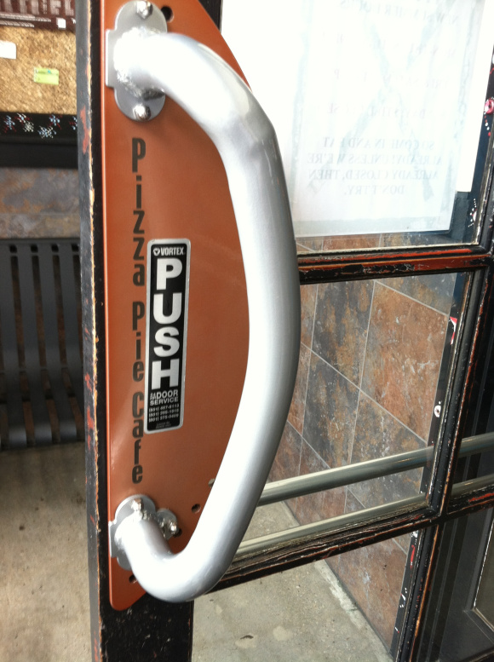
Ask: Is It Usable?
Notes:
Usability – not Compliance – needs to be the focus. Solve usability, and you solve compliance.
TAM fund appropriation and advisory committee specified “accessibility and usability”
Usability as goal; accessibility as a means

Slide 9

Basic UI Usability Test #1
Notes:
Can you efficiently perform your job functions without a mouse?
Primary key actions:
Tab and shift-Tab
Spacebar to select
Arrow to move down/up or across fields

Slide 10
Basic UI Usability Test #2
Drinking straw test

Slide 11
Additional Usability Tips
Content structure
Navigation
Images and non-text elements
Color
Forms
Media
Maps!

Slide 12

Simple is best
Even complex tech is “simple” with planning
Can you anticipate the future?
Add/migrate to multiple platforms
Responsive design v. mobile

Slide 13
Resources
MN.IT accessible websites & applications site
Requirements/Design tab
W3C checklist
UM’s training tool
Development/Testing tab
Testing tools
Mobile tab
Google’s design principles
MN.IT Services Innovation Program reference guide

Slide 14
“Alternative format”
Equal opportunity issue
Accessibility vs. accommodation
DOJ rulings and legislation
Which drive Standards

Slide 15

Accessibility: who is responsible?
Notes:
Content creators, web designers, web developers, buyers, QA…

Slide 16
Questions?

Slide 17
Thank You!
Jay Wyant
jay.wyant@state.mn.us
https://mn.gov/mnit/programs/accessibility

