Slide 1
Meteo-France : Openwis harnesses implementation
Michaël Claudon, Yves Goupil
Toulouse, 20th March 2017

Slide 2
Summary
Harnesses used for each DCPC
Focus on LocalDataSource Harness
Views of DCPC subselection portals

Slide 3
Harnesses used for each DCPC
Harness = interface between Openwis API and "local back office".
DCPC NWP
LocalDataSource Harness
http://dcpc-nwp.meteo.fr/
DCPC Odyssey
LocalDataSource Harness
DataSource Harness
http://dcpc-odc.meteo.fr/
DCPC VAAC
LocalDataSource Harness
http://dcpc-vaac.meteo.fr
DCPC CAMS50 (Copernicus)
LocalDataSource Harness
http://data.regional.atmosphere.copernicus.eu/

Slide 4
Focus on localDataSource harness
Ingestion
Extraction
3 different ways :
ad-hoc request (OpenWIS GUI)
subscription on a product arrival
subscription for a chosen product at a defined date, periodically launched at each defined time interval

Slide 5
Focus on LocalDataSource Harness : Openwis dependencies
Openwis-harness-client
OpenWIS EJB remote interfaces, to be used on the client side.
openwis-harness-localdatasource
LocalDataSource interface
Openwis-harness-subselectionparameters
SubSelectionParameters interface

Slide 6
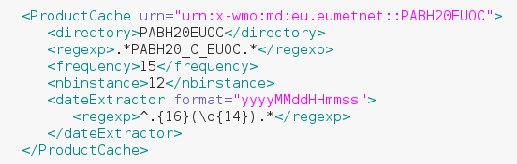




LocalDataSource harness : Ingestion
LocalDataSource Harness
OpenWIS
IngestionFileTreatment
DataService
WSDL
OpenwisProductArrival
ProductConfig.xml
~/incoming
~/error
~/cache
Incoming
File

Slide 7



LocalDataSource harness : extraction
OpenWIS
LocalDataSource harness
DataService
WSDL
OpenwisProductArrival
Extraction
JMS
MDB
WS
localDataSource
Subscriptions DB
dcpc_extraction_request DB
~/stagingPost
User Portal
Subscription Form or
ad-hoc request
SubSelection Portal
ProductConfig.xml
WS
SubSelectionParameters.getSubSelectionParametersForSubscription()
OK

Slide 8
LocalDataSource harness : other implemented functionalities
Extraction request table purge with a TimerService Implementation
Cron to purge ~/cache directory

Slide 9
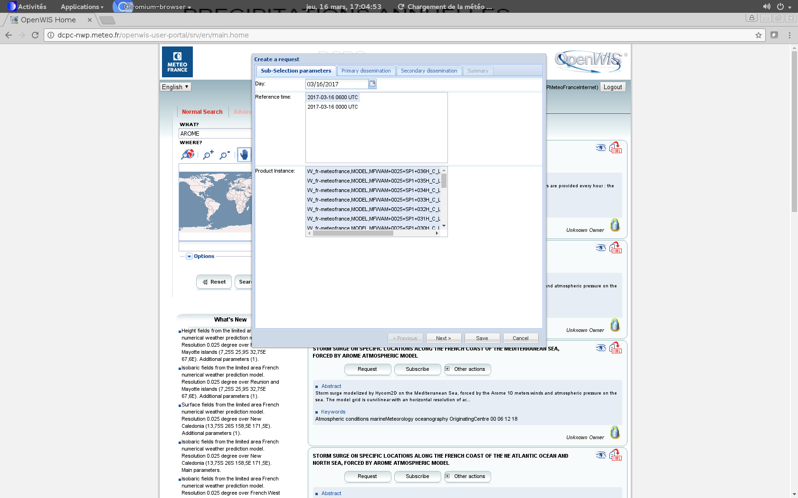
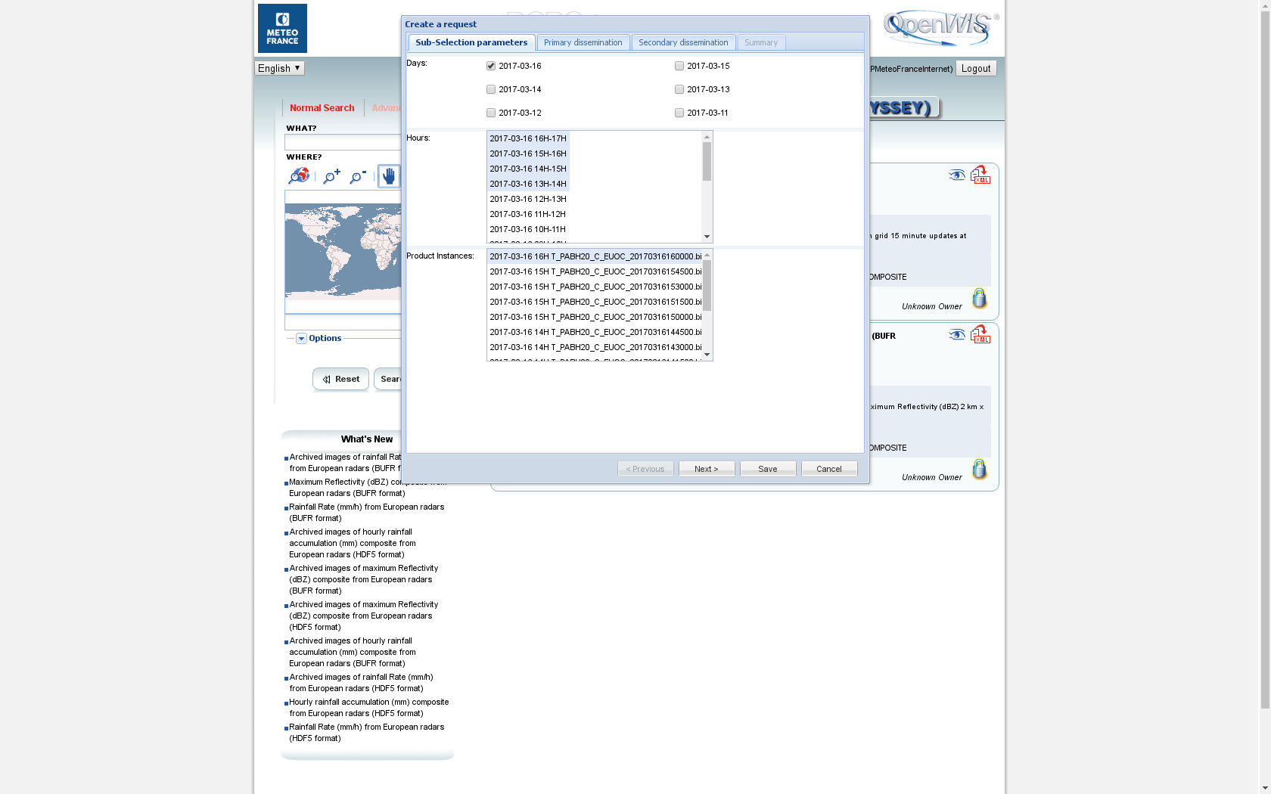
Views of DCPC subselection portals : create a request
DCPC NWP
DCPC ODC

Slide 10
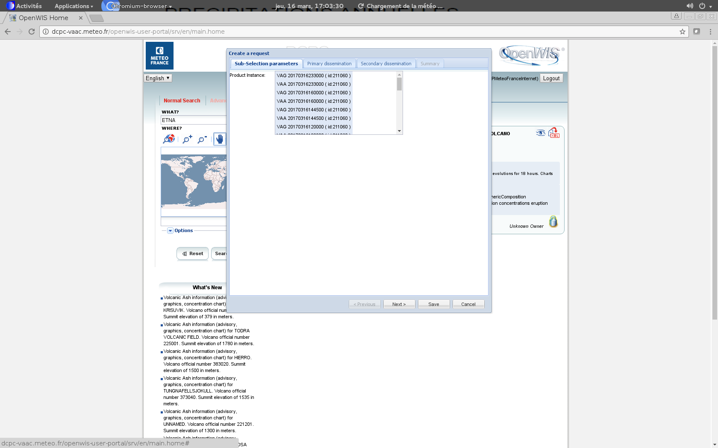
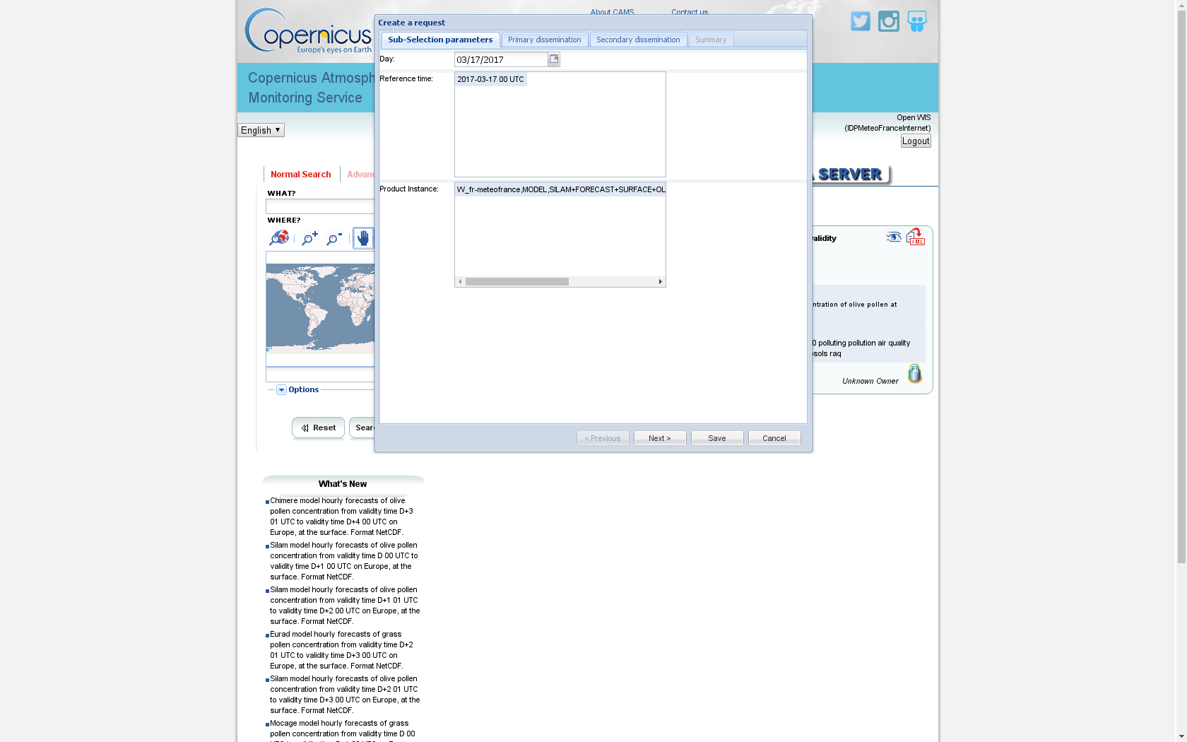
Views of DCPC subselection portals : create a request
DCPC VAAC – Etna volcano
DCPC CAMS50

Slide 11
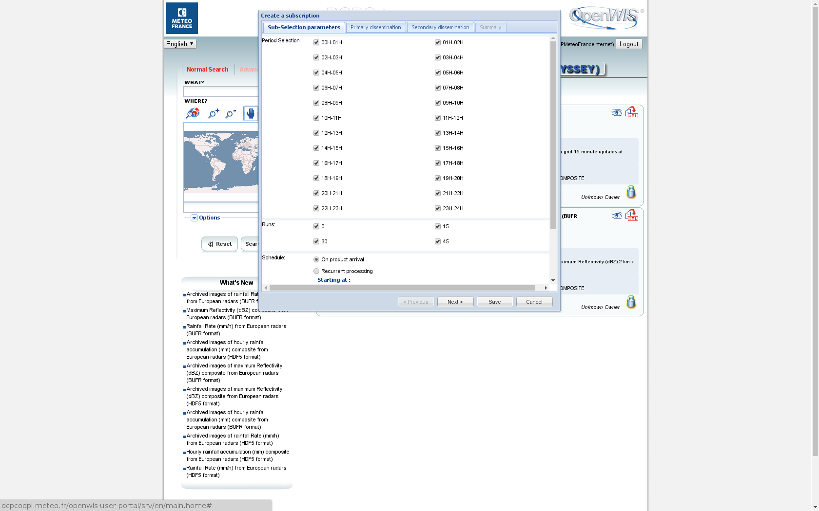
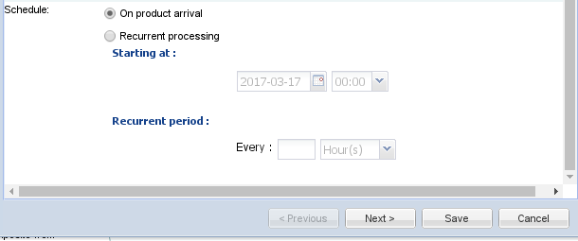

Views of DCPC Odyssey subselection portal : create a subscription
DCPC ODC

Slide 12
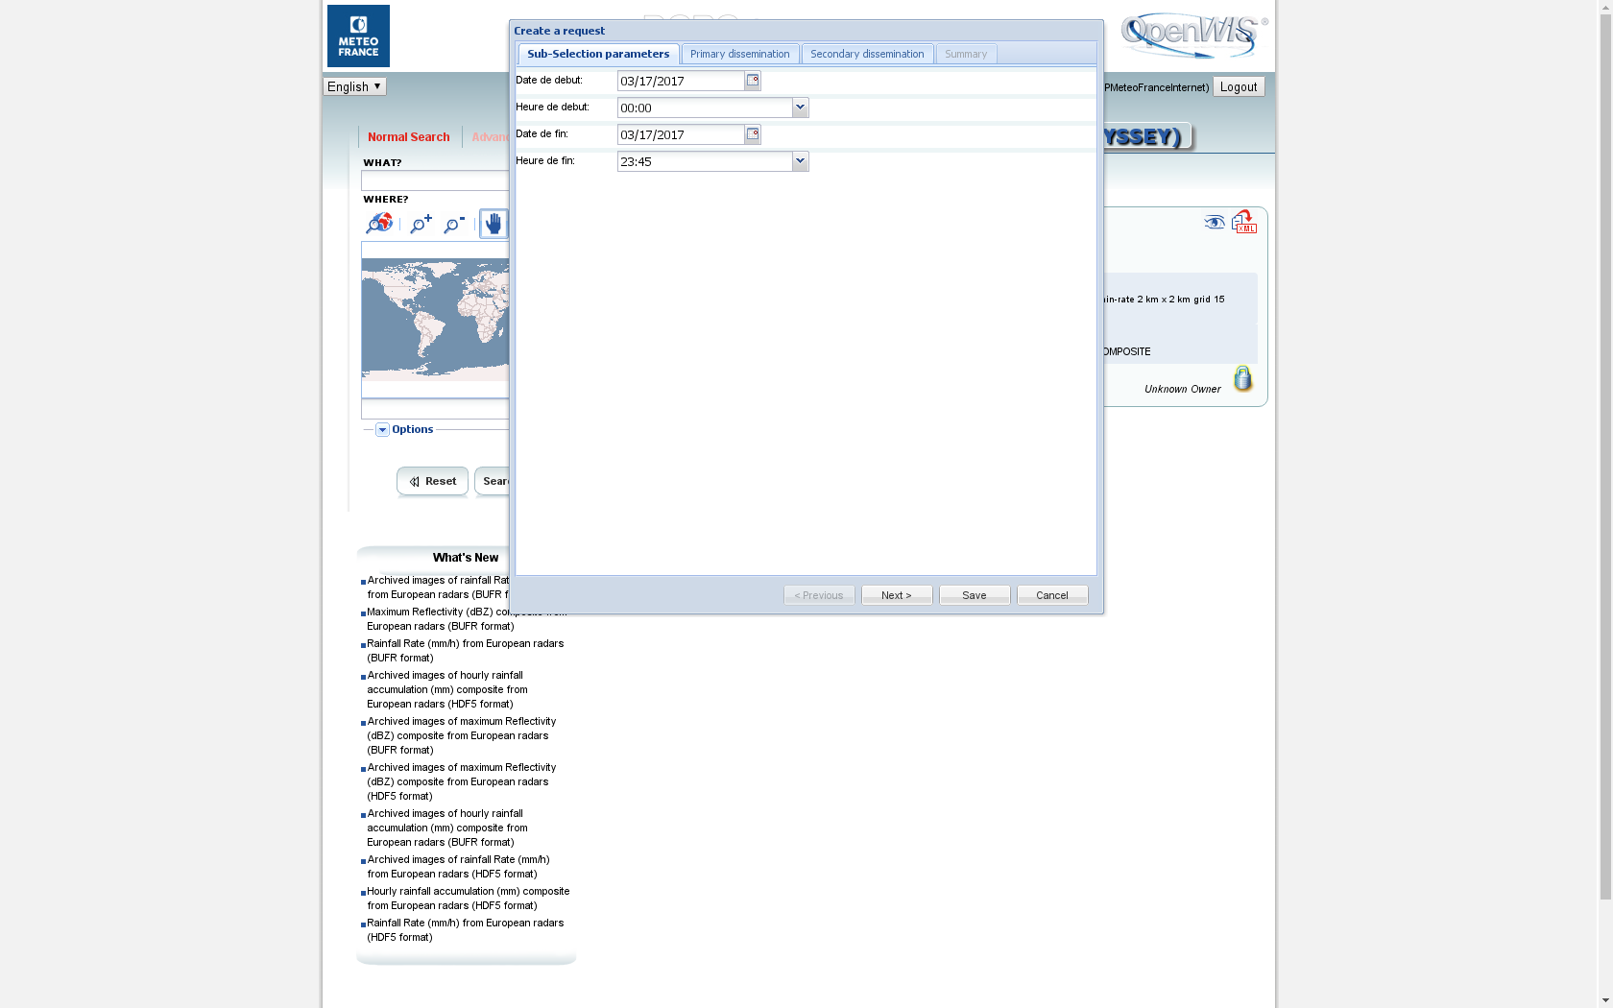
Views of DCPC Odyssey subselection portal for archived data
DCPC ODC
DataSource harness
Start Date
Start Time
End Date
End Time

Slide 13

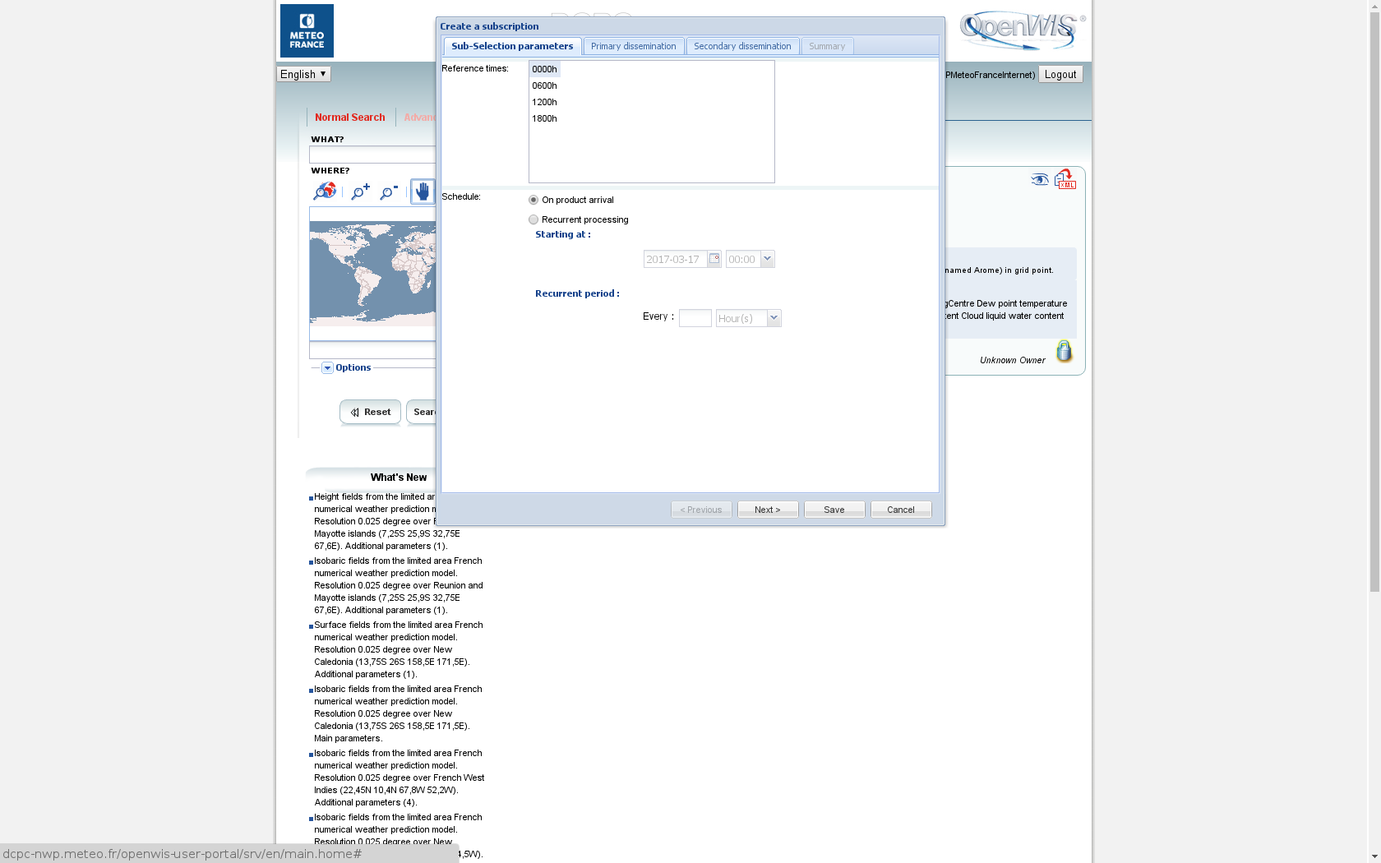
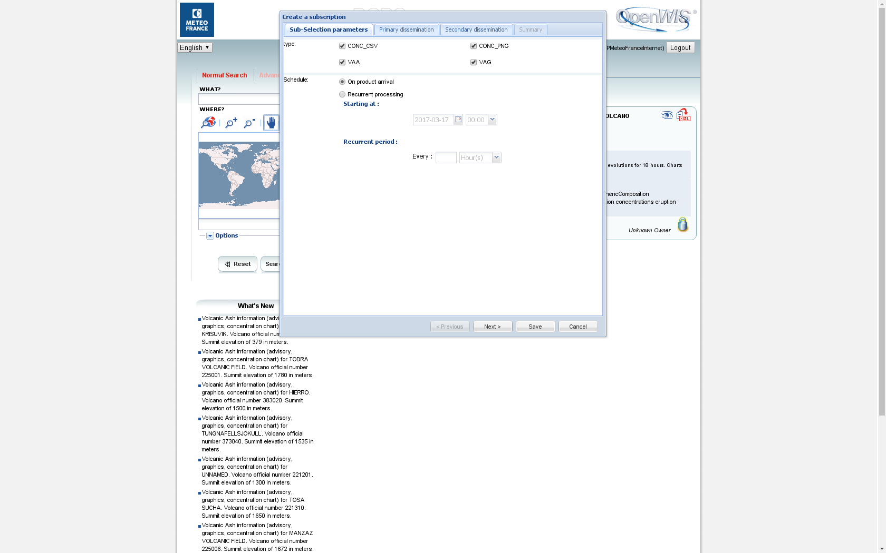
Views of DCPC NWP, VAAC and CAMS50 subselection portals – create a subscription
DCPC CAMS50
DCPC NWP
DCPC VAAC – Etna volcano

Slide 14
Harness - perspectives
What about making harness code OpenSource and sharing experience on harness implementation / deployment ?

Slide 15
Thank you for your attention
Any questions ?

