Slide 1

OPENWIS Customer Feature Requests
Rémy GIBAULT March 2017

Slide 2
Agenda
MFI customers using Openwis
Feature Requests

Slide 3
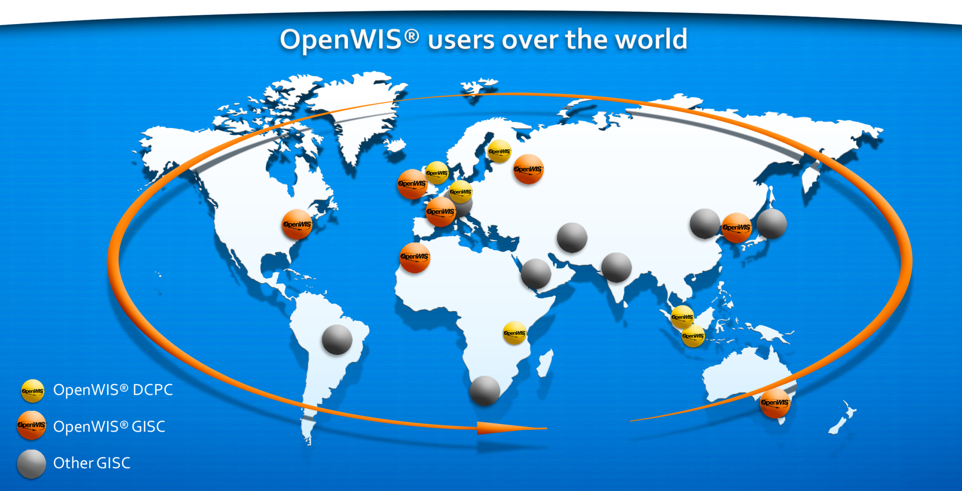
MFI customers using Openwis
GISC: Casablanca, Moscow (Modules)
DCPC: Singapore, Nairobi, Jakarta

Slide 4
Feature Requests

Slide 5
Singapore meteorological services (MSS)
Account Request and Account Recovery forms
MSS has expressed to MFI the necessity to incorporate the Account Request and Account Recovery forms (similar to what Australian BOM has implemented) in Singapore WIS site.
Security features:
The password used as the means of authentication must:
be made up of a minimum of eight alphanumeric characters, containing at least one letter and one numeral;
be changed at least every 90 days ( except for accounts used in e-Services by members of the public);
not allow the password to be reused for at least three generations of password;
not be displayed in clear;
be encrypted during transmission and in storage;
be locked out at a maximum of six failed attempts;
be protected against dictionary or brute-force attack;
be changed upon the first login; and not be the same as the account ID or user ID.

Slide 6
Singapore meteorological services (MSS)
Security features :
HTTPS implementation
Entering original password before changing password
Session timeout implementation
Concurrent logon (with same user account) should not be allowed

Slide 7
BMKG (Indonesia)
Administration Portal
No | Current | Enhancement request
1 | Selection period for global report is only up to 10 days. | Need to be extended up to a month
2 | Limited period for viewing user subscription (only 5 days) | Need to be extended up to a month, including the user's activities history
3 | Some monitoring records are still unclear i.e the correlation between disseminated vs extracted data (sometimes disseminated data is higher than extracted, but sometimes the extracted data is higher.) | Need to add more details to know data disseminated per day per user per title /product with wide range data period. good to know which product is the most subscribed.
4 | Some monitoring records are still unclear i.e the correlation between disseminated vs extracted data (sometimes disseminated data is higher than extracted, but sometimes the extracted data is higher.) | To be clarified
5 | On user registration still allowing zero column left, so we only get name, email and username) | User need to fill all required column including his/her occupation, organisation ...
6 | Availability statistic is on daily statistic. | Need to add monthly statistic
7 | Some export features doesn't provide "save as" file dialog, but only shows XML tree | Need to make enable for exporting to csv or notepad too

Slide 8
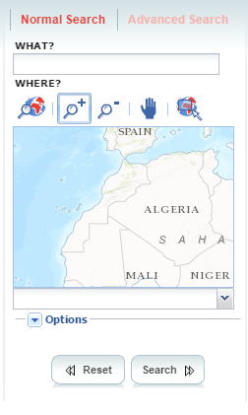
Other countries
Kenya:
Map already focused on the country when displaying the
‘search’ page
Morroco:
New map with ‘official’ borders
WisMonitoring
All countries:
Quick access to data
By bypassing:
Primary & Secondary dissemination screens (using favorites)
Summary screen
By providing latest data in one click
By providing on the shelf packages (synop of the country for current year)
Access rights per category (metadata visibility, harvesting restrictions)

