Slide 1
OpenWIS Technical Committee 2017
MF OpenWIS deployments
Goupil Y., Saclier B., Claudon M.
Toulouse, 20th - 22nd March 2017

Slide 2
MF OpenWIS deployments
Summary
  MF vGISC deployment
  DCPC standard deployment
  gisc-metadata.meteo.fr deployment
  Metrics
  MF deployments urls

Slide 3

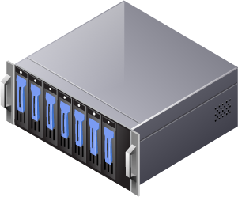
Internet
user Portal
RMDCN
user Portal
Authentication
Authorization
Admin
Portal
DISS harness
StagingPost
DB - Solr
Dataservice
MF vGISC deployment
DMZ
Internet
user Portal
Frontend
RMDCN
RMDCN
user Portal
Security zone
Authentication
Authorization
Admin
Portal
in grey, the backup servers
Dataservice
Backend
DB - Solr
RMDCN
StagingPost
DISS harness
NAS

Slide 4
MF OpenWIS deployments : hardware features
  Internet user portal :
    16 CPUs - RAM 24 GB - /data 70GB
  RMDCN user portal :
    16 CPUs - RAM 24 GB - /data 70GB
  Admin portal :
    8 CPUs - RAM 6 GB - /data 70GB
  Authentication/Authorization server :
    16 CPUs - RAM 24 GB - /data 70GB
  Data/Management Service server :
    16 CPUs - RAM 24 GB - /data 70GB
  DB & Solr server :
    16 CPUs - RAM 24 GB /data 10GB /drdb 200GB
  StagingPost server :
    16 CPUs - RAM 24 GB /data 10GB stagingPost 200GB on NAS
  DISS harness server :
    16 CPUs - RAM 24 GB /data 10GB /drdb 475GB
  NAS : FAS2240 NETAPP 2 x 1,4 TB

Slide 5

DCPC MF standard deployment
→ User portal :
/data = 20GB
2 CPUs – 4GB RAM
Internet
user Portal
Frontend
→ Dataservice Backend :
/data =1,2TB
4 CPUs – 16GB RAM
Dataservice
DataBase
Solr
Harness Service
Admin Portal
Authentication
Authorization
GISC server
Backend
DMZ
Security zone

Slide 6
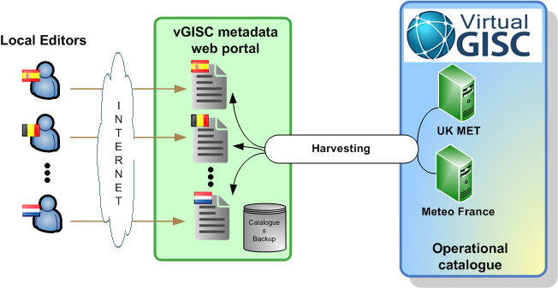
MF OpenWIS deployments : gisc-metadata
gisc-metadata.meteo.fr : specific OpenWis web portal and tools for metadata manipulation

Slide 7
GISC-metadata deployment
Internet
user Portal
Frontend
DMZ
Securityservice
Dataservice
DataBase
Solr
Harness Service
Admin Portal
Backend

Slide 8
MF OpenWIS deployments
Metrics
WebSite | Service | Cache |  | Users |  | Visits per day
 |  | Retention | Size | Regi-stered | Active | Nb. | Vol.
DCPC Odyssey | Staging post | 5 d + arch | 2,1 GB | 20 | 1 | 300 | 200 MB
DCPC Odyssey | Web service | 5 d + arch | 2,1 GB | 1 | 1 | 576 | 500 MB
DCPC NWP | Staging post | 5 d | 380 GB | 8 | 5 | 700 | 100 GB
DCPC NWP | Web service | 5 d | 380 GB |  | 150 | 30 000 | 2500 GB
vGISC | Staging post | 24 H | 8,3 GB | 700 | 10 | 100 | 200 KB
DCPC VAAC | Staging post | unlimited | 0 | 0 | 0 | 0 | 0
DCPC CAMS50 Copernicus | Staging post | 30 d | 2,4 TB | 5 | 1 | 7 | 180 MB
 |  | 30 d | 2,4 TB |  | 100 | 15 000 | 600 GB

Slide 9
MF OpenWIS deployments
MF GISC & DCPCs deployment urls :
  vGISC internet user portal
    http://wispi.meteo.fr/openwis-user-portal/srv/en/main.home
  gisc-metadata
    http://gisc-metadata.meteo.fr/openwis-user-portal/srv/en/main.home
  DCPC Odyssey
    http://dcpcodpi.meteo.fr/openwis-user-portal/srv/en/main.home
  DCPC-NWP
    http://dcpc-nwp.meteo.fr/openwis-user-portal/srv/en/main.home
  DCPC CAMS50 Copernicus
    http://data.regional.atmosphere.copernicus.eu/openwis-user-portal/srv/en/main.home
  DCPC-VAAC
    http://dcpc-vaac.meteo.fr/openwis-user-portal/srv/en/main.home
  Planned for 2017 1st semester : DCPC Cyclone and DCPC RCC

Slide 10
MF OpenWIS deployments
Thank you for your attention,
Any questions ?

