Slide 1
The following slides are used in the GeoMapProject appendix to illustrate how
maps are integrated with a web application.

Slide 2
Web Mapping Application Workflow Summary
Source Data
Application
/application files
/assets/
application configuration
data-maps/
layer files
map configurations
data-ts/
time series data files
graph templates
Web Data
File downloads via URL
Web services via URL
Web Mapping Application – Public Static Website
Interactive maps
Interactive graphs, visualizations, stories, etc.
Data downloads and original source data
Workflow
Web/Cloud
Desktop/
Server
Application locates
data using
“data path”
and refreshes
the application
data based on
refresh interval
Also: Models, R,
Excel, GIS, etc.
Processing is run
on interval that is
appropriate for
data type.
GeoProcessor
- spatial data focus
- command files
TSTool
- time series focus
- command files
Workflow repository GitHub or Equivalent Application repository
- command files Web/Cloud - code
- configurations - application configuration
- controlling data - website content

Slide 3
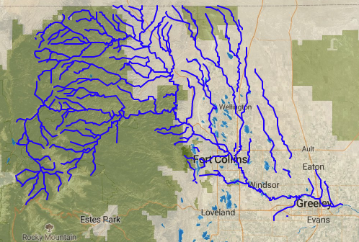
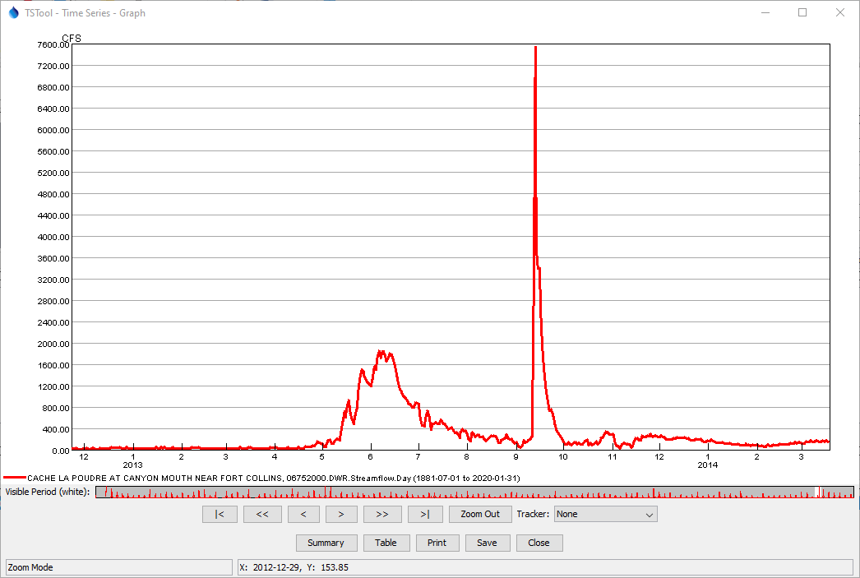
Web Mapping Application Event Handling Summary (mouse click on map to display graph)
Application Software
Application Data Files
/assets/
application configuration
data-maps/
layer files
map configurations
data-ts/
time series data files
graph templates
Map configuration
Event handler
defines action
Reusable or custom application code
handles event and displays data.
Time series graph
template and data
are used for display

