Slide 1
Open Water Foundation InfoMapper AWS SaaS Design
Last updated: 2022-12-05

Slide 2
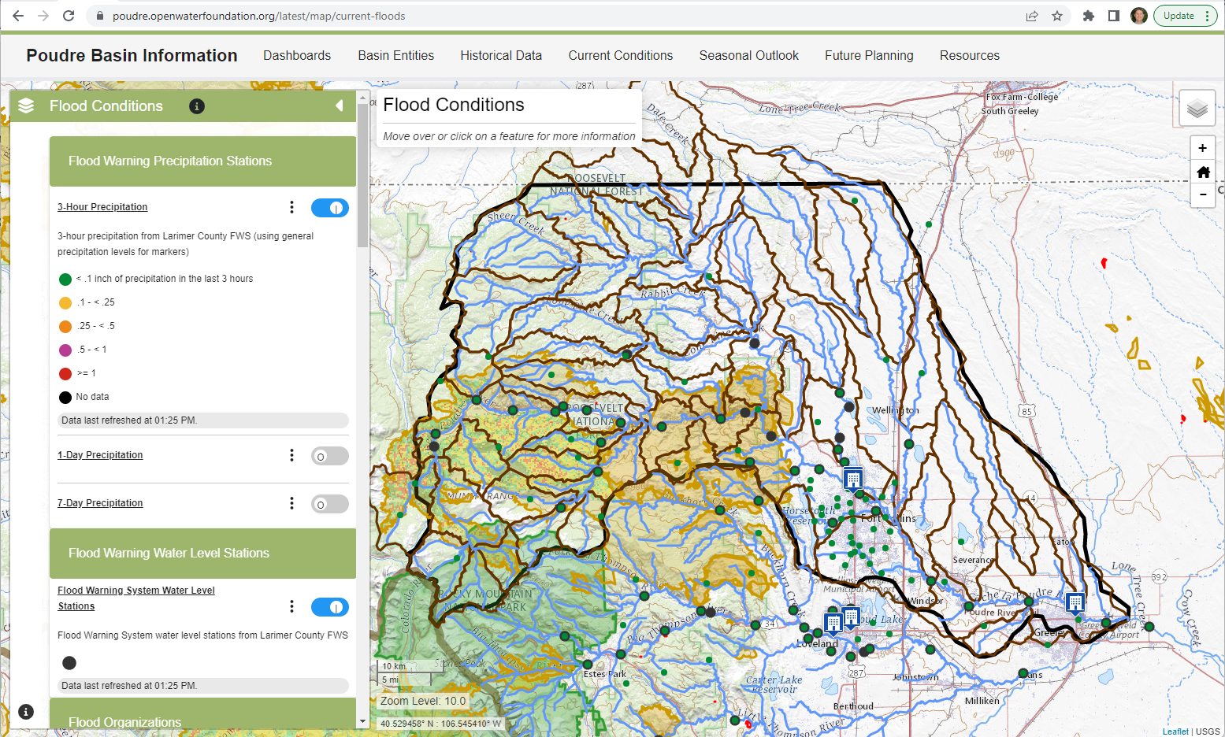
Example of Deployed InfoMapper
Hosted as static S3 website with CloudFront.
Public site so not currently using authentication.
Use lambda function to ensure index.html is added if URL ends in a folder.

Slide 3
Dataset Management
Open source TSTool (for time series) and GeoProcessor (for spatial data) software developed by OWF automates data processing and uploads datasets to S3.
See the TSTool AWS plugin, which uses the ASW Java SDK: https://software.openwaterfoundation.org/tstool-aws-plugin/
Datasets are hosted on AWS using an S3 bucket and CloudFront distribution, for example: https://data.openwaterfoundation.org/state/co/dwr/stream-reaches/
Most datasets are open data formats such as GeoJSON, CSV, and JSON.
Datasets are managed using workflows of commands.
Controlling data and workflows are saved in GitHub repositories.

Slide 4
Overview of Hosted Application Design
Back-end System
Builder System
Viewing System
S3 Cloud Storage (versioned URLs)
Datasets
1. CRUD operations on S3 resources (JSON, etc.)
InfoMapper Builder
Software
Angular app
InfoMapper Configurations
InfoMapper Software
Angular app
2. Invalidate distribution
CloudFront CDN
https
Caching
Edge servers
3. Edit a versioned release (1.2.3) and publish to “latest”.
View by accessing a CDN InfoMapper URL.

Slide 5
Open Water Foundation AWS Application Account Design for Multiple Organizations
Mobile/Web Client
Cognito
1.5. Sets authorization token properties depending on which multi-tenant approach is used, if any.
IAM (Identity & Access Management)
Amazon SES (email)
Cognito has a top out of 50 emails a day. SES has a top out of 62,000 emails a day.
1. Authenticate / Validate
User pool
2. JWT Token
3. Get AWS Credentials
Identity pool
User can be in more than one organization. Each will be assigned a role with different permissions. Identity pools might be useful for more granular permissions per user pool user (admin, non-admin, etc.)
4. Return token with granular access properties set, depending on what multi-tenant approach is used.
CloudFront
S3
OWF-bucket/tenant1/app/infomapper1
OWF-bucket/tenant2/app/infomapper2
OWF-bucket/tenant3/data/dataset
OWF-bucket/tenant4/app/infomapper3
5. Access AWS resources using the Amazon Amplify SDK with user credentials.
6. Access to the bucket path using the authentication properties set from the user pool group or identity pool.
Types of tenants can be
Organization
Personal
Community
Amazon Amplify SDK

Slide 6
Use Case for Login using User-Pool-Based Multi-Tenancy
User: Joe.Smith or joe.smith@abc.com
Password: *****
Organization: User can be a part of multiple…
Organization: User can be a part of multiple…
User: Joe.Smith or joe.smith@abc.com
Password: *****
Can users create a new organization on their own? Or does OWF have to do it?
What comes first? The new organization or the new user?

