Slide 1
The following is used in the install-qgis content.

Slide 2
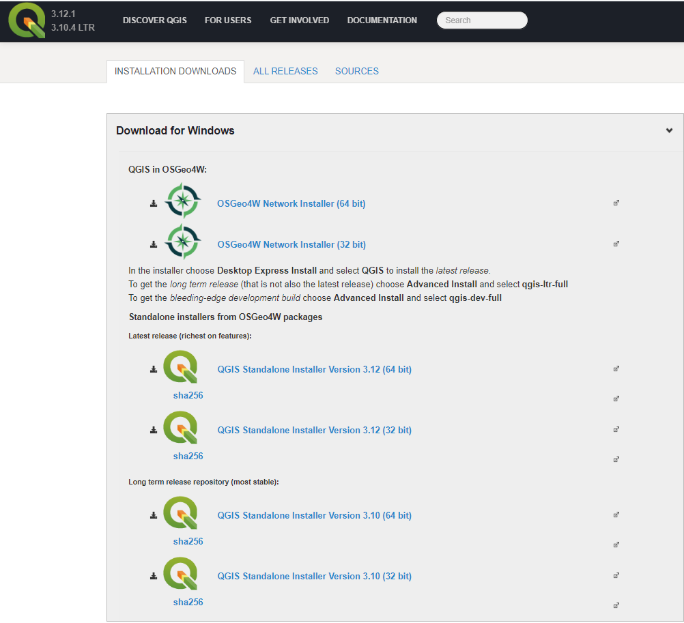
Current version information
Default install location is C:\OSGeo4W64,
not a versioned installation folder.
Standalone installer is recommended for general use
Default install location is C:\Program Files\QGIS 3.12
C:\Program Files\QGIS 3.12\apps\qgis\python
should be used in PYTHONPATH for Python applications.
Default install location is C:\Program Files\QGIS 3.12
C:\Program Files\QGIS 3.12\apps\qgis-ltr\python
should be used in PYTHONPATH for Python applications.
C:\Program Files\QGIS 3.12\apps\qgis\python
may exist but is typically empty.

