Slide 1
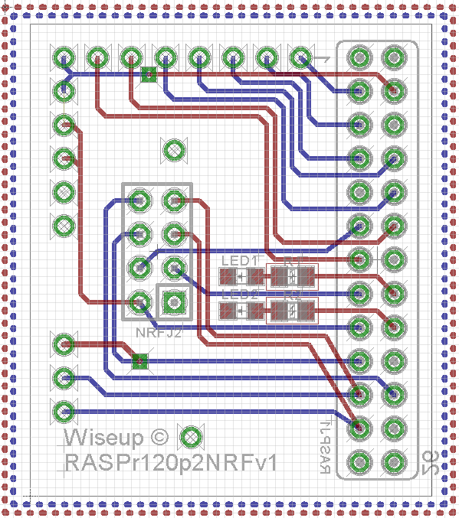
3.3655 cm
Wireless module electronics
Wireless module
0.4 cm
0.1 cm
0.8 cm
2.2 cm
3.81 cm
0.1 cm
Our PCB
0.8 cm
Connector
Raspberry Pi PCB

