Slide 1


eXtensible Imaging Platform (Xip)
Sylvain Jaume – Sep 2008
Siemens Corporate Research
Princeton, NJ

Slide 2
Academic & Industrial Effort
Initiated by caBIG consortium
  Joint effort of Washington Univ. in St Louis and Siemens Corporate Research
  Xip was created with NCI funding
  Publicly available under BSD license
Deployed in commercial products
  Siemens builds software using Xip
  Deployed for pharmaceutical companies and Department of Defense

Slide 3
Rapid Prototyping
Visual Programming
  Based on the concept of scene graphs
  Implemented with Qt (GPL license)
  Drag and drop components

Slide 4
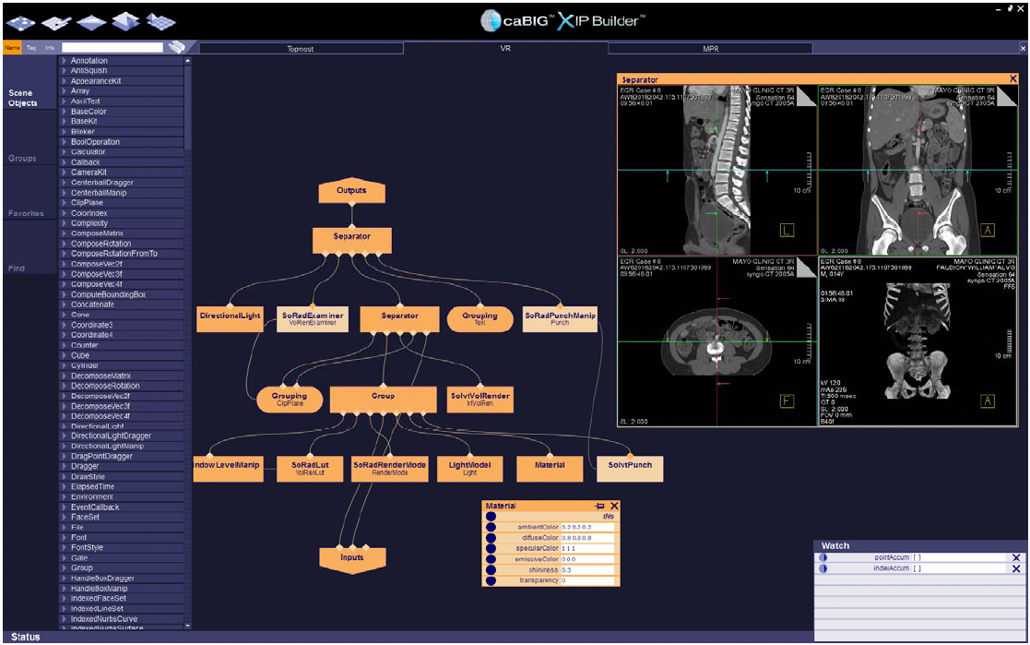
Rapid Prototyping

Slide 5
Interoperability
Supports vendor interoperability
  Adopted by Workgroup DICOM 23
  Standardization in progress by major scanner manufacturers
Runs on Windows, Mac and Linux
  Cross-platform configuration (CMake)
  Automated testing and nightly builds
  Binaries available on GForge server

Slide 6
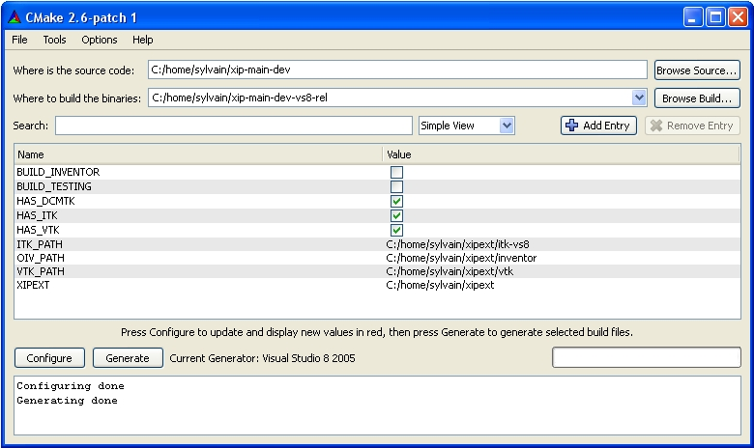
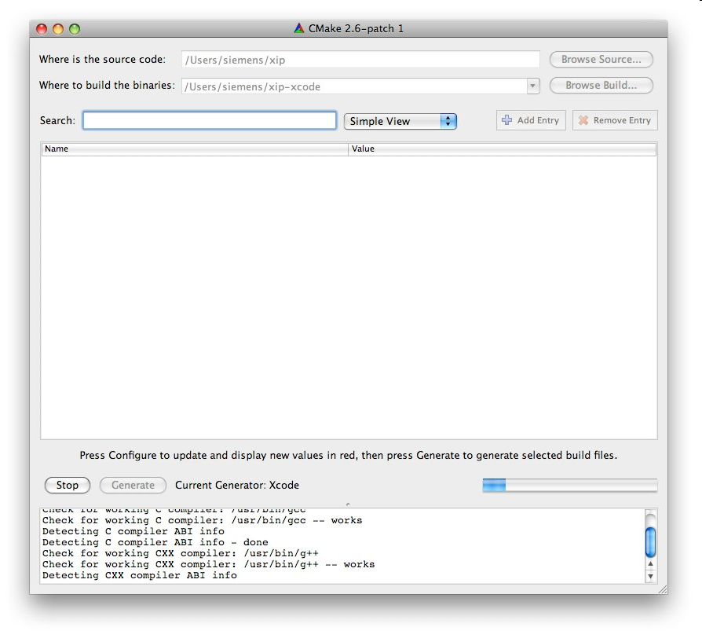
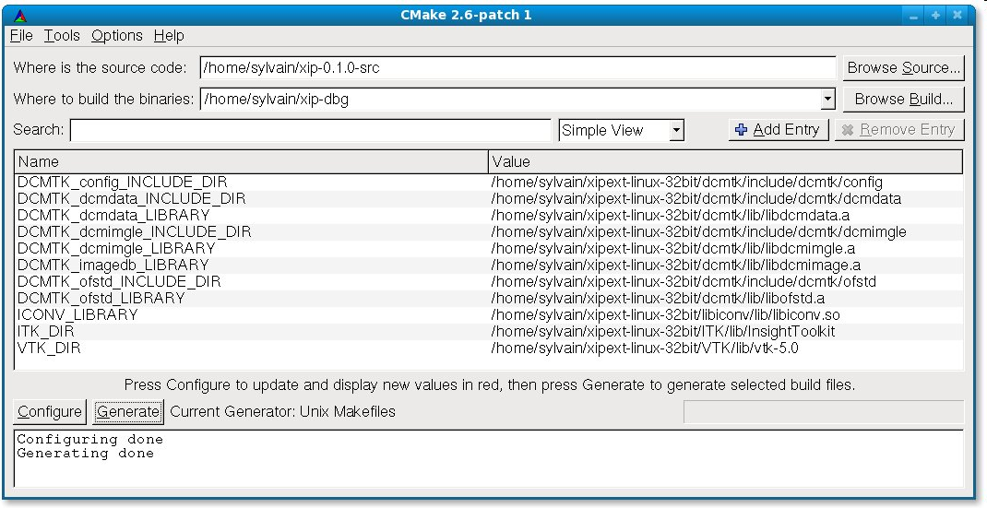
Interoperability
Cross-platform:
  Windows
  Mac
  Linux

Slide 7
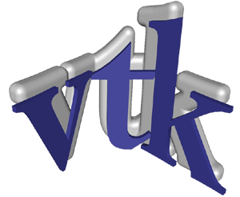



Open Source
Leverages existing OpenSource projects
  Open Inventor: layer on OpenGL
  DCMTK: support for DICOM format
  ITK: image segmentation and registration
  VTK: visualization algorithms
  GLSL: advanced rendering

Slide 8
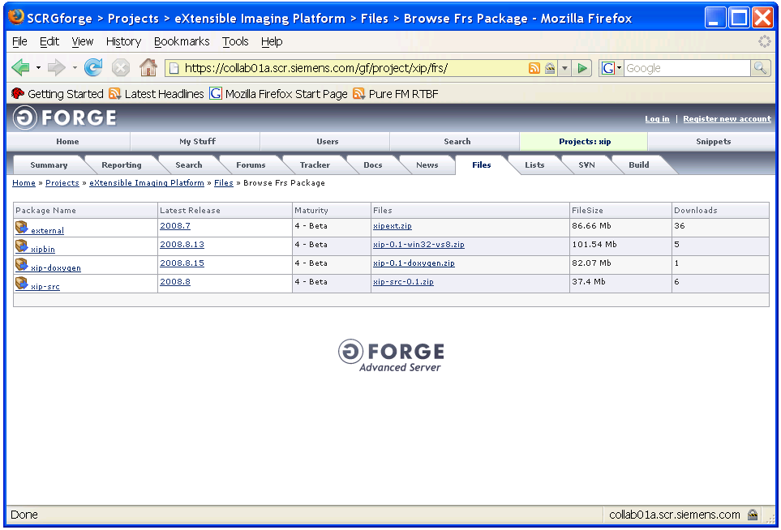
Open Source
Available at http://openxip.org

Slide 9
Cutting Edge
Siemens contributes novel algorithms
  Volume rendering of high-resolution data
  DICOM tags overlaid on images
  GPU acceleration (GLSL, CUDA)
  Remote visualization
Collaboration with 10s of universities
  100 PhD students and scientists use Xip
  Implementation of published algorithms released immediately

Slide 10
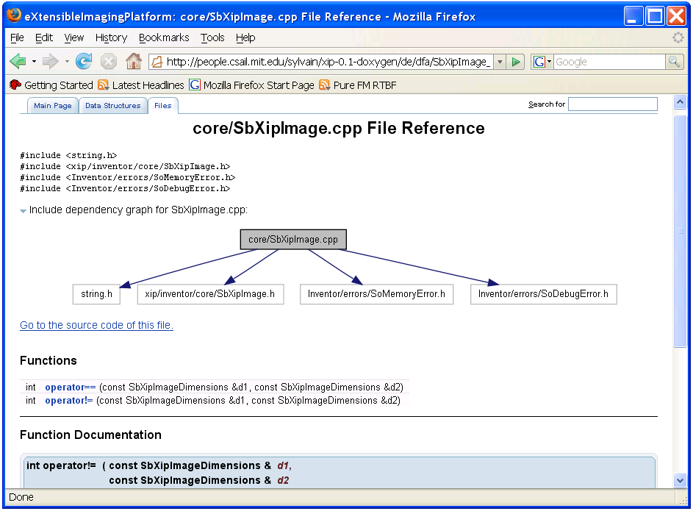
Cutting Edge
Automated documentation (Doxygen)

Slide 11
eXtensible Imaging Platform
Extensible
  Add your own plug-ins (dynamic libraries)
  Plug-ins can be Open Source or proprietary
  Can be combined with Java and HTML

Slide 12
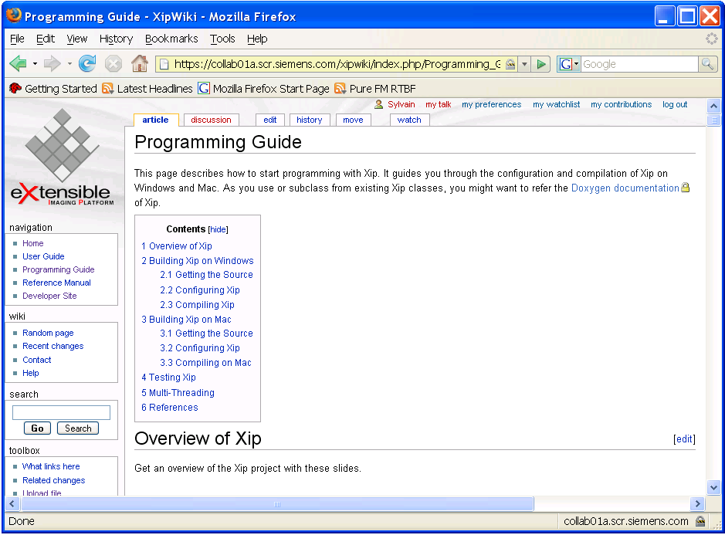
eXtensible Imaging Platform
Tutorials to use and extend Xip

Slide 13
Status
900 developers from 50 NCI Institutions
32 developers at WUSTL
13 developers at SCR
70 projects
Codebase: 698,198 lines

