Slide 1


CUDA Module for Xip
Sylvain Jaume – Aug 2008
Siemens Corporate Research
Princeton, NJ

Slide 2
CUDA Plug-in
Goal
  GPU acceleration using NVIDIA language
Plugin
  Drag-and-drop plugin in XipBuilder bin dir
Availability
  Available for collaborators in XipPro

Slide 3
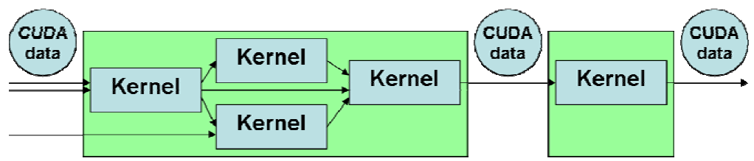
Kernels
Kernels are units for processing data
Combined into one or separate pipeline
Input data from GPU memory
Output data to GPU memory

Slide 4
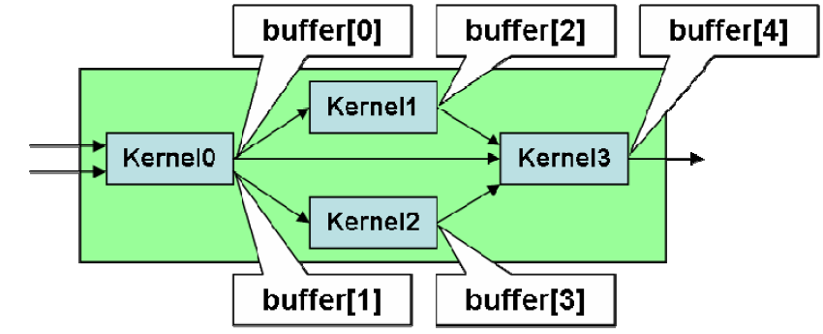
Buffers
Linear memory on GPU is called buffer
Buffers are produced and used by kernels
Pipelines have input/output to CPU memory

Slide 5
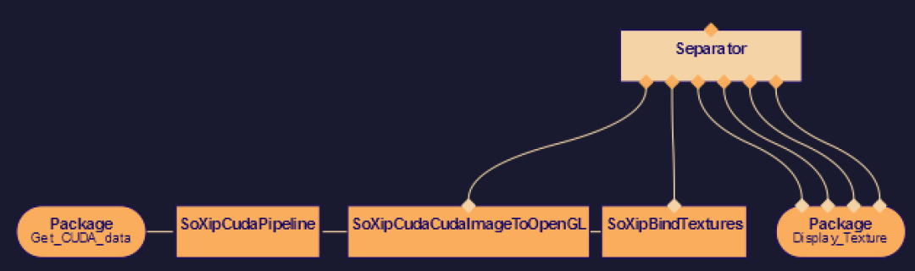
Scenegraphs
Organized in scenegraphs
Buffers are transferred to OpenGL texture
Texture ID bound and mapped to geometry for rendering

Slide 6
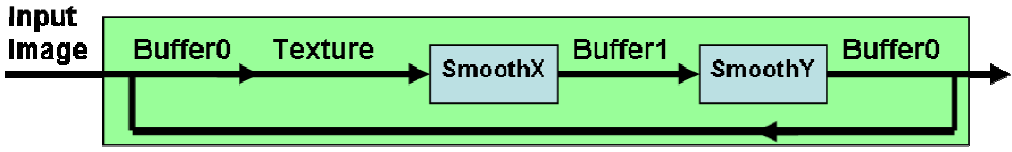
Box Filter Example
Wrapping of NVIDIA SDK’s Box Filter
2 kernels, one for each image axis
2 buffers, first buffer formatted as texture
Second kernel writes to first buffer
=> Pipeline iterates

Slide 7
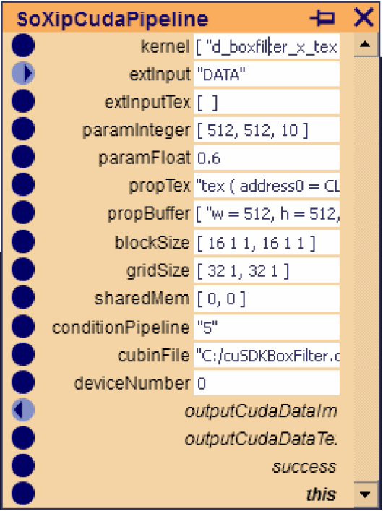
Visual Programming
Xip Builder offers a UI
Drag-&-Drop of Engines and Nodes
Connected with the mouse
Parameter set in a list of fields

Slide 8
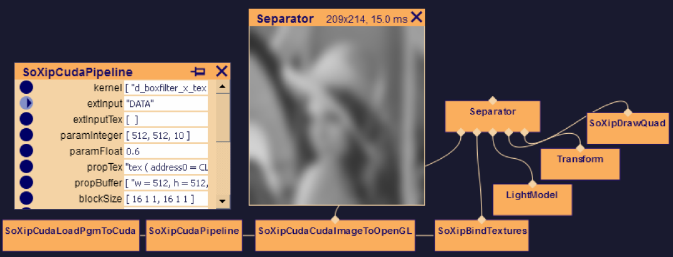
Results
Box Filter smooths an image
Image copied to GPU memory
Processed by kernels on the GPU
Buffer mapped to texture for rendering

Slide 9
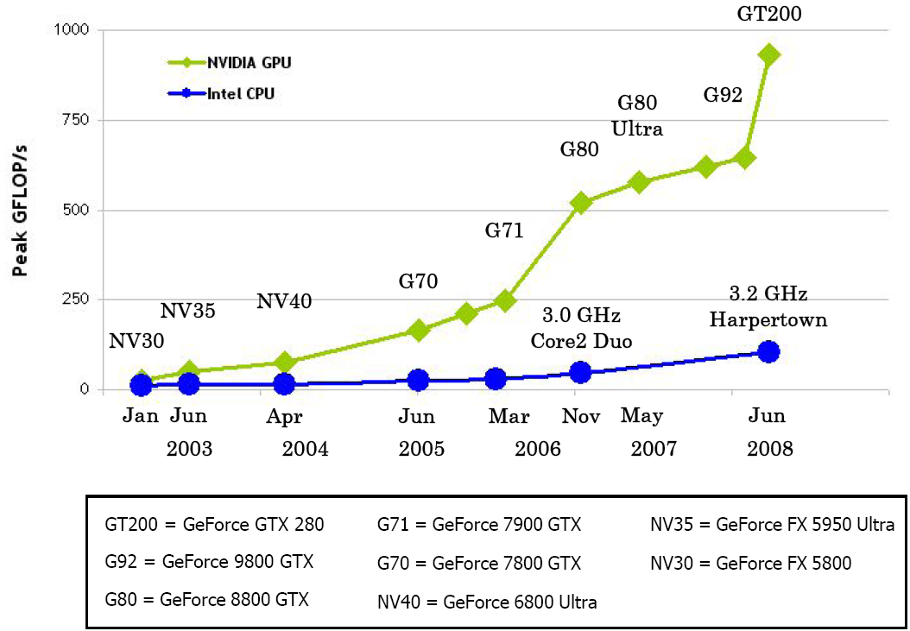

Slide 10
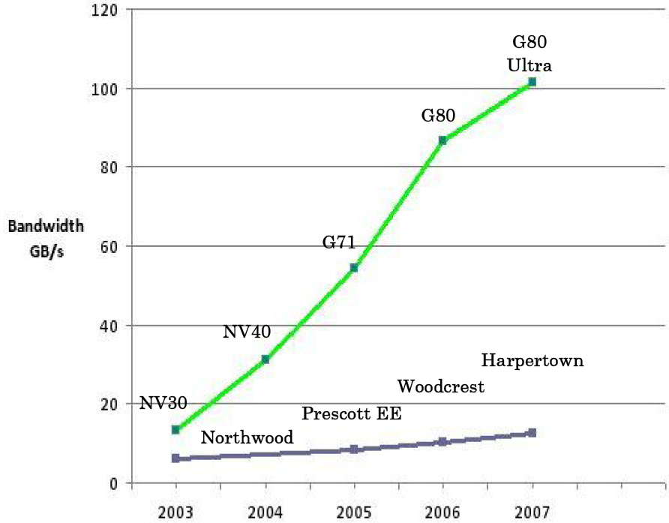

Slide 11
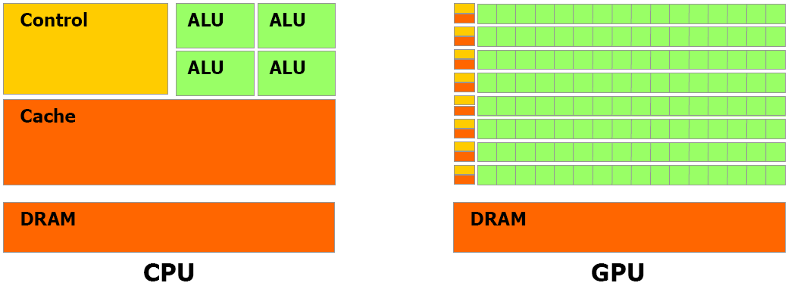

Slide 12
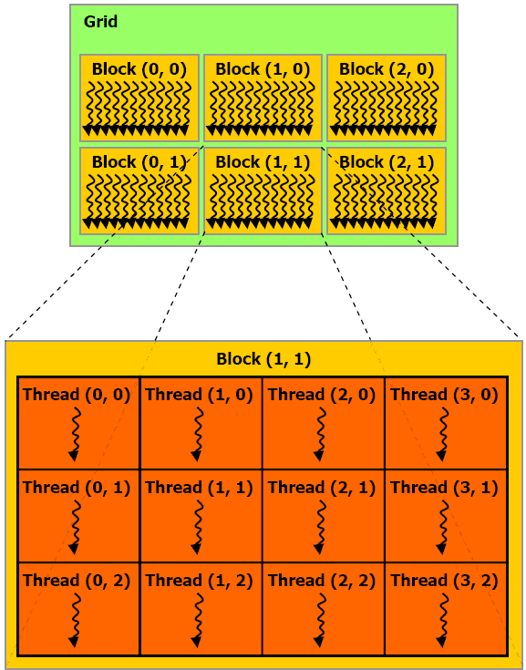

Slide 13
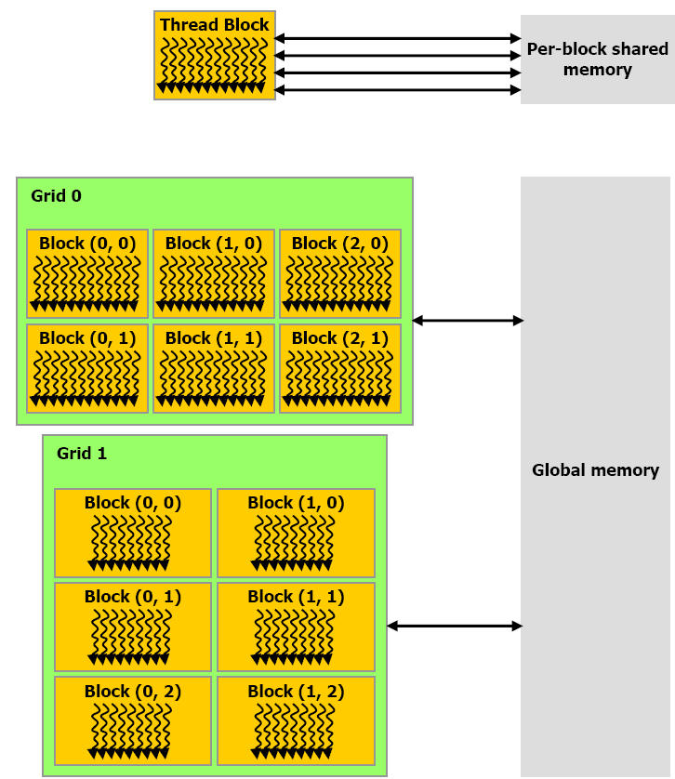

Slide 14
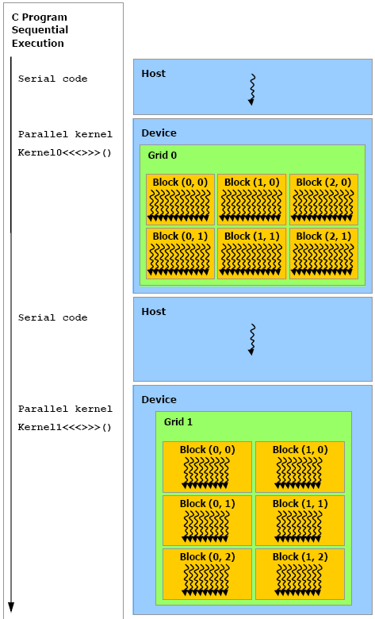

Slide 15
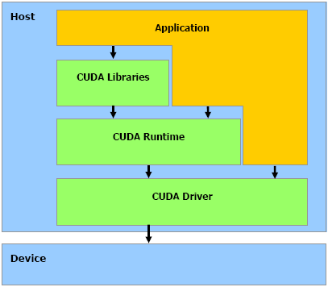

Slide 16
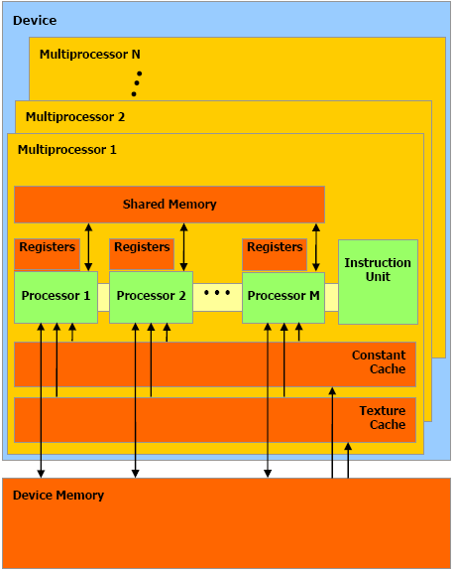

Slide 17
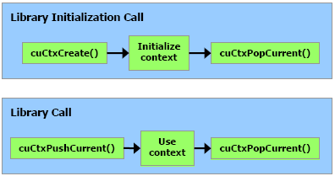

Slide 18
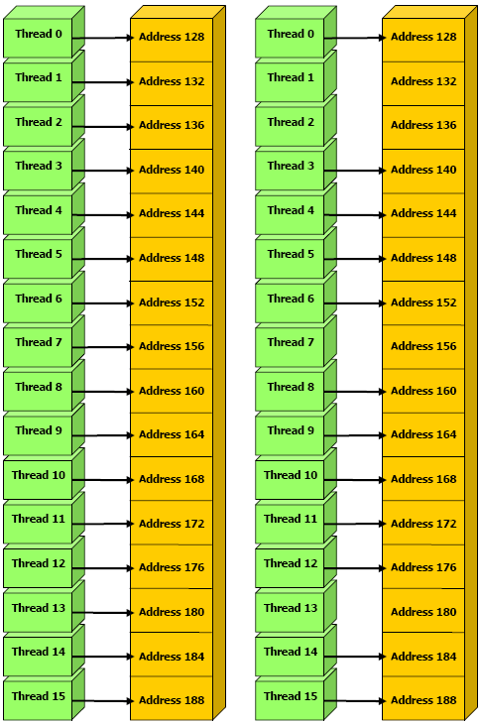

Slide 19
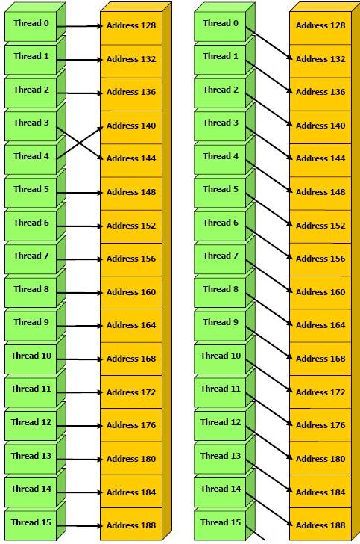

Slide 20
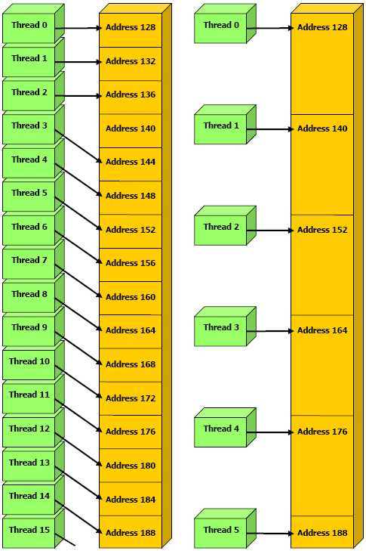

Slide 21
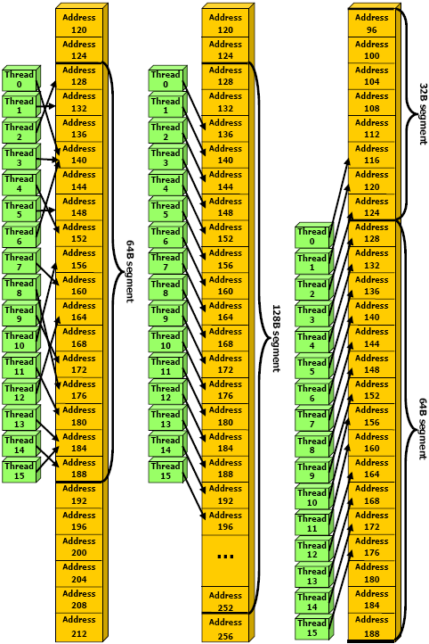

Slide 22
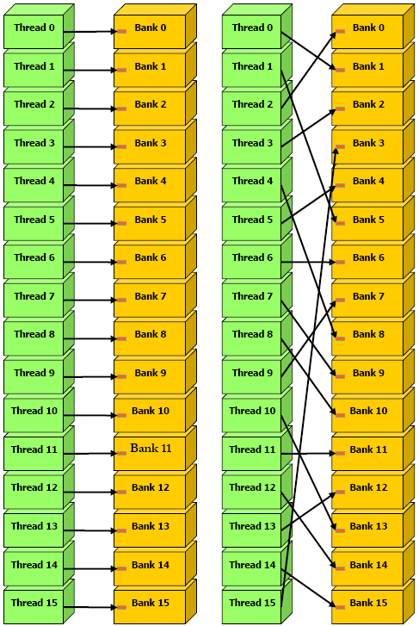

Slide 23
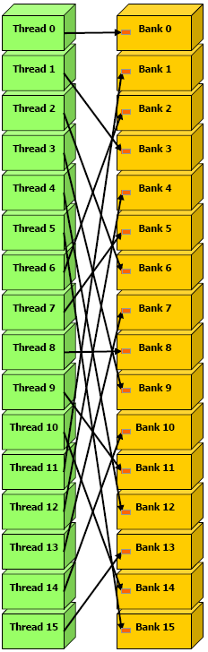

Slide 24
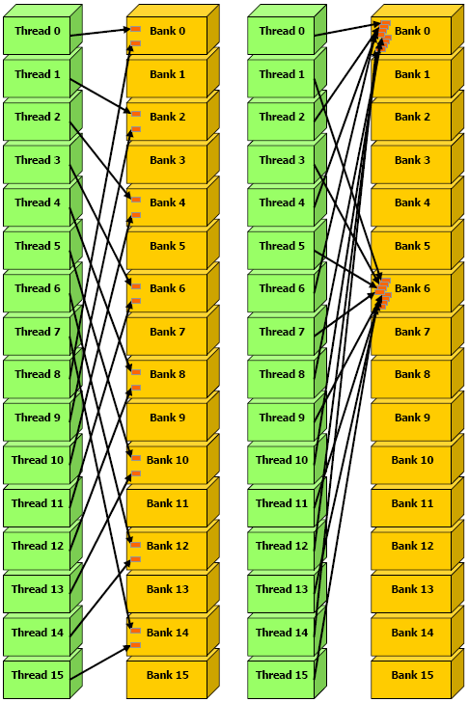

Slide 25
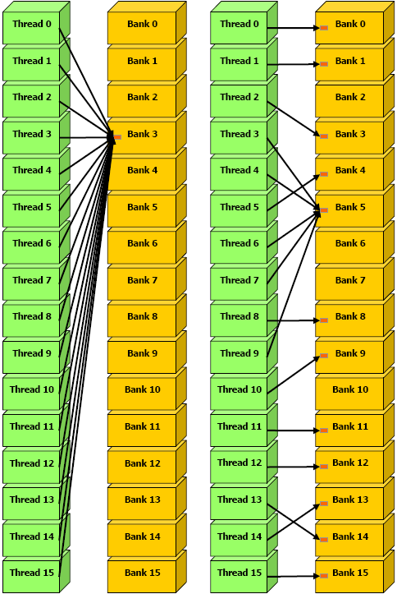

Slide 26
