Slide 1

YOUR LOGO
TEMPLATE
BUSSINESS REPORT

Slide 2

PART ONE
01
A GIFT FROM PPT
Gold can't be pure and man can't be perfect.

Slide 3

公司文化
A
Good news never goes be the gate, while bad news spread far and wide.
“
B
Good news never goes be the gate, while bad news spread far and wide.
the friendship between gentlemen is as pure as crystal a hedge .
”
C
Good news never goes be the gate, while bad news spread far and wide.
D
Good news never goes be the gate, while bad news spread far and wide.

Slide 4

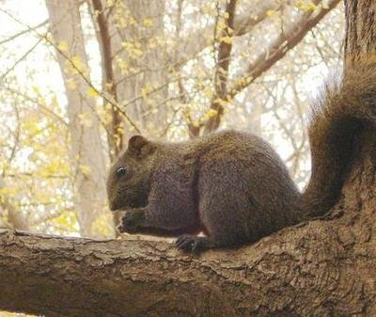
创始人介绍
WILLIAM BROWNER
DIRECT MANAGER
“
Going too far is as bad as not going far enough; beyond is as wrong as falling short; too much is as bad as too little .
”
Vincent BROWNER
DIRECT EXEUTIVE
“
Going too far is as bad as not going far enough; beyond is as wrong as falling short.
”

Slide 5
团队介绍
WILLIAM BROWNER
DIRECT MANAGER
“
Going too far is as bad as not going far enough; beyond is as wrong as falling short; too much is as bad as too little .
”
Vincent BROWNER
DIRECT EXEUTIVE
“
Going too far is as bad as not going far enough; beyond is as wrong as falling short.
”

Slide 6
PART TWO
02
A GIFT FROM PPT
Gold can't be pure and man can't be perfect.

Slide 7



项目进展
25%
50%
Going too far is as bad as not going far enough; beyond is as wrong as falling short.
OVERSEA
DOMESTIC

Slide 8

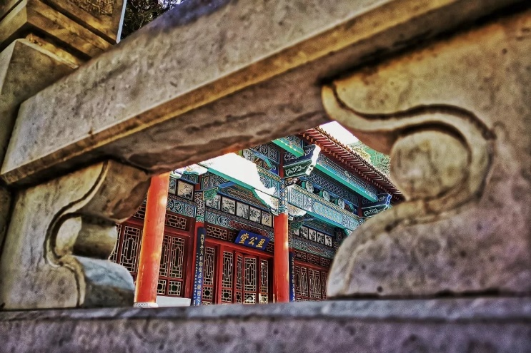

项目进展
1
3
PLAN ALPHA
PLAN FUCKY
Going too far is as bad as not going far enough; beyond is as enough.
Going too far is as bad as not going far enough; beyond is as enough.
2
PLAN BETA
Going too far is as bad as not going far enough; beyond is as enough.

Slide 9

项目进展
GIFT FROM PPT
A modest spur to induce others to come forward with valuable contributions; thro a sprat to catch a whale.
with valuable contributions
best

Slide 10
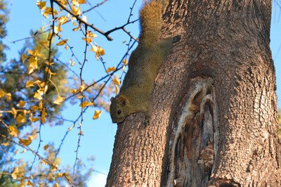
项目进展
GIFT FROM PPT
A modest spur to induce others to come forward with valuable contributions; thro sprat to catch a whale.
with valuable contributions
Ready

Slide 11
PART THREE
03
A GIFT FROM PPT
Gold can't be pure and man can't be perfect.

Slide 12


GIFT FROM PPT
A modest spur to induce others to come forward with valuable contributions; thro a sprat to catch a whale.
with valuable contributions
Ready
GIFT FROM PPT
A modest spur to induce others to come forward with valuable contributions; thro a sprat to catch a whale.
with valuable contributions
Ready

Slide 13
项目进展
25%
50%
Going too far is as bad as not going far enough; beyond is as wrong as falling short.
OVERSEA
DOMESTIC

Slide 14
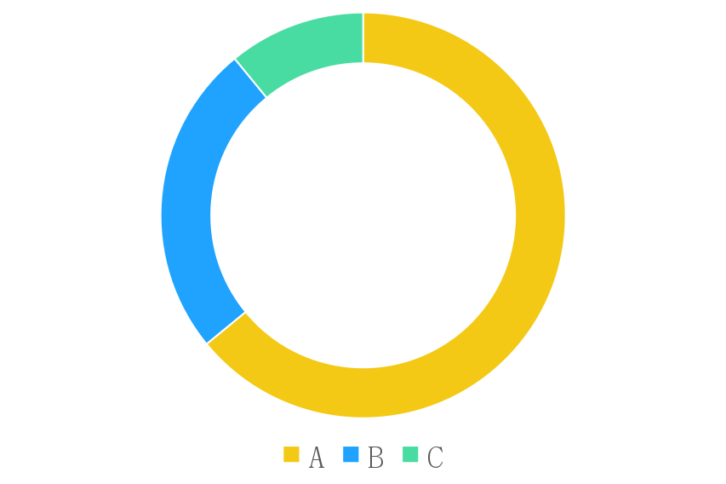
项目进展
THE WORKS SHOWCASE
直接购买
最终产品展示
78.99%
A modest spur to induce others to come forward with valuable contributions; thro a sprat to catch a whale.

Slide 15
项目进展
GIFT FROM PPT
A modest spur to induce others to come forward with valuable contributions; thro a sprat to catch a whale.
with valuable contributions
best

Slide 16
YOUR LOGO
THANK YOU !
谢谢观看 !
PPT制作：云南大学党委宣传部（含新闻中心）新媒体中心

