Slide 1

CHALLENGE 05 @ HACKDAYS 2019
Resources Forecasting for Tourist Offices

Slide 2
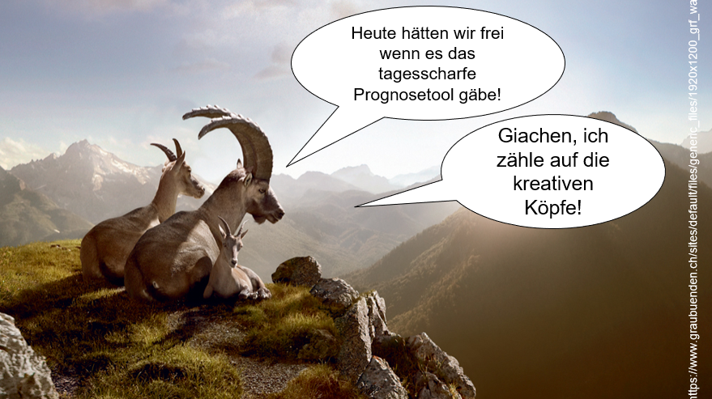
initial situation

Slide 3
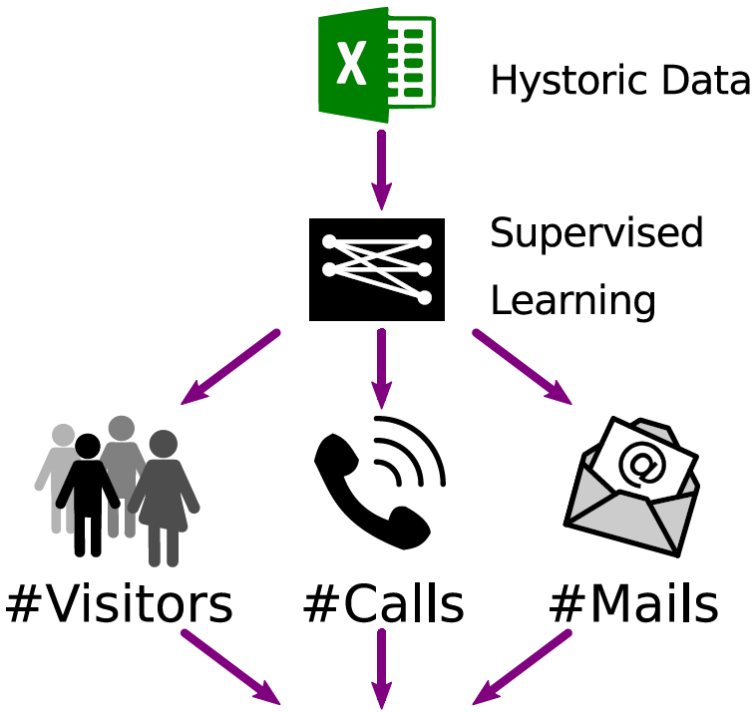
Process

Slide 4
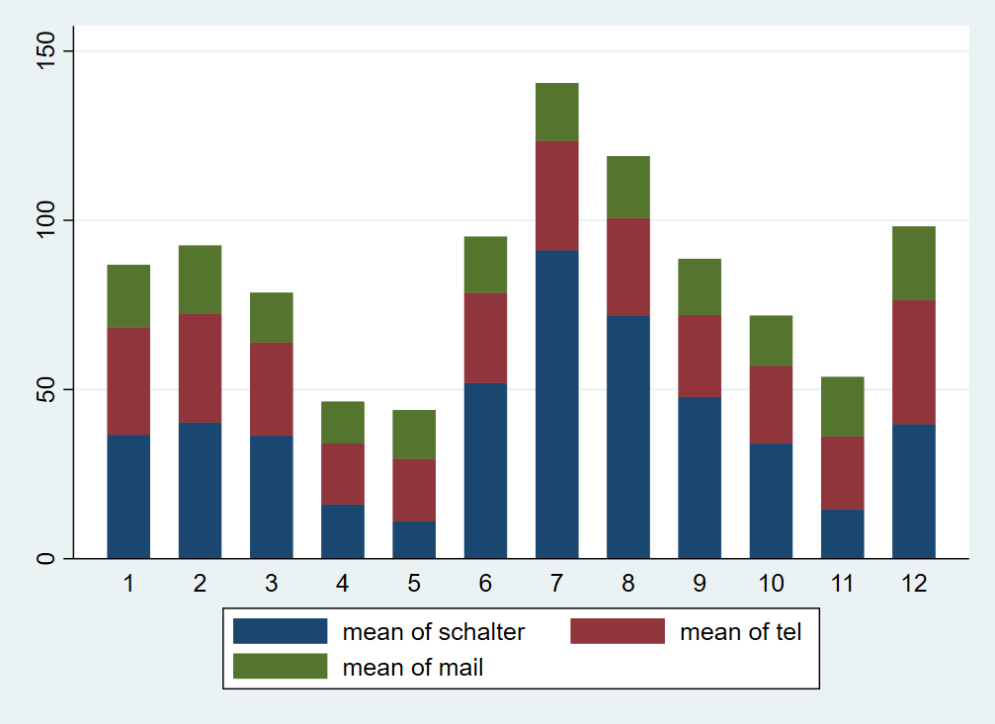
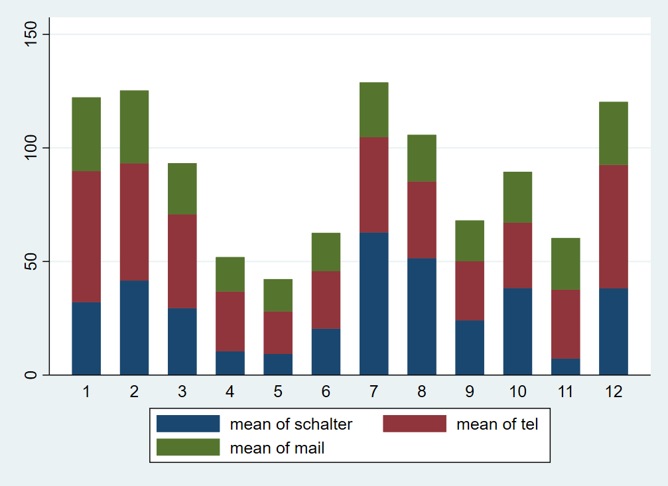
Tourist contacts per channel
Arosa
Lenzerheide
Notes:
Durchschnitt über Monate

Slide 5
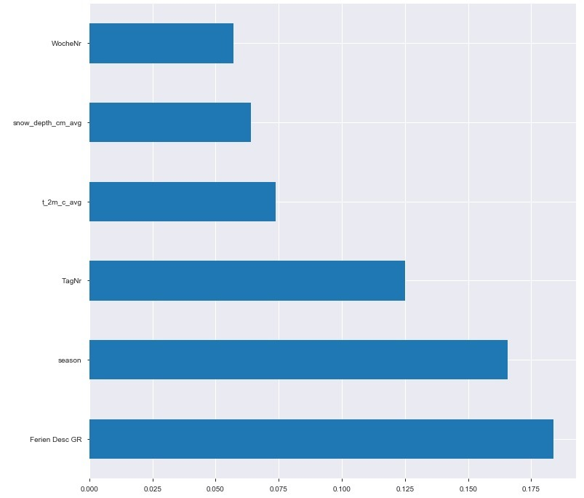
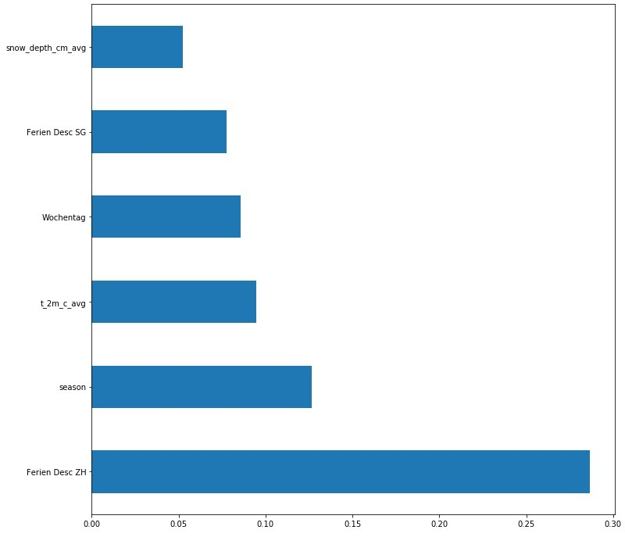
Feature importance (evaluation I/II)
Arosa
Lenzerheide
Notes:
Durchschnitt über Monate

Slide 6
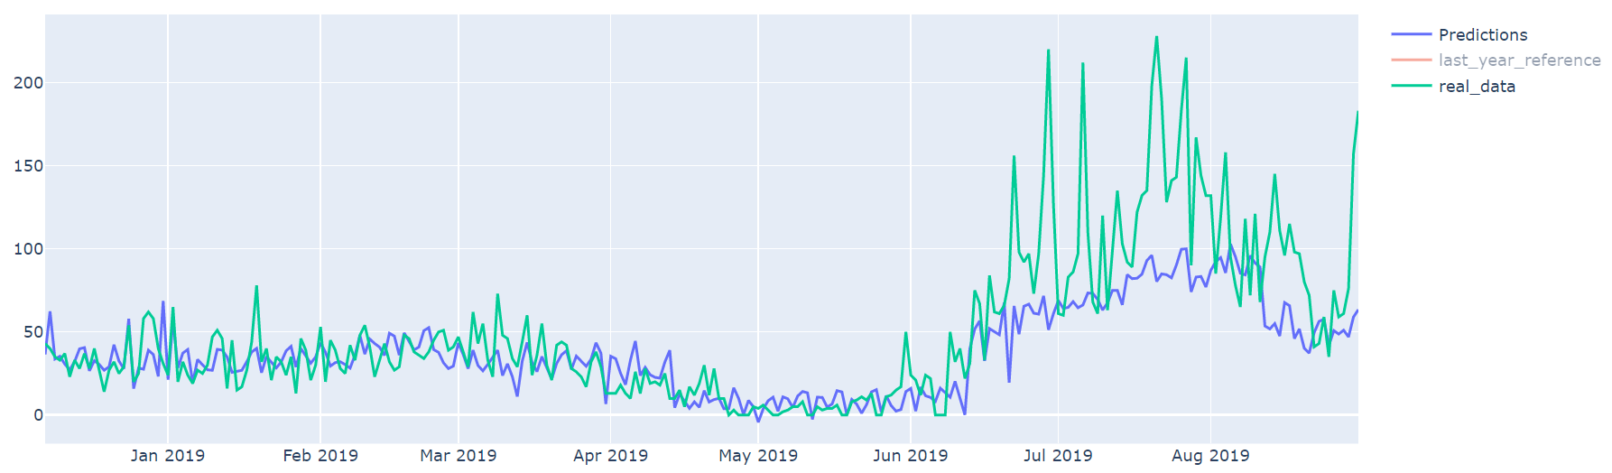
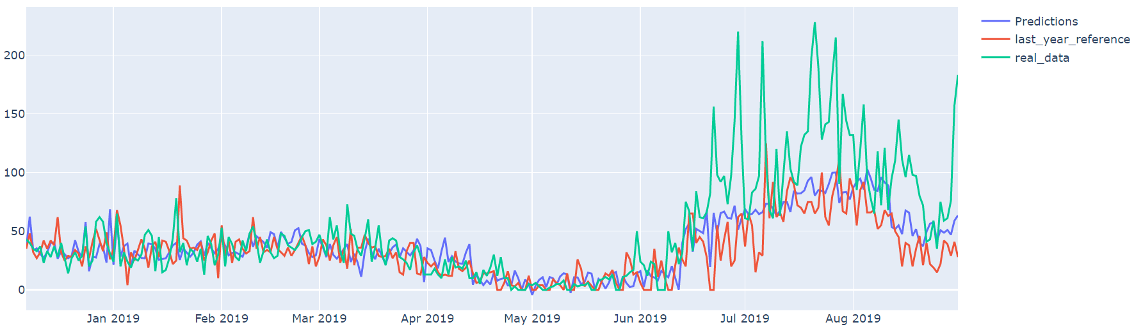
Prediction accuracy | Arosa (evaluation II/II)

Slide 7
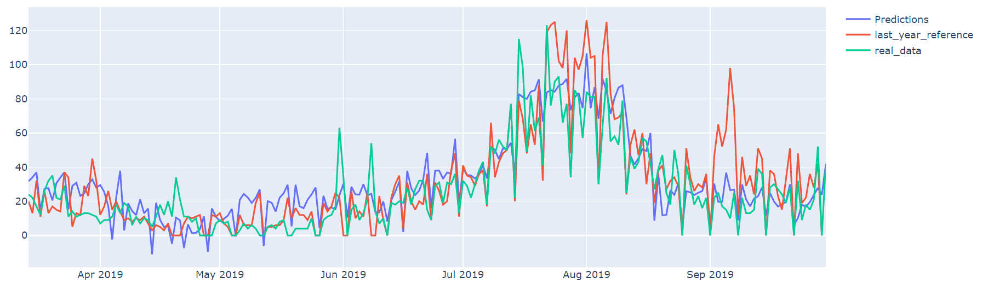
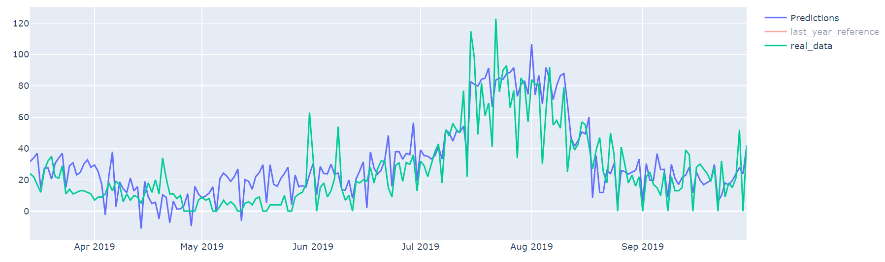
Prediction accuracy | Lenzerheide (evaluation II/II)

Slide 8
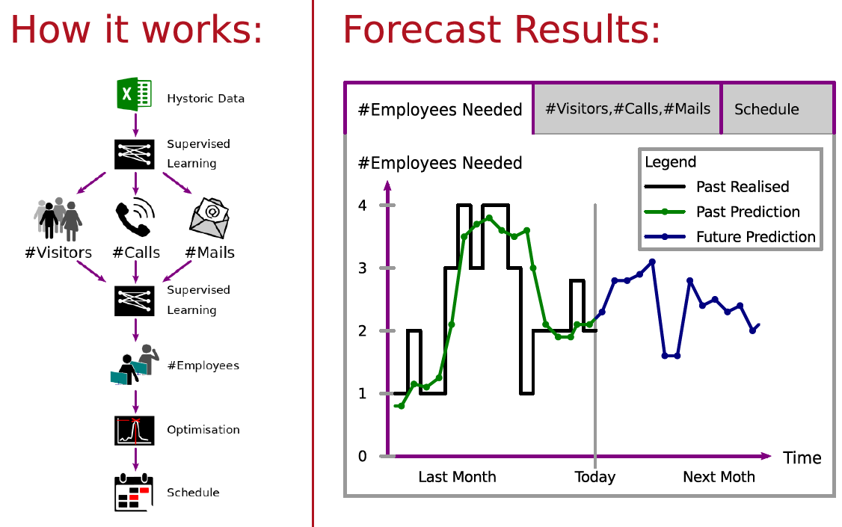
Prototyp Frontend Ressourcencontrolling

Slide 9
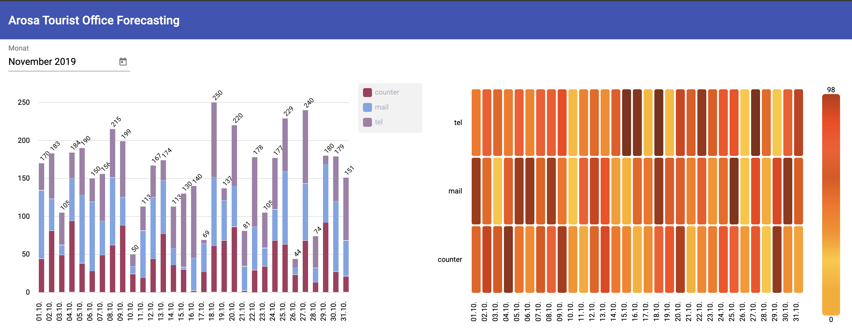
Prototyp Frontend resources forecasting

