Slide 1
Octopus DDS*
Jan. 8, 2020 (original)
Feb 19, 2020 (added FM vs AM slide at end)
* DDS = Direct Digital Synthesis

Slide 2
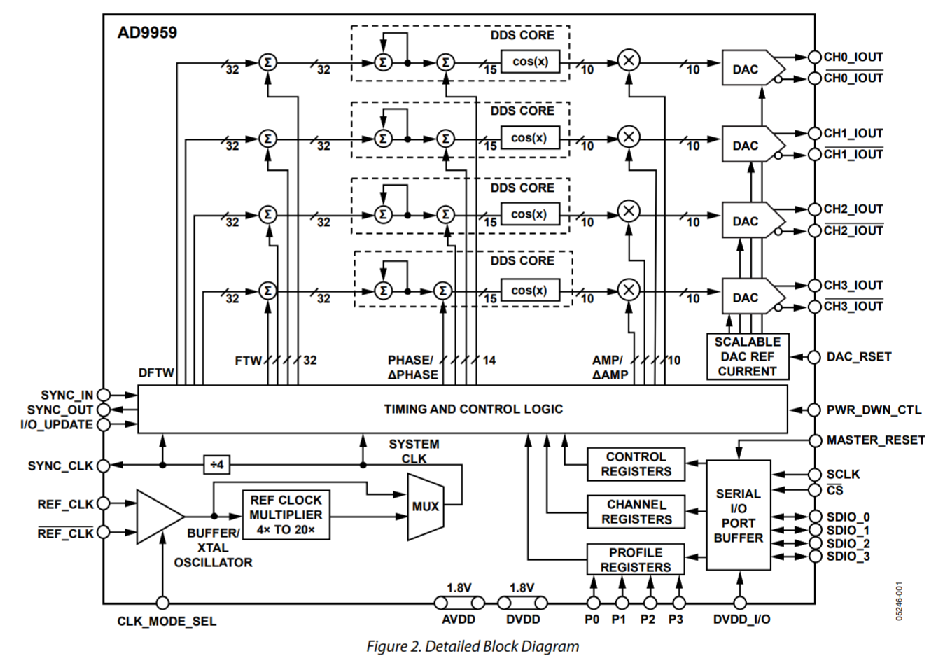
AD9959
Four independent channels
Up to 500MSa/s each
FSK/PSK/ASK modulation control
Up to 16-levels
P0:P3 pins
10bit output amplitude resolution (DAC)
14bit phase offset resolution (32-bit accumulation)

Slide 3
Programming (I/O_Update)
Need SYNC_CLK to transfer data from serial I/O buffer to active reg in device (pg.30) – SYNC_CLK derived from System Clock/4 or external
I/O_UPDATE inits start of buffer transfer (do at end of serial comm) and may be asynch to SYNC_CLK with minimum pulse width of 2 SYNC_CLK or greater (send when serial comm complete to make active)
Serial clk max 200MHz
Note for single-tone mode, to program different FTW (Reg 0x04) and POW (Reg 0x05) for each channel, one has to enable one a single channel (Reg 0x00), program 0x04 and 0x05, repeat enable and writing for each channel separately, then send I/O update signal at end. (pg.31) All channels share regs 0x03 to 0x18 but each channel has a copy
2phases to serial comm:
1. instruction cycle: each bit of instr byte registered on SCLK rising (Instr byte determines write or read and has addr)
2. actual data transfer: #bytes is function of register being accessed
Serial bit registered by AD9959 on rising edge for WRITE, applied to SDIO on falling edge (so you/FPGA registers on rising edge) of SCLK for READ

Slide 4
Serial communication
Modes of operation: Set in CSR[2:1]
2’b00 = Single-bit serial (2-wire) [Default Mode]
2’b01 = Single-bit serial (3-wire)
2’b10 = 2-bit serial mode
2’b11 = 4-bit serial mode (SYNC_I/O not available)
For Single-bit serial (2-wire) default mode:
SCLK, _CS, SDI0, and SYNC_I/O (SDIO3) - note SDIO1, SDIO2 unused.
SYNC_I/O used to re-synch serial I/O port controller if out of proper sequence
High aborts, upon return to low can start serial comm again (start with instruction byte)
Can be used to abort write, thereby allowing fewer bytes to write register
Do not let SYNC_I/O float in single-bit or 2-bit modes.
Can be MS-bit or LS-bit – Set with CSR[0] (0=MS,1=LS)
Default is MS-bit (send MS-bit first)

Slide 5
Mode: two-level amplitude modulation
Two-level modulation mode can be enabled on any channel in any combination at the same time
Program Amplitude Frequency Phase (AFP) selectect bits CFR[23:22] = 0x01 for amp mod
Program Modulation bits FR1[9:8] = 0x00 for 2-level modulation
RU/RD (FR1[11:10] = 0x00) for disabled (ramp up/down) and CFR[14] linear sweep disabled
PPC bits (FR1[14:12]) assign profile pins (and/or SDIO) to dedicated channel? Doc seems to indicate P0:P3 <-> CH0:CH3 in this mode (automatically)

Slide 6
Clocking
Xtal 20-30MHz: 25MHz
CLK_MODE_SEL = high and attach xtal to REF_CLK_P, REF_CLK_N
PLL multiplication factor programmable from 4:20 (integer steps)
Reg 0x01 FR1 bits[22:18] 20 = 0x14
VCO range 255-500MHz (ctrl bit high) or 100-160 (low) [160-255 nope]
For AOM output: f_{out} = (FTW)*f_{s}/2³², or rather: FTW = (f_{out} / f_{s})* 2³²
E.g. FTW = (100MHz/500MHz)*4294967296 = 858993459 = 0x33333333
Phase offset POW = (φ/360º)*2¹⁴ to place channels in known phase relationship to one another

Slide 7
Output
DAC current: Reg CFR bits [9:8]=0x3 full (half:0x2, ¼:0x1, 1/8:0x0)
I_{out}(max): determined by R_{SET} = 18.91/I_{out}(max) [DAC_RSET=1.91k]
I_{out}(max) = 9.9mA
[R_{load} is 49.9 Ohm] for 0.49V [Recommended AVDD+/-0.5V]
Bypass output multiplier ACR[12] = 0

Slide 8
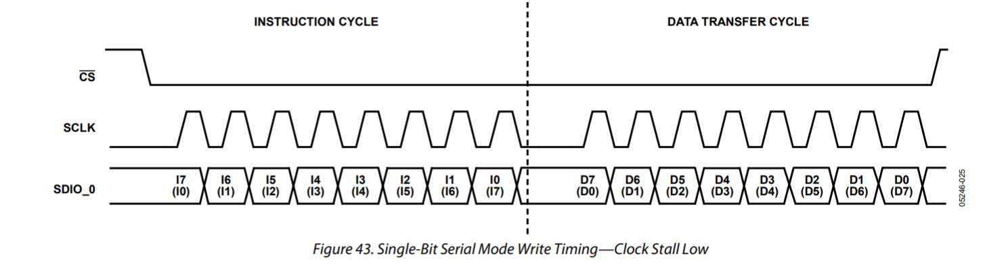
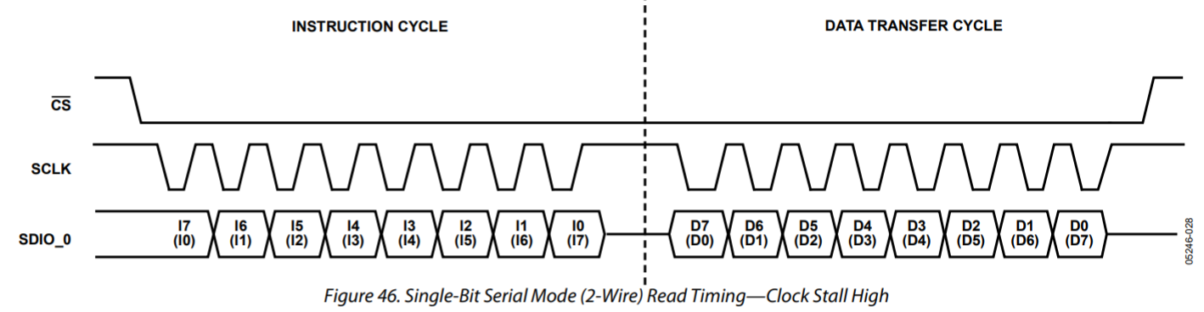
Instruction Byte
Bit index | Description
7 (MSb) | Read/NotWrite
6 | X (don’t care)
5 | X (don’t care)
4:0 | Register Address A4:A0
E.g. “0x00” is “write addr 0x00”
Note: pg.34 shows single-cycle SCLK stall (SCLK holds low or high, SDIO_0 holds or don’t’ care) between Instruction Byte and Actual Data Transfer.

Slide 9
Addr 0x00 Control Select Register (CSR)
Bit index | Description
7(MS-bit):4 | CH3, CH2, CH1, CH0 enable bits
3 | Must be 0
2:1 | Serial I/O mode select
0 | LS-bit first control
1 Byte wide
Default = 0xF0 (all CH enabled for reg writing), MS-bit first, and Serial I/O mode is ‘Single-bit serial 2-wire’
We will want to write 0x10 for CH0, write the FTW, then disable CH0 (0x00);
Then write 0x20 for CH1, write the FTW, then disable CH1 (0x00);
Then 0x40 for CH2, etc.

Slide 10
Addr 0x01 Function Register 1 (FR1)
Bit index | Description
23 (MS-bit) | VCO gain ctrl (1 if sysclk > 255MHz)
22:18 | PLL divider ratio (20 = 5’b10100 = 0x14 for 500MHz sysclk)
17:16 | Charge pump control (00 is default 75uA)
15 | Open
14:12 | Profile Pin Configuration (PPC) (2’b00 is P0:P3 <-> CH0:3)
11:10 | Ramp-up/Ramp-down (RU/RD) (2’b00 is disabled)
9:8 | Modulation level (2’b00 is 2-level)
7 | Ref Clock input power-down (0=default=clk cct en)
6 | External power-down mode (1 en full pwdn, 0 is light pwdn)
5 | SYNC_CLK disable (0=active – to FPGA, 1 is disabled)
4 | DAC reference power down (0=en, 1=pwdn)
3:2 | Open
1 | Manual HW sync (0=inactive, 1=active)
0 | Manual SW sync (0=inactive, 1=active)
3 Bytes wide
Default = 0x000000
We want = 0xD00000
which is (MS-bit first)
1_10100_00
_0_000_00_00
_0_0_0_0_00_0_0

Slide 11
Addr 0x02 Function Register 2 (FR2)
Bit index | Description
15 | All channels autoclear sweep accumulator (1=auto clear on I/O_Update)
14 | All channels clear sweep accumulator (1=async clear all 4 channel sweep acc)
13 | All channels autoclear phase accumulator (1=autoclear all 4 on I/O_Update)
12 | All channels clear phase accumulator (1=async clear all 4 chan)
11:10 | Open
9:8 | Open
7 | Auto sync enable (for syncing mult AD9959 dev, ignore)
6 | Multidevice sync master enable (for syncing mult AD9959 dev, ignore)
5 | Multidevice sync status (for syncing mult AD9959 dev, ignore)
4 | Multidevice sync mask (for syncing mult AD9959 dev, ignore)
3:2 | Open
1:0 | System clock offset (for syncing mult AD9959 dev, ignore)
2 Bytes wide
Default = 0x0000
We want = 0x0000
Bits: (MS-bit first)
0_0_0_0_00_00
_0_0_0_0_00_00
(note: using per chan autoclear vs global here)

Slide 12
Addr 0x03 Channel Function Register (CFR)
Bit index | Description
23:22 | Amplitude Frequency Phase (AFP) select; 0x1 for Amplitude modulation
21:16 | Open
15 | Linear sweep no-dwell (0=inactive)
14 | Linear sweep enable (0=inactive)
13 | Load SRR at I/O_UPDATE (0=not, but not using linear sweep so don’t care)
12:11 | Open
10 | Must be 0
9:8 | DAC full-scale current control (0x3 for largest value/full-scale)
7 | Digital Power-down (1=disable dig core to lowest power state)
6 | DAC Power-down (1=disable DAC to lowest power state)
5 | Matched pipe delays active (only for single-tone mode not 2-mod, so 0)
4,3 | Autoclear sweep accumulator; clear sweep accumulator
2,1 | Autoclear phase accumulator; clear phase accumulator (autoclear clears on I/O_Update, clear does async clr)
0 | Sine wave output enable (0=cosine vs 1=sine)
3 Bytes wide
Default = 0x000302
We want=0x400315
Bits (MS-bit first):
01_000000
_0_0_0_00_0_11
_0_0_0_1_0_1_0_1
Note: not using sweep, but autoclear it too
Addr 0x02 autoclear/clear seem to be global vs per-channel, use per-channel

Slide 13
Addr 0x04 Channel Freq Tune Word0 (CFTW0)
Bit index | Description
31:0 | Frequency Tuning Word 0 (Note: CSR[7:4] determine which Channels will get this value)
4 Bytes wide
Recall from prev slide:
For AOM output: f_{out} = (FTW)*f_{s}/2³², or rather: FTW = (f_{out} / f_{s})* 2³²
E.g. FTW = (100MHz/500MHz)*4294967296 = 858993459 = 0x33333333

Slide 14
Addr 0x05 Chan Phase Offset Word0 (CPOW0)
Bit index | Description
15:14 | Open
13:0 | Phase Offset Word 0 (Note: CSR[7:4] determine which Channels will get this value)
2 Bytes wide
Default 0x0000

Slide 15
Addr 0x06 Amplitude Control Reg (ACR)
Bit index | Description
23:16 | Amplitude ramp rate (ARR)
15:14 | Increment/decrement step size
13 | Open
12 | Amplitude multiplier enable (1 to en manual control)
11 | Ramp-up/Ramp-down enable (valid only if ACR[12]=1)
10 | Load ARR at I/O_UPDATE
9:0 | Amplitude scale factor
3 Bytes wide
Default = 0x??0000
We want = 0x000000
Bits (MS-bit first):
00000000
_00_0_0_0_0_00
_00000000

Slide 16
Addr 0x07 Linear Sweep Ramp Rate (LSRR)
Bit index | Description
15:8 | Falling sweep ramp rate (FSRR)
7:0 | Rising sweep ramp rate (RSRR)
2 Bytes wide
Default = N/A
We can program 0x0000 (or maybe even ignore)

Slide 17
Addr 0x08 LSR Rising Delta Word (RDW)
Bit index | Description
31:0 | Rising delta word
4 Bytes wide
Default = N/A
We can program 0x00000000 (or maybe even ignore)

Slide 18
Addr 0x09 LSR Falling Delta Word (FDW)
Bit index | Description
31:0 | Falling delta word
4 Bytes wide
Default = N/A
We can program 0x00000000 (or maybe even ignore)

Slide 19
Addr 0x0A to 0x18 Channel Word 1:15 (CW1:15)
Bit index | Description
31:0 31:18 31:22 | Freq Tuning Word, or Phase Word, or Amplitude Word
4 Bytes wide
Default = N/A
Each chan has 16 profile (channel word) regs that may hold freq, phase or amp data for modulation mode. Reg 0x04, 0x05, and 0x06 are dedicated reg for freq, phase and amp respectively (but the first word in modulation mode – ‘CW0’)
Freq (32b), phase (14b) and amp (10b) word must be MS-bit aligned
We want: 2-level mod so Reg0x0A (corresponding to P0=1) else P0=0 is 0x06

Slide 20
Writing to DDS: AM modulation of sine out
INSTR PAYLOAD Description
0x00 0x10 CSR: Enable reg writes for CH0 (OctopusCH3)
0x01 0xD00000 FR1: 500MHz sysclk
0x02 0x0000 FR2: [Default]
0x03 0x400315 CFR: Amp mod, DAC FS, autoclear sweep,acc
0x04 FTW FTW = (f_{out} / 500MHz)* 2³²
E.g. FTW = 0x08888888 is 16.667MHz (use for debug)
0x05 0x0000 CPOW: chan phase offset word
0x06 0x000000 ACR: off, automatic output scaling (ASF=0)
0x07 0x0000 LSRR <unused, maybe don’t write this>
0x08 0x00000000 LSRR:RDW <unused, maybe don’t write this>
0x09 0x00000000 LSRR:FDW <unused, maybe don’t write this>
0x0A 0xFC000000 CW1 (ASF=all 1’s)
0x0B to 0x18 0x00000000 CW2 to CW15 <unused, maybe don’t write this>
0x00 0x00 CSR: Disable reg writes for all CH0:3
INSTR cont. PAYLOAD cont. Description cont.
0x00 0x20 CSR: Enable reg writes for CH1 (OctopusCH4)
<same writes for 0x01:0x06 and 0x0A, but 0x04 FTW=0x04444444 (8.333MHz)>
0x00 0x00 CSR: Disable reg writes for all CH0:3
0x00 0x20 CSR: Enable reg writes for CH2 (OctopusCH1)
<same writes for 0x01:0x06 and 0x0A, but 0x04 FTW=0x02222222 (4.167MHz)
0x00 0x00 CSR: Disable reg writes for all CH0:3
0x00 0x40 CSR: Enable reg writes for CH3 (OctopusCH2)
<same writes for 0x01:0x06 and 0x0A, but 0x04 FTW=0x01111111 (2.083MHz)
0x00 0x00 CSR: Disable reg writes for all CH0:3
Issue I/O_Update

Slide 21
Writing to Octopus: AM modulation
DDS SPI:
1B Instruction Byte + 1 to 4B payload
3bits for Byte count of read/write payload
Ctrl_reg for “Go” -> write/read of spi reg
1b I/O_Update pulse
5b*4 (20b) for P0:P3 mux select out of GPIO
4b enable for output driver amp
INST NUM PAYLOAD
BYTE BYTES BYTE(S)
0x00 1 0x10
0x01 3 0xD00000
0x02 2 0x0000
0x03 3 0x400315
0x04 4 0x08888888
0x05 2 0x0000
0x06 3 0x000000
0x0A 4 0xFC000000
0x00 1 0x00
0x00 1 0x20
0x01 3 0xD00000
0x02 2 0x0000
0x03 3 0x400315
0x04 4 0x04444444
0x05 2 0x0000
0x06 3 0x000000
0x0A 4 0xFC000000
0x00 1 0x00
0x00 1 0x40
0x01 3 0xD00000
0x02 2 0x0000
0x03 3 0x400315
0x04 4 0x02222222
0x05 2 0x0000
0x06 3 0x000000
0x0A 4 0xFC000000
0x00 1 0x00
0x00 1 0x80
0x01 3 0xD00000
0x02 2 0x0000
0x03 3 0x400315
0x04 4 0x01111111
0x05 2 0x0000
0x06 3 0x000000
0x0A 4 0xFC000000
0x00 1 0x00

Slide 22
Option 2. FM modulation (vs AM)
E.g. for CH3 (Octopus CH2)
What changes (marked in red) for FM modulation
Addr 0x03 CFR: 10_000000__0_0_0_00_0_11__0_0_0_1_0_1_0_1 🡪 0x8000315
Modulation mode 01->10 (FM)
Addr 0x04 CW0: 🡪 0x00000000
Off for P=0
Addr 0x06 ACR: 🡪 0x0003FF
Amplitude Scale Factor (ASF) = 0x3FF (full scale) <may not be needed?>
Addr 0xA0 CW1: FTW = (f_{out} / 500MHz)* 2³² E.g. 0x33333333 for 100MHz output
On for P=1
0x00 1 0x80
0x01 3 0xD00000
0x02 2 0x0000
0x03 3 0x800315
0x04 4 0x00000000
0x05 2 0x0000
0x06 3 0x0003FF
0x0A 4 0x33333333
0x00 1 0x00

