Slide 1
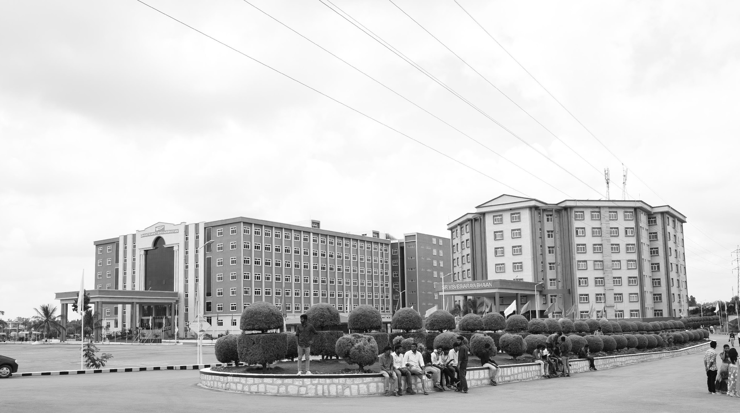

ROS2 LIDAR AUTO-CALIBRATION AND SLAM
Review-I
AY 2025-26
Capstone Project – Introduction (PROJ2999)
GITAM (Deemed-to-be) University
Department of Electrical Electronics and Communication Engineering
Project Team:
Jamiu A.O BU22EECE0100484
Project Mentor:
Dr. Prithvi P. S.
Project In-charge:
Dr. Subashish Tiwari
www.gitam.edu

Slide 2
Objective and Goals
Objective
The primary objective of this research is to develop a target-based calibration framework, for extrinsic Sensor-to-Vehicle (S2V) calibration of a LiDAR or multi-LiDAR systems with arbitrary, potentially non-overlapping fields of view, with the help of other external sensing devices or feature-rich environments.
Goals
Main Goals
Test the state of art/function of each required sensors, and record the cloud point data of the test environment (Completed).
Preprocess the acquired data(cloud point) and validate the visibility solid field-of-view of the target(Completed).
Analysis and comparison between the cloud points(LiDAR, Camera, etc) (Completed).
Alignment of the cloud point data, generation of the Extrinsic Calibration Matrix and evaluation of the error metrics, using the ICP algorithm.
Additional Goals
Applying the achieved data and configuration files to maneuver the vehicle Localization and Navigation.
Calibration with other sensors(IMU and RADAR).
Fine-tune Calibration data, base on different sensor’s placement scenarios and vehicle orientation.

Slide 3
Project Plan (Clearly mention milestone for objectives under each reviews)
Gant Chart - Milestones and Activities

Slide 4
Literature Survey
Key Publications
Google scholar research best 6-8 papers
Key Resources – Whitepaper| Application Notes | Datasheet| Others
XX
XX
XX
Existing Implementations – Products| Opensource| GitHub etc
XX
XX
XX

Slide 5
Architecture
Structural Diagram

Slide 6
Use Cases & Testing
Use Cases
Xx
Xx
X
X
Test Cases
XX
XX
XX

Slide 7
Implementation and Results – Iteration 1
Iteration 1 : Results

Slide 8
Implementation and Results – Iteration 2
Iteration : Results + Validation against the use cases and test cases

Slide 9
Implementation and Results – Iteration 3 (Optional)
Iteration : Results + Validation against the use cases and test cases

Slide 10
Conclusion & Future Work
Summary and Conclusion
The proposed system using ICP algorithm with RANSAC algorithm for proper preprocessing and alignment of the cloudpoint, which gives the extrinsic calibration parameters of the LiDAR to the vehicle, bringing the vehicle perception credibility in a good state with a reduced/optimal metrics, improving its localization and navigation.
LiDAR calibration is essential for ensuring accurate spatial perception and sensor fusion in autonomous vehicles, particularly when integrated with modalities like mmWave radar or other sensors. Precise calibration minimizes misalignment, reduces environmental noise, and enhances object detection reliability across dynamic conditions.
Future Work
Pair-pair calibration, ike LiDAR to LiDAR,etc, of each model to enable mutual metrics validation and distinct homogeneous calibration

Slide 11
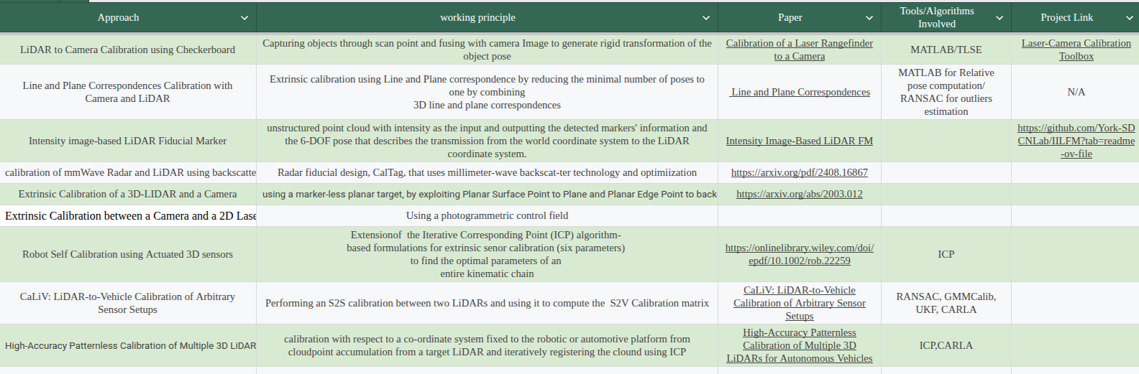
References
Xu, J., Bansal, K., & Bharadia, D. (2024). CalTag: Robust calibration of mmWave Radar and LiDAR using backscatter tags. ArXiv. https://arxiv.org/abs/2408.16867
Peters, A. & Knoll, A. C. (2024) Robot self-calibration using actuated 3D sensors. Journal of Field Robotics, 41, 327–346. https://doi.org/10.1002/rob.22259

Slide 12
THANK YOU
Have a Great Day !

