Slide 1
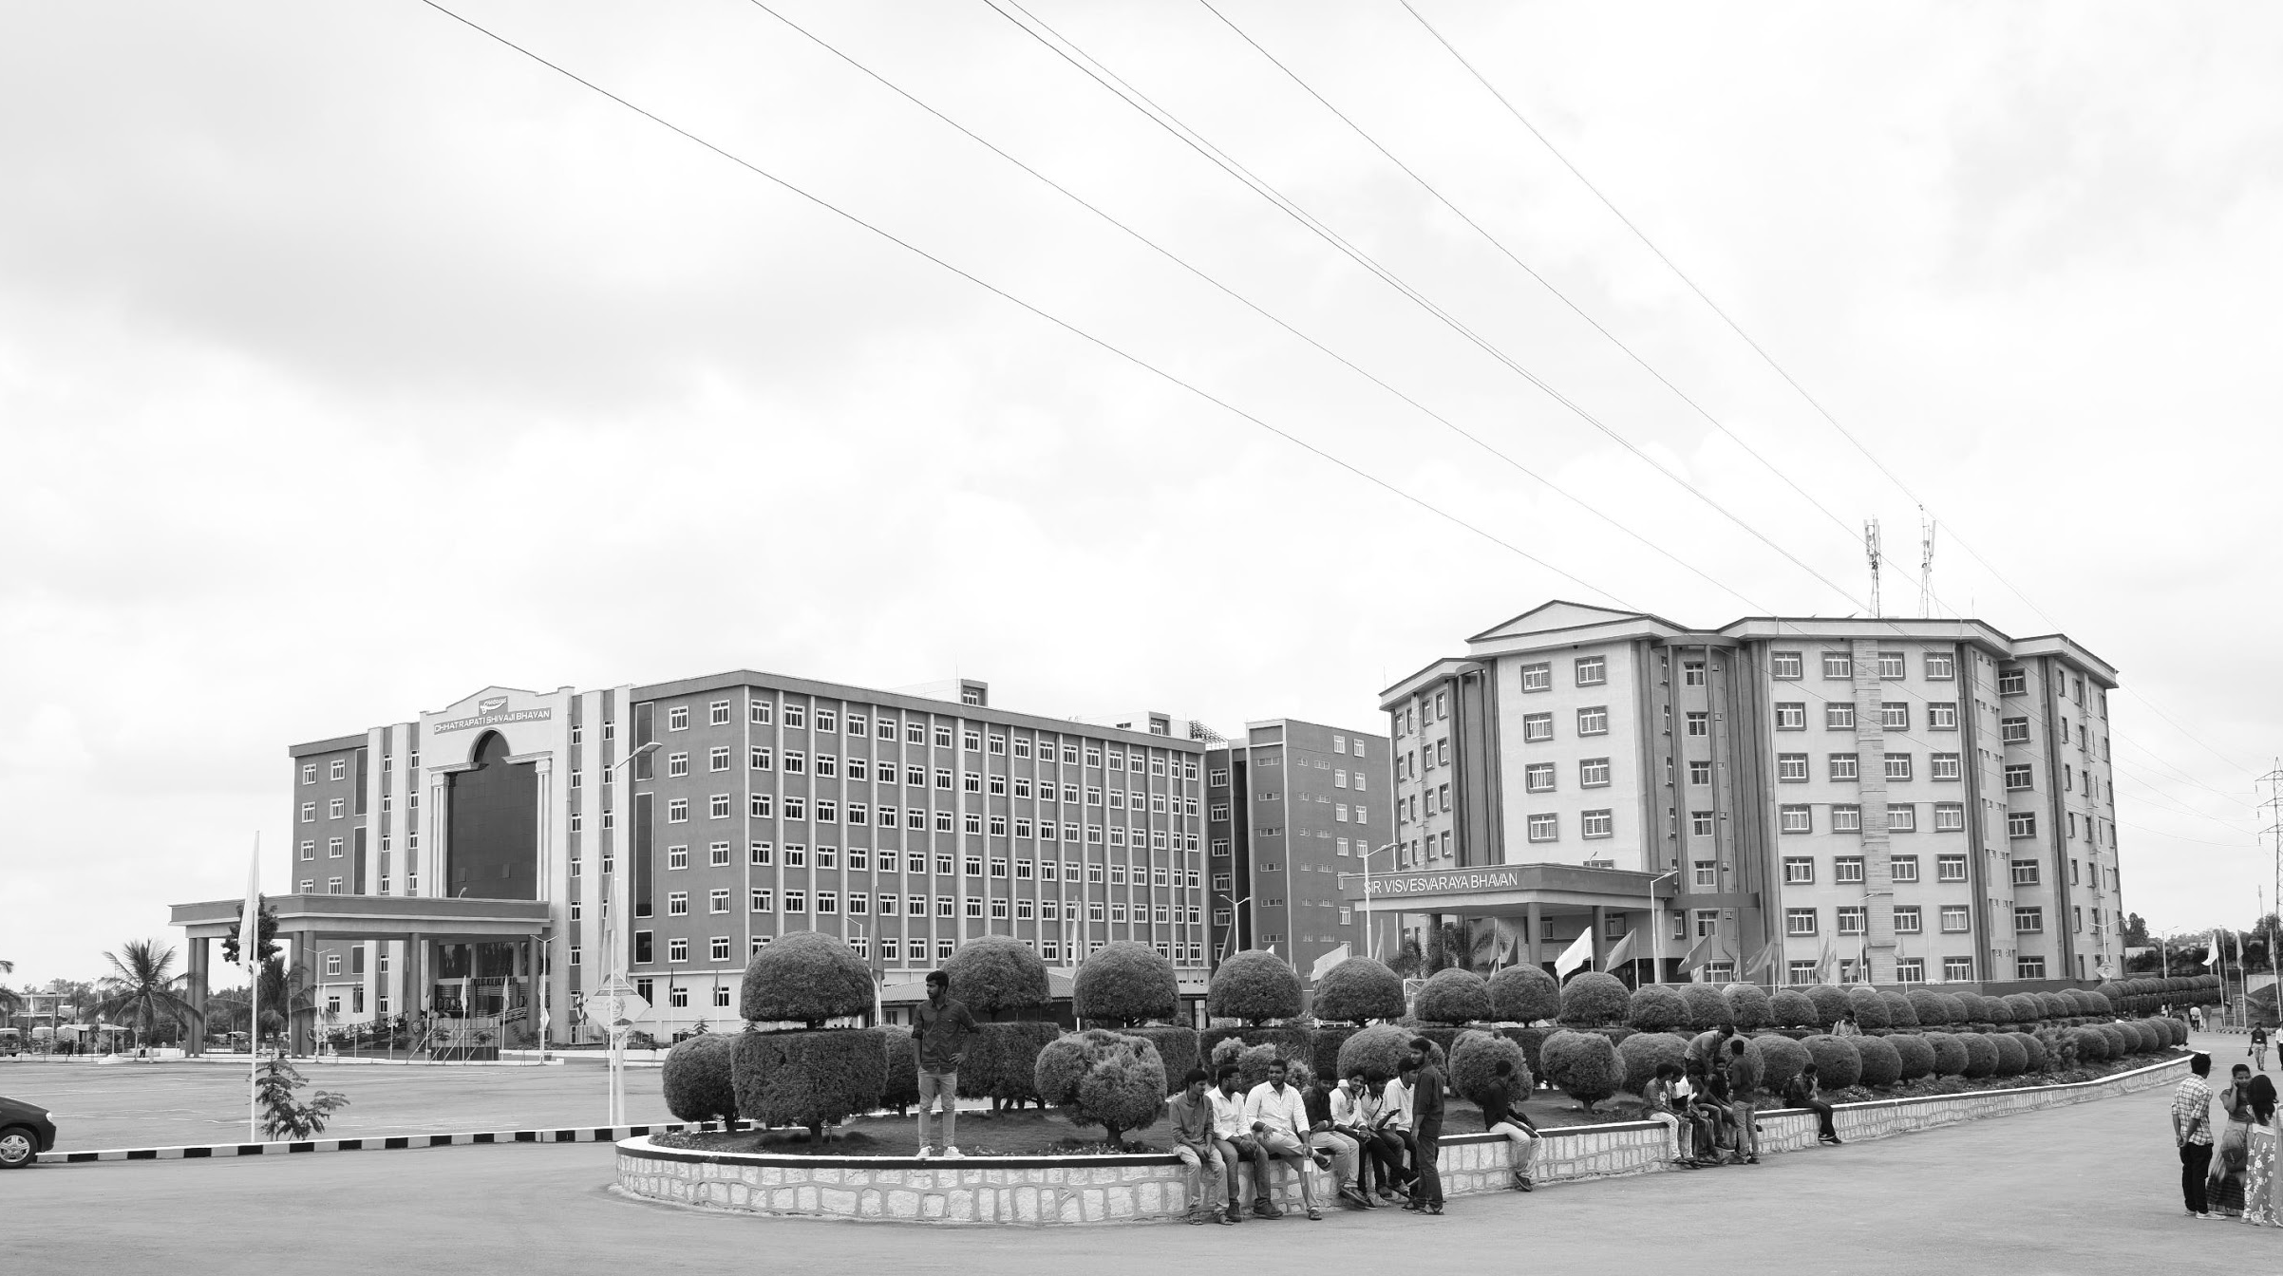

ROS2 LIDAR AUTO-CALIBRATION AND SLAM
Review-I
AY 2025-26
Capstone Project – Introduction (PROJ2999)
GITAM (Deemed-to-be) University
Department of Electrical Electronics and Communication Engineering
Project Team:
Jamiu A.O BU22EECE0100484
Project Mentor:
Dr. Prithvi P. S.
Project In-charge:
Dr. Subashish Tiwari
www.gitam.edu

Slide 2
Objective and Goals
Objective
The primary objective of this research is to develop a target-based calibration framework, for extrinsic Sensor-to-Vehicle (S2V) calibration of a LiDAR or multi-LiDAR systems with arbitrary, potentially non-overlapping fields of view, with the help of other external sensing devices or feature-rich environments.
Goals
Main Goals
Test the state of art/function of each required sensors, and record the cloud point data of the test environment (Completed).
Preprocess the acquired data(cloud point) and validate the visibility solid field-of-view of the target(Completed).
Analysis and comparison between the cloud points(LiDAR, Camera, etc) (Completed).
Alignment of the cloud point data, generation of the Extrinsic Calibration Matrix and evaluation of the error metrics, using the ICP algorithm.
Additional Goals
Applying the achieved data and configuration files to maneuver the vehicle Localization and Navigation.
Calibration with other sensors(IMU and RADAR).
Fine-tune Calibration data, base on different sensor’s placement scenarios and vehicle orientation.

Slide 3
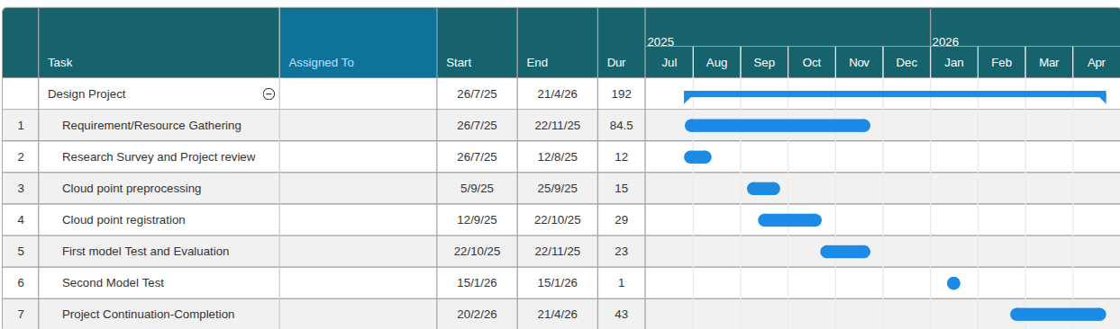
Project Plan (Clearly mention milestone for objectives under each reviews)
Gantt Chart - Milestones and Activities

Slide 4
Literature Survey
Key Publications
1. CalTag: Robust calibration of mmWave Radar and LiDAR using backscatter tags
Xu et al. (2024) propose CalTag, a mmWave backscatter system that modulates return-signal frequency to eliminate background clutter and resolve corner reflector inconsistencies.
This approach enables radar to precisely detect its location and isolate single objects in cluttered environments, reducing reliance on manual alignment and correcting sensor rotation errors.
The observation proved that CalTag is more robust than corner reflectors in terms of high calibration accuracy in high clustered environment with high consistent calibration performance across different degrees of sensor rotation.
2. Robot self‐calibration using actuated 3D sensors
Peters et al. (2024) highlight that current calibration methods, though automated, still depend on specialized equipment and manually placed objects like markers and checkerboards., etc.
They also stated the wrong treatment of calibration as a once-in-a-lifetime action. As system parameters change over usage time due to inevitable environmental factors.
They proposed a framework providing complete on-site self-calibration for a robot through an eye-in-hand 3D sensor, in any unknown, static environment.
The approach allows any kinematic chain calibration and depth sensor combination, by using point cloud registration techniques for multiple scans fusion with extensive ICP(iterative corresponding point)algorithm.

Slide 5
Literature Survey
Key Publications
1. CaLiV: LiDAR-to-Vehicle Calibration of Arbitrary Sensor Setups
Tahiraj et al. (2025) identified the challenges in calibrating arbitrary sensors used in robotic systems, particularly those lacking standardized interfaces or consistent data formats. These inconsistencies hinder accurate sensor fusion and system integration, affecting performance and reliability.
They provide a modular calibration framework to streamline sensor setup and alignment across diverse platforms. The approach includes automated data acquisition, transformation modeling, and error minimization techniques to ensure precise calibration regardless of sensor type.
4 Extrinsic Calibration between a Camera and a 2D LiDAR using a Photogrammetric Control Field
Huang et al. (2019)integration of cameras and 2D laser rangefinders (LRFs) in robotics and mapping often suffers from data misregistration due to imprecise sensor alignment. Existing calibration methods, require multiple shots, leading to instability, noise sensitivity, and potential convergence to local minima or multiple solutions.
The authors propose using a photogrammetric control field as a common reference to decouple calibration, requiring only one shot. The LRF is calibrated via a simplified perspective-three-point (P3P) problem using the room corner for robust intersection points, while the camera uses direct linear transformation (DLT) with numerous control points for accuracy.

Slide 6
Literature Survey
Existing Implementations – Products| Opensource| GitHub etc
LiDAR to Camera Calibration using Checkerboard
Ranjit Unnikrishnan
Laser-Camera Calibration Toolbox (LCCT), a Matlab® -based graphical user interface to an easy and portable technique for external calibration of a camera to a laser rangefinder.
https://www.cs.cmu.edu/~ranjith/lcct.html
Intensity image-based LiDAR Fiducial Marker
Liu et al. 2022
Using unstructured point cloud with intensity as the input and outputting the detected markers' information and the 6-DOF pose that describes the transmission from the world coordinate system to the LiDAR coordinate system.
https://github.com/York-SDCNLab/IILFM?tab=readme-ov-file

Slide 7
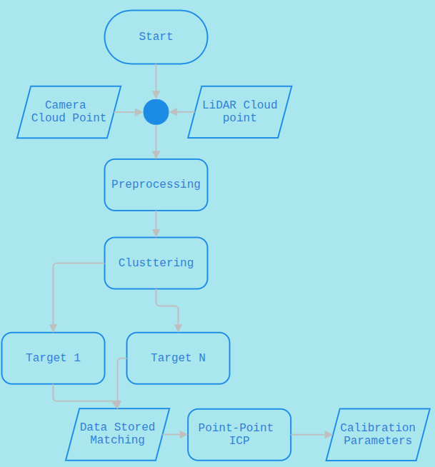
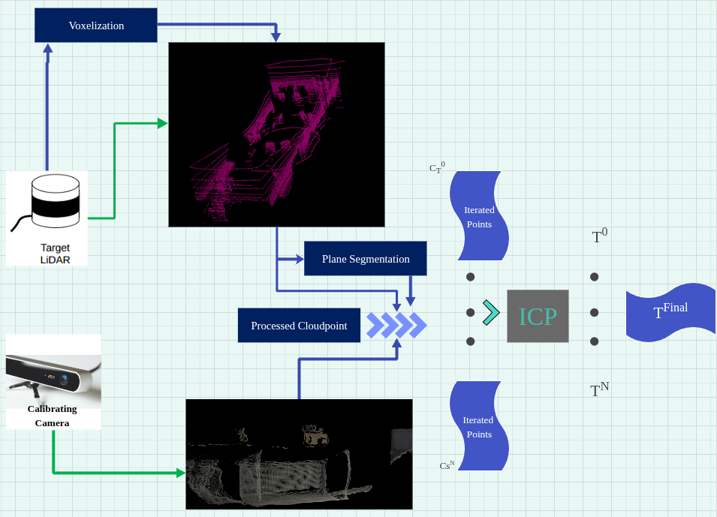
Architecture
Structural Diagram
FlowChart

Slide 8
Use Cases & Testing
Use Cases
Autonomous Vehicles
Calibrating multiple roof-mounted LiDARs to achieve 360° perception.
Reducing blind spots by fusing data from differently oriented sensors.
Robotics & Drones
Multi-LiDAR calibration for mobile robots operating in warehouses, mines, or construction sites.
UAVs with forward and downward LiDARs needing consistent mapping.
Transportation & Logistics
Automated shuttles or delivery robots requiring consistent calibration without manual patterns.
Infrastructure Monitoring
Road-mapping vehicles with multiple LiDARs for lane, curb, and building reconstruction.
Research & Development
Providing an open-source tool (via ROS) for robotics and AV researchers to quickly calibrate sensors.
Sensor Fusion Systems
Feeding downstream algorithms (object detection, SLAM, semantic mapping) with well-aligned LiDAR data.
Test Cases
Simulation-based accuracy tests
Vary LiDAR configurations (aligned, tilted, etc).
Introduce different initial guess errors (translation and rotation)
Convergence behavior
Measure how many iterations are needed for stable calibration.
Test with and without decay factor (γ) in ICP maximum correspondence distance.
Localization robustness
Use perfect ground-truth localization vs noisy odometry
Check calibration error sensitivity to noise levels.
Different LiDAR specs
Use sensors with different resolutions (16-layer vs 32-layer vs 64-layer).
Validate whether the method still converges.
Real-world experiments
Mount LiDARs on autonomous vehicles and minibuses.
Validate alignment qualitatively by overlaying point clouds.
Comparison with baselines
Benchmark against state-of-the-art methods (e.g., MLCC).
Compare translation and rotation errors quantitatively.

Slide 9
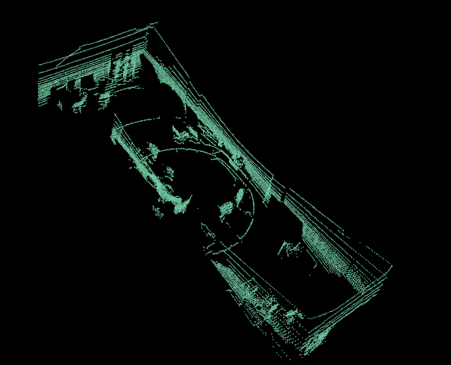
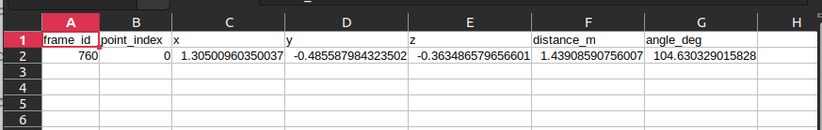
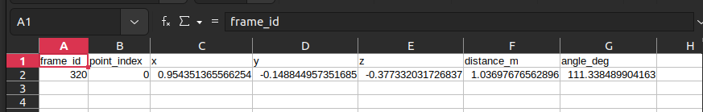
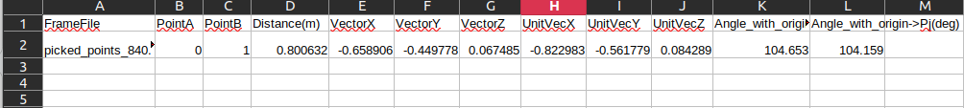

Implementation and Results – Iteration 1

Slide 10
Implementation and Results – Iteration 2
Iteration 2 : Results

Slide 11
Implementation and Results – Iteration 3 (Optional)
Iteration3 : Results + Validation against the use cases and test cases

Slide 12
Conclusion & Future Work
Summary and Conclusion
The proposed system using ICP algorithm with RANSAC algorithm for proper preprocessing and alignment of the cloudpoint, which gives the extrinsic calibration parameters of the LiDAR to the vehicle, bringing the vehicle perception credibility in a good state with a reduced/optimal metrics, improving its localization and navigation.
LiDAR calibration is essential for ensuring accurate spatial perception and sensor fusion in autonomous vehicles, particularly when integrated with modalities like mmWave radar or other sensors. Precise calibration minimizes misalignment, reduces environmental noise, and enhances object detection reliability across dynamic conditions.
Future Work
Pair-pair calibration, ike LiDAR to LiDAR,etc, of each model to enable mutual metrics validation and distinct homogeneous calibration

Slide 13
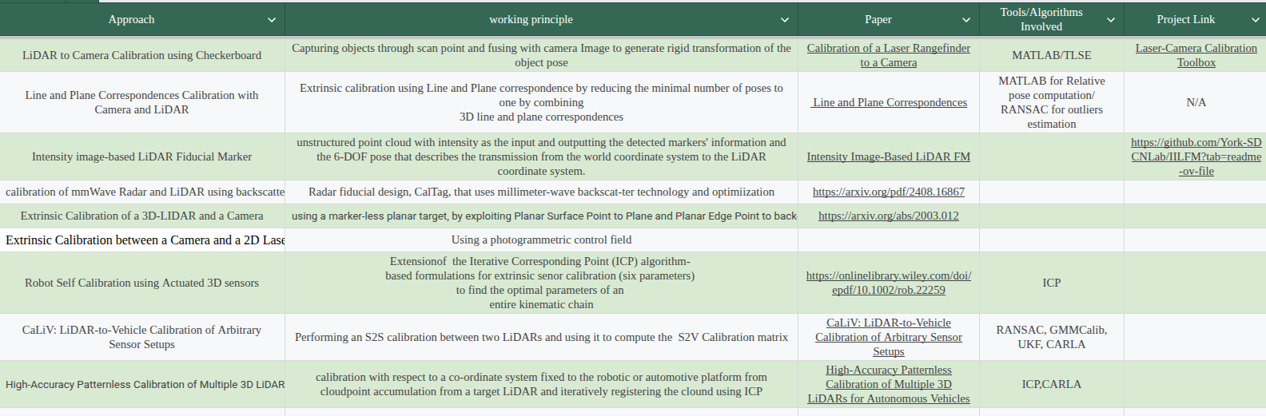
References
Xu, J., Bansal, K., & Bharadia, D. (2024). CalTag: Robust calibration of mmWave Radar and LiDAR using backscatter tags. ArXiv. https://arxiv.org/abs/2408.16867
Peters, A. & Knoll, A. C. (2024) Robot self-calibration using actuated 3D sensors. Journal of Field Robotics, 41, 327–346. https://doi.org/10.1002/rob.22259

Slide 14
THANK YOU
Have a Great Day !

