Slide 1
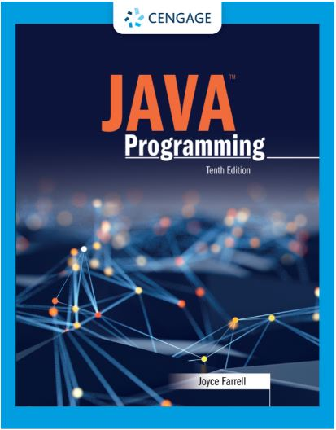
Java Programming, 10e
Chapter 09: Inheritance and Interfaces
Joyce Farrell, Java Programming, 10th Edition. © 2023 Cengage. All Rights Reserved. May not be scanned, copied or duplicated, or posted to a publicly accessible website, in whole or in part.

Slide 2
Chapter Objectives (1 of 2)
By the end of this chapter, you should be able to:
09.01 Describe the concept of inheritance
09.02 Extend classes
09.03 Override superclass methods
09.04 Call constructors during inheritance
09.05 Access superclass methods
09.06 Employ information hiding
09.07 Describe which methods you cannot override
Notes:
Instructions:
Briefly review with students the major concepts you will be covering during this class. There is one objective for every major A-Head section of the chapter.

Slide 3
Chapter Objectives (2 of 2)
By the end of this chapter, you should be able to:
09.08 Create and use abstract classes
09.09 Use dynamic method binding
09.10 Create arrays of subclass objects
09.11 Use the Object class and its methods
09.12 Create and use interfaces
09.13 Use records, anonymous inner classes, and lambda expressions
Notes:
Instructions:
Briefly review with students the major concepts you will be covering during this class. There is one objective for every major A-Head section of the chapter.

Slide 4
9.1 Learning About the Concept of Inheritance (1 of 4)
Inheritance
The classes you create in object-oriented programming languages can inherit data and methods from existing classes
A mechanism that enables one class to acquire all of the behaviors and attributes of another class
You can create a new class simply by indicating the ways in which it differs from an existing, tested class
The new class automatically contains the data fields and methods from the original class

Slide 5
9.1 Learning About the Concept of Inheritance (2 of 4)
Benefits of inheritance
Saves time because fields and methods already exist
Reduce errors because methods have been used and tested
Reduce new learning needed for programmers to use the class if they are familiar with the original

Slide 6
9.1 Learning About the Concept of Inheritance (3 of 4)
Base class
Class used as basis for inheritance
Superclass
Parent class
Derived class
Class that inherits from a base class
Subclass
Child class

Slide 7
9.1 Learning About the Concept of Inheritance (4 of 4)
“Is a” describes inheritance
Containment
“has a” situation
A class contains one or more members of another class

Slide 8
9.2 Extending Classes (1 of 1)
extends keyword
Used to achieve inheritance in Java
public class EmployeeWithTerritory extends Employee
In addition
A child inherits from a parent
A parent class object does not have access to its child’s data and methods
Subclasses are more specific than the superclass they extend
instanceof yields true if the operand on the left can be upcast to the operand on the right

Slide 9
9.3 Overriding Superclass Methods (1 of 2)
Override
To use the child’s version of a field or method instead of parent’s
Each subclass method overrides any method in the parent class with the same name and parameter list
If the parent class method has the same name but different parameters, the subclass overloads the parent class
Polymorphism
Using the same method name to indicate different implementations

Slide 10
9.3 Overriding Superclass Methods (2 of 2)
Using the @Override annotation
Lets the compiler know the intention to override a method in parent class
Instead of creating a method with a new signature
Compiler issues an error message if you do not use the @Override tag

Slide 11
9.4 Calling Constructors During Inheritance (1 of 3)
Calling a constructor
When you create an object you are calling a constructor
When you create a child object, both the parent and child constructors execute
You usually want the superclass constructor to initialize the data fields that originate in the superclass.
The subclass constructor usually needs to initialize only its specific data fields

Slide 12
9.4 Calling Constructors During Inheritance (2 of 3)
Using superclass constructors that require arguments
Default constructor doesn’t need arguments
When you write your own constructor it replaces default
If a superclass has only constructors that require arguments, subclasses must provide the superclass constructor with arguments
When a superclass requires constructor arguments, you must write a subclass constructor so it can call on a superclass constructor
The keyword super always refers to the superclass of the class in which you use it

Slide 13
9.4 Calling Constructors During Inheritance (3 of 3)
Conditions under which a subclass constructor is required
Not required: If a superclass contains no constructors written by the programmer
Not required: If a superclass contains a default constructor written by the programmer
Required: If a superclass contains only nondefault constructors
Subclasses must contain a constructor that calls the superclass constructor

Slide 14
9.5 Accessing Superclass Methods (1 of 3)
Calling a superclass constructor
When you call a superclass constructor from a subclass constructor the call must be the first statement in the constructor
When you call an ordinary superclass method withing a subclass method, the call is not required to be the first statement

Slide 15
9.5 Accessing Superclass Methods (2 of 3)
Comparing this and super
sometimes refer to the same method, but not always
If a subclass has overridden a superclass method someMethod(), then within the subclass
super.someMethod() refers to the superclass method
someMethod() refers to the subclass version
this.someMethod() refers to the subclass version
If a subclass has not overridden a superclass method, the child can use the method name:
With super
With this
Alone

Slide 16
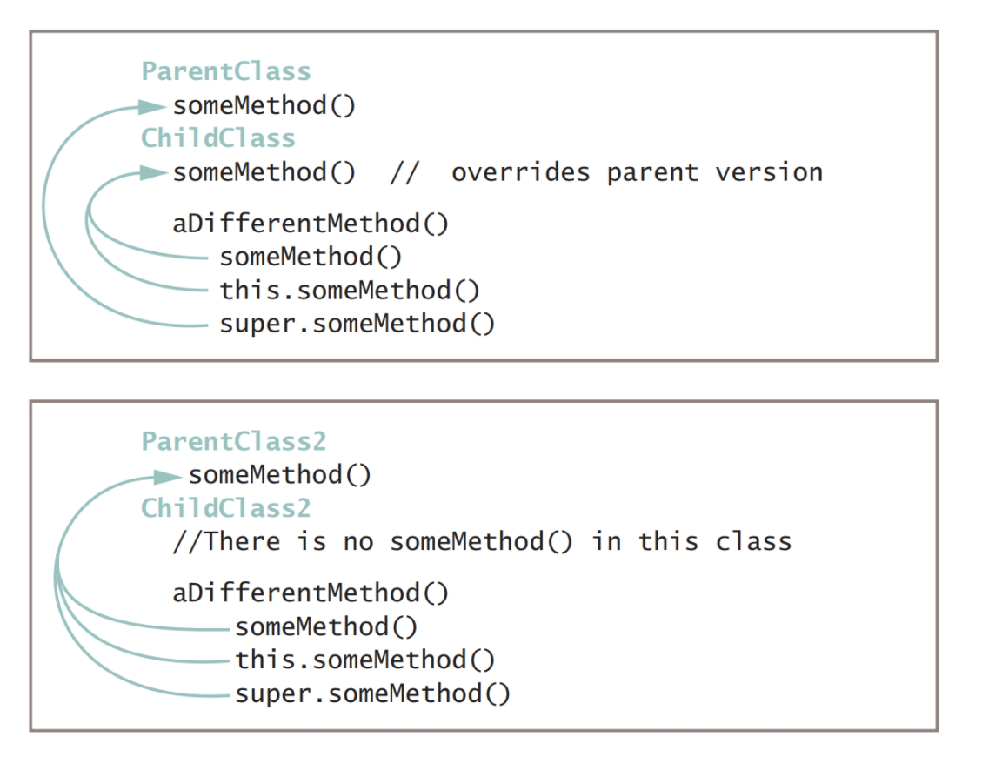
Accessing Superclass Methods (3 of 3)

Slide 17
9.6 Employing Information Hiding (1 of 2)
Information hiding
The concept of keeping data private
Data only can be altered by methods and in ways you choose/control
private members of a parent class are not accessible within a child class’s methods
Protected access
Between public and private
Can only be used by a class and its descendants

Slide 18
9.6 Employing Information Hiding (2 of 2)
You only need to make parent class fields protected if:
You want child classes to access parent data directly
You want to prohibit other classes from accessing the fields
Whenever possible use information hiding rather than protected
Fragile classes
Classes that use field from parent classes
Prone to errors

Slide 19
9.7 Methods You Cannot Override (1 of 5)
Three types of methods you cannot override in a subclass
static methods
final methods
Methods within the final classes

Slide 20
9.7 Methods You Cannot Override (2 of 5)
static methods
A subclass cannot override static methods in its superclass
It can hide a static method in the superclass
Declaring a static method in the subclass
Same signature as static method in superclass
The static method that hides the superclass static method cannot access the parent method using the super object
You cannot override a static method with a nonstatic method

Slide 21
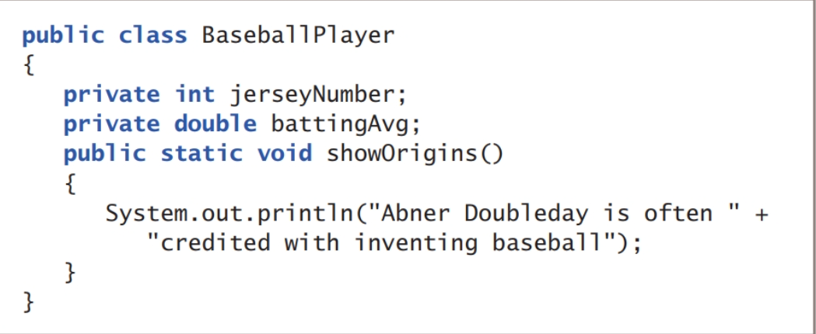
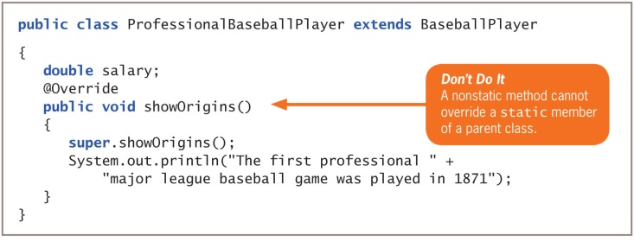
Methods You Cannot Override

Slide 22
9.7 Methods You Cannot Override (3 of 5)
final methods
A subclass cannot override methods that are declared final in the superclass
Use the final modifier with methods you don’t want to be overridden
Virtual method calls
All instance method calls are virtual by default
Version of the method used is not determined when the program is compiled
It is determined when the method call is made

Slide 23
9.7 Methods You Cannot Override (4 of 5)
Inlining
Compiler optimizes a program’s performance by removing calls to final methods
Replaces them with the expanded code of their definitions at each method call location
You are never aware when inlining takes place
Compiler only inlines a final method if it contains only one or two lines of code

Slide 24
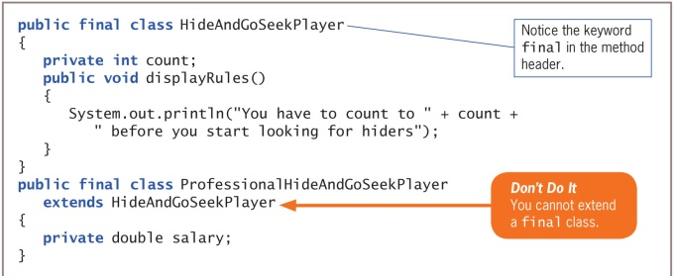
9.7 Methods You Cannot Override (5 of 5)
final superclass
A subclass cannot override methods in a final superclass
A final class cannot be a parent
You cannot extend a final class

Slide 25
9.8 Creating and Using Abstract Classes (1 of 2)
Concrete class
One from which you can instantiate objects
Abstract class
A class you create only to extend from
Keyword abstract
Known in other languages as a virtual class

Slide 26
9.8 Creating and Using Abstract Classes (2 of 2)
Types of methods within an abstract class
Nonabstract: implemented in the abstract class and inherited by its children
Abstract: has no body and must be implemented in its child classes
Abstract declarations
If you declare a class to be abstract, its methods can be abstract or not
If you declare a method to be abstract, you must declare its class abstract
Polymorphism
Using the same method name to indicate different implementations

Slide 27
9.9 Using Dynamic Method Binding (1 of 1)
Dynamic method binding
When a superclass is abstract, you can indirectly create a reference to a superclass abstract object
An application’s ability to select the correct subclass method depending on argument type
Also called late method binding
The opposite of static or fixed method binding
Most useful when you want to create a method with one or more parameters that might be of several types

Slide 28
9.10 Creating Arrays of Subclass Objects (1 of 1)
Arrays of subclass objects
Every array element must be the same data type
An array is a space for references to objects
When you create an array of superclass references it can hold subclass references
True whether the superclass is abstract or concrete

Slide 29
9.11 Using the Object Class and Its Methods (1 of 4)
Object class
Defined in the java.lang package
When you define a class, if you do not explicitly extend another class, the class is an extension of the Object class
Includes methods that descendant classes can use, overload, or override

Slide 30
9.11 Using the Object Class and Its Methods (2 of 4)
Using the toString() method
Converts an Object into a String that contains information about the Object
A hash code is a calculated number used to uniquely identify an object
If two objects have the same Java identifier, they will each have a unique hash code
It is usually more useful to write your own overloaded toString() version than use the automatic method with your classes
toString() compiles with any object whose details you want to see

Slide 31
9.11 Using the Object Class and Its Methods (3 of 4)
Using the equals() method
Not static
Takes a single argument that is compared to the calling object
Returns a Boolean value indicating whether the objects are equal
To create a method that compares two objects based on values they hold:
Create a method and use an identifier such as areTheyEqual()
Overload the Object class equals() method
Override the Object class equals() method

Slide 32
9.11 Using the Object Class and Its Methods (4 of 4)
Overloading equals()
A method overloads another when their parameter lists differ
Overriding equals()
When a subclass method overrides its parent, the signatures must be the same

Slide 33
9.12 Creating and Using Interfaces (1 of 4)
Multiple inheritance
The capability to inherit from one or more class
Inexperienced programmers may encounter problems
Interface
An alternative to multiple inheritance
Looks like a class, but all of its methods (if any) are public and abstract
All of its data items (if any) are public, static, and final
A description of what a class does, but not how it is done
Declares method headers, but not instructions
Keyword implements and the interface name in the class header

Slide 34
9.12 Creating and Using Interfaces (2 of 4)
Compare abstract classes and interfaces
Similar in that you cannot instantiate concrete objects from either one
Differ because abstract classes can contain nonabstract methods, but all methods in an interface must be abstract
A class can inherit from only one abstract superclass, but can implement from any number of interfaces

Slide 35
9.12 Creating and Using Interfaces (3 of 4)
 | Variables | Constructors | Methods
Interface | All variables in an interface must be public, static, and final. | An interface has no constructor and cannot be instantiated. | All methods in an interface must be public, abstract, and nonstatic.
Abstract class | There are no restrictions on variables in an abstract class. | An abstract class’s constructor is invoked when a child class object is instantiated. | There are no restrictions on methods in an abstract class, although an abstract class frequently contains one or more abstract methods.
Table 9-3: Comparing components of abstract classes and interfaces

Slide 36
9.12 Creating and Using Interfaces (4 of 4)
Creating interfaces
When you know what actions you want to include but want every user to separately define the behavior that occurs when the method executes
When you want a class to implement behavior from more than one parent
Data fields must be public, static, and final
Can’t be private because they cannot contain method bodies
Must be static because you cannot create interface objects
Must be final, because there is no other way to set or change data fields’ values

Slide 37
Don’t Do It (1 of 2)
Don’t capitalize the o in the instanceof operator
Don’t try to directly access private superclass members from a subclass
Don’t forget to call a superclass constructor within a subclass constructor if the superclass does not contain a default constructor
Don’t try to override a final method in an extended class
Don’t try to extend a final class
Don’t write a body for an abstract method

Slide 38
Don’t Do It (2 of 2)
Don’t forget to end an abstract method header with a semicolon
Don’t forget to override any abstract methods in any subclasses you derive
Don’t mistakenly overload an abstract method instead of overriding it; the subclass method must have the same parameter list as the parent’s abstract method
Don’t try to instantiate an abstract class object
Don’t forget to override all the methods in an interface that you implement

Slide 39
Self-Assessment (1 of 2)
For what purpose do programmers use inheritance?
Explain what the extends keyword is used for.
Differentiate between overloading and overriding.
Is a subclass constructor required when the superclass contains no constructors written by the programmer?
Compare the keywords this and super. When would you use each?
For what purpose do programmers use information hiding?
List three types of methods you cannot override in a subclass.
Notes:
Instructions:
Use the Self-Assessment question to encourage students to evaluate their progress or goals in the course, as well as determine how they might apply their learning or grow as an individual.

Slide 40
Self-Assessment (2 of 2)
Differentiate between concrete and abstract classes.
In Java, what types of methods use dynamic binding?
Explain the problem with referring to “an array of objects.”
Define the term, hash code, as used in Java.
Explain why data fields in an interface must be public, static, and final.
For what purpose would you use an anonymous inner class?
Notes:
Instructions:
Use the Self-Assessment question to encourage students to evaluate their progress or goals in the course, as well as determine how they might apply their learning or grow as an individual.

Slide 41
Summary
Click the link to review the objectives for this presentation.
Link to Objectives
Notes:
Instructions:
Reiterate the learning objectives for the lesson. Students should use this information to guide their studies and reinforcement of new concepts.

