Slide 1
SMS Signup Service
An accessible student registration tool for
The Exploratory
developed by Team Master Branch

Slide 2
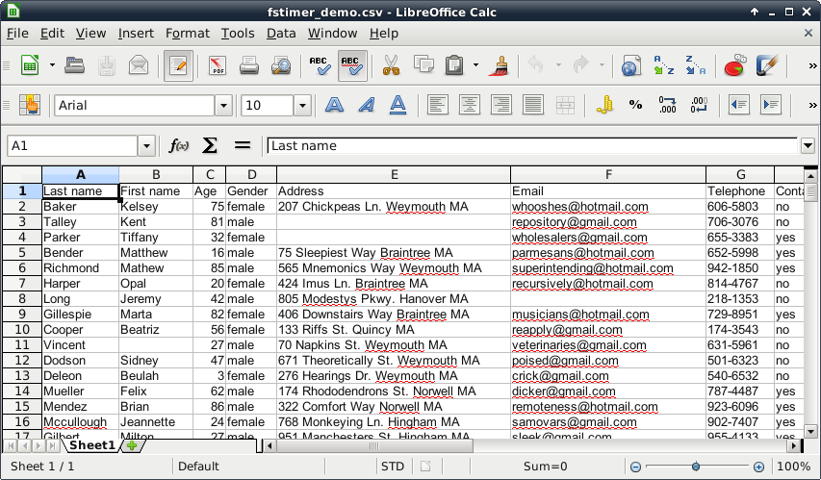
http://fstimer.org/documentation/documentation_figs/fstimer_fig4.png

Slide 3


Slide 4


Slide 5
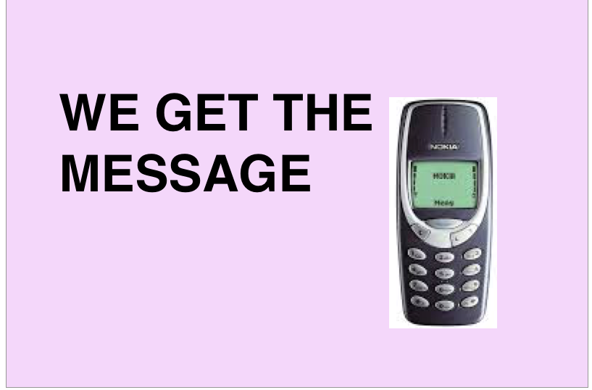

Slide 6
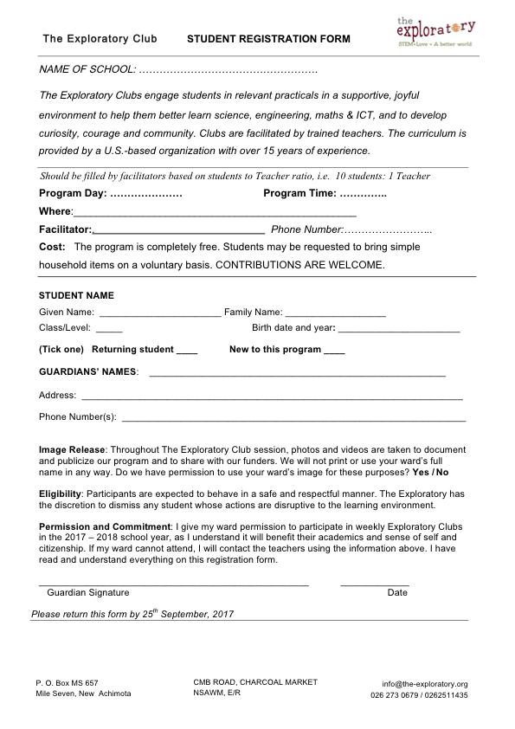

Slide 7
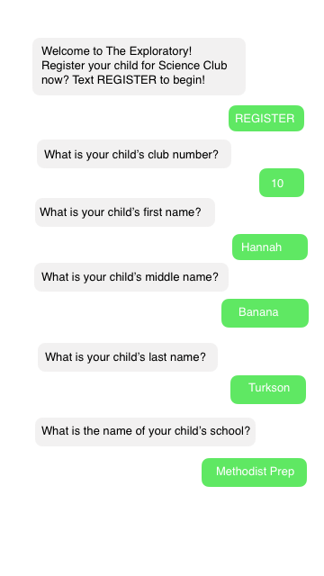

Slide 8
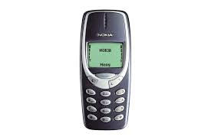
No Smartphone?
No Wifi?
NO PROBLEM!

