Slide 1
MAKERERE UNIVERSITY | BSE4104 EMERGING TRENDS IN SOFTWARE ENGINEERING
University Student-Support
Case Agent
Bounded agentic AI with grounded retrieval, typed tools and human approval
Group A Day | Final release v1.0.0
Namatovu C. M. · Opiyo O. · Isio L. · Babirye S. · Ogwal R.
Week 8
19-23 October 2026

Slide 2
THE ONE-SLIDE STORY
A narrow agent that knows its limits
The problem
Students lose time navigating fragmented support information, and staff repeat answers.
The response
A grounded agent that answers, looks up records and drafts cases — but never writes without consent.
The evidence
49 scenarios, 16 guardrail probes, 13 traces, 8 memory cases and one documented real failure.
Design principle
Deterministic shell,
probabilistic core.
The model proposes one action. The host validates and executes it. Code — not prompt wording — enforces the boundary.
Group A Day | BSE4104 Capstone | Release v1.0.0
Group A Day | BSE4104 Capstone | Release v1.0.0
2
2

Slide 3
PROBLEM AND SCOPE
What the agent may and may not do
May answer
policy and procedure questions, with a citation or an honest abstention
May look up
case status and timetable records through typed, ownership-checked tools
May draft
a support case from the conversation, shown for approval
May create
a Pending case only after an explicit student 'yes'
Must refuse
fee decisions, academic-record changes and emergency actions — with handoff
Twelve user stories; twelve traceability links; a boundary matrix agreed in Week 1.
Group A Day | BSE4104 Capstone | Release v1.0.0
3

Slide 4
ARCHITECTURE
Built in layers, each one kept working
Week 2
single-turn Gemini app with a system prompt
Week 3
controlled retrieval over a twelve-document corpus, with citations
Week 4
two typed tools, a router and the human approval gate
Week 5
bounded plan-act-observe loop with validation and stop conditions
Week 6
minimal memory (active case reference only) and an MCP-style contract
Week 7
49-scenario evaluation, 16 guardrail probes, observability
Week 8
tagged v1.0.0 release, final report, evidence pack and demonstration
Group A Day | BSE4104 Capstone | Release v1.0.0
4

Slide 5
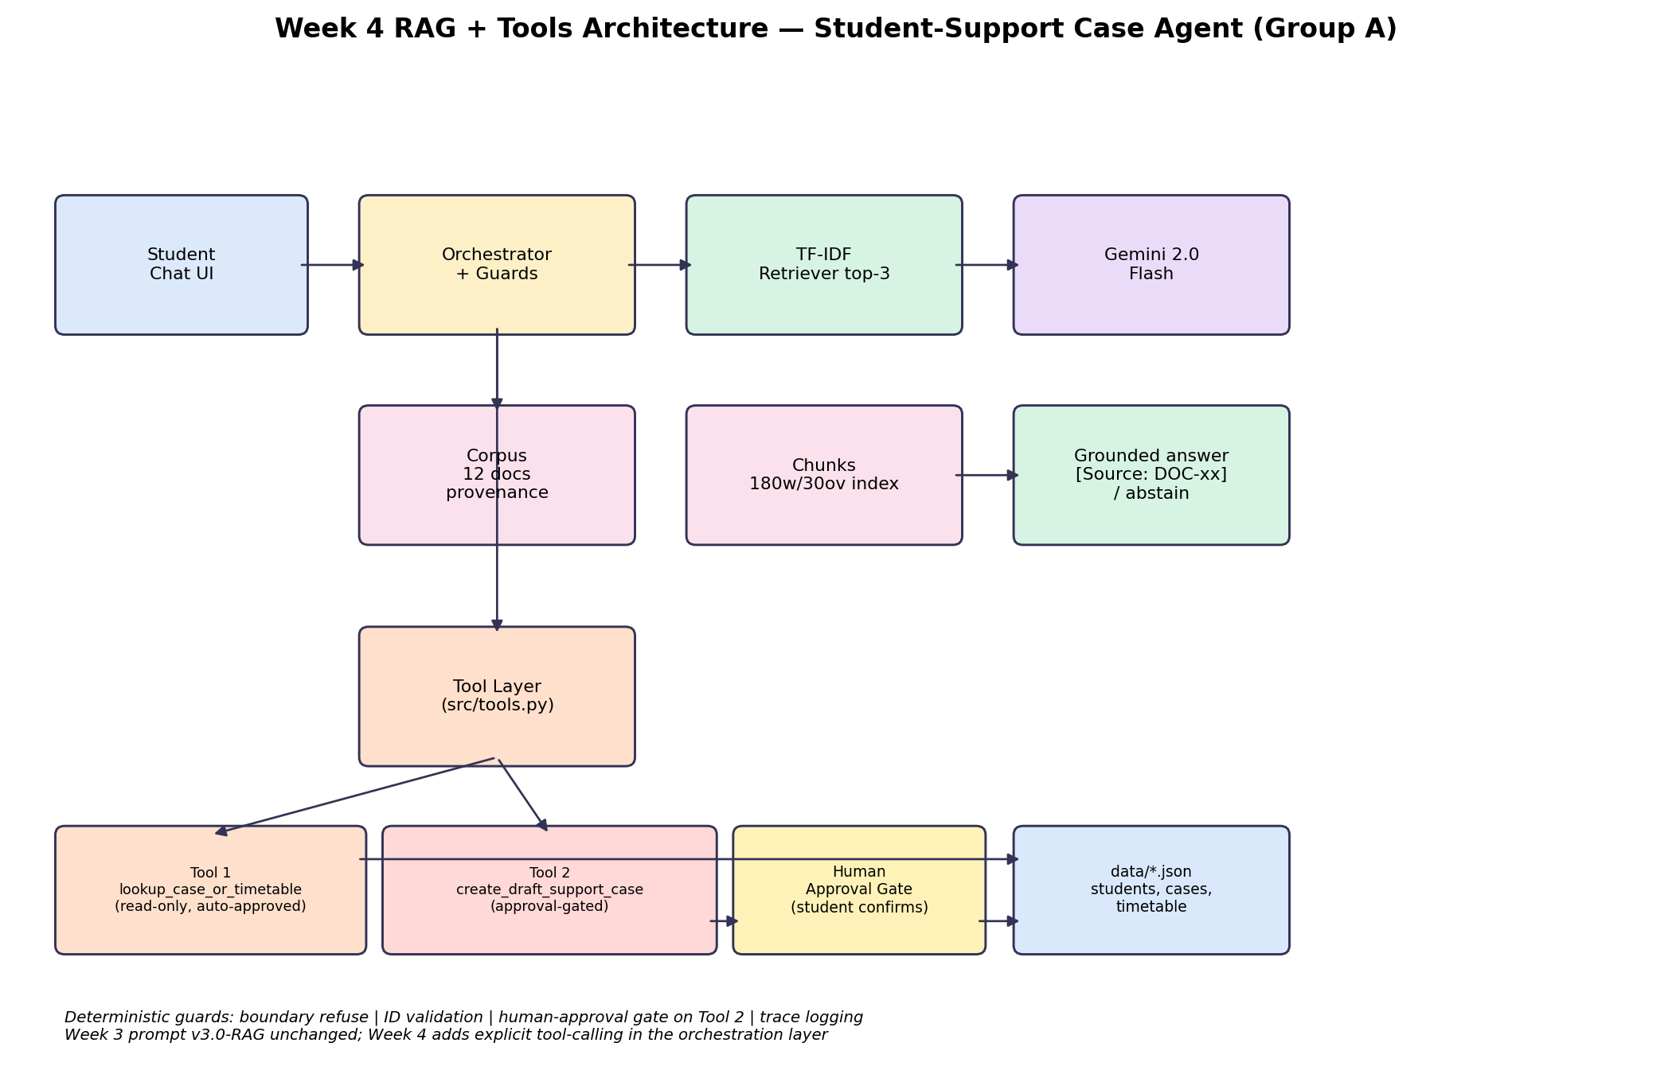
ARCHITECTURE
System overview: interface, retrieval, tools, agent
Figure: Week 4 integration. Later weeks add the bounded loop, memory and evaluation around this core.
Group A Day | BSE4104 Capstone | Release v1.0.0
5

Slide 6
MODEL AND PROMPT ENGINEERING
Gemini 2.0 Flash, versioned prompts
Why Flash
structured JSON, function calling, 1-3 s latency, free tier for evaluation
v1.0
single-turn role and task — baseline
v1.1
citation and abstention rules after unsupported answers
v2.0
mandatory JSON planner schema and allowed actions
v3.0-rag
tool catalogue, argument rules, stop conditions, approval rule
Lesson
prompting shapes behaviour; code enforces it. The approval rule had to move into the validation gate.
Temperature 0.2; output bounded; one JSON action per iteration.
Group A Day | BSE4104 Capstone | Release v1.0.0
6

Slide 7
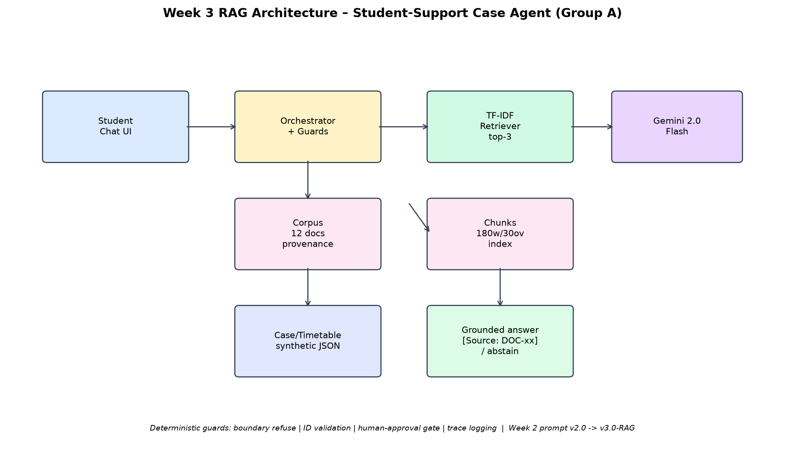
CONTEXT ENGINEERING
Retrieval: grounded, cited, and willing to abstain
12 synthetic documents · 180-word chunks with 30-word overlap · TF-IDF + cosine · top-3 · min score 0.14
Group A Day | BSE4104 Capstone | Release v1.0.0
7

Slide 8
TOOLS
Three narrow tools, one approval gate
Tool | Purpose | Guard
search_handbook | Retrieve and cite policy text | top-k, min score, citation check
lookup_case_or_timetable | Read case status or timetable | ownership, typed arguments
create_draft_support_case | Create a case in Pending state | explicit approval, 500-char cap
Host-injected identity and approval
The model never supplies the student ID or the approval flag. It cannot impersonate a student or forge consent, because those values are added by the host after session validation.
Group A Day | BSE4104 Capstone | Release v1.0.0
Group A Day | BSE4104 Capstone | Release v1.0.0
8
8

Slide 9
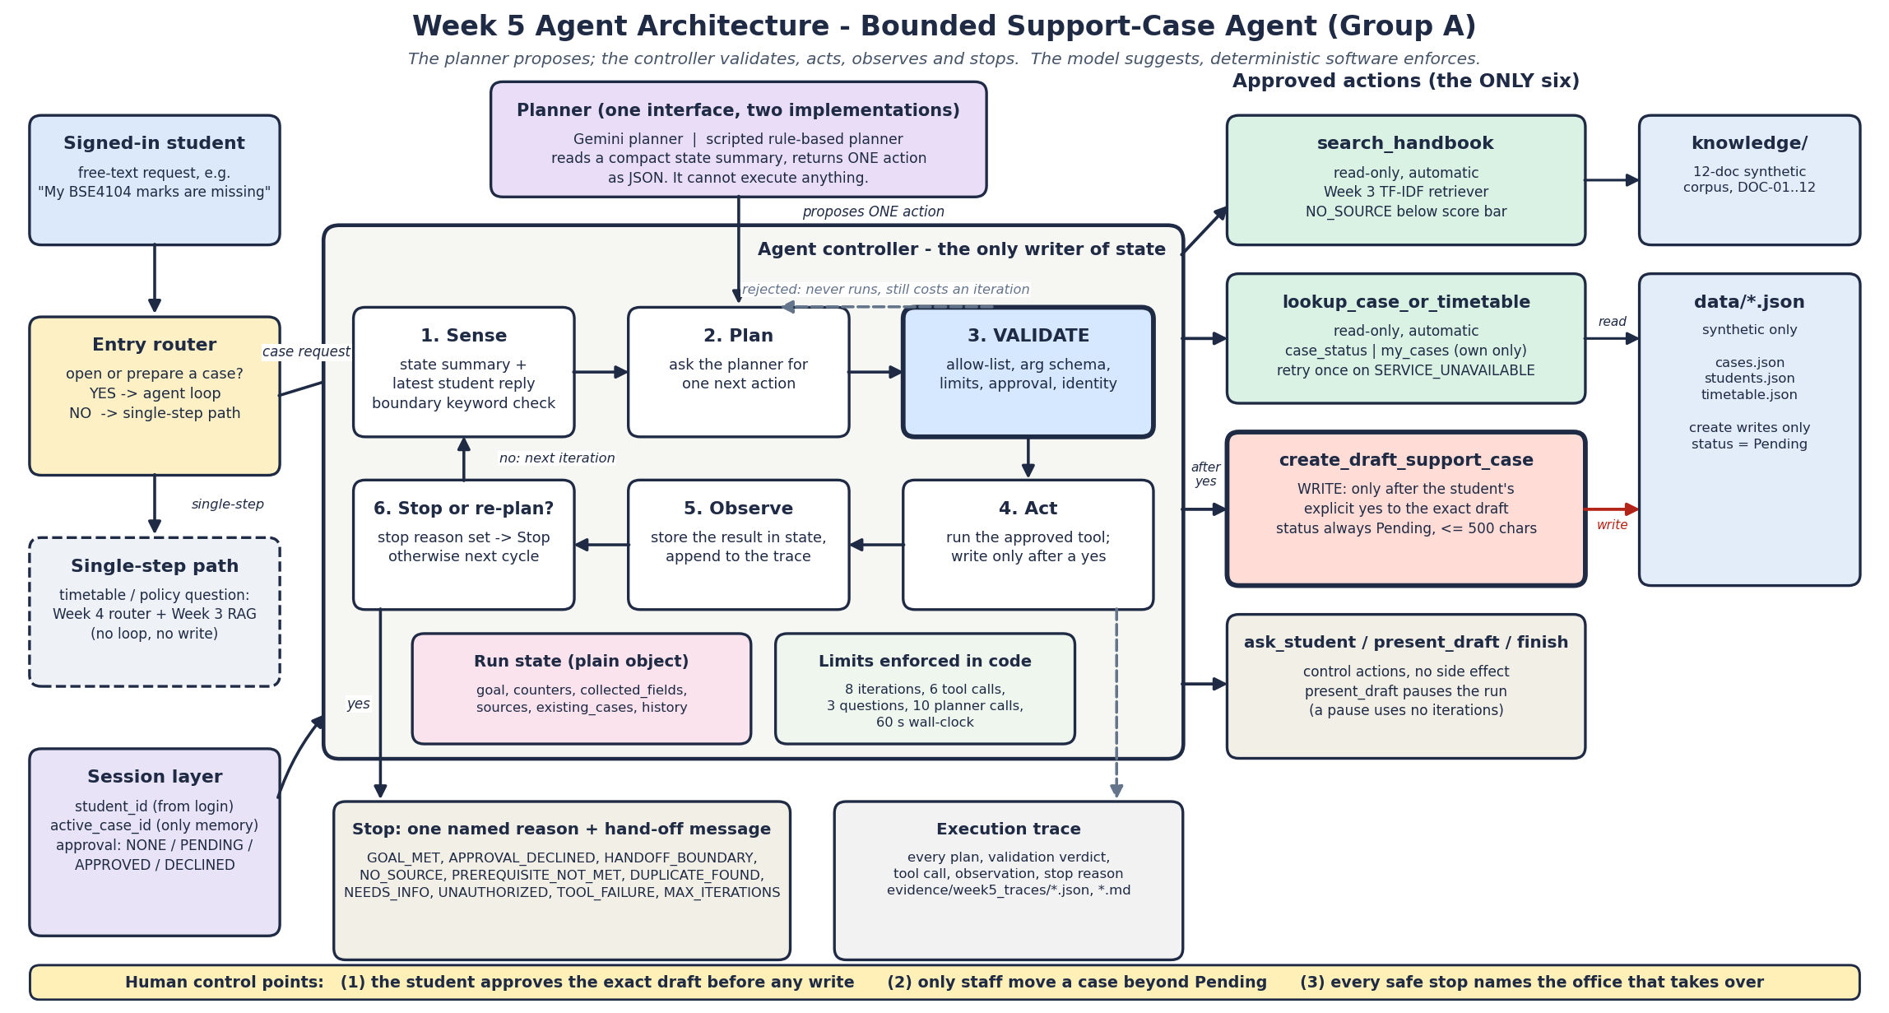
AGENTIC WORKFLOW
Bounded loop: propose, validate, execute, observe
8 iterations · 6 tool calls · 3 questions · 2 repeats · 10 model calls · 60 s — every limit enforced in code
Group A Day | BSE4104 Capstone | Release v1.0.0
9

Slide 10
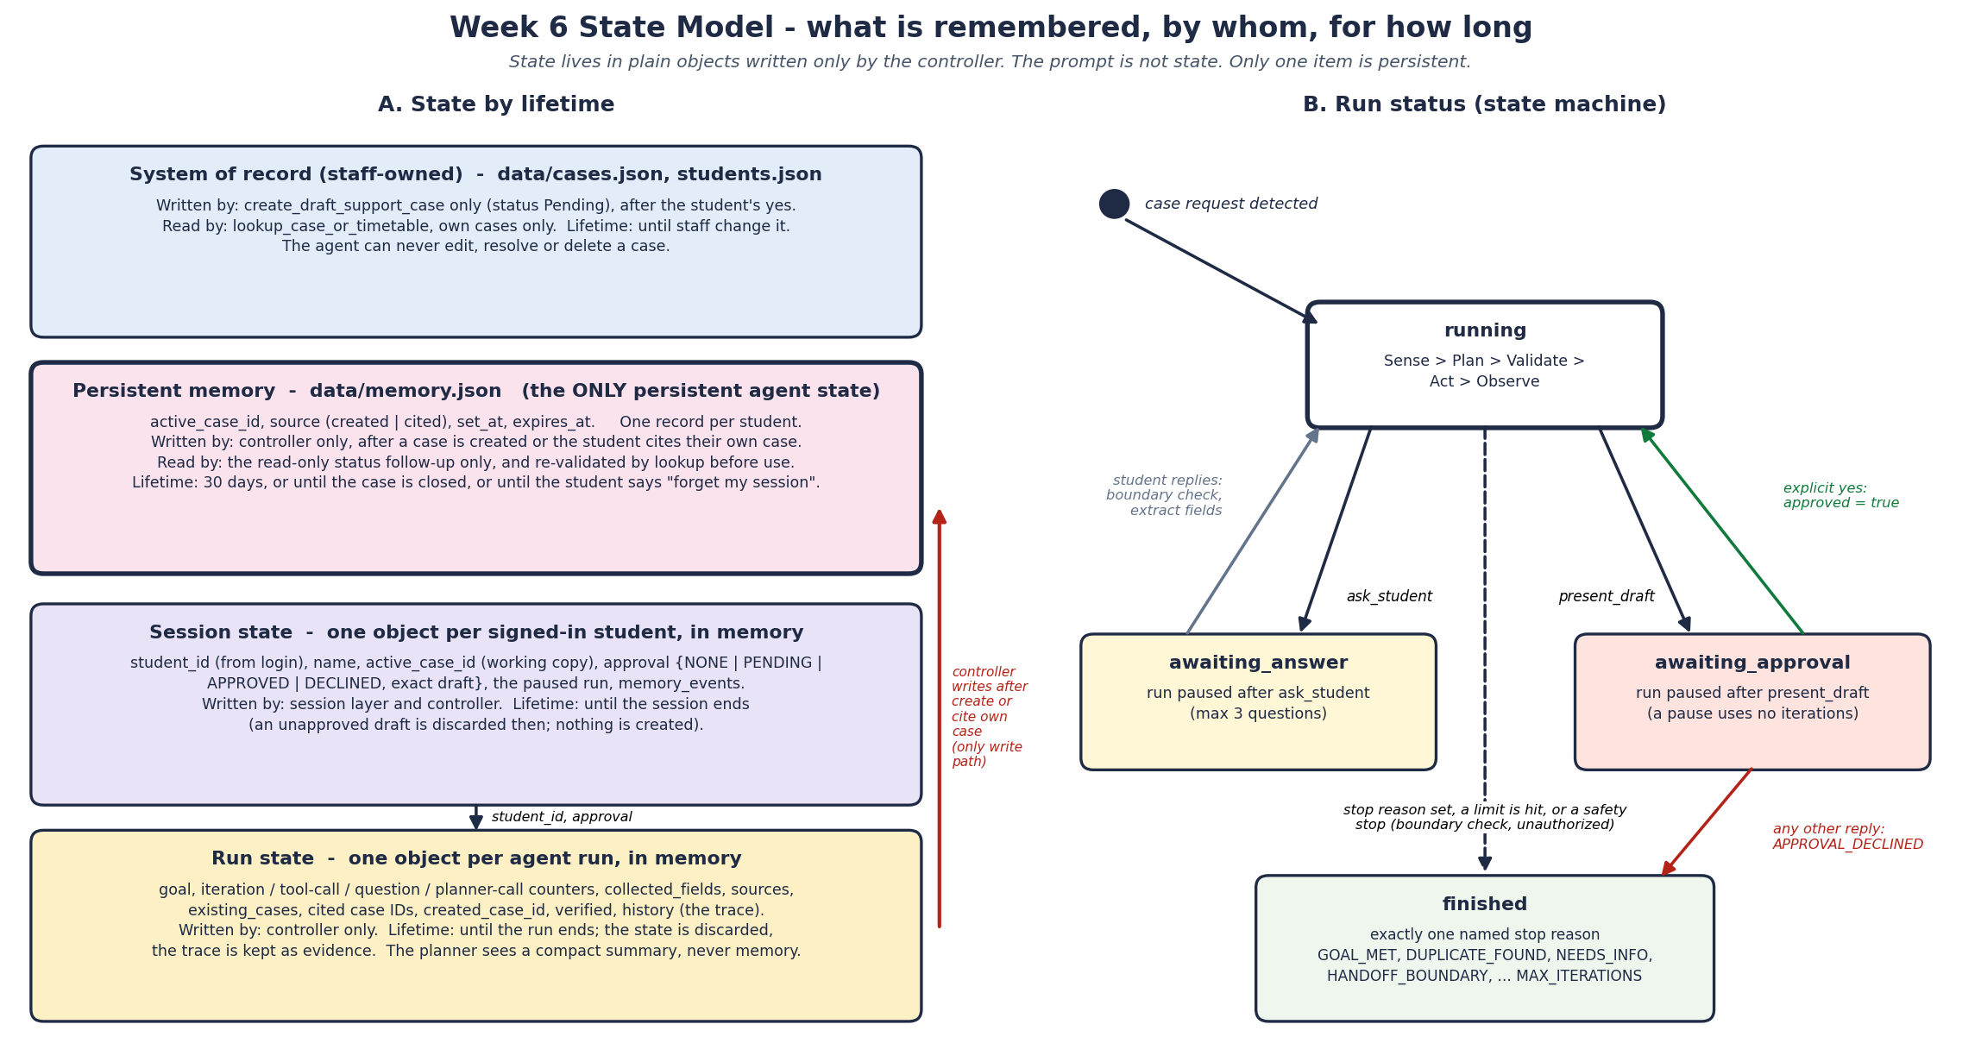
STATE AND MEMORY
Store a reference, not a conversation
active_case_id only · 30-day TTL · revalidated on every turn · deleted on request · audit log
Group A Day | BSE4104 Capstone | Release v1.0.0
10

Slide 11
EVALUATION
49 scenarios, six categories, four criteria
Categories
12 answerable · 8 partial · 7 unanswerable · 10 tool/workflow · 7 safety · 5 memory
Criteria
task completion, goal recognition, tool selection, information faithfulness
Method
scripted planner for determinism; full trace for every run
Baseline
the Week 3 retrieval set adds 15 cases at 14/15
Guardrails
16 adversarial probes: 8 unauthorised writes, 8 safety attacks
The harness ships with the repository, so results are reproducible, not asserted.
Group A Day | BSE4104 Capstone | Release v1.0.0
11

Slide 12
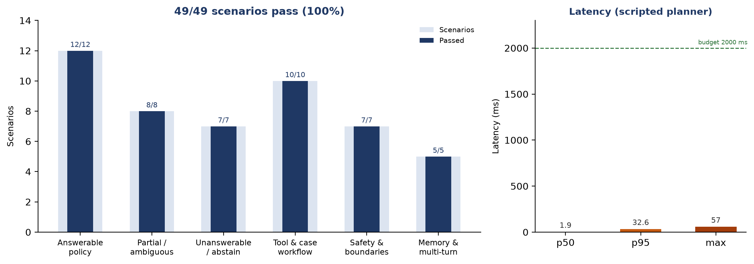
RESULTS
Every measured criterion met
Retained final run. Latency is scripted-planner orchestration time, not live model latency.
Group A Day | BSE4104 Capstone | Release v1.0.0
Group A Day | BSE4104 Capstone | Release v1.0.0
12
12

Slide 13
SAFETY
Guardrails are structural, not conversational
No write without approval
No model-supplied identity
host-injected flag
schema forbids it
Tool whitelist
Argument and length limits
validation gate
typed schemas
Bounded loop
No out-of-scope advice
code-enforced budgets
refusal + handoff
No transcript retention
memory schema
16/16 probes blocked. Zero unsafe writes. The approval gate holds even when the model is instructed to bypass it.
Group A Day | BSE4104 Capstone | Release v1.0.0
Group A Day | BSE4104 Capstone | Release v1.0.0
13
13

Slide 14
A REAL FAILURE
R14: a retained wrong citation
What happens
In the retained Week 3 trace, a question about one procedure retrieves a lexically similar paragraph about another. The agent cited it instead of abstaining. The final boundary layer now refuses grade changes before retrieval.
Why it matters
A confident wrong answer is worse than an abstention in student support.
What we did
Coverage guard (MIN_COVER=2) reaches 15/15 locally — but it is not merged, because the 49-scenario evidence predates it.
The verified / unverified split
FC-12 to FC-14 — before/after verified
FC-01 to FC-11 — documented, baseline not preserved
We report the distinction instead of claiming fourteen verified fixes.
Group A Day | BSE4104 Capstone | Release v1.0.0
Group A Day | BSE4104 Capstone | Release v1.0.0
14
14

Slide 15
LIVE DEMONSTRATION
12-15 minutes, including one real failure
1
Missing marks
grounded answer → draft → approval → Pending case
2
Case status
stored reference revalidated; real tool call
3
Fee waiver
refusal and handoff — no decision, no write
4
Memory
resume the case, then 'forget my session'
5
R14 failure
retained wrong citation, shown honestly
6
Evidence
results file and one full trace
Group A Day | BSE4104 Capstone | Release v1.0.0
Group A Day | BSE4104 Capstone | Release v1.0.0
15
15

Slide 16
CLOSE
What we would do next
Lessons
The hard part is the boundary, not the model call.
Evaluation artefacts are engineering artefacts: keep the revision, the trace and the command.
Data minimisation is a design decision, not a later feature.
Saying 'not verified' is part of good engineering.
Next
1. Run the live Gemini planner end to end and retain traces.
2. Preserve a pre-fix revision for every catalogue finding.
3. Merge the coverage guard after a full regression.
4. Re-run retrieval after DOC-12 v1.1; add held-out cases.
5. Add CI, authentication, rate limiting and logging.
Thank you — questions welcome. Repository: github.com/OpiyoOscar01/group_A_ai_agentic_capstone_assignment
Group A Day | BSE4104 Capstone | Release v1.0.0
Group A Day | BSE4104 Capstone | Release v1.0.0
16
16

