Slide 1


Credit Card Customers Case Study
By :- Omprakash Kumar Sharma

Slide 2
CONTENTS
Case Study
Objectives
Data Analysis
Important Factors
Customer’s Age
Dependent Number
Gender
Relation with Bank
Education Level
Inactivity Level
Marital Status
Card Category
Average Utilization
Findings

Slide 3
This case study consists of 1 dataset.
This dataset consists of 10,127 customers mentioning their age, salary, marital status, credit card limit, credit card category, etc. There are a total of 21 features.
Case Study

Slide 4
Objectives
Analyse the data and predict who is going to get consider so that we can proactively go to the customer to provide them better services and turn customers’ decisions in the opposite direction.
Publish the findings based on data analysis.

Slide 5

Data Analysis
For analysing the data, various factors affecting the business (i.e; the important attributes) should be listed out.
In this case study, there are 21 factors mentioning the age, salary, marital status, credit card category, etc. of 10127 customers

Slide 6
Important factors forming a general trend
amongst Affecting Customers
Customer’s Age
Gender
Education Level
Marital Status
Card Category
Tenure of Relationship with Bank
Tenure of Inactivity
Average Utilization

Slide 7
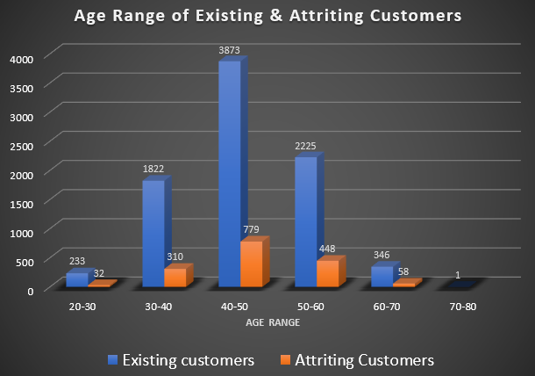
Customer’s Age
The number of customers attrition in the age range of 40-50 years is the highest followed by 50-60 years.
The possibility of customers attrition between the range of 40-50 years is the highest followed by 50-60 years.

Slide 8
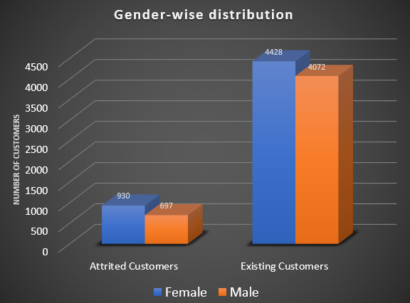
Gender
The number of females is higher amongst both the attrition and existing customers.
The possibility of a female customer attrition is higher than that of a male customer.

Slide 9
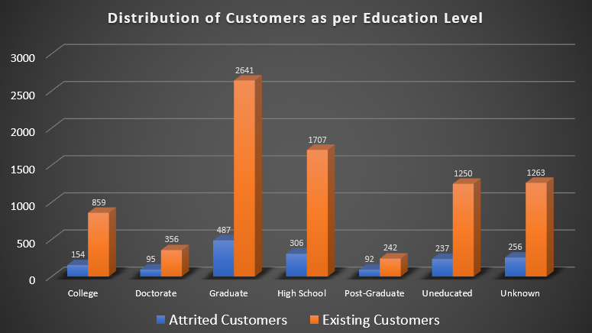
Education Level
The percentage of attrition customers to existing customers is fairly uniform amongst the different education level and hovers around 17-18% with the highest being for Doctorates (26.69%) followed by Post-Graduates(21.70%) hence the risk of customers churning is higher for the customers who are Doctorates and Post-Graduates as compared to the others.

Slide 10
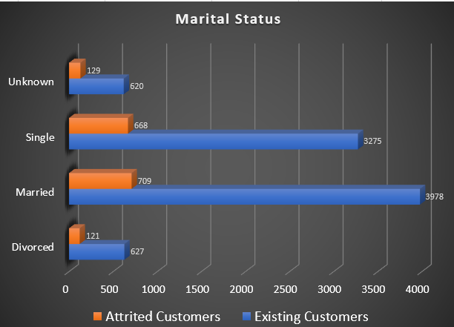
Marital Status
We can hardly find a difference in the percentage of attrition to existing customers as per their marital status. It ranges between 17%-20% across the different level hence we cannot predict a possibility of customer’s leaving based on their marital status.

Slide 11
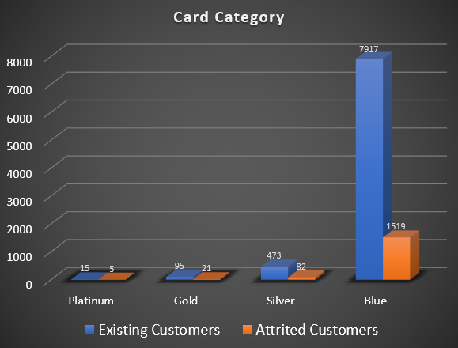
Card Category
The percentage of attrition to existing customers as per their card category (Platinum 33.33% and gold 22.10% ) is decent enough hence the risk of churning the credit card service is more possible for two card category.

Slide 12
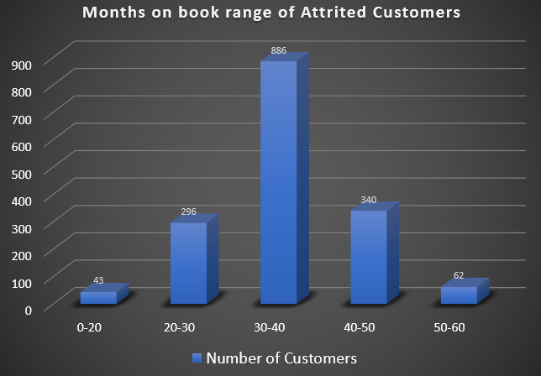
Tenure of Relationship with Bank
The percentage of customers attrition is the highest amongst customers who have been with the bank for 30-40 months followed by 40-50 months and 20-30 months.
We should concentrate on the range of 20-50 months’ customers with the bank.

Slide 13
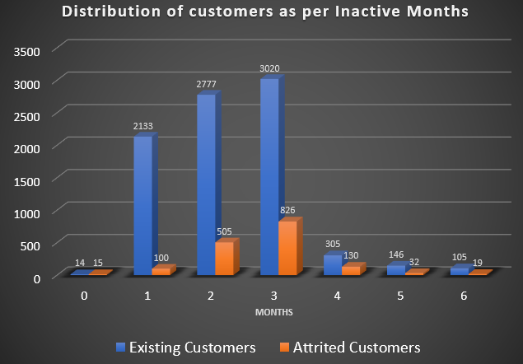
Tenure of Inactive Months
The percentage of customers attrition is the highest amongst customers who have inactivity followed by customers who have 4 months(42.62%) of inactivity and then by customers who have 3 months (27.35%) of inactivity. Hence we can conclude that the lesser the activity on the customer’s card the higher the chance of attrition.

Slide 14
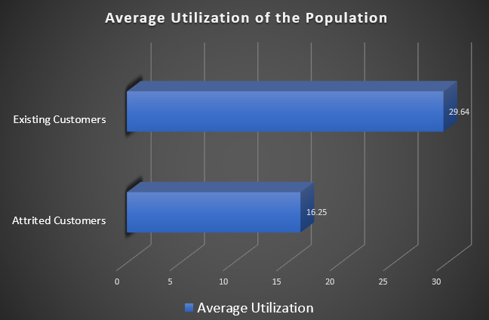
Average Utilization
The average utilization of attrition customers is 16.25% as compared to 29.64% for existing customers. Hence we can summarize that the lesser the utilization on the customer’s card the higher the chance of attrition.

Slide 15
Findings
The possibility of customers churning between the age range of 40-50 years is the highest followed by 50-60 years.
The possibility of a female customer attrition is higher than that of a male customer.
The risk of attrition is higher for the customers who are Doctorates and Post-Graduates as compared to the others.
The risk of customers leaving is higher for the customers who have been with the bank for 20-50 months.
The lesser the activity on the customer’s card the higher the chance of attrition.

