Slide 1
Challenges for Designers in FLOSS Projects
Notes:
What is this talk about?
- How to involve designers into your project and work with them

Slide 2
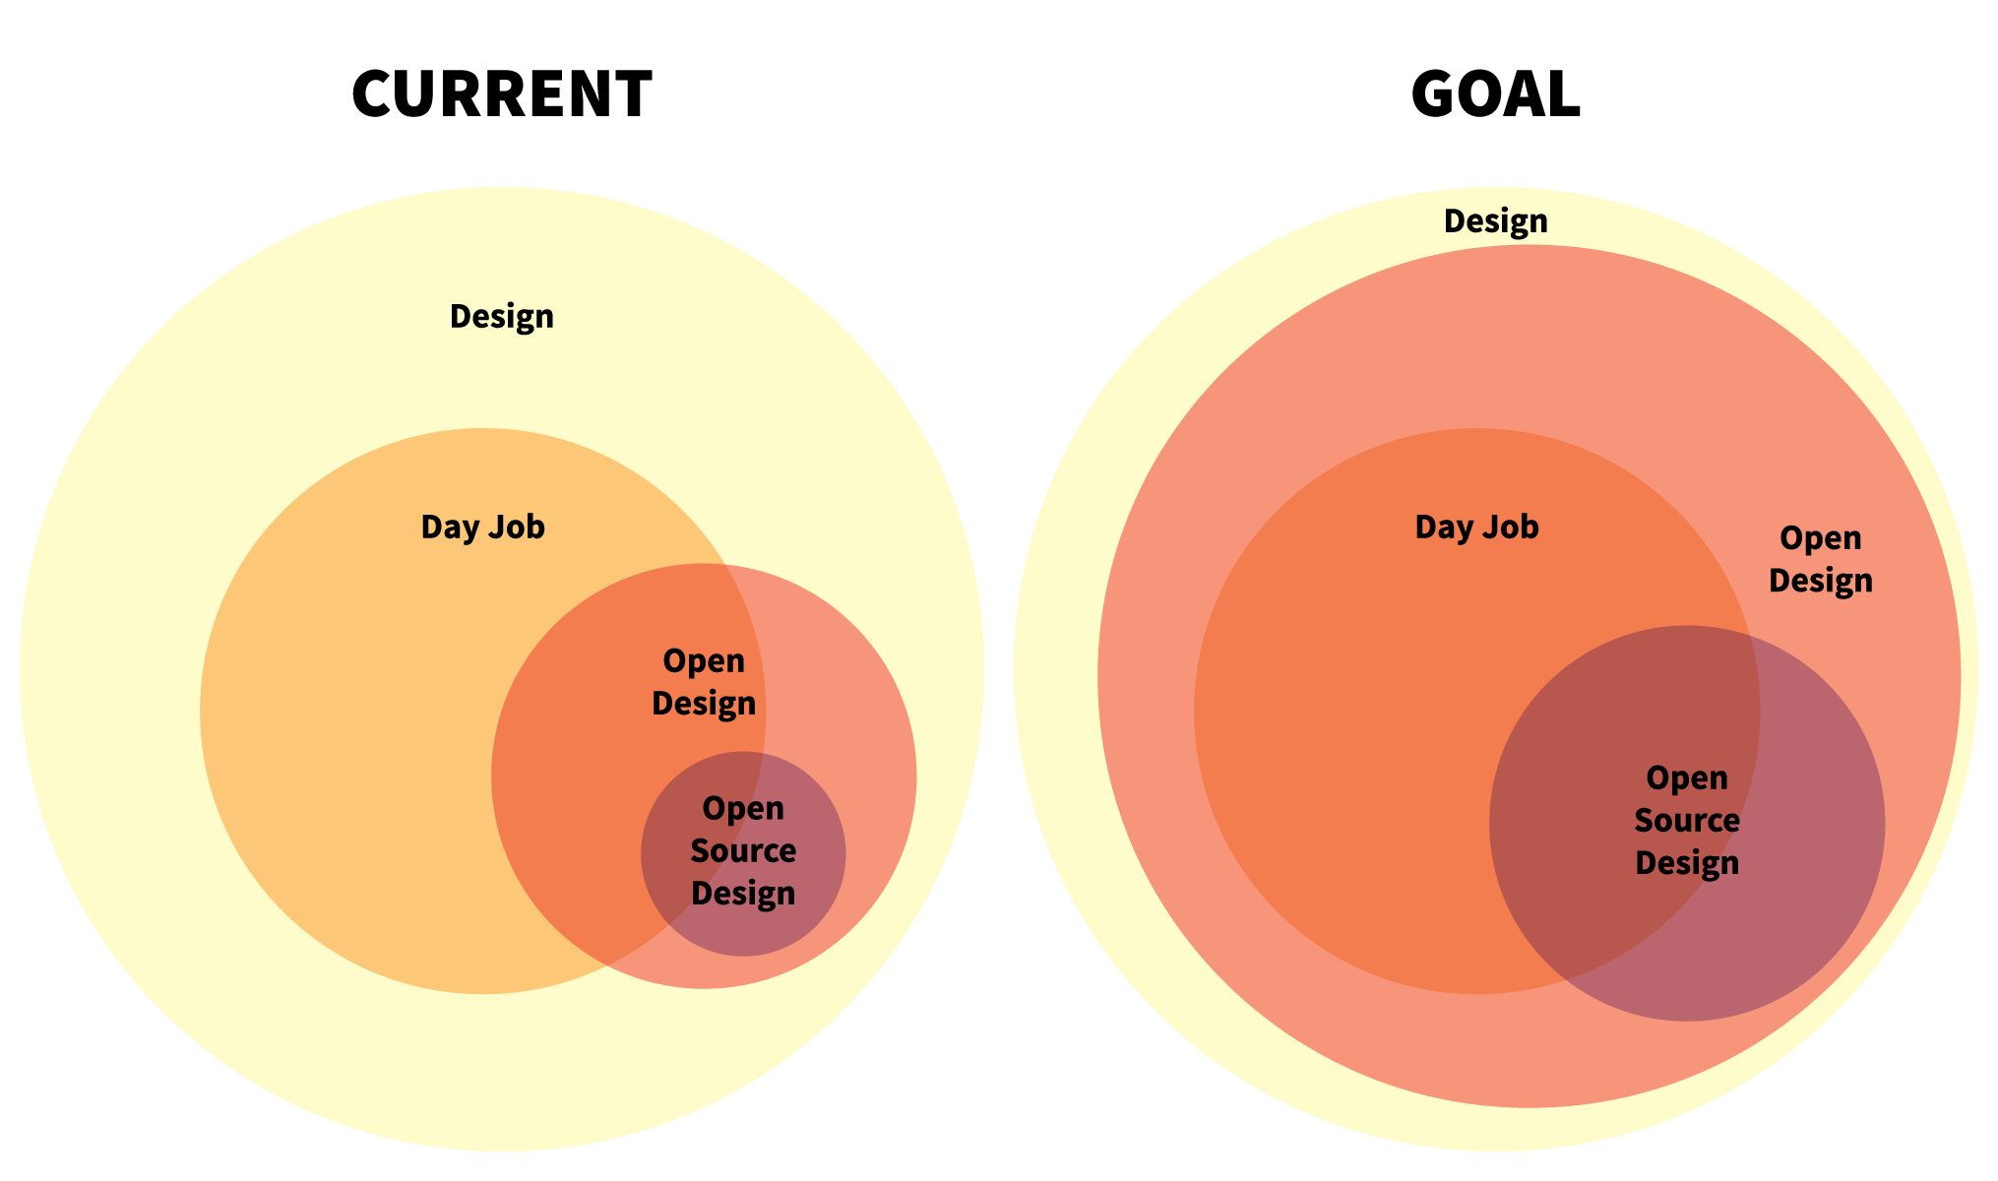
Context: open design
- Share Process and Results
- Contribute and allow others to build upon your works
Notes:
Part of designopen, a group which wants to push sharing designs and processes with others
I am part of this collective SWITCH

Slide 3
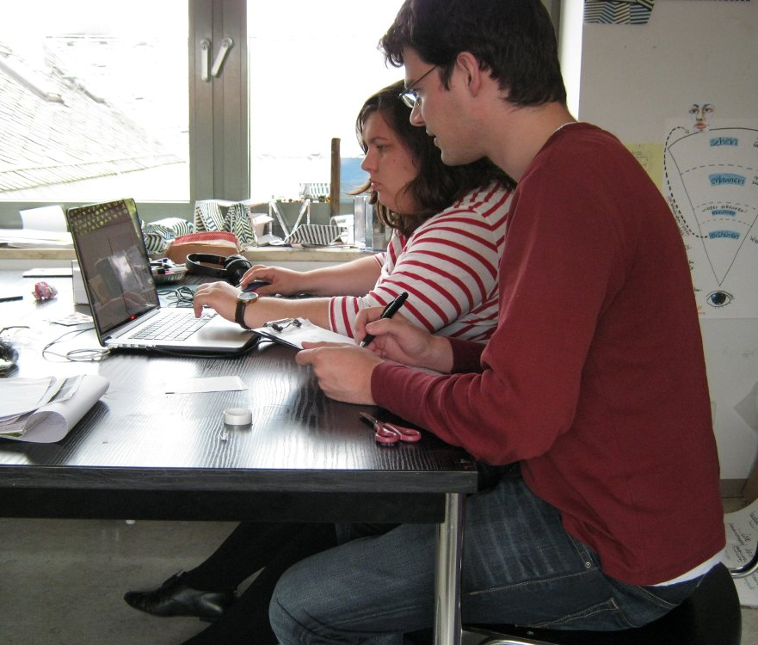
Context: Me
User Need Research
UX Design
Notes:
Linux User
User Researcher
UX Designer… Talking about Design SWITCH

Slide 4
What is design?
Aesthetics: e.g. create a great looking web page or imagine a well working color scheme for your GUI.
Usability: e.g. improve a dialog by rearranging and renaming controls
Usefulness: e.g. observe users editing documents with your software to see what is important to them
Notes:
Not just pretty.

Slide 5
Parts:
Onboarding: Getting to know the project
Tasks: What to do and How
Tools: Are programmer’s tools suitable for design(ers)?
Notes:
These are the things I want to discuss.

Slide 6
Part 1: Getting to know the project
Notes:
All going to be rather general!
How get people who are not familiar with your project yet to kno why your project is a great one?

Slide 7
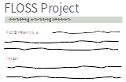
Getting to know the project
Notes:
NEXT: EXAMPLE
Usually: What your software does? (Is it what I need?)
How do I make this happen?
It matters a lot how this is written.

Slide 8
Getting to know the project
»Fauxflake is an easily embeddable, decentralized, k-ordered unique ID generator. It can use the same encoded ID format as Twitter’s Snowflake […]«
vs.
Fauxflake is a time machine. It handles accurately assigning chronological IDs to events, across computers, so you can track as many as four million events per second. […]
Vitorio Miliano, http://designopen.org/articles/import-designers/
Notes:
NEXT: SETUP Requires detailed knowledge of the project and similar products
You probably know a lot, and newcomers know much less (Usability test experience)

Slide 9
Setting it up
Just pull the repo and set the server up. You need an apache and a reverse proxy. Look at the error logs if it fails.
vs.
If you want to install the software you need to do the following
  Download the install files or Pull the repo (What is pulling?)
  Set up a an Apache Environment
  …
Notes:
Details matter, even for experienced people.
It is not a good idea to keep people out by making it hard.

Slide 10
Summary
Present without jargon and long winded sentences.
Step by step instructions to set up an installation
Don’t trust on “intuition” and “they will just try and get it right”
Notes:
Now, imagine they want to contribute. Nex phase, they need to use the contrib. infrastructure

Slide 11
Part 2: What to do?
Notes:
Where can they help the most? Where is it most enjoyable for them?
If I work on something…

Slide 12

Notes:
Having some meaningful impact

Slide 13
»…create some icons or a great font«
Vague: What exactly is needed?
Unwanted(?): Drop-in resources
Not only pretty:
  Redesigning hard-to-use UIs?
  Determining user needs?
Notes:
Commitment: If you think designers may contribute, they are going to have some influence and interwoven in the community
I understand this is scary/difficult so…

Slide 14
Clearly state needs
»Test 10 Users in a think-aloud study to check [if x works]«
»Redesign the “Project” Panel to reduce wrongly assigned resources when working with multiple projects«
Notes:
Already more than “just do”
What does it look like as a full bug?

Slide 15
Task and Reconstruction, Screenshot
Context: Which role has the concerned part in your software?
Give a reason:
  For usability: Why is this a problem?
  Use J. Nielsen’s Heuristics
  For Research: Why do we need to find out? Suggested Methods?
Implementation: How will the design be used?
Notes:
NEXT: examples

Slide 16
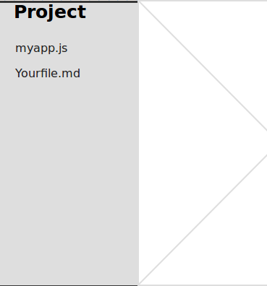
Task: Redesign the “Project” Panel to reduce wrongly assigned resources when working with multiple projects.
Possible Reasons for the Problem: This may be related to lack of Visibility of the status.
Context: The project panel enables access to related files[…]
Implementation: We would like to include the change for version 0.8 (Schedule here)
Current Interface:

Slide 17
Task: Find out how files are used in Projects and how different project files are interrelated
Context: Our IDE operates on files, which may be parts of different projects. However, we know that our current approach is in conflict with the workflow of many users
Methods: Observation and Interviews and/or using existing research
Implementation: Long term changes, possibly for 1.1

Slide 18
Guidelines for design discussions
What is the problem that should be solved? Does the solution solve it?
Avoid vagueness (“slick”) and discussions about taste (“don’t like…”). Instead:…
Evaluate against criteria: heuristics, scenarios, guidelines, user tests etc.

Slide 19
»It sucks because its not very slick« (subjective, vague)
»The proposed solution should make the interface more less cluttered. Now users could archive the result with one click less. However, it introduces an invisible “mode” which will probably cause confusion.«

Slide 20
Tasks: Findability
Example Bug from ownCloud’s GitHub
Give “design” tags or even: design-usability, design-visual etc.
Have a estimation of skill needed like “Starter”, “Advanced” etc.

Slide 21
Part 3: Using tools
Notes:
All going to be rather general!
How get people who are not familiar with your project yet to kno why your project is a great one?

Slide 22

Tools
Notes:
Don’t know any of these, but2nd nature for devs
What to do?

Slide 23
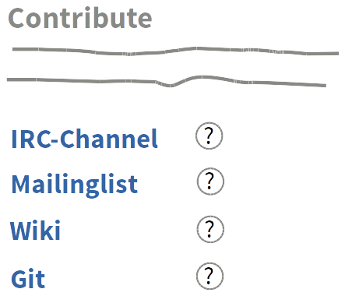
Tools – Solution
Help along
Notes:
Accept that newcomers might not know these tools

Slide 24
Silver Bullets or Golden Hammers?
Tools used for software development are code- and text centric
→ Are they suited for design tasks?
Notes:
NEXT: Pro and Con

Slide 25
We already use these tools
They are de-facto standards
Keeping it together rather than separate
They could just learn it™
Design is not text based
Discussions and decisions better visual
Designer’s files are often binary and need tools that can handle those (git!)

Slide 26
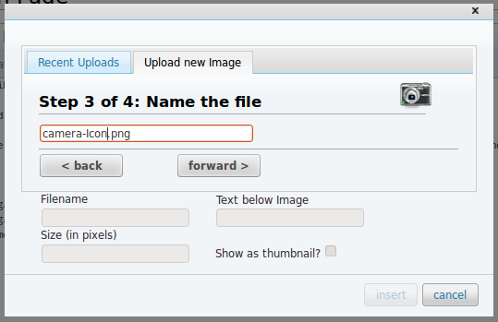
Is that a preview? Seems like an icon
Blue is the “passive” color here, gray the active?
What about vice-versa?
Should that not be activated nevertheless
Notes:
Text: Link say: The… in… at…
Instead of pointing

Slide 27
What could be used for that?
GitHub has visual diffs of images
pixelapse.com is a “github for designer”
Visual Bugtracker (BugHerd etc.)
Needed: Free/Libre tools which support creation and discussion of concepts and interfaces and the collaboration with developers

Slide 28
Summary
Clearly explain what your project is about and how to set oneself up
Provide clear tasks and give guidelines
Consider that programmer’s tools for communication and collaboration may not suit designer’s needs (possibly: change that!)

Slide 29
See you on…
http://designopen.org/
https://github.com/opensourcedesign/
Jan.Dittrich@posteo.de
http://fordes.de/
@simulo

Slide 30
Links
»Barriers for Designers« http://designopen.org/articles/barriers-for-designers/
»How to get designers (or anyone) to work on your open source project« http://designopen.org/articles/import-designers/
Tagging Usability bugs: http://uxmag.com/articles/quantifying-usability
10 Usability Heuristics for User Interface Design: www.nngroup.com/articles/ten-usability-heuristics/
Usability in Free Software: http://jancborchardt.net/usability-in-free-software

