Slide 1

The Rise of the Network Commons
Book project, supported by EU-project Confine and carried out under organisation of Funkfeuer, Vienna
http://www.thenextlayer.org/NetworkCommons
arminmedosch@gmail.com

Slide 2

Network Commons:
Better term than wireless community network
independent of technology (cable bound networks can also be in commons)
expresses idea better (not vague idea of community but network as a commons →
Netzwerkallmende (our teacher Volker Grassmuck, book Freie Software 1998 and conferences Wizards of Operating Systems 1999-2006
Definition of commons poses challenge

Slide 3
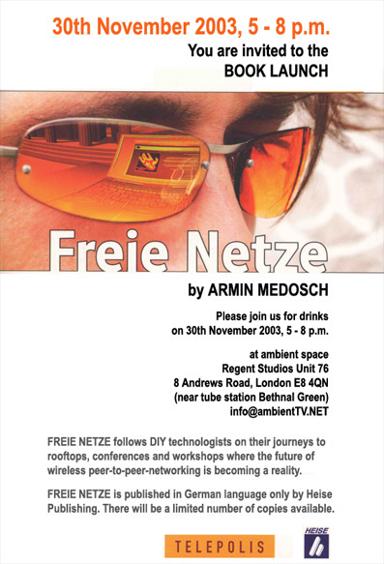
Freie Netze, Heise 2004

Slide 4
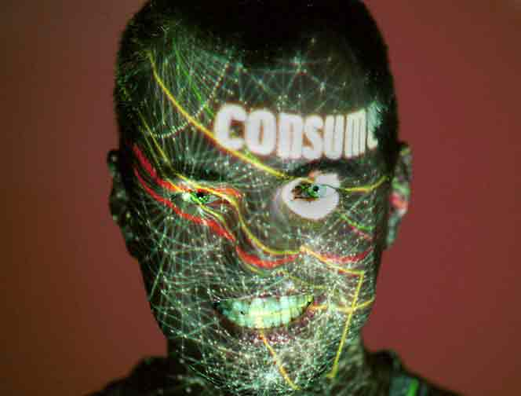
Consume the Net
Model 1 by Consume created dispositif of network freedom
Dispositif spread to continent where it fell on more fertile ground

Slide 5


Dispositif of Network Commons
Dispositif term by philosopher Michel Foucault who was concerned with how power works in society
Free networks self- empowerment, self-ruling networks
political freedom communication freedom
democratization of technology

Slide 6
Consume the Net, Model 1
libertarian or anarchist model, completely decentralized
each node owned and maintained by user
ad-hoc mode used to create large scale networks
no central organization, no legal entity
decentralized technology, mesh network
cooperation, commons-based-peer-production
talking to the neighbor, strong aspect of localism

Slide 7
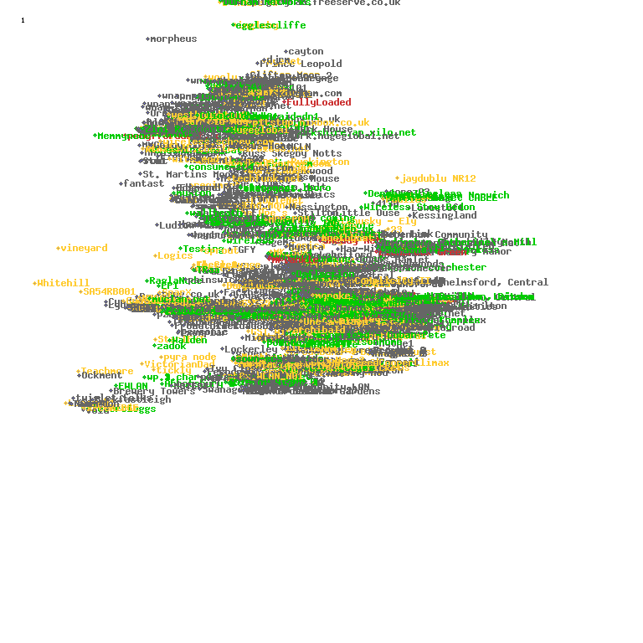
Consume NodeDB (2004)

Slide 8
PicoPeering Agreement, Feb 2004 at Copenhagen Interpolation
1. Free Transit:
The owner agrees to provide free transit accross their free network.
The owner agrees not to modify or interfere with data as it passes through their free network.
2. Open Communication:
The owner agrees to publish the information necessary for peering to take place
This information shall be published under a free licence
The owner agrees to be contactable and will provide at least an email adress
3. No Warranty
http://www.picopeer.net/PPA-en.html

Slide 9
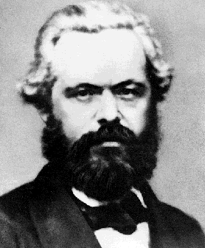
RTFM = Read the Fucking Manual
or
RTFM = Read the Fucking Marx

Slide 10

Commodity Fetishism / Warenfetischismus
As the product of labor is separated from the worker, it confronts her or him as an object that is outside of her or him and threatening; the thing becomes imbued with “mystical powers.”
the powers that are actually the powers of people become seen as the power of things
elationships between people become understood as relationships between things
relationships of people become thinglike (social networks)

Slide 11
The Open-Everything Ideology
the openness of technology is considered an antidot against capitalist recuperation
because of openness of technology, it can be shared by all
the commons is (wrongly) considered as in contradiction to capitalism
Commonism: commons activists (Michel Bauwens, Silke Helfrich, David Bollier) hope that a commons based production system will supersede capitalism
commons as a new paradigm: http://wealthofthecommons.org/contents
Openness is a myth. What is a myth? A myth is a narrative which projects (either into the future or into the past) the resolution of social conflicts in symbolic form (rather than actually solving them).

Slide 12
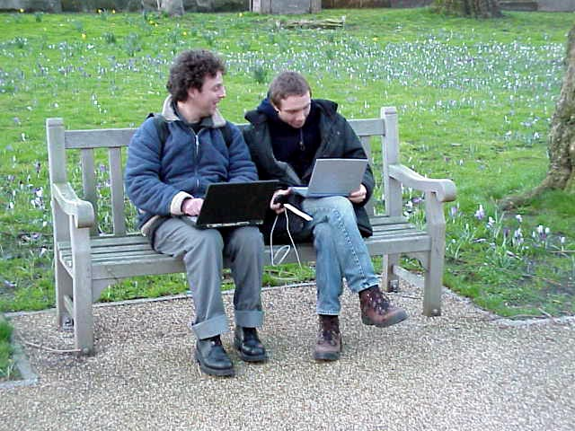
From Hierarchies to Network Power

Slide 13
Joseph Weizebaum, Computer Power and Human Reason: From Judgement to Calculation (1976)
The obsessive compulsive programmer:
the obsession something positive, a type of “fun” (Linus Torvald created Linux “just for fun”
problem when the obsession becomes compulsion (German “zwanghaft”) then it becomes pathological
obsessive compulsive technology disorder on the social scale
Technological determinism in definition of freedom
free software, free networks, free hardware
open, neutral, free (mantra of developers)
Social definition of freedom as „habitus“ - an attitude, freedom as a practice

Slide 14
Towards the Network Commons
Commons can exist when there is a community which defines its rules and has ways of enforcing those rules (Elinor Ostrom)
importance of community building (Guifi.net, Freifunk)
defining the borders of the commons with society, sharing the commons with wider society without it getting destroyed
starting conflict resolution mechanisms (Freifunk advisory board)
advocacy, not just of wireless community networks
advocacy of the idea that networks should become more transparent to people rather than people more transparent to network power

Slide 15
The future:
Rewrite the draft book, seek publisher, or Kickstarter, we will be in touch
http://www.thenextlayer.org/NetworkCommons
arminmedosch@gmail.com

