Slide 1
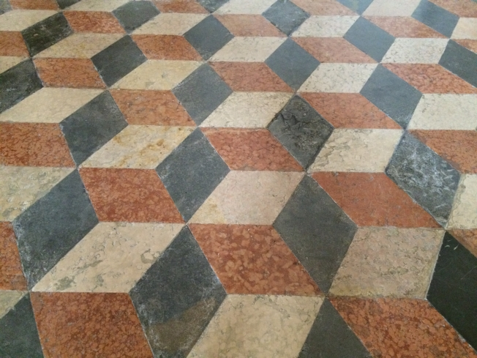
Open Standards in Perils?
The ongoing revision of the European Interoperability Framework

Slide 2

Consultation

Slide 3
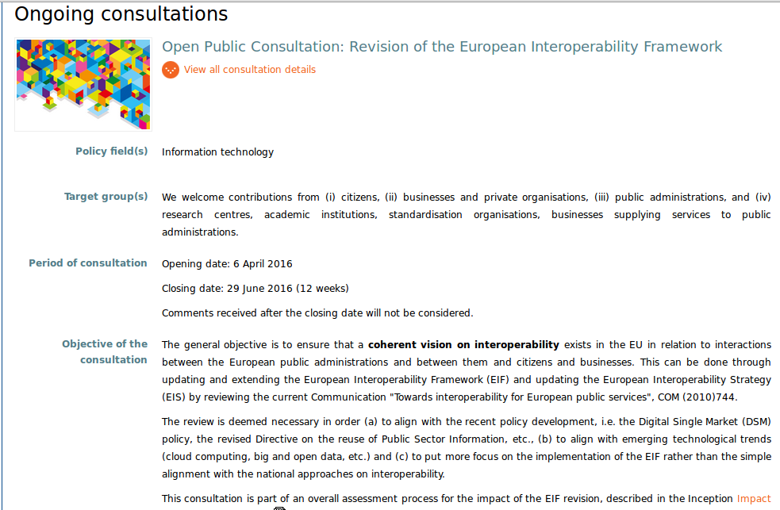

Slide 4
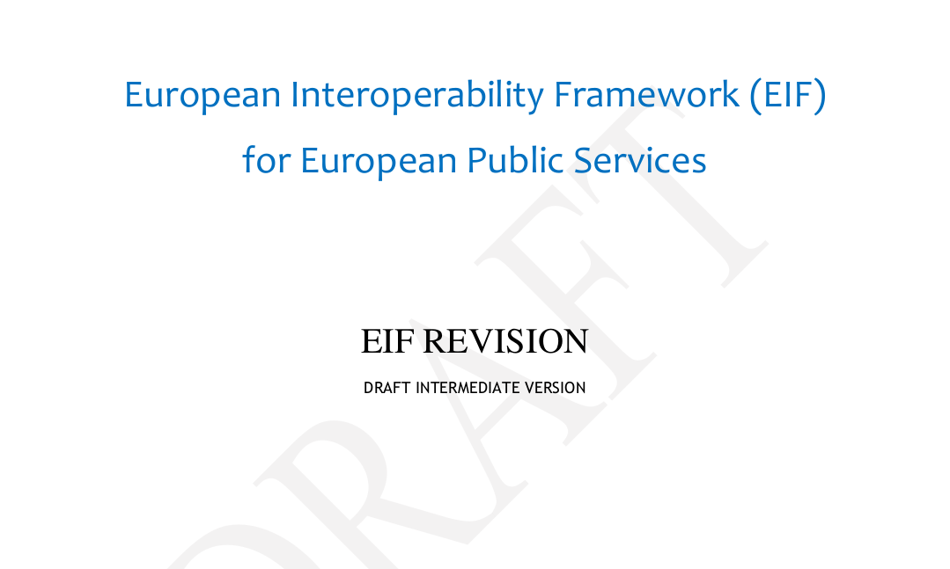

Slide 5
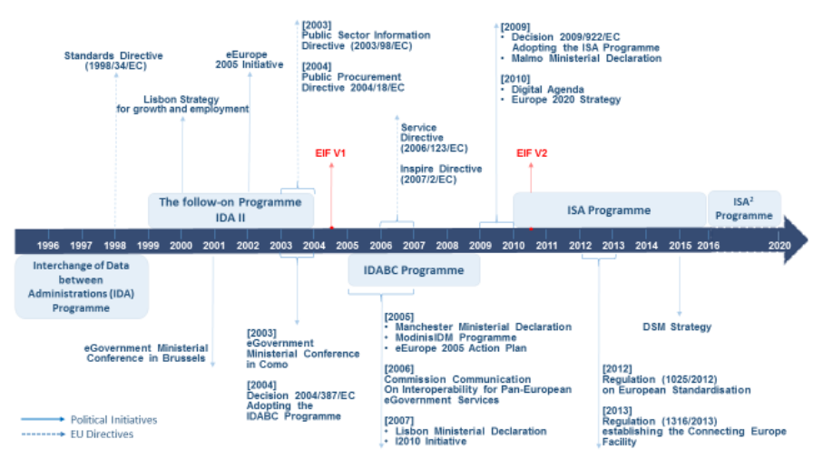

Slide 6
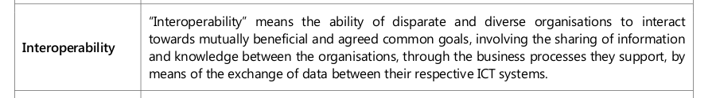
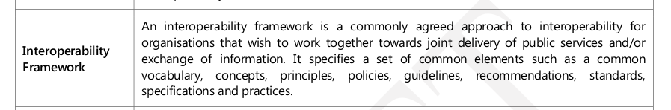
EU Definitions

Slide 7
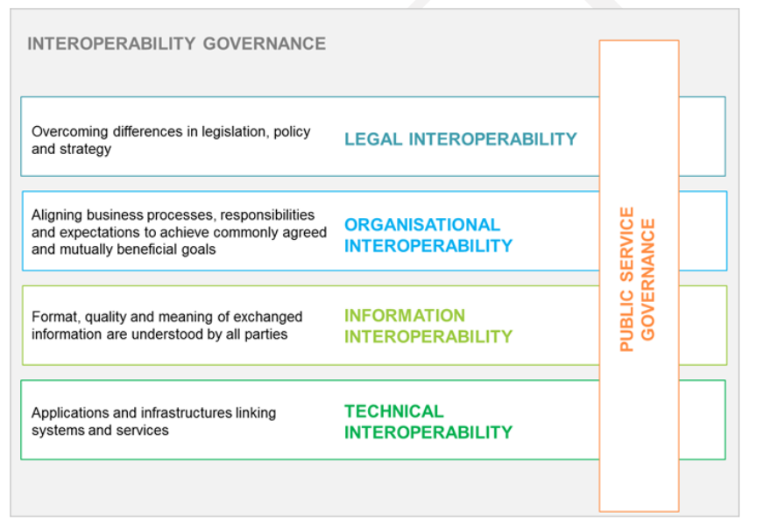

Slide 8
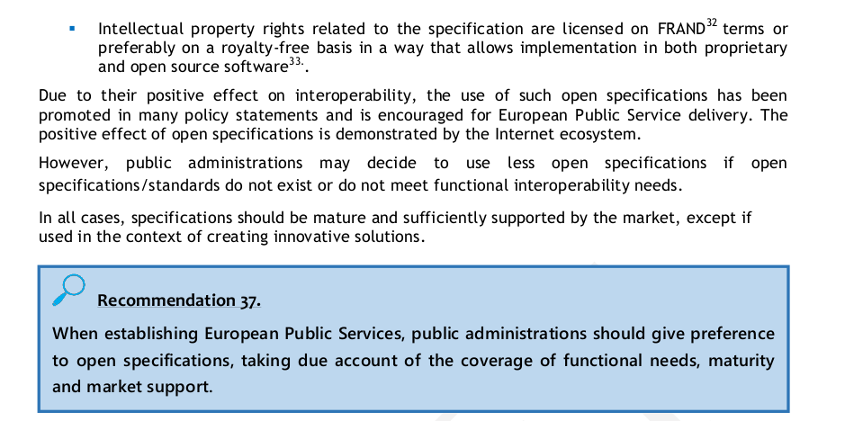

Slide 9
Fixes
Restore narrow scope of interoperability
Delete explicit FRAND reference
Expand on "openness" (not just pretext for transparency)
Add problem-driven approach
Advocate highvalue projects with a positive technical interoperability outcome:
e.g. promotion of open document exchange formats, plugfests etc.

Slide 10
IEEE Code of Ethics No. 7
„to seek, accept, and offer honest criticism of technical work, to acknowledge and correct errors, and to credit properly the contributions of others;“

