Slide 1

picoTCP
Technical Introduction
Toon Peters - Intelligent Systems / Altran

Slide 2
picoTCP
A fully featured, highly portable TCP/IP stack designed for small footprint embedded systems

Slide 3
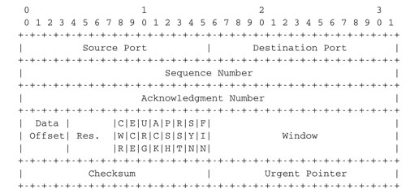
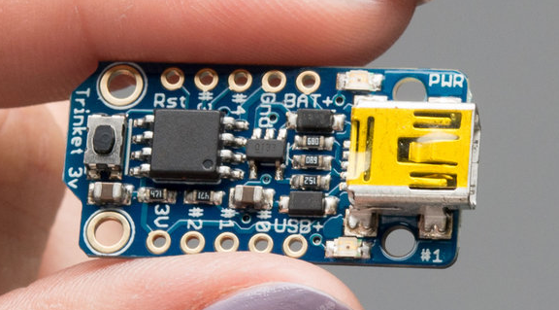
picoTCP
C

Slide 4
picoTCP History
Start: 1-man hobby project
Basic TCP implementation
Start IPv6
MDNS, TFTP
Mesh networking
First hardware
port
First WIFI
driver
GeoNetworking
Various features
PPP
Full IPv6 compliancy
6LoWPAN
PTP
...
IPv4 Done
IPv6 Ready
Becomes a TASS project

Slide 5





picoTCP

Slide 6

Modularity
Broad
cast
Client
SNTP
IPv6
Uni
cast
IPv4
Server
UDP
DHCP
6LoWPAN
Multicast
SLAAC
picoTCP
core
IGMP
mDNS
TCP
HTTP(s)
NAT
DNS
Filter
ICMP
TFTP
Route
AODV
OLSR
NTP
DNS SD
105 kB¹
¹ Figures for ARM Cortex M4 & GCC

Slide 7
Modularity
Broad
cast
ICMPv4
Uni
cast
IPv4
UDP
Multicast
picoTCP
core
16 kB¹
¹ Figures for ARM Cortex M4 & GCC

Slide 8
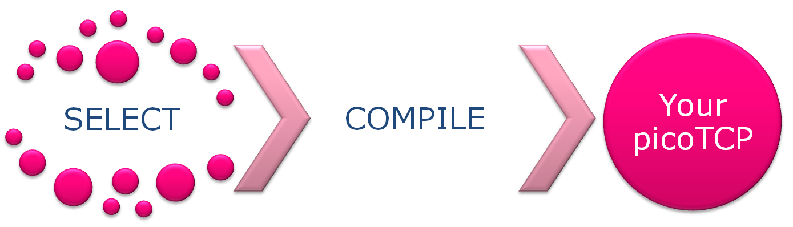
Modularity
$> make ARCH=lpc43xx CROSS_COMPILE=arm-none-eabi- \
TCP=1 UDP=1 IPV4=1 IPFRAG=0 NAT=0 ICMP4=0 \
MCAST=0 DEVLOOP=0 PING=0 DHCP_CLIENT=0 \
DHCP_SERVER=0 DNS_CLIENT=0 IPFILTER=0 \
CRC=0 OLSR=0 SLAACV4=0 STRIP=1 DEBUG=0 PERF=0
[CC] ...
[CC] ...
[AR] ./build/lib/libpicotcp.a
[RANLIB] ./build/lib/libpicotcp.a
[STRIP] ./build/lib/libpicotcp.a
[LIBSIZE] 70240 ./build/lib/libpicotcp.a
...
text data bss dec hex filename
24261 370 568 28199 6e27 (TOTALS)
¹ Figures for ARM Cortex M4 & GCC

Slide 9

Portability
CPU architecture independent
8, 16, 32 & 64 bit. Big or Little endian
Bare Metal / Embedded OS / OS / RTOS

Slide 10
Portability
  Platforms
  32 bit
    ARM variants:
      NXP: LPC17xx, LPC18xx (Cortex-M3)
      NXP: LPC43xx (Cortex-M0 + Cortex-M4)
      ST: STM32F1xx, STM32F2, STM32F4xx
      TI: Stellaris LM3S
  16 bit
    TI: MSP430
    Microchip: PIC24Fxxxx
  8 bit
    AVR: ATmega128
    Compilers
    GCC (>= 4.7 for warning free compilation)
    Clang
    TCC
    ARM-RCVT
    IAR
    XC-16
    MSP-GCC
    AVR-GCC
    Supported RTOSes
    No OS / Bare metal
    FreeRTOS
    mbed-RTOS (CMSIS-RTOS compliant)
Linux / POSIX
      Supported chips
      BCM43362 (IEEE 802.11)
      MRF24WG (IEEE 802.11)
      LPC Ethernet ENET/EMAC (IEEE 802.3)
      Stellaris Ethernet (IEEE 802.3)
      STM32 Ethernet (IEEE 802.3)
      Wiznet W5100 (IEEE 802.3)
      USB CDC-ECM (CDC1.2)
      Virtual drivers
        TUN/TAP
        VDE
        Libpcap
      and more….
    Compatible with
    WolfSSL
    Fossa (Multi-protocol library)
    HTTP native library (server and client)
    ZeroMQ (WIP)
    MQTT
    …

Slide 11

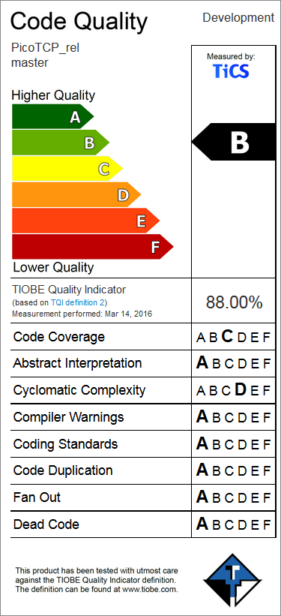

Quality
Unit tests
Compiler warning tests
Static analysis
Dynamic analysis
RFC compliance

Slide 12

picoTCP
GPLv2

Slide 13

Community
Projects

Slide 14


Community
Projects

Slide 15


Community
Projects

Slide 16

Community
Projects

Slide 17
Community
Projects
Yours?
Let us know info@picotcp.com

Slide 18
Workshop 4pm
int main(void) {
/* Main application */
uint8_t mac[6] = {0x00,0x00,0x00,0x12,0x34,0x56};
char ipaddr[]="192.168.2.150";
struct pico_ip4 my_eth_addr, netmask;
struct pico_device *pico_dev_eth;
pico_stack_init();
/* Setup device */
pico_dev_eth = (struct pico_device *) pico_eth_create("eth", mac);
if (!pico_dev_eth)
while (1);
pico_string_to_ipv4(ipaddr, &my_eth_addr.addr);
pico_string_to_ipv4("255.255.255.0", &netmask.addr);
pico_ipv4_link_add(pico_dev_eth, my_eth_addr, netmask);
/* Setup socket */
setup_socket();
/* Main loop */
for (;;)
pico_stack_tick();
}

Slide 19





@phalox
phalox.be
linkedin.com/in/toonpeters
toon.peters@altran.com
@picoTCP
picotcp.com
github.com/tass-belgium/picotcp
info@picotcp.com

