Slide 1
Optical Character and Digit Recognition

Slide 2
Who are we 😅
Name | ID | Year | Department
Omar Ahmed | 20218007 | 3 | Medical
Doaa Mohamed | 20218003 | 3 | Medical
Rana Amr | 20218004 | 3 | Medical
Sohila Mustafa | 20218019 | 4 | Medical

Slide 3
Our Idea
We mix between two ideas in this project
20 An Automated Optical Character Recognition of Handwritten English Letters using [idea 20] Artificial
Neural Networks
22 An Automated Optical Character Recognition of Handwritten Arabic Numerals/Digits using [idea 22]
Artificial Neural Networks

Slide 4
Main functionalities of our project
Accuracy and Confidence Scores:
Confidence Level Indicators: Display confidence scores for each recognized character or digit to help users assess the reliability of the results.
Error Handling: Implement mechanisms to identify and handle recognition errors, providing transparency to users about potential inaccuracies.
Customization and Training:
Model Customization: Allow advanced users to fine-tune or customize the CNN model based on specific requirements.
Training Interface: Provide an interface for users to train the model on their own datasets, enhancing adaptability to diverse content.
Language Support:
English Support: Include support for recognizing characters and digits in English,

Slide 5
Main functionalities of our project
Image Input:
Upload Images: Allow users to upload images containing text and/or digits for recognition.
Text and Digit Recognition:
Character Recognition: Use CNNs to accurately recognize and extract alphanumeric characters from the provided images.
Digit Recognition: Specifically identify and extract digits from images, which is useful for applications like reading serial numbers, license plates, or any numerical data.
Batch Processing:
Bulk Upload and Processing: Support the ability to process multiple images in a batch to improve efficiency for users with large datasets.
Preprocessing Options:
Cropping and Rotation: Allow users to crop or rotate images to optimize OCR performance.
User-Friendly Interface:
Intuitive Design: Create a user-friendly interface that is easy to navigate, allowing users to interact with the software effortlessly.

Slide 6
Our data set
1- We use minist data set from kears for digit recognition that has 60000 training images and 10000 testing source of it
2- We use A-Z Handwritten Alphabets for character recognition that is has 372450 char source of it

Slide 7
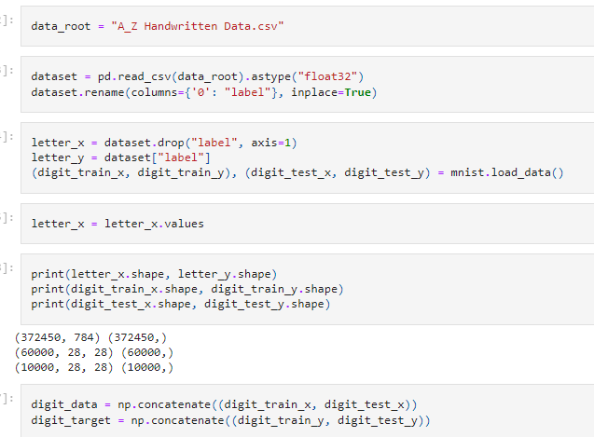
Project structure
The link of our project is here
First we load a A-Z Handwritten data
Second we load a minist data set that is locaed in keras
So we do on them some operations , make the two data sets with a same shape and show them idependently and finally concatenate them

Slide 8
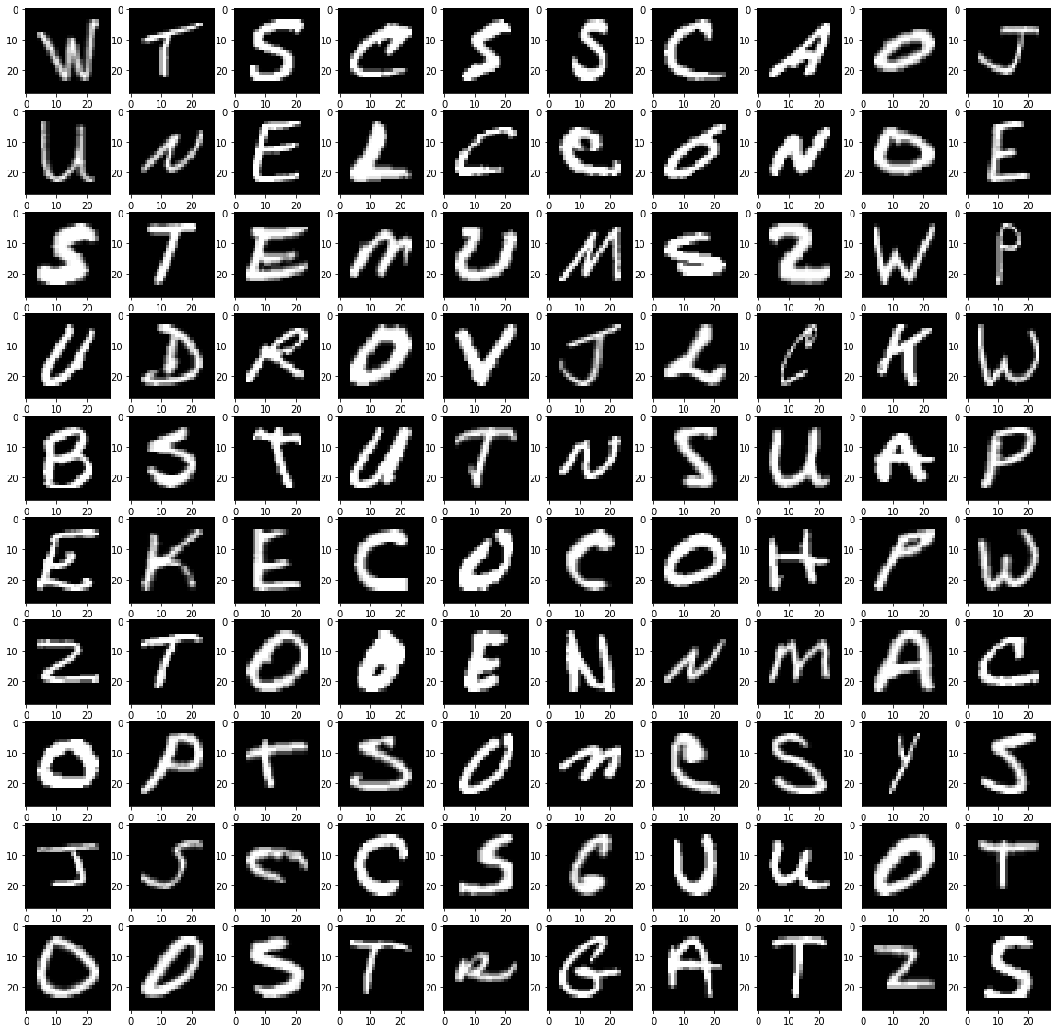
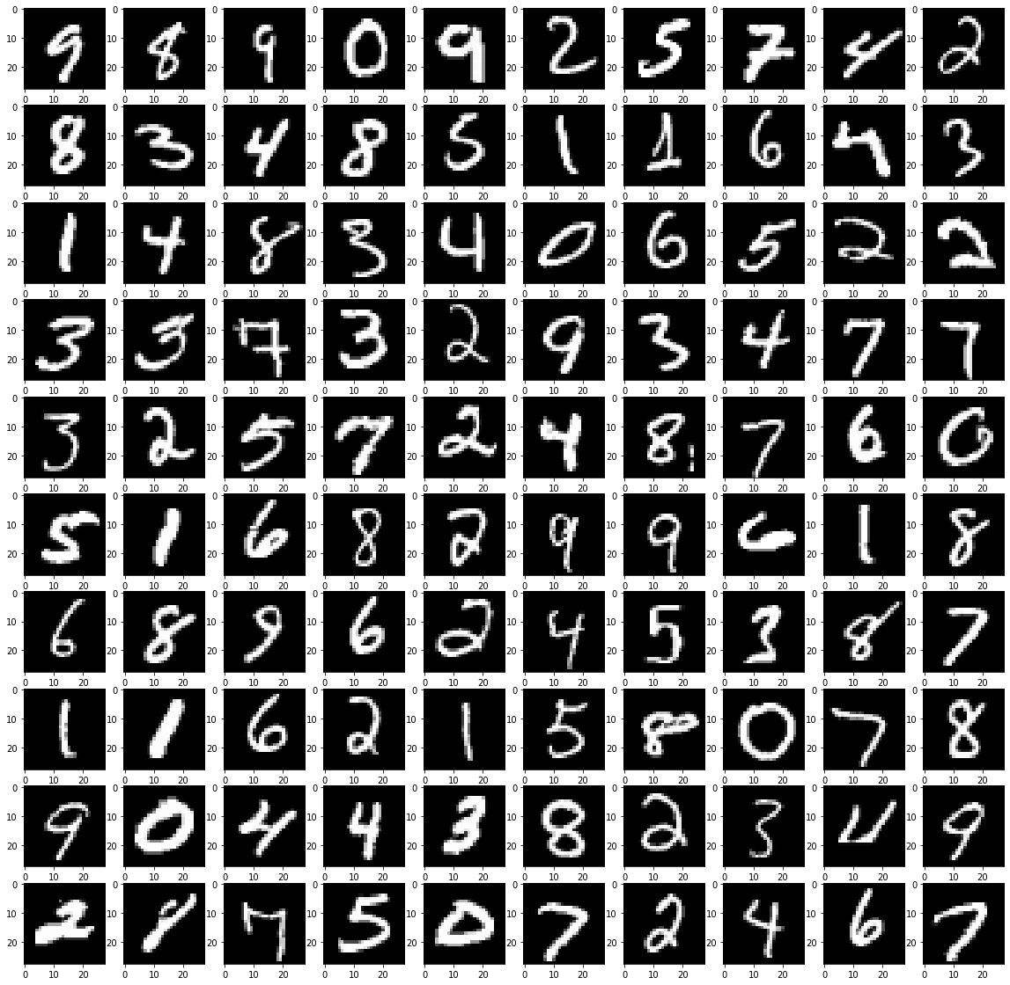
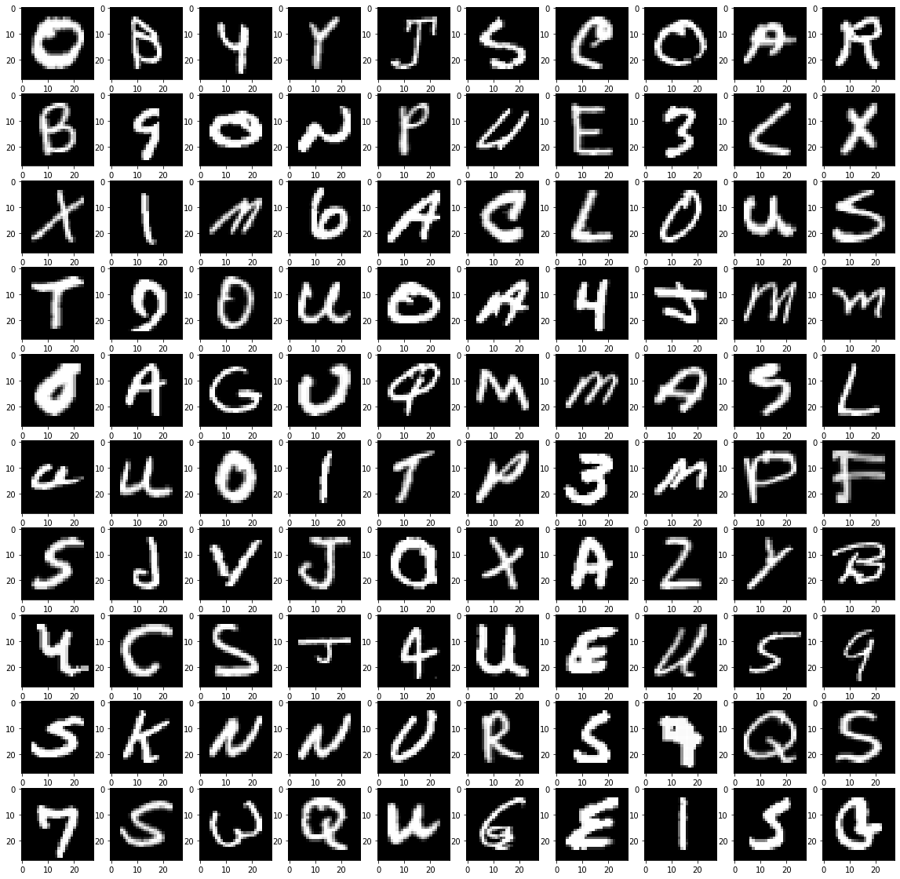
Project structure
Character data set
Digits data set
Merged data set

Slide 9
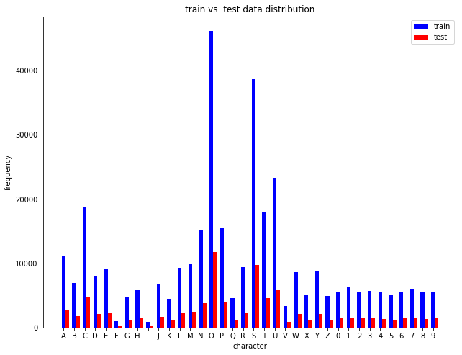
Project structure
Occurrance of labels in the merged data set

Slide 10
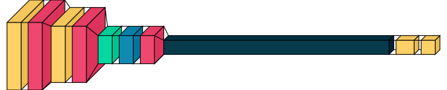
Project structure
So we preprocess the data in data preprocessing file ,next we make a CNN model in it that has this structure to classify between 36 classes (26 characters and 10 digits)

Slide 11
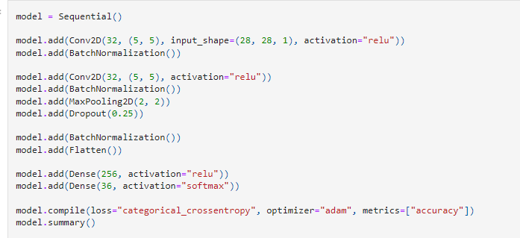
Project structure
In summary, this CNN architecture is designed for classifying images of size 28x28 pixels with one channel into one of 36 classes (26 characters and 10 digits). The model includes convolutional layers, batch normalization, max pooling, dropout for regularization, and fully connected layers. The softmax activation in the last layer makes it suitable for multi-class classification.

Slide 12
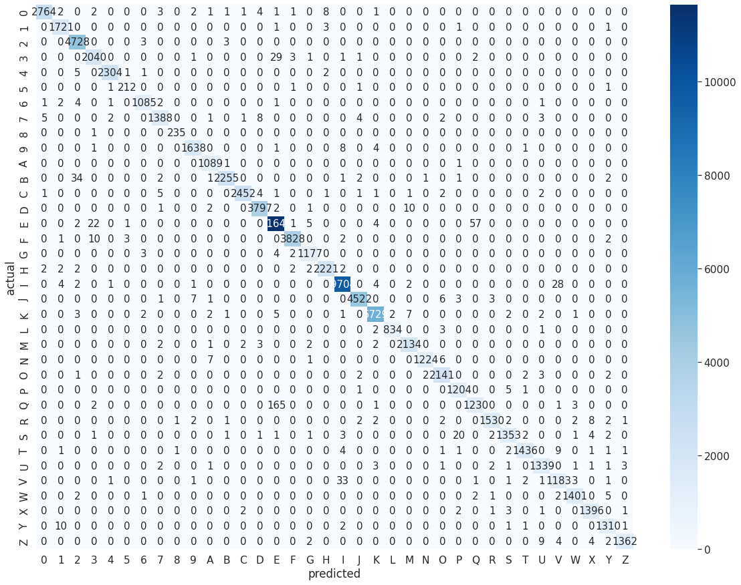
Project structure
The accuracy of our model is 99% and we plot all the testing data accuracy as this

Slide 13
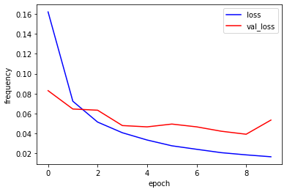
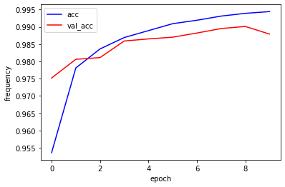
Project structure
So when we train a model when epoches increase loss decreases
So when we train a model when epoches increases accuracy increase

Slide 14
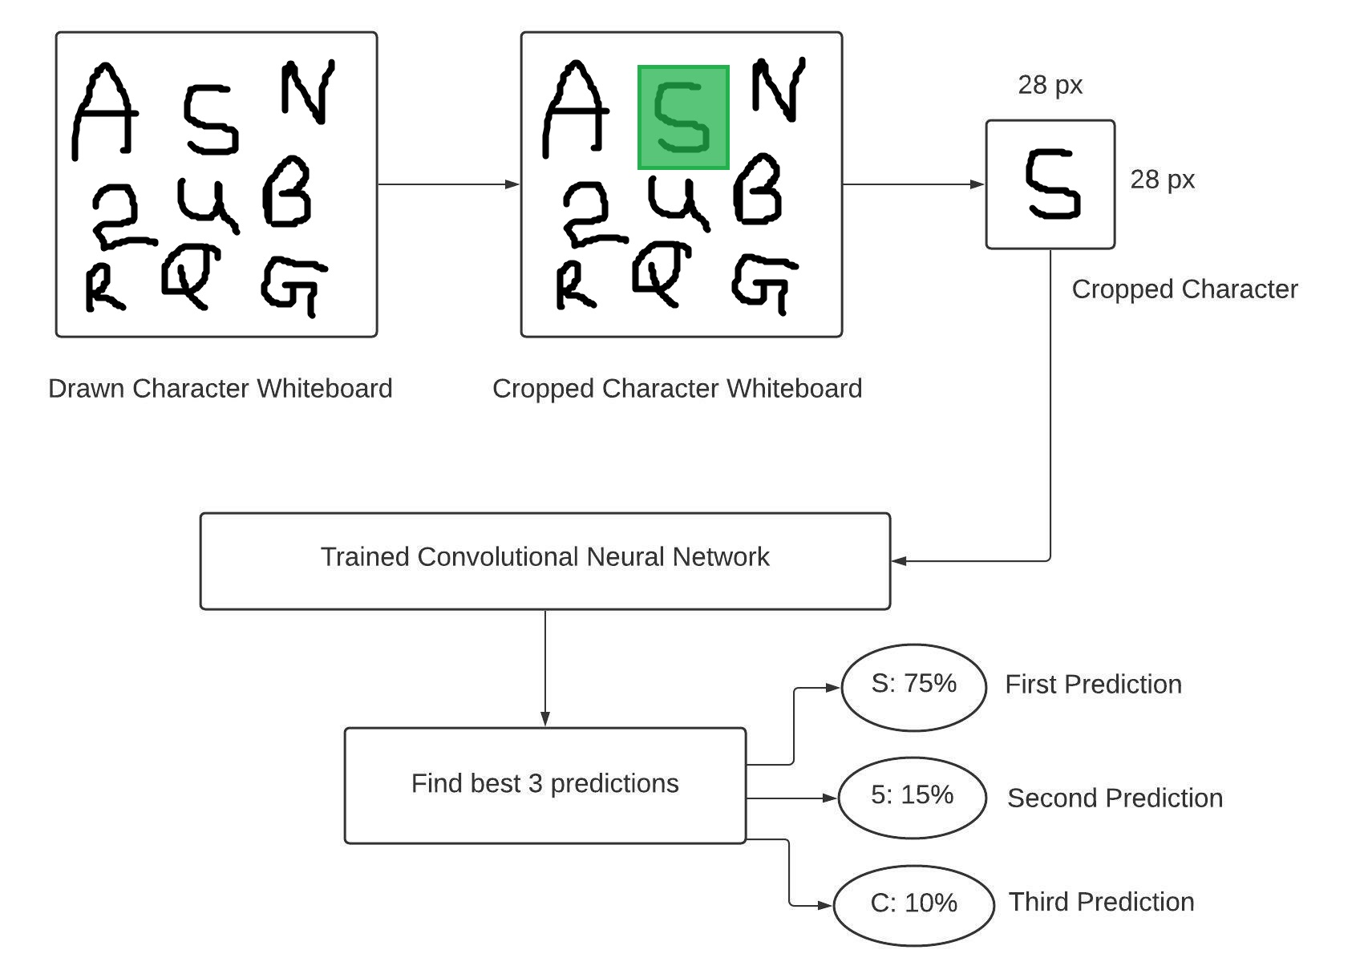
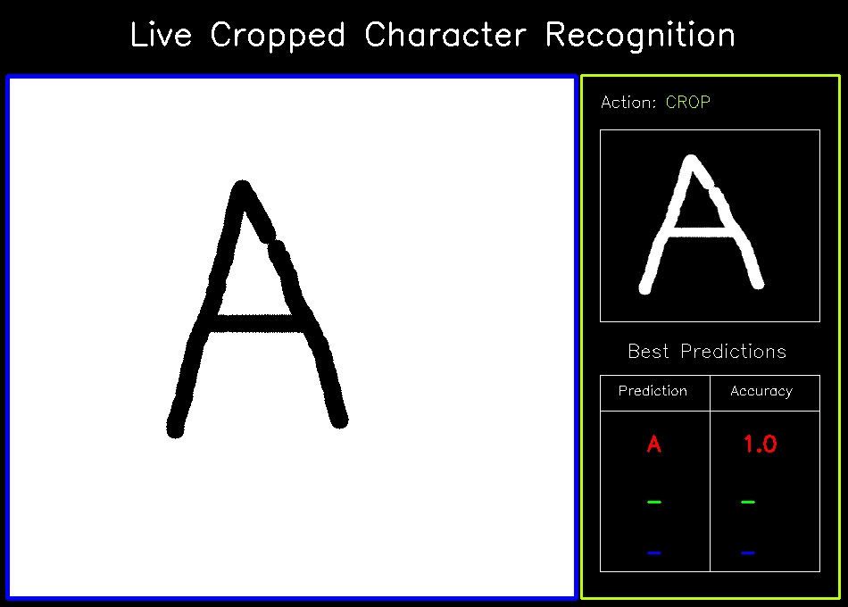
Project structure
This is our GUI that predict our painting data on it and I have a video explain it how to run in this link

