Slide 1

A Reduced-Input Machine Learning Framework for
Predicting Water Quality Index Using WQI Sub-indices as
Engineered Features
Full name: Toan Nguyen The (Toan)
Student ID: U2560895
Supervisor: Dr. Muhammad Zahid Hussain
Date: 13/05/2026
Department of Computer Science, University of Huddersfield
1
Notes:
Good morning Dr. Hussain and my examiner Dr. sa Inuwa-Dutse. My name is Toan and I’m come from Vietnam and today, I’m going to present my individual project which names A Reduced-Input Machine Learning Framework for Predicting Water Quality Index Using WQI Sub-Indices as Engineered Features

Slide 2

OUTLINE
1
Introduction
2
Methods
3
Results and Discussion
4
Conclusions
2
Notes:
My presentation has 4 main parts.
First, I will begin with an introduction.
Next, I will explain methods of my study, followed by its results and discussion. Finally, I will summarize my whole project in the conclusion
Let me start with the introduction.

Slide 3


1. Introduction
3

Slide 4
Introduction
Background information
Water quality management is important as it impacts many aspects of society and economy (Mogane et al, 2023)
Water Quality Index helps to manage easier by integrating multiple parameters into an single scores (Chidiac et al., 2023)
Applying machine learning and feature selection to predict WQI can help reduce cost and effort (Lap et al., 2023)
Recently studies lack a standardized framework and using WQI sub-indices as input variables.
4
Notes:
Water quality management is important because it affects many aspects of society and the economy.
The WQI helps people understand water quality more easily by combining multiple parameters into a single score.
In other words, people only need to interpret one overall score instead of analysing many individual parameters.
Machine learning can be applied to predict WQI using the input parameters required for WQI calculation.
And applying feature selection to reduce the number of input parameters can help reduce costs and effort.
However, recently studies lack a standardized framework and using WQI sub-indices as input variables.

Slide 5
Introduction: Aims & Objective
The study aims to develop a reduced-input yet reliable machine learning framework for predicting the VN_WQI, balancing predictive accuracy and resource cost.
To identify the best-performing machine learning model for WQI prediction in Quang Ninh province.
To compare the effects of raw features, and WQI sub-index as input features, in predictive modelling, and to assess their predictive performance relative to reduced-parameter WQI formulas.
To investigate the effectiveness of different feature selection methods.
5
Notes:
To handle these research gaps, this study aims to develop a reduced-input yet reliable machine learning framework for predicting the VN_WQI, balancing predictive accuracy and resource cost.
To achieve this aim, the study has three main objectives:
Firstly, To identify the best-performing machine learning model for WQI prediction in Quang Ninh province.
Secondly, To compare the effects of raw features, and WQI sub-index as input features, in predictive modelling, and to assess their predictive performance relative to reduced-parameter WQI formulas.
Lastly, To investigate the effectiveness of different feature selection methods.

Slide 6
2. Methods
6
Notes:
To achieve these objective, the study uses the following methods

Slide 7
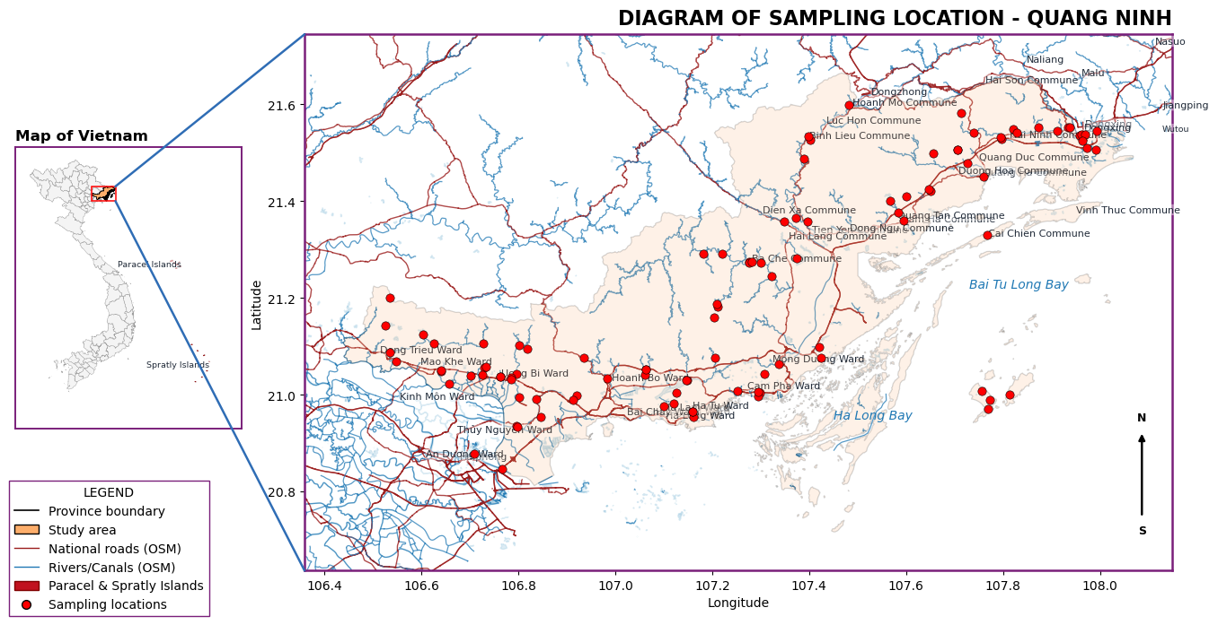
Methods: Study Area
125 monitoring locations
Between 2021 and 2024
Located near Ha Long Bay (UNESCO site)
1,101 records
16 features
Fig 1. Spatial distribution of the study area and water quality sampling stations in Quang Ninh Province, Vietnam.
7
Notes:
First, we will begin with the dataset. I made this dataset by collecting records from many environment reports of Vietnamese government.
As you can see, each point in the figure 1 represent for a locations and there are total 125 locations from 2021 to 2024
The reason why I choose these locations is because they are near Ha Long Bay which is UNESCO site.
After pre-processing, this dataset has 1,101 records and 16 features

Slide 8
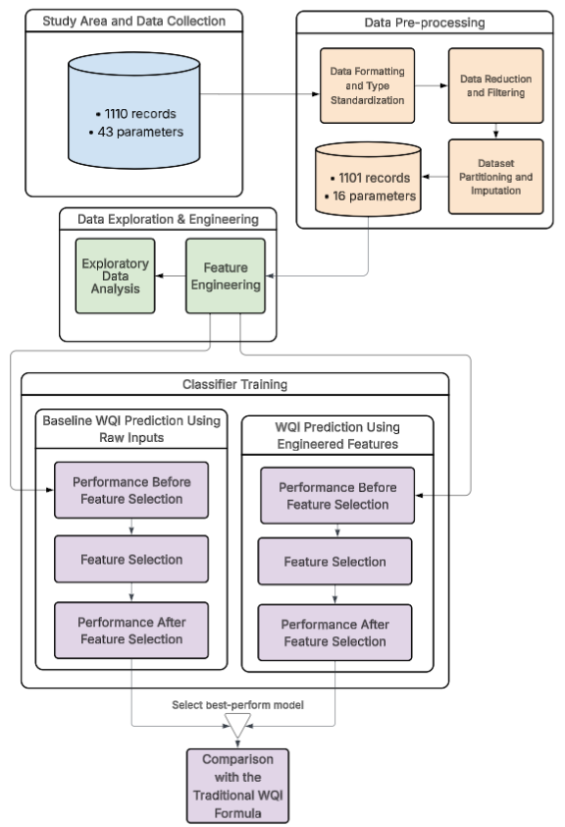
Methods: Workflow
1. Data pre-processing
Standardisation of Missing Data Indicators
Treatment of Censored Data
Numerical Localisation
Numerical Data Conversion
2. Data pre-processing
Cross-Validation Configuration
KNN Imputation for Missing Values
3. Feature Engineering Framework
Derivation of WQI-based Features
Data Standardisation
Exploratory Data Analysis
Fig 2: High-Level Overview of the Workflow
8
Notes:
Moving on to the workflow, before data preprocessing, the dataset consisted of 1,110 records and 43 parameters.
After preprocessing, it was reduced to 1,101 records and 16 parameters.
After engineering dataset, the study use it as input for four scenarios, which will be described more details later. Finally, the best-performing model from the best scenario will be compared with the WQI formula performance.

Slide 9
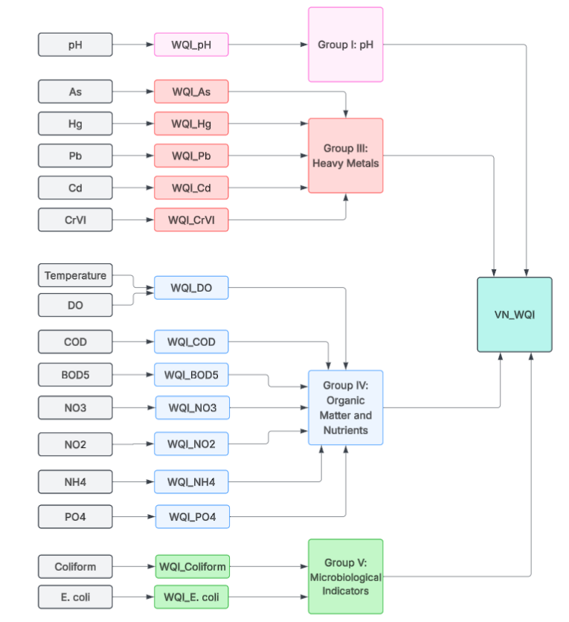

Methods: WQI Formula
The WQI formula was calculated according to the guidelines of MONRE (2019).
Water quality parameters are converted into WQI sub-indices.
The WQI sub-indices are grouped into 4 categories, which are then combined to obtain the VN_WQI.
$$WQI = \frac{{WQI}_{pH}}{100}×\frac{{\left(\prod_{a=1}^{5}{{WQI}_{III}}\right)}^{\frac{1}{5}}}{100}×{\left(\frac{1}{7}\sum_{b=1}^{7}{{WQI}_{IV}}×\frac{1}{2}\sum_{c=1}^{2}{{WQI}_{IV}}\right)}^{\frac{1}{2}}$$
Fig 3: Visualisation of WQI Formula
9
Notes:
Before moving on to the details of 4 senarios. I would like to describe the WQI formula so that you can understand its inputs, outputs, and the relationship between them.
First, each raw parameter is used to calculate its WQI sub-index. For example, pH is transformed into a WQI-pH.
After that, the WQI sub-indices are grouped into four categories, as shown in Figure 3.
Finally, the overall WQI is calculated based on these four groups. Here is the formula used to compute the final WQI.

Slide 10
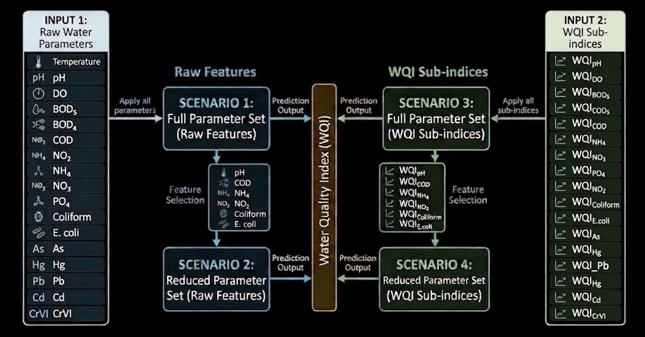
Methods: Experimental Design Scenarios
Total 4 scenarios:
Same pipeline
Different Inputs
Scenario 1: Full raw inputs
(16 parameters)
Scenario 2: Selected raw inputs
(6 parameters)
Scenario 3: Full engineered inputs
(15 parameters)
Scenario 4: Selected engineered inputs
(6 parameters)
Fig 4: Experimental Scenarios Overview
10
Notes:
Now, I will talk about four scenarios. The first thing is all of them follow the same pipeline; the only difference between them is input features.
In Scenario 1, the study uses the full set of raw inputs which is 16 parameters. In Scenario 2, after feature selection, only the most important 6 raw features are used.
For Scenarios 3 and 4, WQI sub-indices are used as inputs. Scenario 3 includes all WQI sub-index parameters, while Scenario 4 uses only the selected sub-index features.

Slide 11
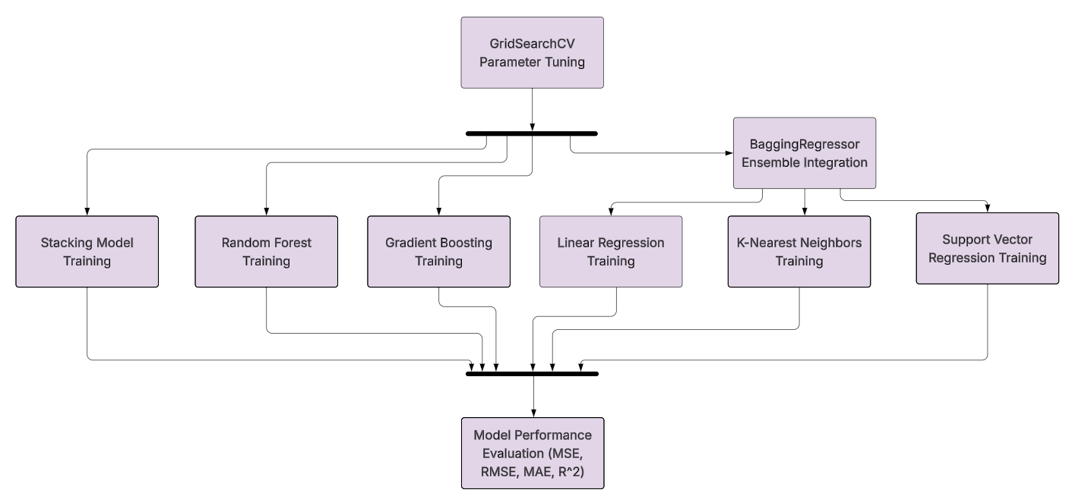
Methods: Experimental Design Scenarios
Applied GridSearchCV for hyperparameter tuning across traditional ML models.
Applied 5 single models and 26 stacking models.
Evaluated models using RMSE, MSE, MAE, and R².
Fig 5: Unified Pipeline Machine Learning for 4 Scenarios
11
Notes:
Here is the pipeline for all 4 scenarios. As shown in Figure 5, the pipeline applies GridSearchCV to optimize hyperparameters.
After that, five single models and 26 stacking models were trained.
In the final stage, the models are assessed using several metrics.

Slide 12
3. Results and Discussion
12
Notes:
Now I will show the result of project and also discuss about it

Slide 13
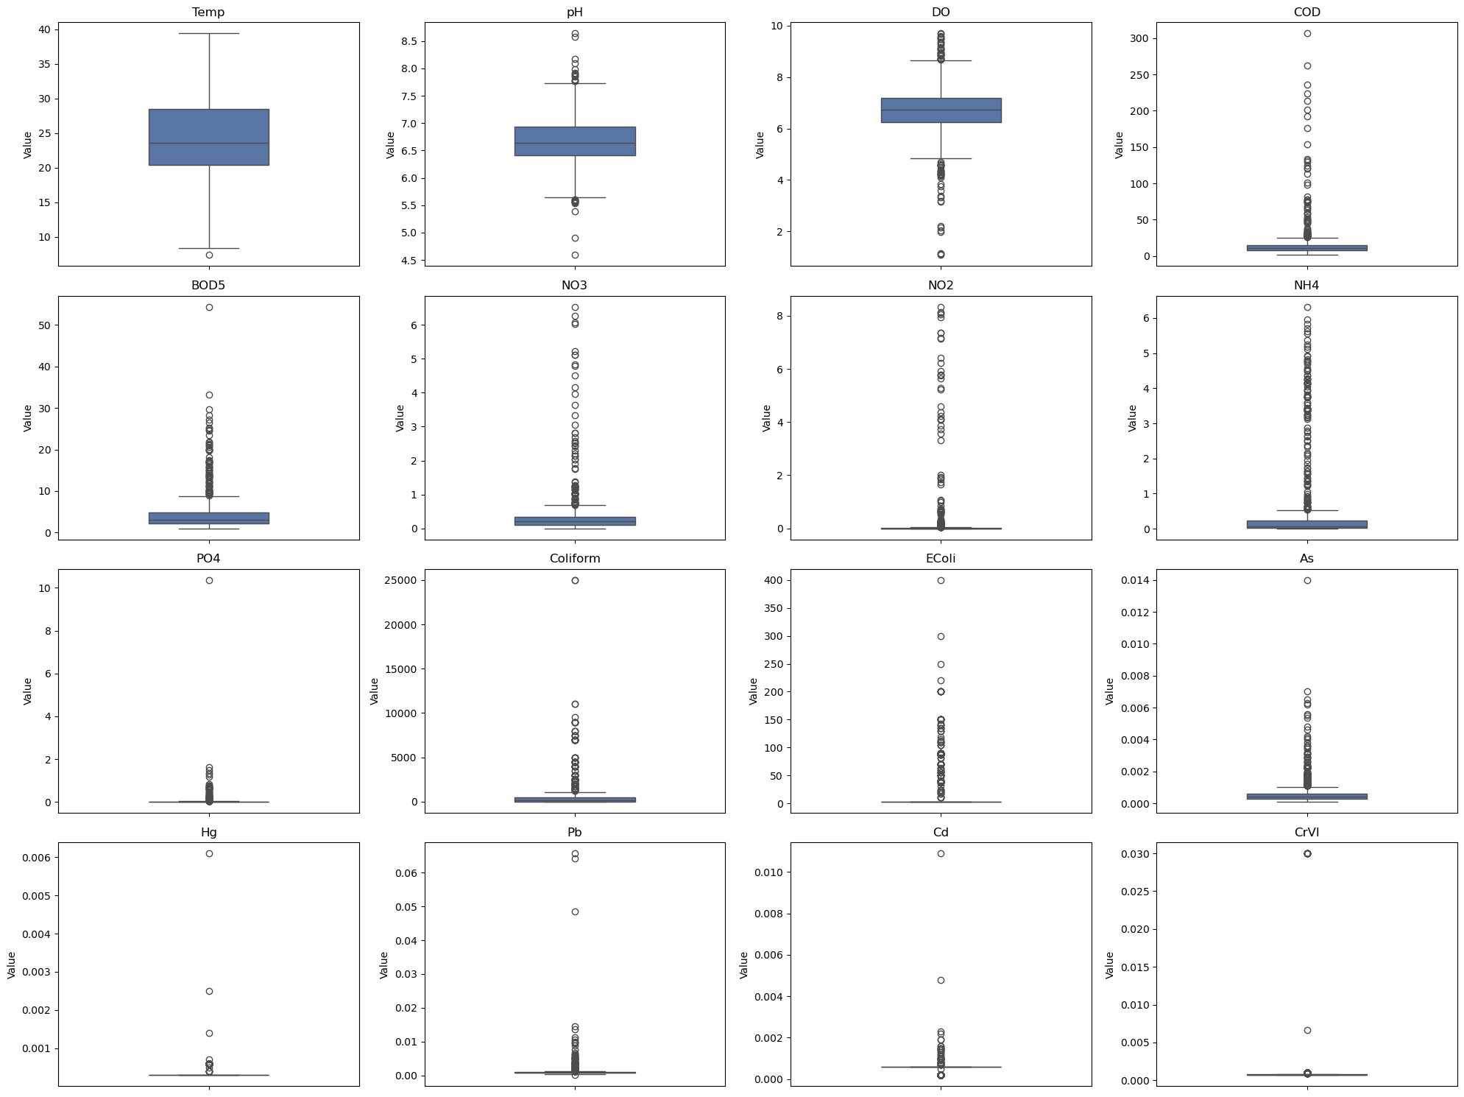
Results and Discussion
Exploratory Data Analysis
Although many outliers may represent noise, extreme values are likely associated with intensive open-pit coal mining activities (Thien, 2017; Marquez et al., 2018)
Nevertheless, noisy records should still be carefully considered in other studies.
Fig 6. Box Plots of the Attributes in the Dataset
13
Notes:
As illustrated in figure 6, there are many outliers but it is real values because of open-pit coal mining activities.
However, people should consider about noisy records in other studies.

Slide 14
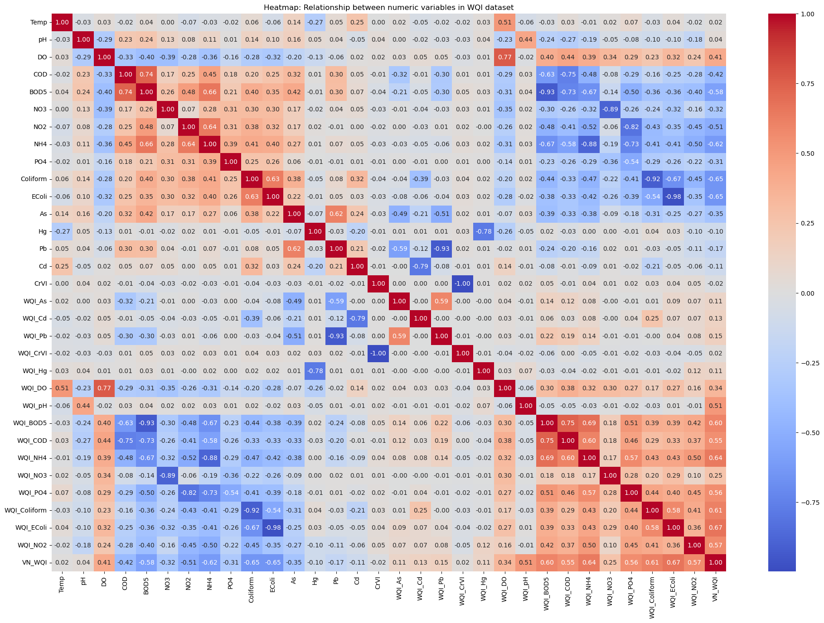
Results and Discussion
Exploratory Data Analysis (Cont.)
Correlation of COD with BOD is 0.74.
Can remove one of them.
WQI sub-index attributes are highly impact to WQI scores.
=> This evidence lead to motivate to using WQI-sub index as inputs.
Fig 7: Heatmap of Relationships Between Numeric Variables
14
Notes:
The figure 7 show the heatmap of the dataset.
Although it look a little bit complex but the knowledge can take away from the heatmap is Correlation of COD with BOD is 0.74 so that we can consider remove one of them to save time and cost.
And also WQI sub-index attributes are highly impact to WQI scores.
This evidence lead to motivate to using WQI-sub index as inputs

Slide 15
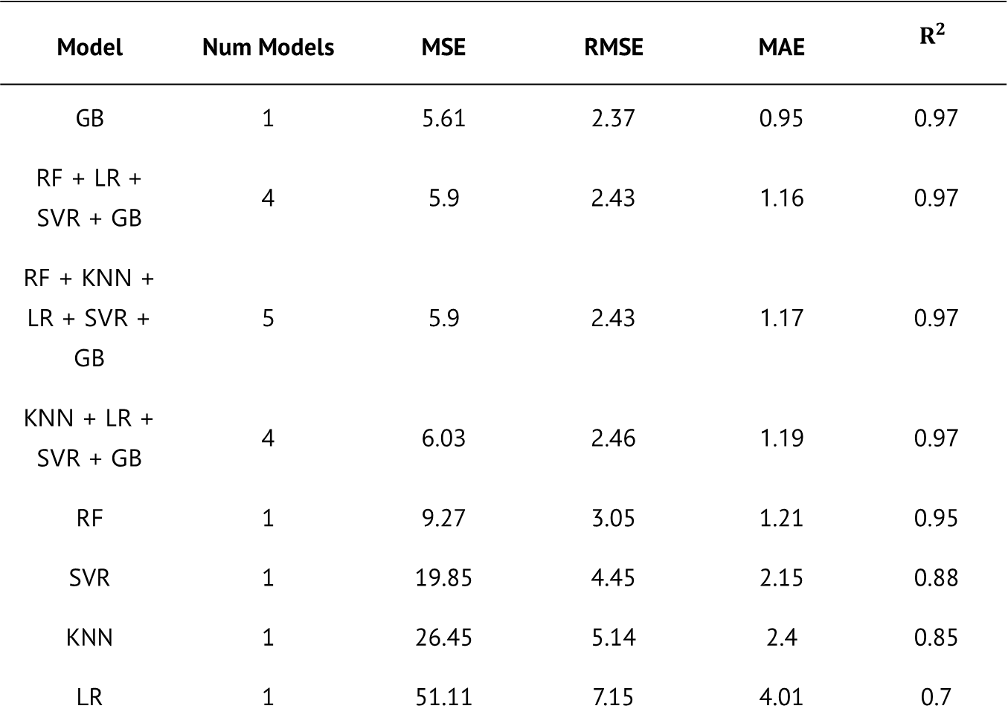
Results and Discussion
Table 1: Regression Models Performance on Raw Water Quality Inputs (Pre Feature Selection)
Scenario 1: Full raw parameters
Gradient Boosting is the best-perform model
Based-tree model is better than other single models
Stacking models perform worse than single model
Model | Num Models | MSE | RMSE | MAE | $$R^{2}$$
GB | 1 | 5.61 | 2.37 | 0.95 | 0.97
RF + LR + SVR + GB | 4 | 5.9 | 2.43 | 1.16 | 0.97
RF + KNN + LR + SVR + GB | 5 | 5.9 | 2.43 | 1.17 | 0.97
KNN + LR + SVR + GB | 4 | 6.03 | 2.46 | 1.19 | 0.97
RF | 1 | 9.27 | 3.05 | 1.21 | 0.95
SVR | 1 | 19.85 | 4.45 | 2.15 | 0.88
KNN | 1 | 26.45 | 5.14 | 2.4 | 0.85
LR | 1 | 51.11 | 7.15 | 4.01 | 0.7
15
Notes:
Now we start with the first scenario: this scenario use full raw inputs
As you can see in the table 1, Gradient Boosting is the best-perform model
Additionally, Based-tree model is better than other single models
Also, top 3 Stacking model perform worse than the best single model

Slide 16
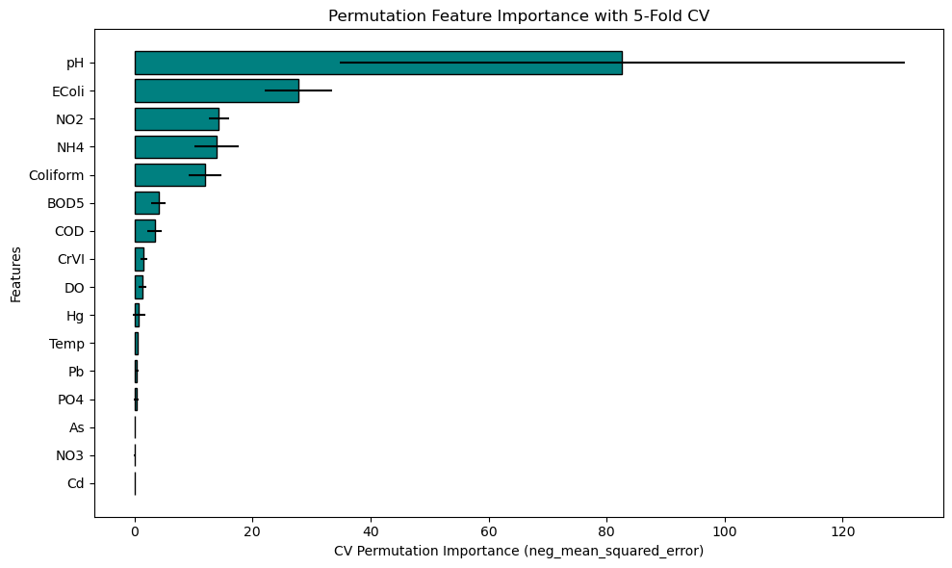
Results and Discussion
Scenario 1: Full raw parameters
Selecting the best-performing GB model for permutation importance analysis.
CrVI, DO, Hg, Temperature, Pb, PO₄, As, NO₃, and Cd were removed as they were found to have little impact on the models.
BOD₅, which is a parameter that takes a long time to measure but can be replaced by COD.
Fig 8: Permutation Feature Importance with 5-Fold CV for WQI Prediction Using Raw Input Parameters (Pre Feature Selection)
16
Notes:
Next, we examine the permutation feature importance shown in Figure 8.
The study selected the best-performing Gradient Boosting model for permutation importance analysis.
9 parameters as shown in the slide were removed as they were found to have little impact on the model’s performance.
BOD5 also were remove because it can be replaced by COD

Slide 17
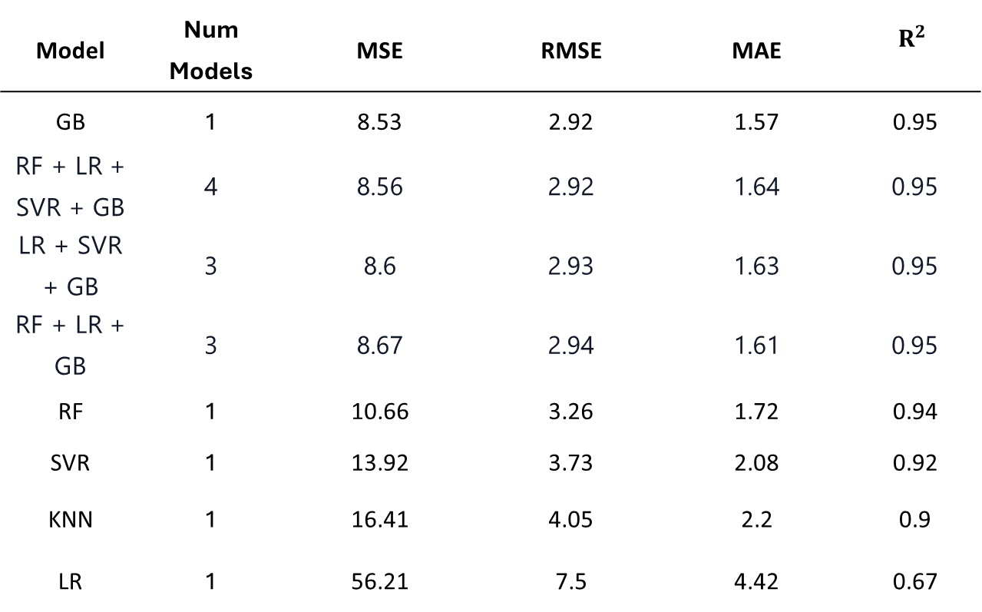
Results and Discussion
Table 2: Regression Models Performance on Raw Water Quality Inputs (After Feature Selection)
Scenario 2: Selected raw parameters
Gradient Boosting is the best-perform model, saving time and cost with minimal accuracy loss
Based-tree model is better than other single models
Stacking model perform worse than single model
=> Apply feature selection doesn’t change ranking of models
Model | Num Models | MSE | RMSE | MAE | $$R^{2}$$
GB | 1 | 8.53 | 2.92 | 1.57 | 0.95
RF + LR + SVR + GB | 4 | 8.56 | 2.92 | 1.64 | 0.95
LR + SVR + GB | 3 | 8.6 | 2.93 | 1.63 | 0.95
RF + LR + GB | 3 | 8.67 | 2.94 | 1.61 | 0.95
RF | 1 | 10.66 | 3.26 | 1.72 | 0.94
SVR | 1 | 13.92 | 3.73 | 2.08 | 0.92
KNN | 1 | 16.41 | 4.05 | 2.2 | 0.9
LR | 1 | 56.21 | 7.5 | 4.42 | 0.67
17
Notes:
After selecting the key raw parameters, the study applied them in Scenario 2.
As can be seen, the conclusion remains the same as before: Gradient Boosting is still the best-performing model.
Tree-based models perform better than other single models, while the top 3 stacking model performs worse than the best single models.
This indicates that applying feature selection does not change the ranking of the models.

Slide 18
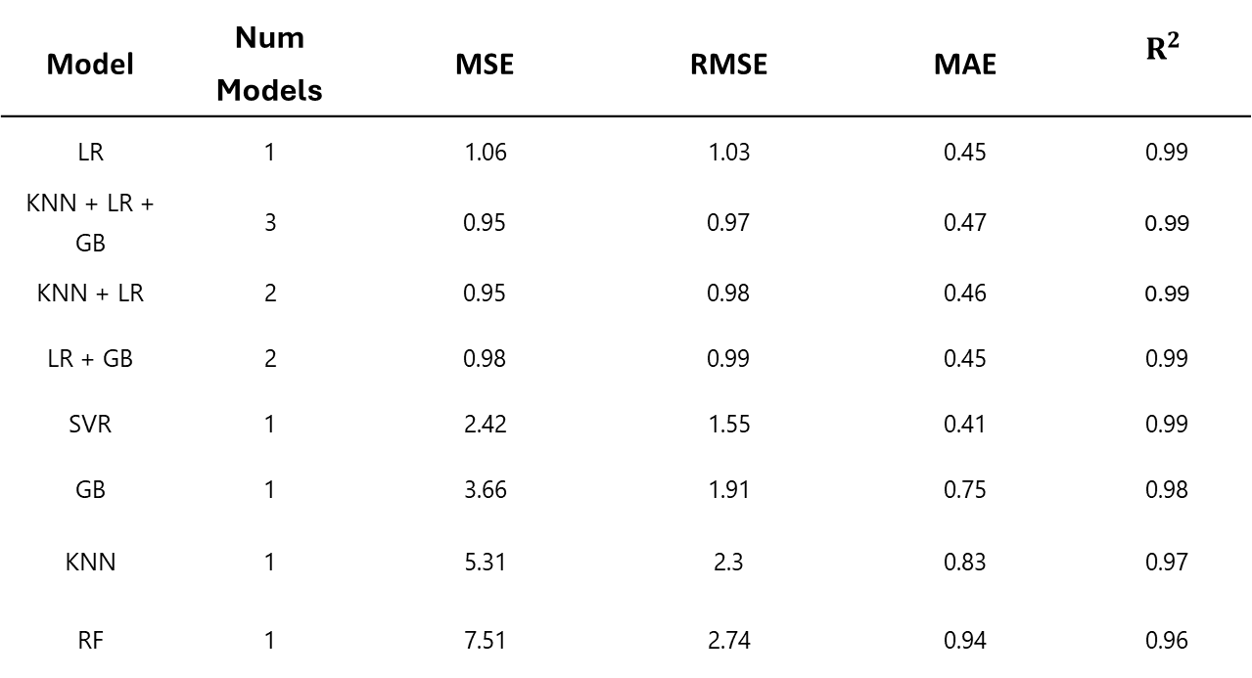
Results and Discussion
Scenario 3: WQI sub-index inputs with full parameters
Table 3: Regression Models Performance on WQI sub-indices Inputs Before Feature Selection
Linear Regression is the best-perform model
Stacking model doesn’t outperform single model
Best model using WQI sub-index inputs perform better than that using raw inputs.
Model | Num Models | MSE | RMSE | MAE | $$R^{2}$$
LR | 1 | 1.06 | 1.03 | 0.45 | 0.99
KNN + LR + GB | 3 | 0.95 | 0.97 | 0.47 | 0.99
KNN + LR | 2 | 0.95 | 0.98 | 0.46 | 0.99
LR + GB | 2 | 0.98 | 0.99 | 0.45 | 0.99
SVR | 1 | 2.42 | 1.55 | 0.41 | 0.99
GB | 1 | 3.66 | 1.91 | 0.75 | 0.98
KNN | 1 | 5.31 | 2.3 | 0.83 | 0.97
RF | 1 | 7.51 | 2.74 | 0.94 | 0.96
18
Notes:
In the scenario 3, the study use WQI sub-index inputs with full parameters
As can be seen in the table 3, Linear Regression is the best-perform model
Also top 3 Stacking model doesn’t outperform single model
And Best-perform model which achieve MSE is 1.06 using WQI sub-index inputs perform better than that using raw inputs which is GB with 5.61 in the scenario 1.

Slide 19
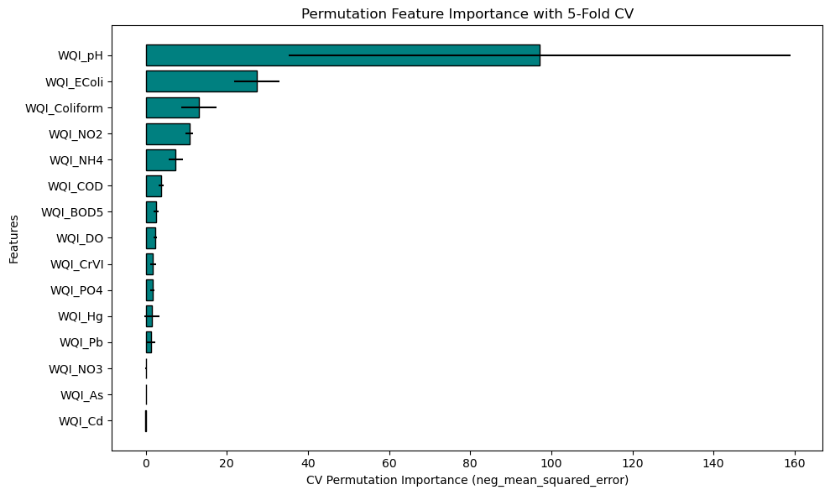

Results and Discussion
Scenario 3: WQI sub-index inputs with full parameters
Selecting the best-performing model (KNN + LR + GB) for permutation importance analysis.
WQ$I_{DO}$, WQ$I_{CrVI}$, WQ$I_{PO_{4}}$, WQ$I_{Hg}$, WQ$I_{Pb}$, WQ$I_{NO_{3}}$, WQ$I_{As}$, and WQ$I_{Cd}$ were removed because they exhibited minimal impact on model performance.
WQ$I_{BOd_{5}}$ was excluded due to slow measurement and redundancy with WQ$I_{COD}$
Fig 9: Permutation Feature Importance with 5-Fold CV for WQI Prediction Using Raw Input Parameters (Pre-Feature Selection)
19
Notes:
After identifying the best-performing model, the study selected it for permutation importance analysis.
These nine parameters were removed due to their minimal impact on the model or were replaced by other parameter.

Slide 20
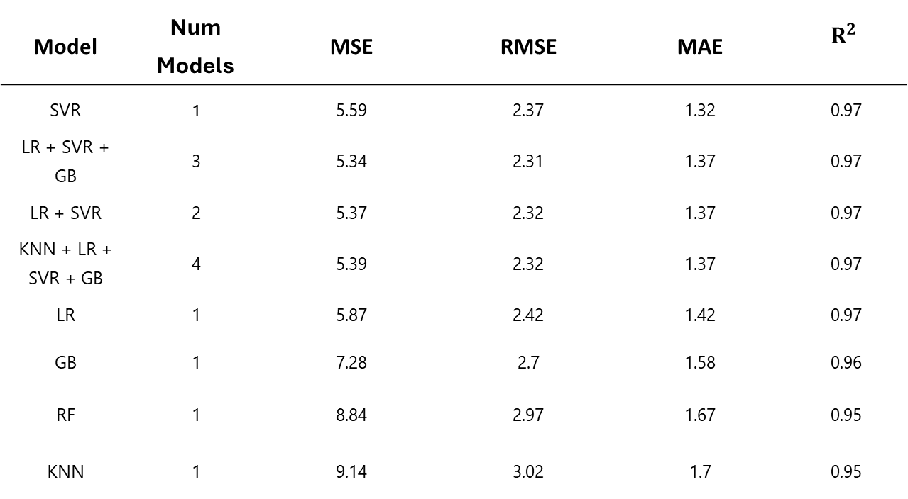
Results and Discussion
Scenario 4: WQI sub-index inputs with selected parameters
Table 4: Regression Models Performance on WQI sub-index
Inputs After Feature Selection
Model | Num Models | MSE | RMSE | MAE | $$R^{2}$$
SVR | 1 | 5.59 | 2.37 | 1.32 | 0.97
LR + SVR + GB | 3 | 5.34 | 2.31 | 1.37 | 0.97
LR + SVR | 2 | 5.37 | 2.32 | 1.37 | 0.97
KNN + LR + SVR + GB | 4 | 5.39 | 2.32 | 1.37 | 0.97
LR | 1 | 5.87 | 2.42 | 1.42 | 0.97
GB | 1 | 7.28 | 2.7 | 1.58 | 0.96
RF | 1 | 8.84 | 2.97 | 1.67 | 0.95
KNN | 1 | 9.14 | 3.02 | 1.7 | 0.95
Support Vector Regression is the best-perform model, saving time and cost with minimal accuracy loss.
Stacking model doesn’t outperform single model.
Best model using WQI sub-index inputs perform better than that using raw inputs.
20
Notes:
After selecting the most important WQI sub-index features, the study proceeds to the final scenario using selected WQI sub-index inputs.
As shown in Table 4, Support Vector Regression is the best-performing model.
Although the best-performing stacking model achieves a lower MSE than the best-perform single model,
it is still outperformed by the best-perform single model in MAE.
Therefore, the stacking model does not outperform the single model.
In addition, the best model using WQI sub-index inputs performs better than that using raw inputs compare with Scenario 3.

Slide 21
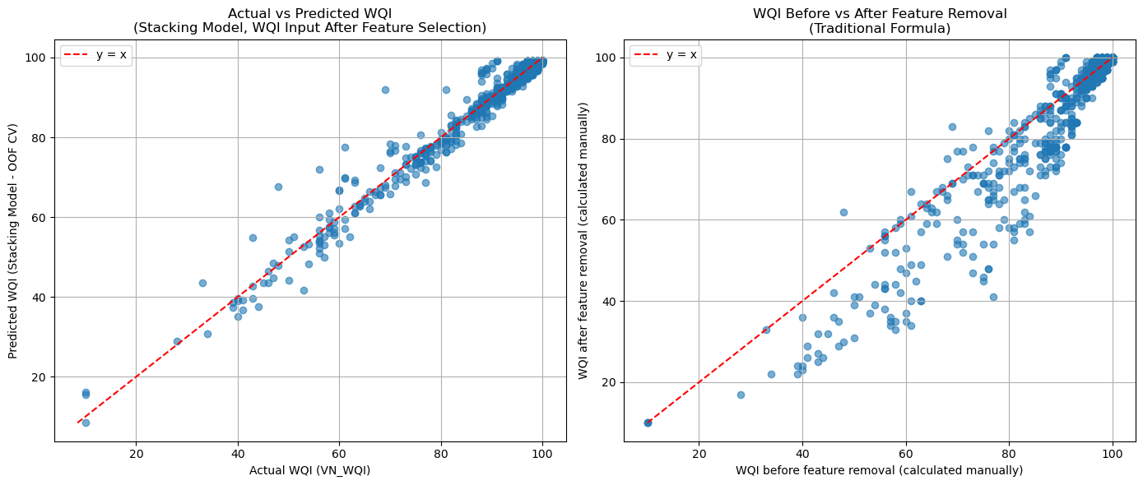
Results and Discussion
Comparative Performance Analysis
Compared to the WQI formula, the machine learning approach provides more stable predictions when using fewer attributes
Fig 10: Performance comparison of Best-Perform Machine Learning Model and Traditional Calculation methods under Feature Reduction constraints.
21
Notes:
Figure 5 shows two scatter plots. In both plots, the y-axis represents the actual WQI scores. In the left plot, the x-axis represents the predictions of the best-performing machine learning model, while in the right plot, it represents the outputs of the reduced WQI formula. And Compared to the WQI formula, the machine learning approach provides more stable predictions when using fewer attributes.

Slide 22
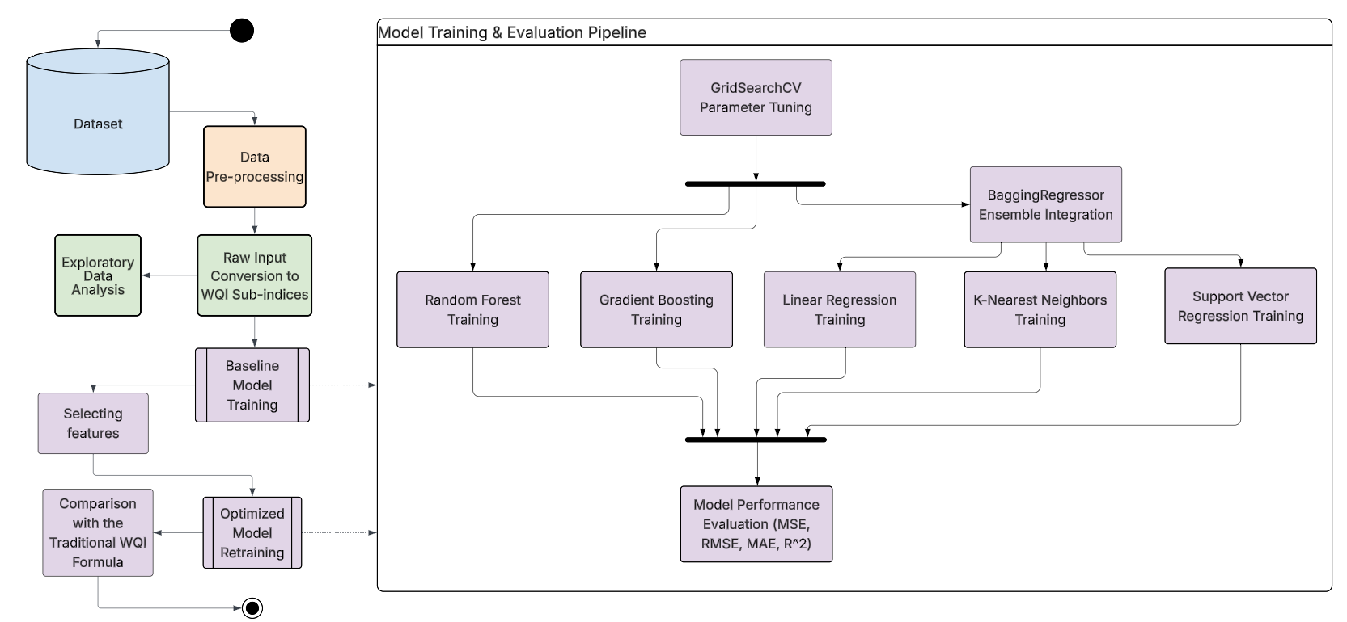
Results and Discussion
Framework Contributions
A flexible ML framework for WQI prediction is proposed for Vietnamese environmental data.
Use WQI sub-indices as input features
The stacking model was not selected.
Fig 11: Proposed Machine Learning Framework for WQI Prediction
22
Notes:
Based on the result illustrated before , The framework was applied to VN_WQI.
WQI sub-indices were used as input features, as experimental results indicated better performance compared to raw inputs.
Finally, The stacking model was not selected as its complex and take more time to training than single model while not outperform single model.

Slide 23
4. Conclusions
23
Notes:
Now we are moving into the last section which is conclusions

Slide 24
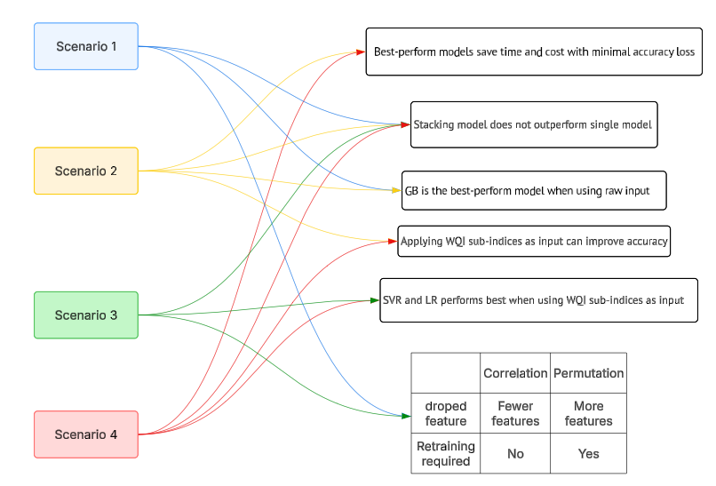
Conclusion
Summary of Achievements
Got knowledge from 4 scenarios
=> Developed a WQI prediction framework based on these knowledge
Fig 11: Knowledge Synthesis from Multi-Scenario Experimental Analysis
24
Notes:
Here is some summary of achievement
From the experimental results, it can be seen that best-perform model save time and cost with minimal accuracy loss and the stacking model does not outperform the single models. In particular, Gradient Boosting consistently shows the best performance when using raw input features.
However, when we switch to WQI sub-indices as input, the overall prediction accuracy improves noticeably. Under this setting, Support Vector Regression and Linear Regression become the best-performing models.
In terms of feature selection strategies, correlation-based selection reduces the number of features without requiring model retraining, whereas permutation importance provides a more detailed selection but requires retraining the model. This highlights a trade-off between efficiency and effectiveness.
Based on these findings, we therefore developed a unified framework that integrates these insights for improved modeling performance and computational efficiency.

Slide 25

Conclusion
Recommendation
Retain outliers (may reflect real observations)
Future Work
Compute exact cost savings
Explore deep learning + SHAP analysis
25
Notes:
In future studies, it is recommended that researchers carefully consider how outliers are handled, as they may represent valid real-world values rather than errors. Moreover, future work should quantify the exact cost savings instead of only reporting the reduction in the number of parameters. In addition, it would be beneficial to explore the application of deep learning models combined with SHAP analysis to improve both predictive performance and model interpretability.

Slide 26
References
Chidiac, S., El Najjar, P., Ouaini, N., El Rayess, Y., & El Azzi, D. (2023). A comprehensive review of water quality indices (WQIs): History, models, attempts and perspectives. Reviews in Environmental Science and Bio/Technology, 22(2), 349–395. https://doi.org/10.1007/s11157-023-09650-7
Lap, B. Q., Phan, T.-T.-H., Nguyen, H. D., Quang, L. X., Hang, P. T., Phi, N. Q., Hoang, V. T., Linh, P. G., & Hang, B. T. T. (2023). Predicting Water Quality Index (WQI) by feature selection and machine learning: A case study of An Kim Hai irrigation system. Ecological Informatics, 74, 101991. https://doi.org/10.1016/j.ecoinf.2023.101991
Marquez, J. E., Pourret, O., Faucon, M.-P., Weber, S., Hoang, T. B. H., & Martinez, R. E. (2018). Effect of cadmium, copper and lead on the growth of rice in the coal mining region of Quang Ninh, Cam-Pha (Vietnam). Sustainability, 10(6), 1758. https://doi.org/10.3390/su10061758
Mogane, L. K., Masebe, T., Msagati, T. A. M., & Ncube, E. (2023). A comprehensive review of water quality indices for lotic and lentic ecosystems. Environmental Monitoring and Assessment, 195(8), Article 926. https://doi.org/10.1007/s10661-023-11512-2
26
Notes:
Here is my reference list

Slide 27
References
Ministry of Natural Resources and Environment (MONRE). (2019). The decision on the promulgation of technical guidelines for calculation and publication of the Vietnam water quality index (VN_WQI).
Thien, C. T. (2017). Study on soil and water environment in coal mining area at Lo Tri coal mine, Quang Ninh Province. VNU Journal of Science: Earth and Environmental Sciences, 33(1S). https://doi.org/10.25073/2588-1094/vnuees.4178
27

Slide 28
Thank You For Listening
28
Notes:
Thank you for your attention. I’ll now be happy to answer any questions you may have.

Slide 29
Any Question?
u2560895@unimail.hud.ac.uk
29
Notes:
Thank you for your question, that’s an interesting point that you raise….
So, you are asking me whether I think this trend will continue?
That’s a good question, let’s see….
This is a complex issue, but let me try to address it.
I have to be honest with you, I’m not 100% sure on that but I would be happy to check the data and get back to you

