Slide 1
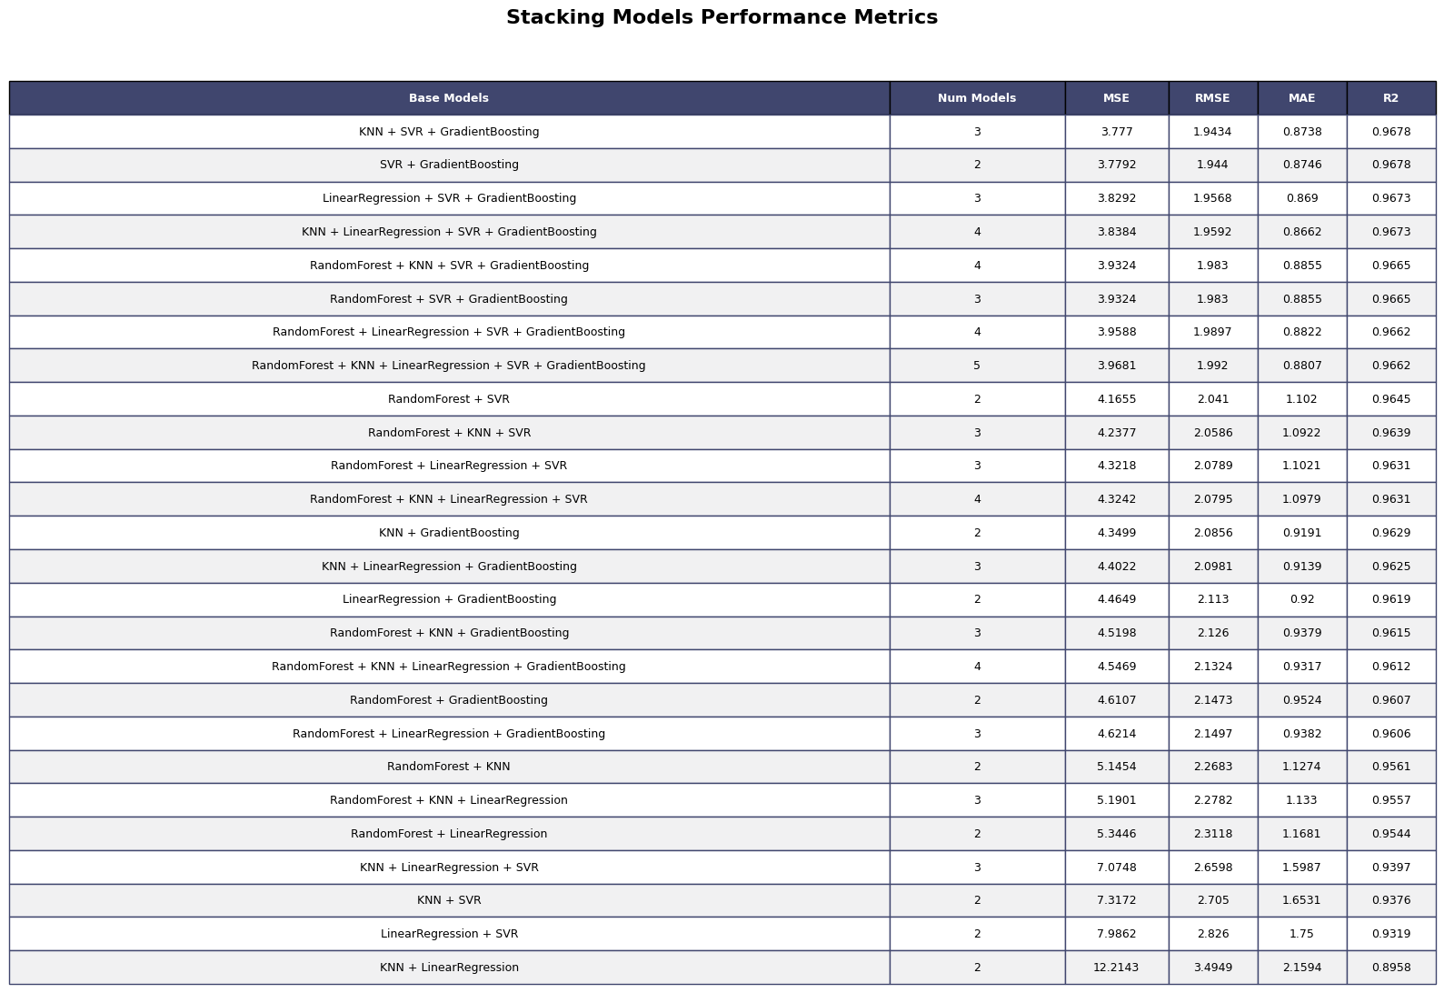
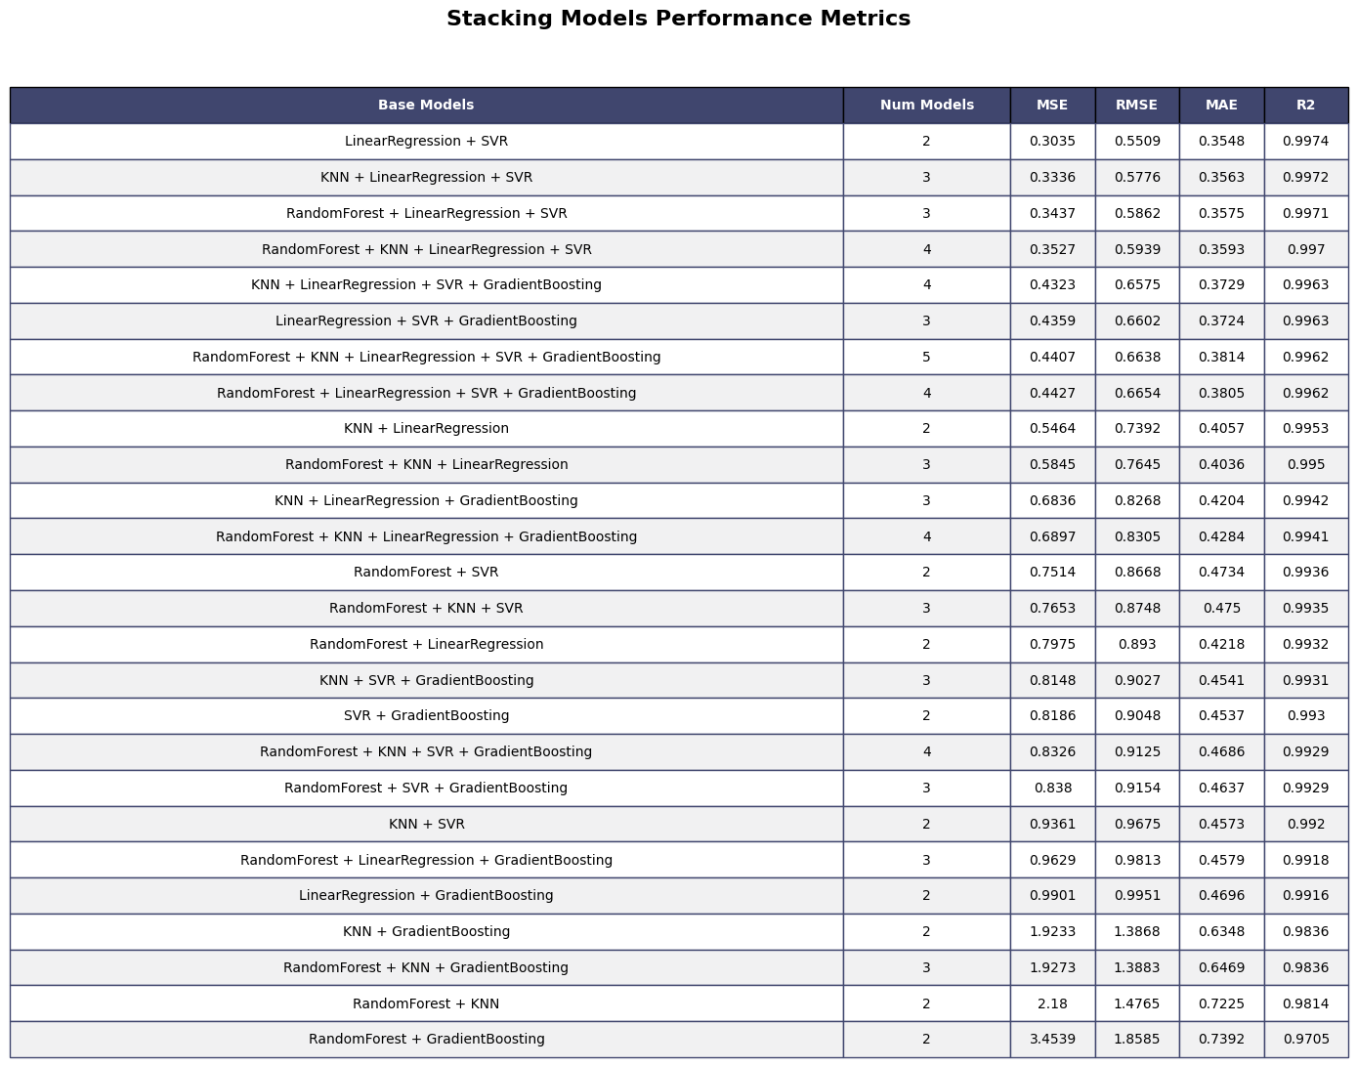
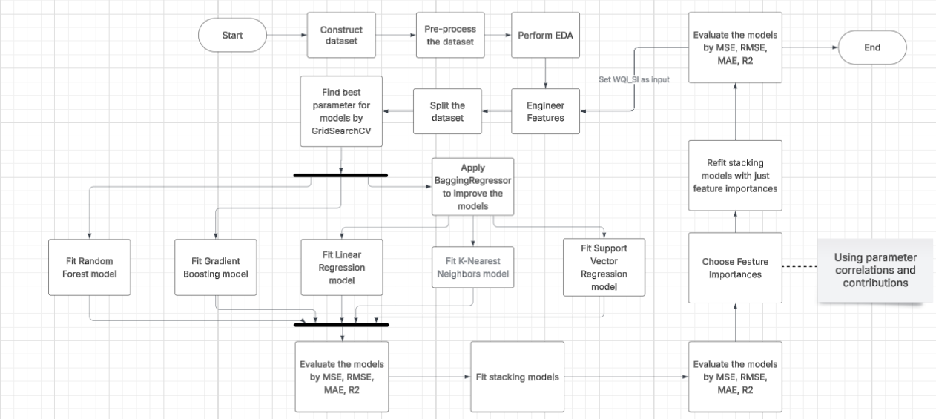
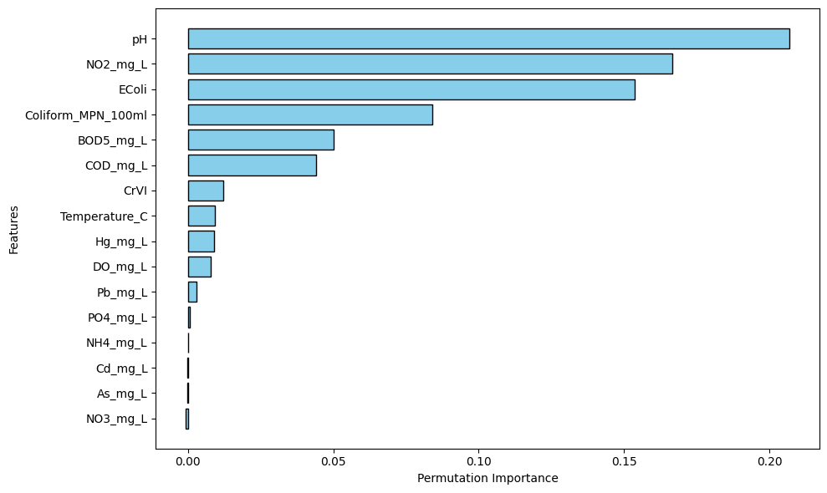
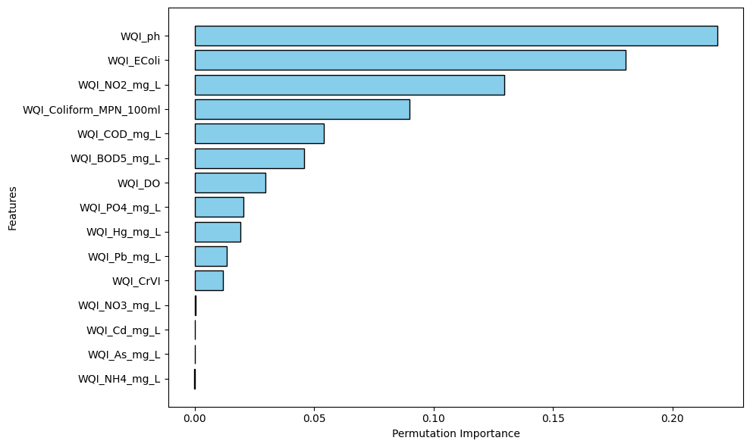
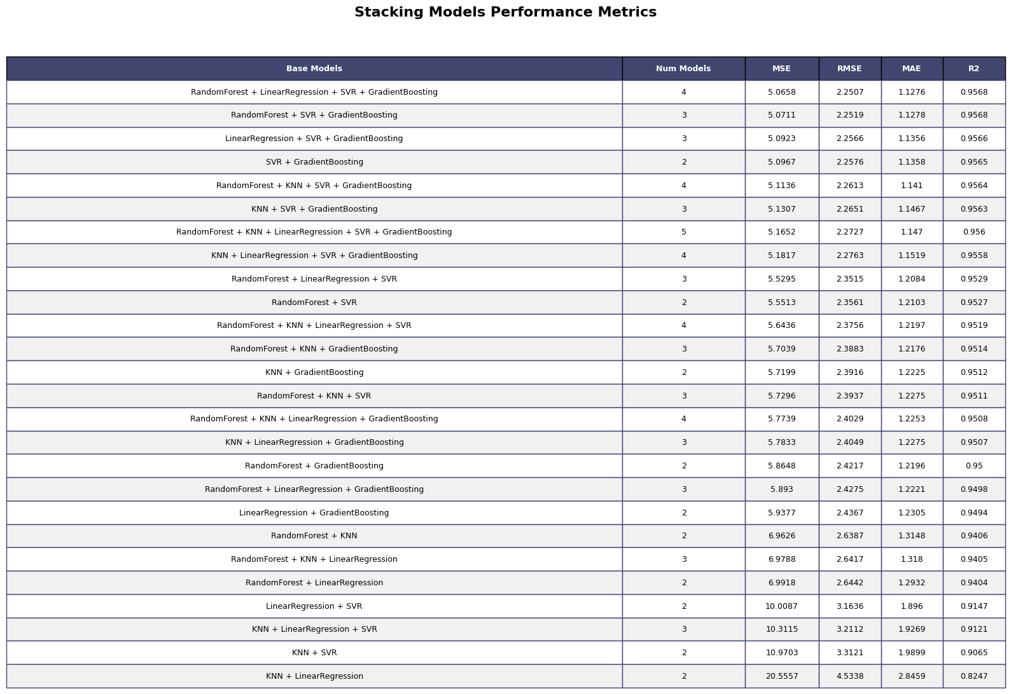
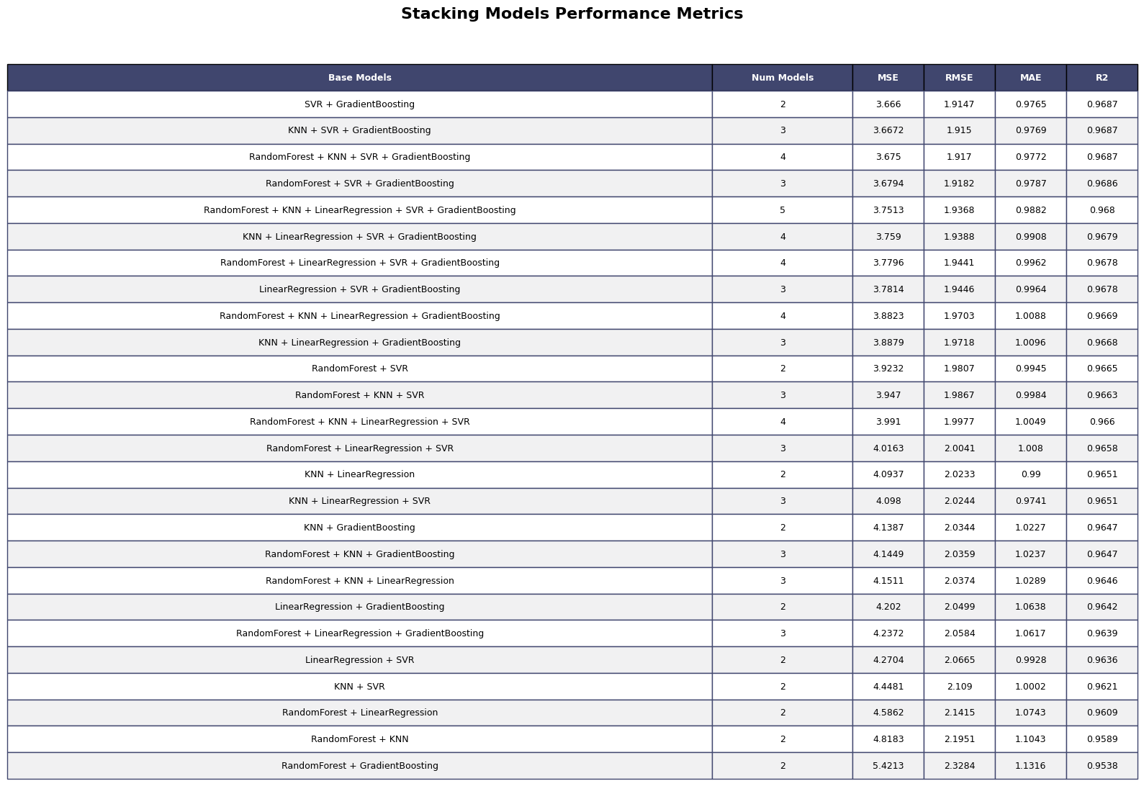
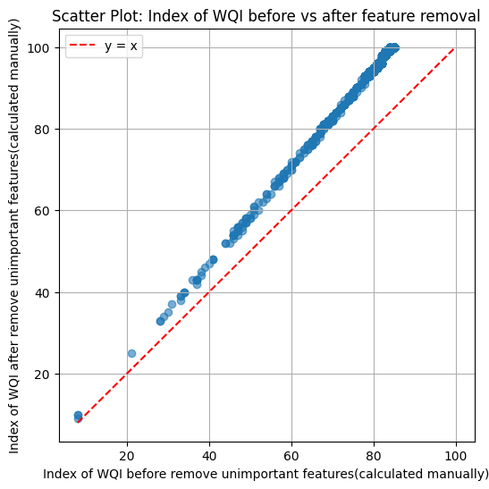
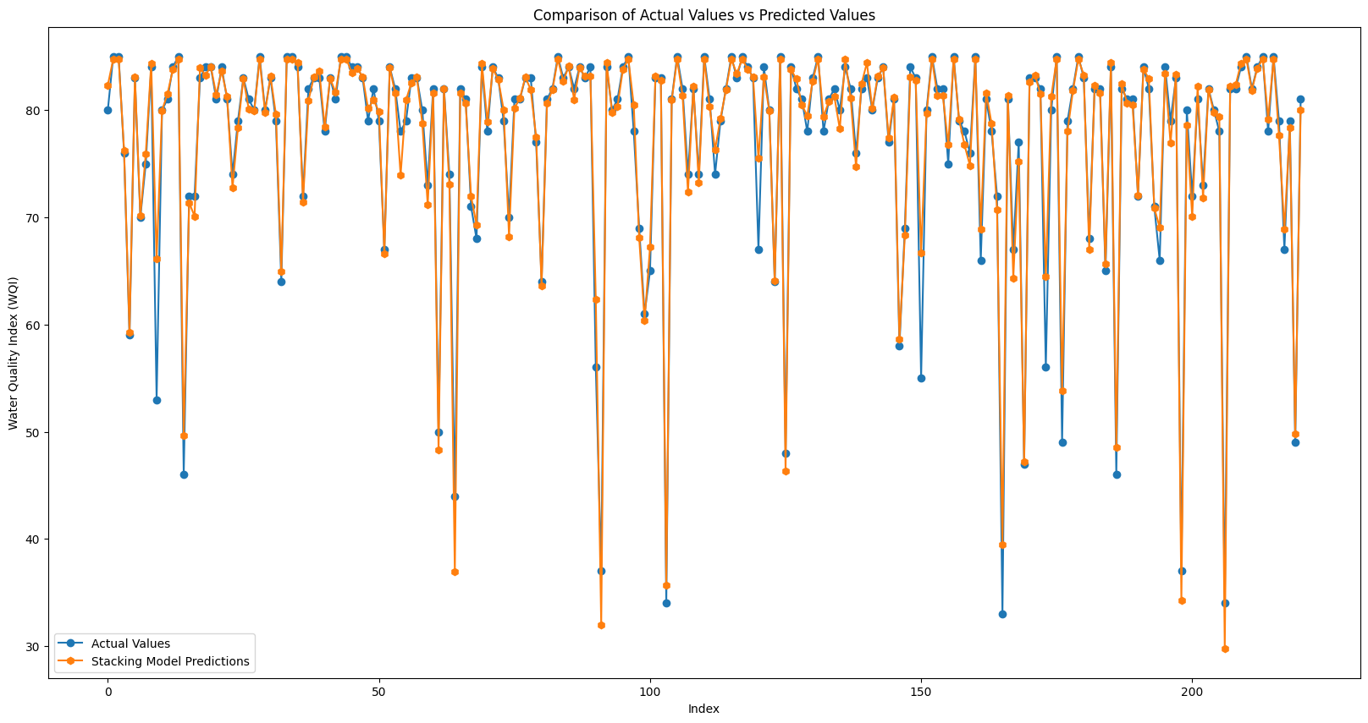
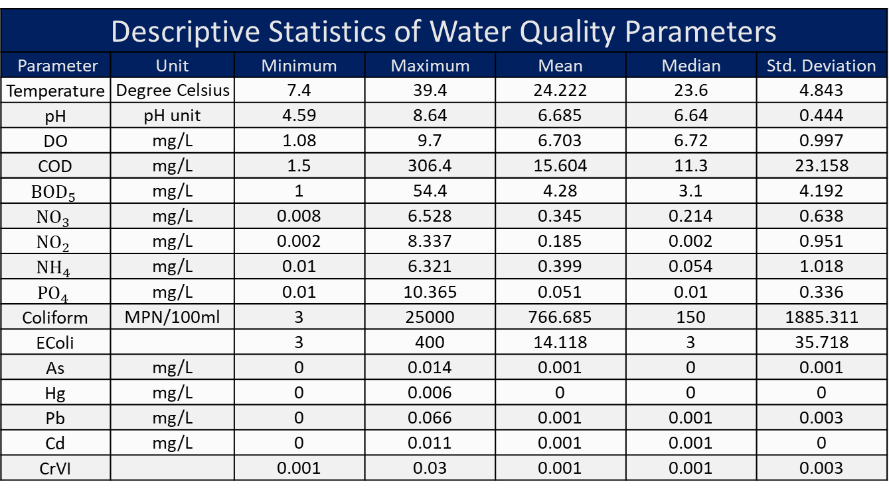
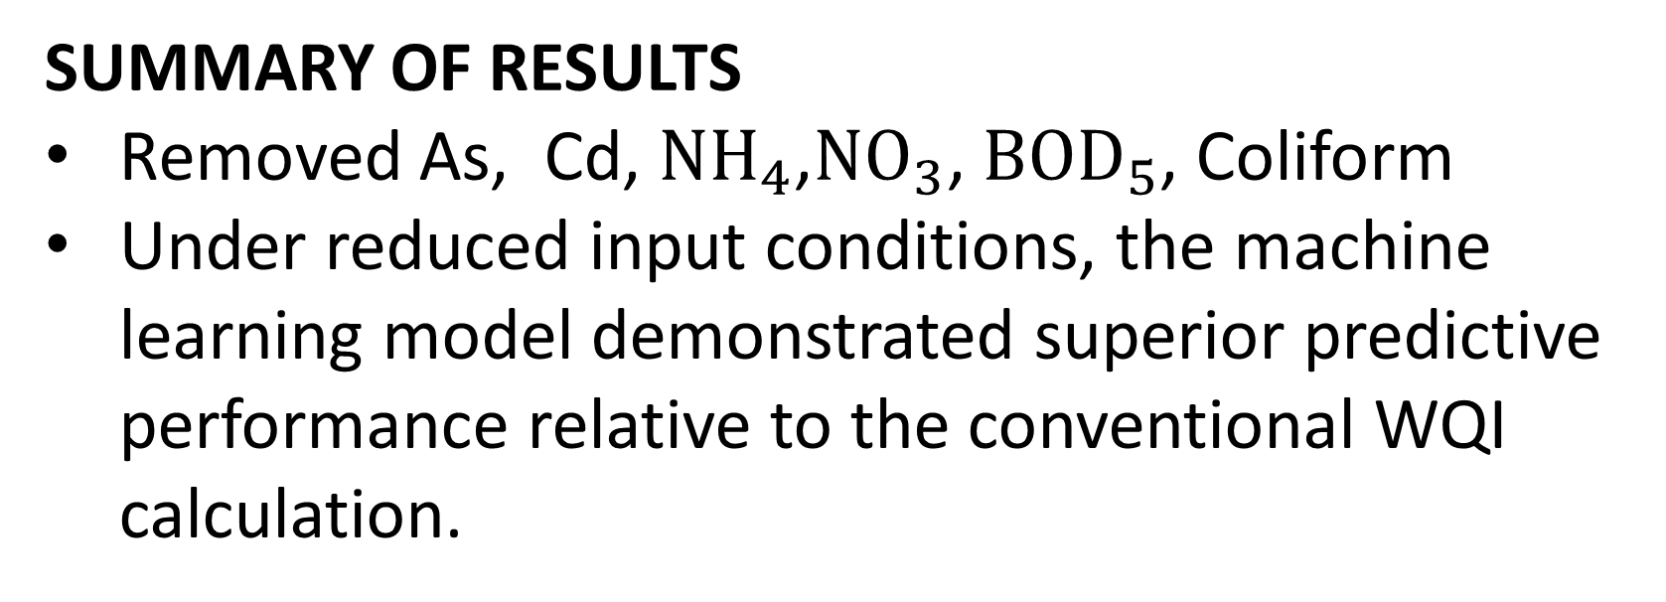
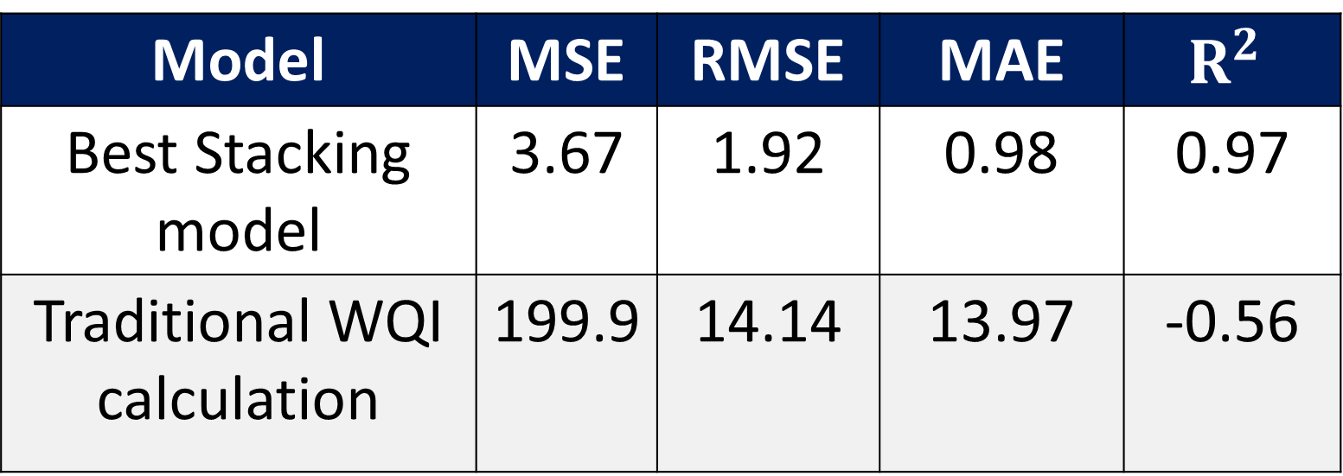
Water Index Quality(WQI) can be reliably predicted using a stacking model with fewer, low-cost parameters than the traditional WQI formula
DETAIL RESULTS
Direct Measurement Inputs
Feature Engineered Inputs (WQI_SI)
Before removing unimportant features
Before removing unimportant features
Model | MSE | RMSE | MAE | R²
Random Forest | 4.97 | 2.23 | 1.06 | 0.96
Gradient Boosting | 4.04 | 2.01 | 0.91 | 0.97
Linear Regression | 27.06 | 5.20 | 3.51 | 0.77
K-Nearest Neighbors | 14.34 | 3.79 | 2.15 | 0.88
Support Vector Regression | 10.31 | 3.21 | 1.75 | 0.91
Model | MSE | RMSE | MAE | R²
Random Forest | 3.54 | 1.88 | 0.71 | 0.97
Gradient Boosting | 3.43 | 1.85 | 0.75 | 0.97
Linear Regression | 0.75 | 0.87 | 0.45 | 0.99
K-Nearest Neighbors | 2.84 | 1.69 | 0.70 | 0.98
Support Vector Regression | 0.73 | 0.85 | 0.40 | 0.99
Title: Machine Learning-based Water Quality Index Prediction in the Quang Ninh Province, Vietnam
m
Toan Nguyen The - toannt204@gmail.com
Applied Computing (Top-up) BSc(Hons) – University of Huddersfield
BACKGROUND:
Water quality management is critical, especially in Quang Ninh Province and Ha Long Bay (UNESCO site).
Traditional WQI calculation is costly, time-consuming, and risky due to extensive field sampling, while WQI calculated with fewer parameters is less accurate.
AI-based WQI prediction is a recent trend due to its ability to use fewer parameters.
OBJECTIVE:
Execute feature selection
To optimize model performance through a data-driven and data-centric AI approach
WORKFLOW
After removing unimportant features
After removing unimportant features
SUMMARY OF RESULTS
Removed As, Cd, $NH_{4}$,$NO_{3}$, ${BOD}_{5}$, Coliform
Under reduced input conditions, the machine learning model demonstrated superior predictive performance relative to the conventional WQI calculation.
DICUSSION
Instead of using raw parameters, WQI sub-indices were used as model inputs, resulting in better model performance.
While previous studies often report that tree-based models perform best due to their robustness to outliers, our results show that after applying the transformed inputs, Linear Regression and Support Vector Regression achieved better performance.
In practice, standardization performed better than robust standardization, which is consistent with findings reported in some existing studies.
Using permutation importance for feature selection may remove critical information, making it harder to predict minority cases.
Descriptive Statistics of Water Quality Parameters
Parameter | Unit | Minimum | Maximum | Mean | Median | Std. Deviation
Temperature | Degree Celsius | 7.4 | 39.4 | 24.222 | 23.6 | 4.843
pH | pH unit | 4.59 | 8.64 | 6.685 | 6.64 | 0.444
DO | mg/L | 1.08 | 9.7 | 6.703 | 6.72 | 0.997
COD | mg/L | 1.5 | 306.4 | 15.604 | 11.3 | 23.158
$${BOD}_{5}$$ | mg/L | 1 | 54.4 | 4.28 | 3.1 | 4.192
$${NO}_{3}$$ | mg/L | 0.008 | 6.528 | 0.345 | 0.214 | 0.638
$${NO}_{2}$$ | mg/L | 0.002 | 8.337 | 0.185 | 0.002 | 0.951
$${NH}_{4}$$ | mg/L | 0.01 | 6.321 | 0.399 | 0.054 | 1.018
$${PO}_{4}$$ | mg/L | 0.01 | 10.365 | 0.051 | 0.01 | 0.336
Coliform | MPN/100ml | 3 | 25000 | 766.685 | 150 | 1885.311
EColi |  | 3 | 400 | 14.118 | 3 | 35.718
As | mg/L | 0 | 0.014 | 0.001 | 0 | 0.001
Hg | mg/L | 0 | 0.006 | 0 | 0 | 0
Pb | mg/L | 0 | 0.066 | 0.001 | 0.001 | 0.003
Cd | mg/L | 0 | 0.011 | 0.001 | 0.001 | 0
CrVI |  | 0.001 | 0.03 | 0.001 | 0.001 | 0.003
Model | MSE | RMSE | MAE | $$R^{2}$$
Best Stacking model | 3.67 | 1.92 | 0.98 | 0.97
Traditional WQI calculation | 199.9 | 14.14 | 13.97 | -0.56
Notes:
Notes:
In Powerpoint, click View > Guides
Keep text within gutter guides.
Author list: Don’t split names onto two lines (e.g., “Jimmy [break] Smith”). If that happens, use a new line, unless you need the space. Bold the first names of anybody who’s presenting in person.
Intro/methods/result: Do not drop below font size 28, but if you have extra space, jack up the font size until the space is full.
Do not use color in the sidebars except in graphs/figures. It’ll pull attention from the center and slow interpretation for passersby.

