Slide 1
Microservices Architecture
Toan Nguyen The - 2560895

Slide 2
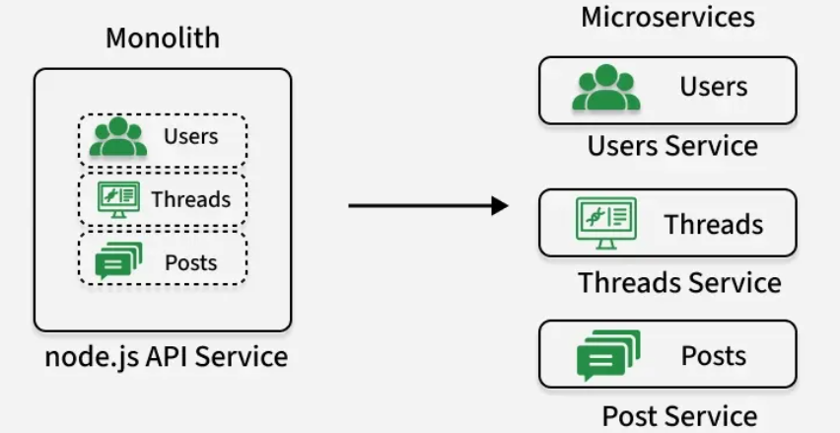
Theory
System split into independent services
Each service handles one business function
Communicates via APIs
Improves scalability, resilience, deployment speed
Fig 1: Example of difference Between normal architecture and microservices (geeksforgeeks, n.d.)

Slide 3
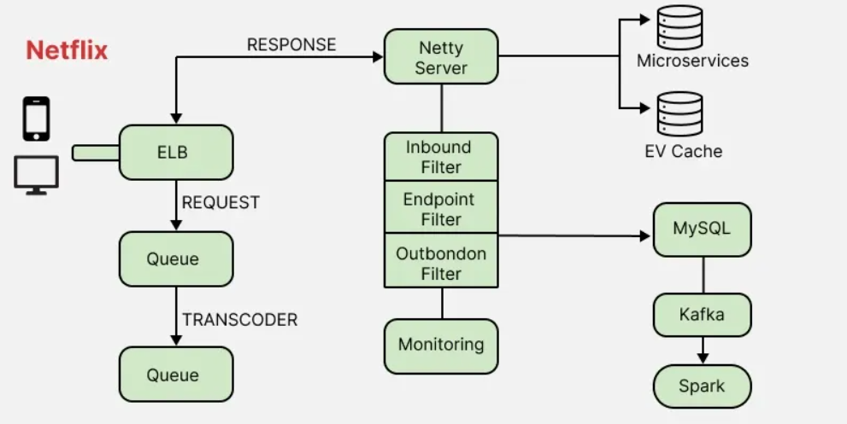
Application
Applied microservices to Netflix system structure
Identified independent services: streaming, user, recommendation
Helped understand scalability and system decomposition
Hindered by hidden dependencies and real-world complexity
Fig 2: A visualization of Netflix Microservice Architecture (geeksforgeeks, n.d.)

Slide 4
Legal Issues
Legal issue: A legal issue involves applying, interpreting, or assessing the validity of legal rules in relation to specific facts (Griffiths, 2016; MacCormick, 2005)
Digital piracy (music, films, games, books) accounts for about 22–40% of usage and rose significantly during the COVID-19 pandemic. (Mazzei et al., 2025).
User profiling & data processing may breach GDPR transparency requirements

Slide 5
Ethical Issues
An ethical issue is a situation where a decision raises questions about what is morally right or wrong, involving values such as fairness, privacy, and responsibility (Floridi et al., 2018; Stahl, 2021).
Therac-25 caused fatal radiation overdoses (Leveson & Turner, 1993).
Microservices dilute accountability by distributing failures across multiple services, making it difficult to assign clear ethical responsibility to individuals or teams.

Slide 6
Social Issues
A social problem refers to a societal condition that is widely regarded by many individuals as harmful or unacceptable and therefore in need of change (Mooney, Knox & Schacht, 2017).
Software-dependent critical infrastructures are tightly coupled, and failures may propagate across systems, causing cascading societal disruptions (Setola & Theocharidou, 2016).
Cloud-based streaming architectures may reinforce digital inequality for users with limited technological access.

Slide 7
Professional Issues
Professional issues involve the duties, ethical behaviour, accountability, and expected standards that professionals must uphold in their work (Loui, 2020).
A key professional issue in software architecture is balancing system performance with user privacy and security, where architects must make design trade-offs while maintaining ethical and professional responsibility (ACM, 2018).
In microservices, a key professional issue is ensuring clear service ownership and accountability across distributed components to avoid responsibility dilution and loss of traceability (Newman, 2021).

Slide 8
Equality Issues
Equality issues refer to unfair differences in opportunities, treatment, rights, or access to resources between individuals or social groups (EHRC, n.d.).
AI can produce biased decisions, thereby increasing equality issues.
In microservices architecture, equality issues arise when resources, access, performance, or opportunities are unevenly distributed across services, users, or teams, potentially resulting in systemic imbalance and operational bias (Verma & Rubin, 2018).

Slide 9
Diversity Issues
Diversity issues refer to challenges arising when differences between individuals or groups are not effectively recognised or managed, leading to exclusion or unequal representation in organisations (Köllen, 2021).
Diversity issues in software architecture occur when systems do not provide inclusive and accessible design across all components, resulting in the exclusion of users with varying abilities or backgrounds (Stephanidis et al., 2019).
Diversity issues in microservices architecture arise when distributed services fail to consistently support multilingual, cultural, and accessibility requirements, resulting in unequal user experiences across different user groups (Newman, 2021).

Slide 10
Inclusion Issues
Inclusion issues refer to challenges that arise when individuals or groups are not fully involved, valued, or given equal opportunities to participate within an organisation or system, leading to exclusion and unequal participation (Adamson et al., 2021).
Inclusion issues in software systems refer to the failure to design technologies that ensure equal participation and accessibility for all users, particularly those from diverse or marginalised groups (Shneiderman et al., 2016).
In microservices architecture, inclusion issues arise when certain stakeholders or requirements are overlooked during system design, leading to fragmented services and reduced collaboration.

Slide 11
Reference
Adamson, M., Kelan, E., Lewis, P., Śliwa, M., & Rumens, N. (2021). Introduction: Critically interrogating inclusion in organisations. Organization, 28(2), 211–227. https://doi.org/10.1177/1350508420973307
Association for Computing Machinery. (2018). ACM code of ethics and professional conduct. https://www.acm.org/code-of-ethics
Equality and Human Rights Commission. (n.d.). What is equality? https://www.equalityhumanrights.com/
Floridi, L., Cowls, J., Beltrametti, M., Chatila, R., Chazerand, P., Dignum, V., Luetge, C., Madelin, R., Pagallo, U., Rossi, F., Schafer, B., Valcke, P., & Vayena, E. (2018). AI4People—An ethical framework for a good AI society: Opportunities, risks, principles, and recommendations. Minds and Machines, 28(4), 689–707. https://doi.org/10.1007/s11023-018-9482-5

Slide 12
Reference
GeeksforGeeks. (2025, January 21). Microservices. https://www.geeksforgeeks.org/system-design/microservices/
GeeksforGeeks. (2025, November 1). System design Netflix | A complete architecture. https://www.geeksforgeeks.org/system-design-netflix-a-complete-architecture/
Griffiths, J. (2016). Intellectual problem solving in law. Cambridge University Press.
Köllen, T. (2021). Diversity management: A critical review and agenda for the future. Journal of Management Inquiry, 30(3), 228–237. https://doi.org/10.1177/1056492619868025

Slide 13
Reference
Leveson, N. G., & Turner, C. S. (1993). An investigation of the Therac-25 accidents. Computer, 26(7), 18–41. https://doi.org/10.1109/MC.1993.274940
Loui, M. C. (2020). Ethics and the development of professional identities of engineering students. Journal of Engineering Education, 109(4), 716–749. https://doi.org/10.1002/jee.20347
MacCormick, N. (2005). Rhetoric and the rule of law: A theory of legal reasoning. Oxford University Press.
Mazzei, J., Martinelli, A., Nuvolari, A., & Poort, J. (2025). Digital piracy in times of COVID-19. Journal of Cultural Economics, 49(4), 717–745. https://doi.org/10.1007/s10824-025-09538-0

Slide 14
Reference
Mooney, L. A., Knox, D., & Schacht, C. (2017). Understanding social problems (10th ed.). Cengage Learning.
Newman, S. (2021). Building microservices: Designing fine-grained systems (2nd ed.). O’Reilly Media.
Setola, R., & Theocharidou, M. (2016). Modelling dependencies between critical infrastructures. In R. Setola, V. Rosato, E. Kyriakides, & E. Rome (Eds.), Managing the complexity of critical infrastructures: A modelling and simulation approach (pp. 19–37). Springer. https://doi.org/10.1007/978-3-319-51043-9_2

Slide 15
Reference
Shneiderman, B., Plaisant, C., Cohen, M., Jacobs, S., Elmqvist, N., & Diakopoulos, N. (2016). Social media analysis and visualization: Toward inclusive, ethical and responsible design. Communications of the ACM, 59(11), 32–39. https://doi.org/10.1145/3000616
Stahl, B. C. (2021). Ethics of emerging information and communication technologies. Springer.
Stephanidis, C., Antoniou, A., Savidis, A., & Dardaillon, L. (2019). Universal access and inclusive design in the digital age. Universal Access in the Information Society, 18, 1–12. https://doi.org/10.1007/s10209-019-00646-8

Slide 16
Reference
Verma, S., & Rubin, J. (2018). Fairness definitions explained. In Proceedings of the International Workshop on Software Fairness (pp. 1–7). Association for Computing Machinery. https://doi.org/10.1145/3194770.3194776

