Slide 1

Add an Arduino and Breadboard
Program an LED Light Show

Slide 2
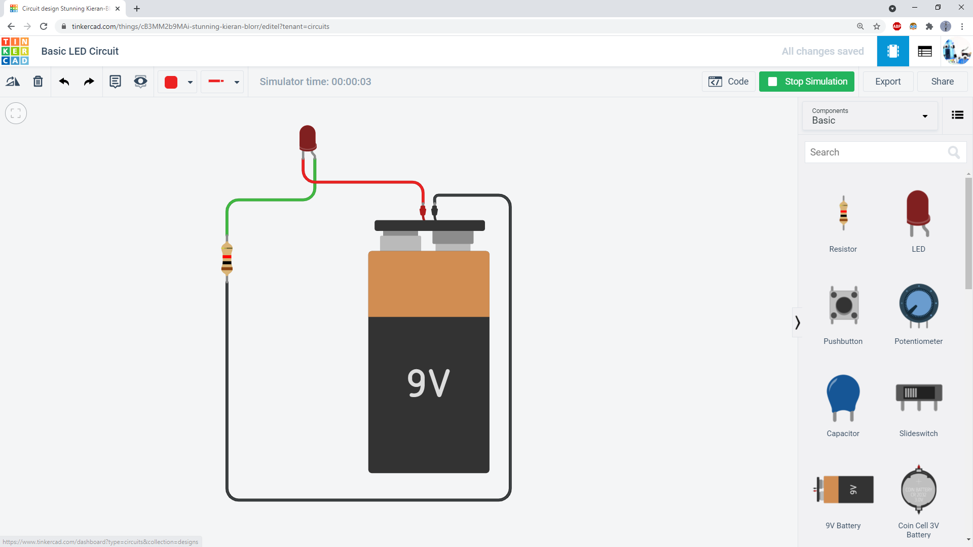
Click the Tinkercad logo to go back to the main Tinkercad page. From there, start a new circuit.

Slide 3
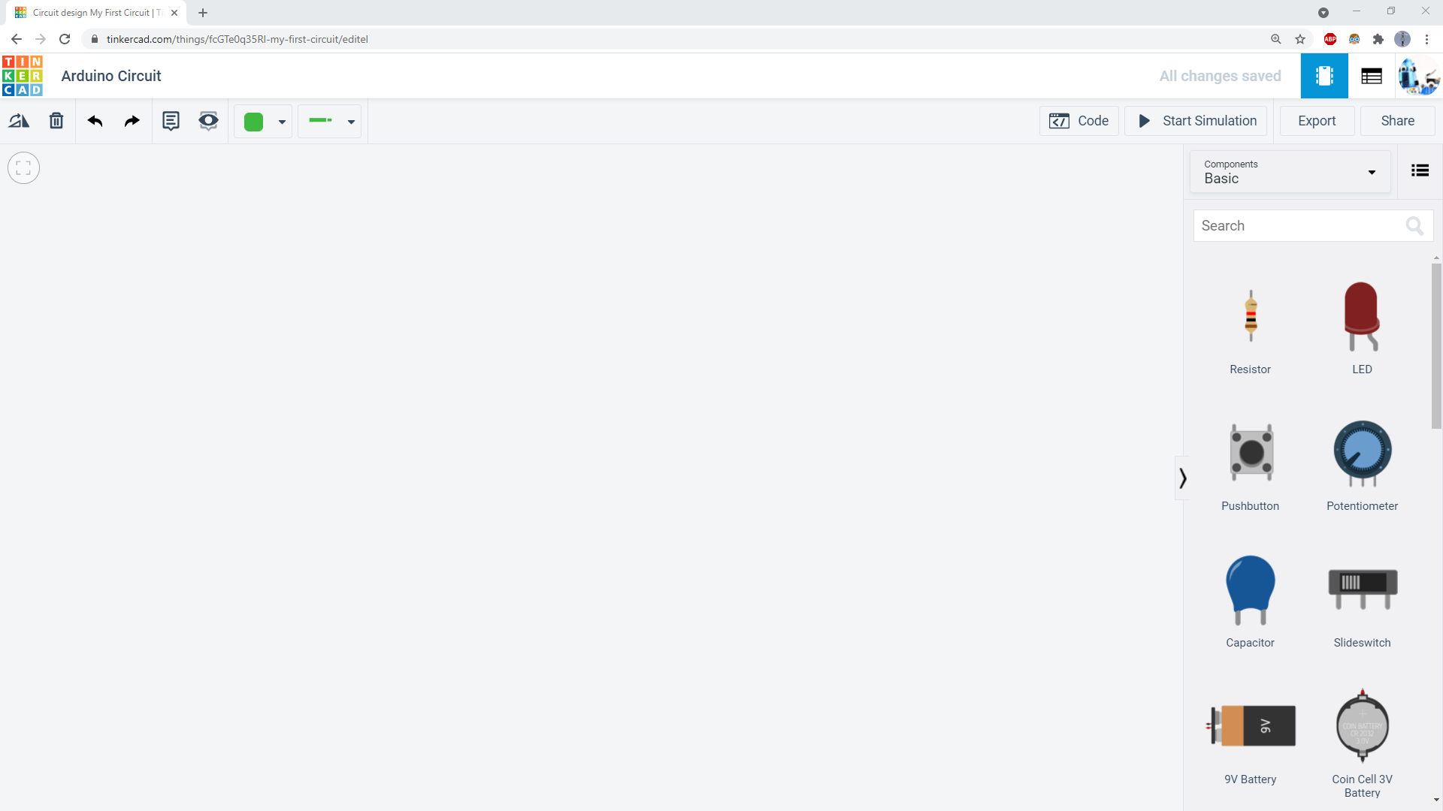
Give your new circuit a name.

Slide 4
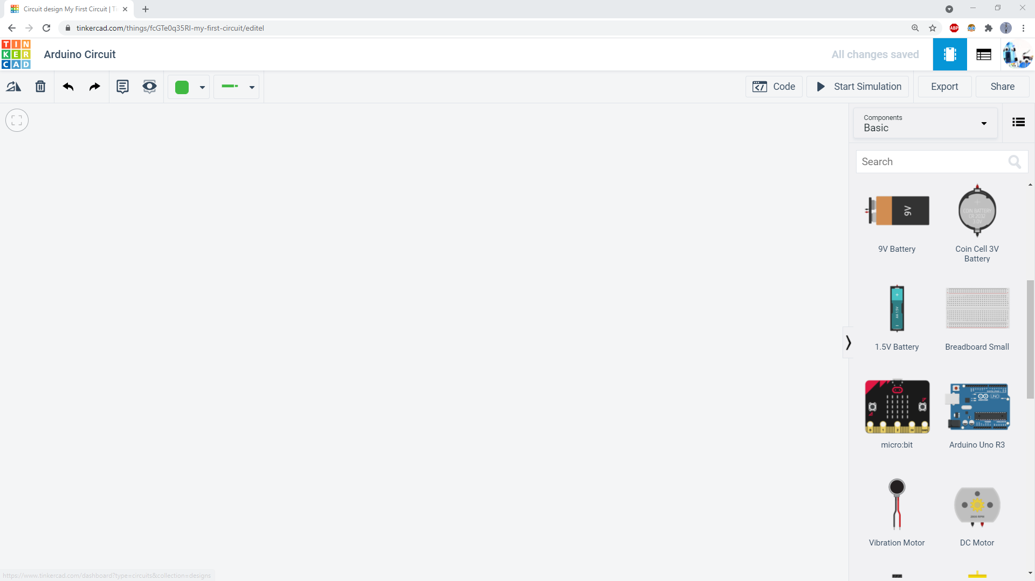
Scroll down in the components list to find an Arduino and a breadboard.

Slide 5
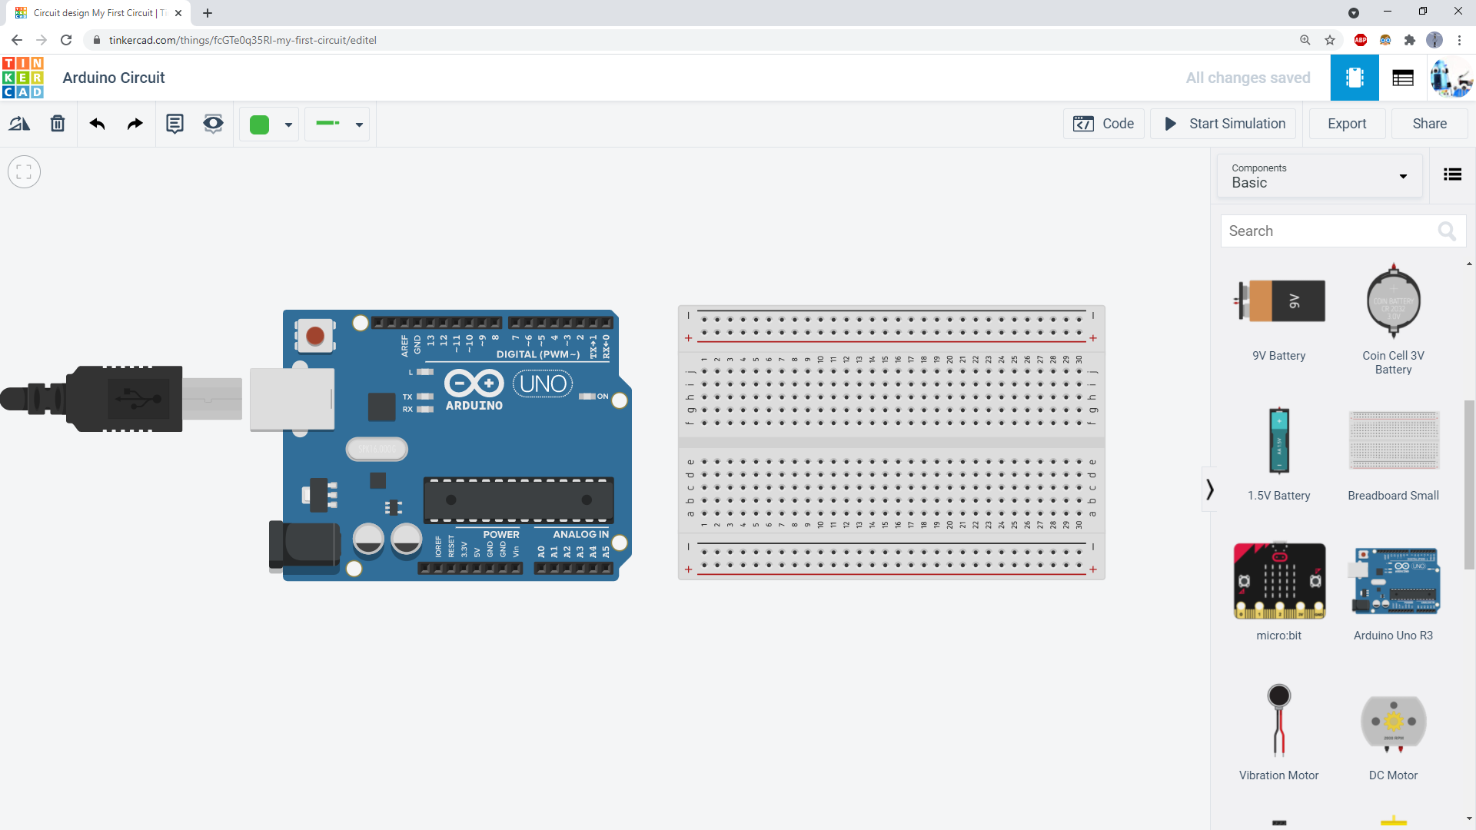
Add them both to your circuit. A breadboard makes it easier to connect things to the Arduino and build more complex circuits.

Slide 6
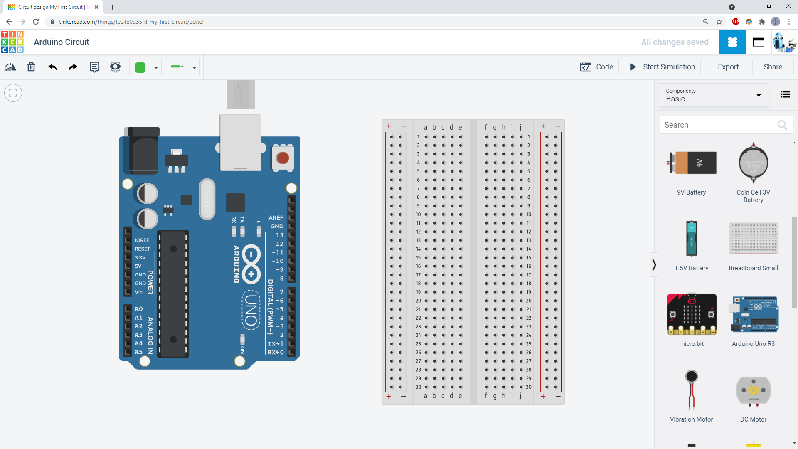
Recommended: rotate them both 90 degrees so the writing is upright. (Technically this is a personal choice, your circuit will still work fine if you leave them horizontal.)

Slide 7
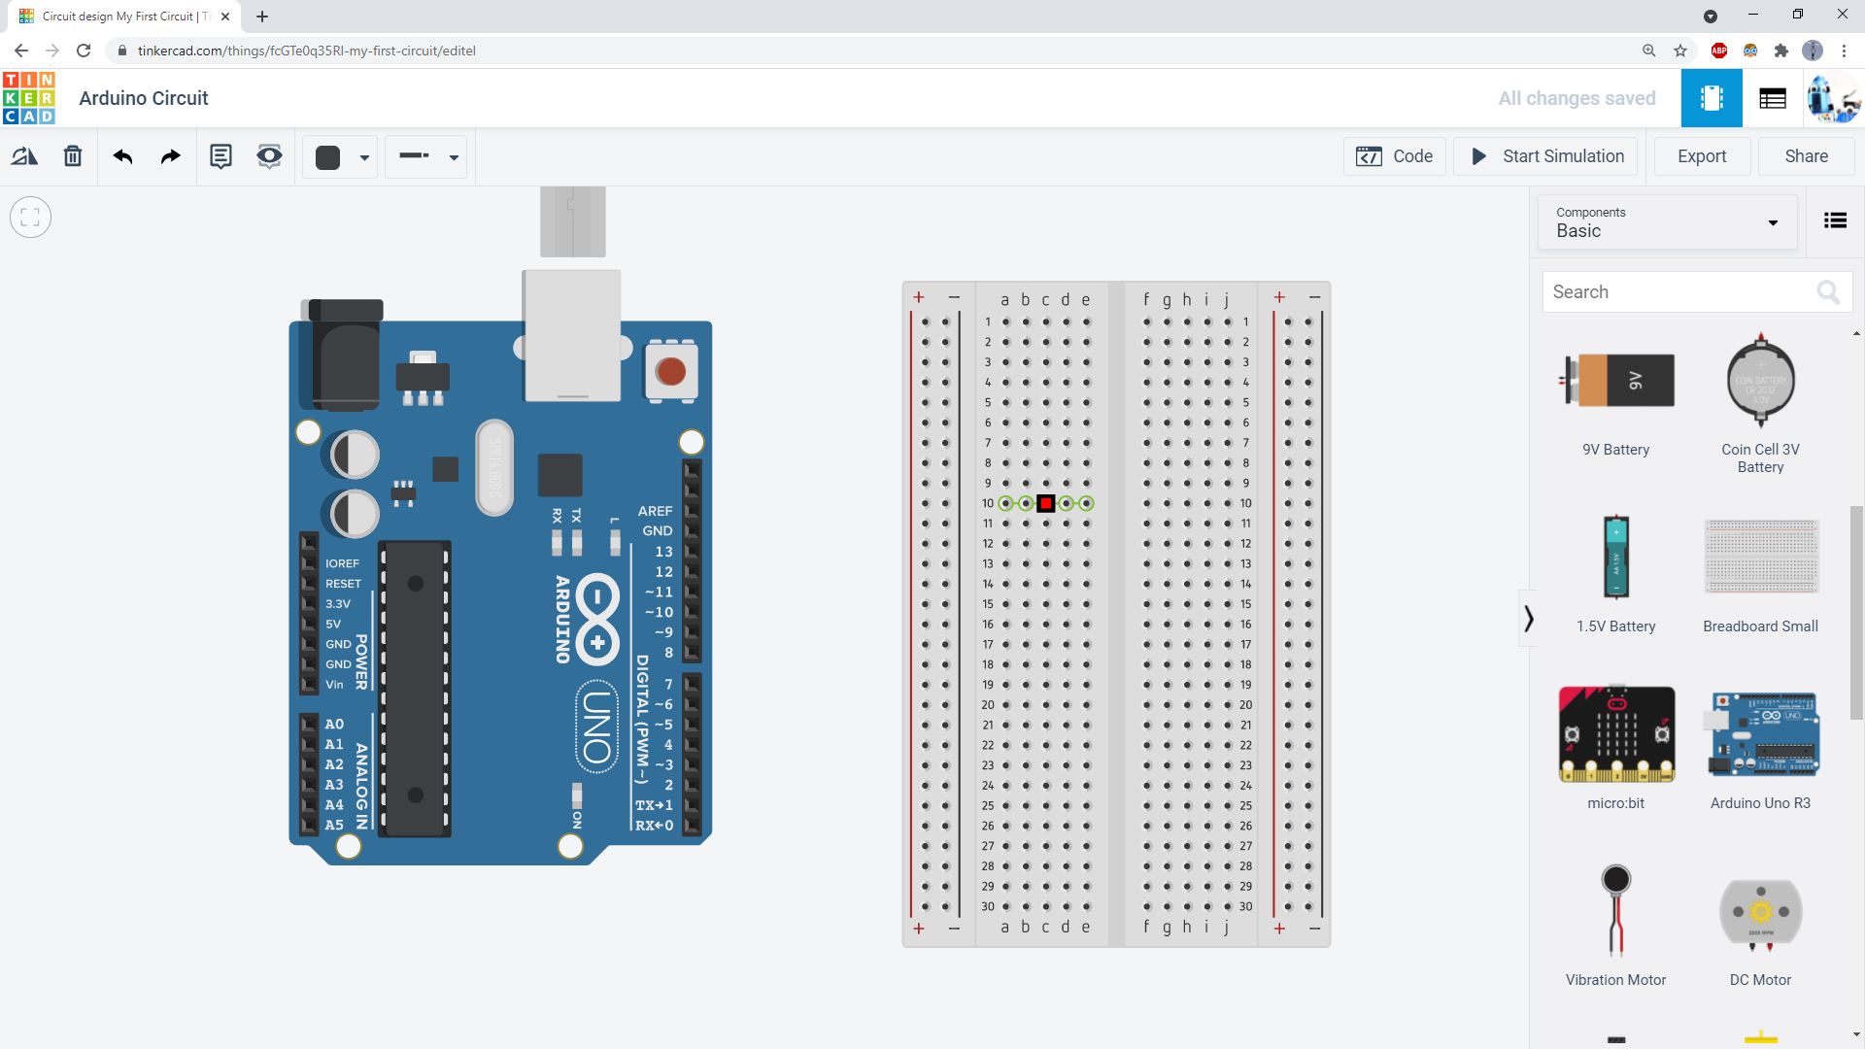
Holes on a breadboard are identified using letters for the columns and numbers for the rows. For example, the red square here is highlighting hole C10.

Slide 8
If you hover your mouse over a hole in the breadboard, Tinkercad will highlight which other holes it’s connected to. Most of the holes are connected in sets of 5.

Slide 9

The buses, also called rails, run the entire length of the breadboard.

Slide 10
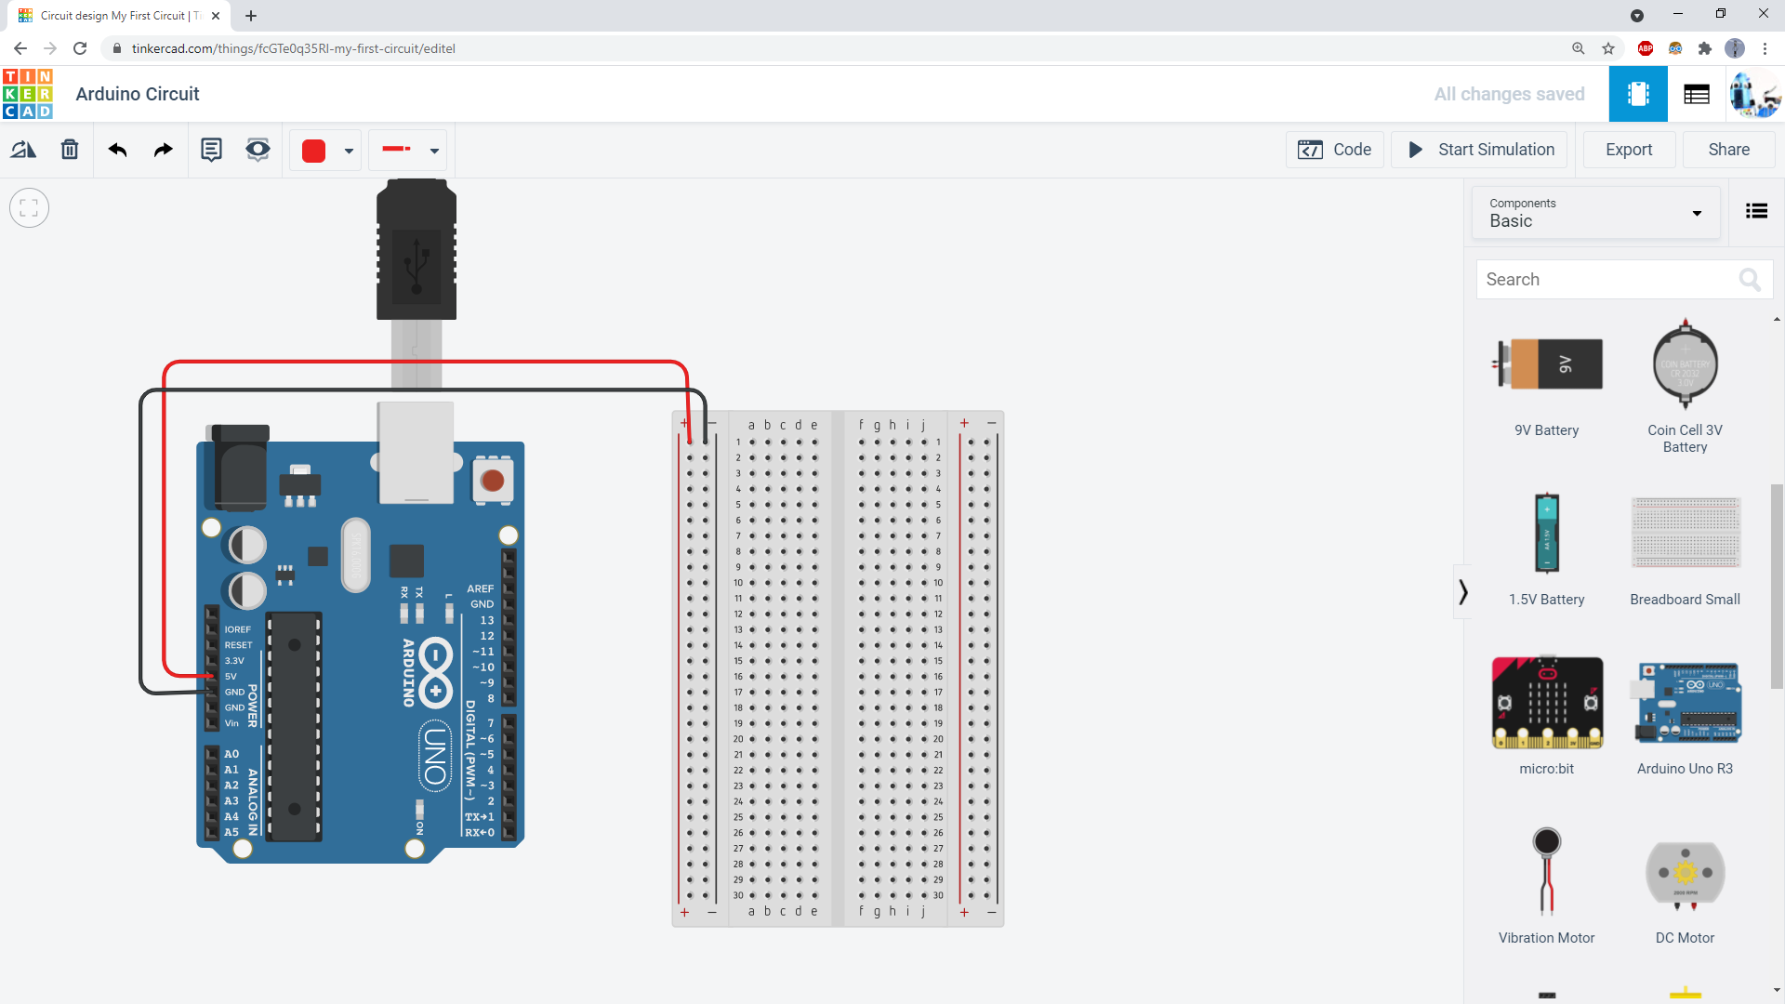
Use wires to connect the Arduino’s 5V and GND pins to the breadboard’s power (+) and ground (-) buses. Color-code the wires: red for positive, black for negative.

Slide 11
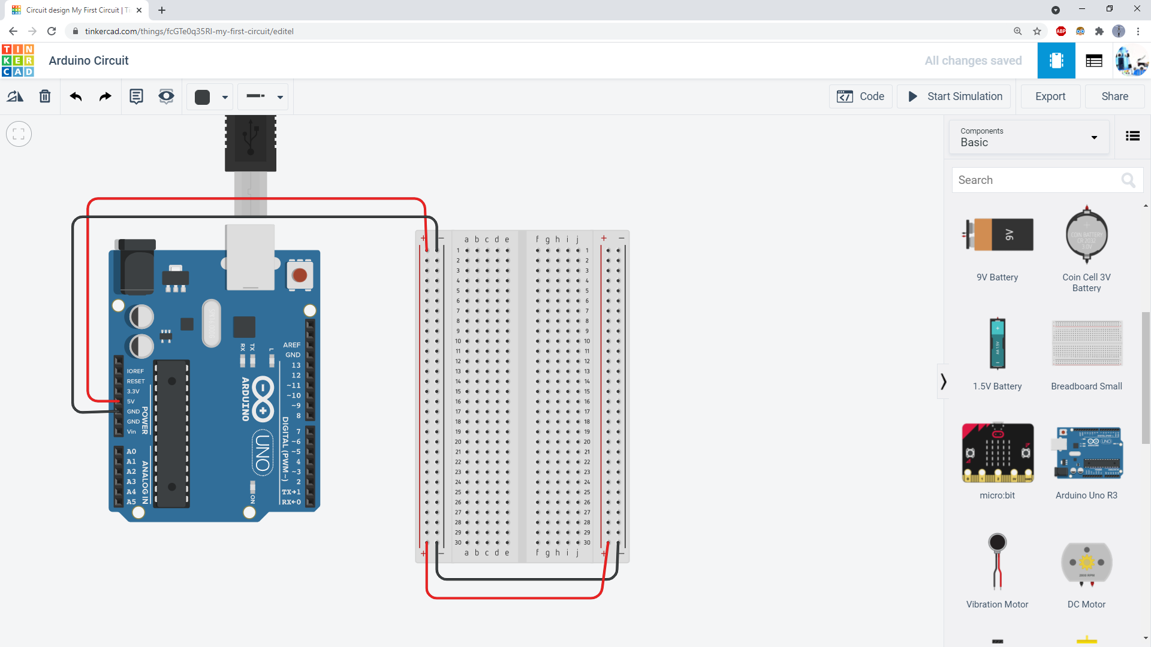
Add two more wires to connect the buses on opposite sides of the breadboard. This is good practice whenever you use a breadboard.

Slide 12
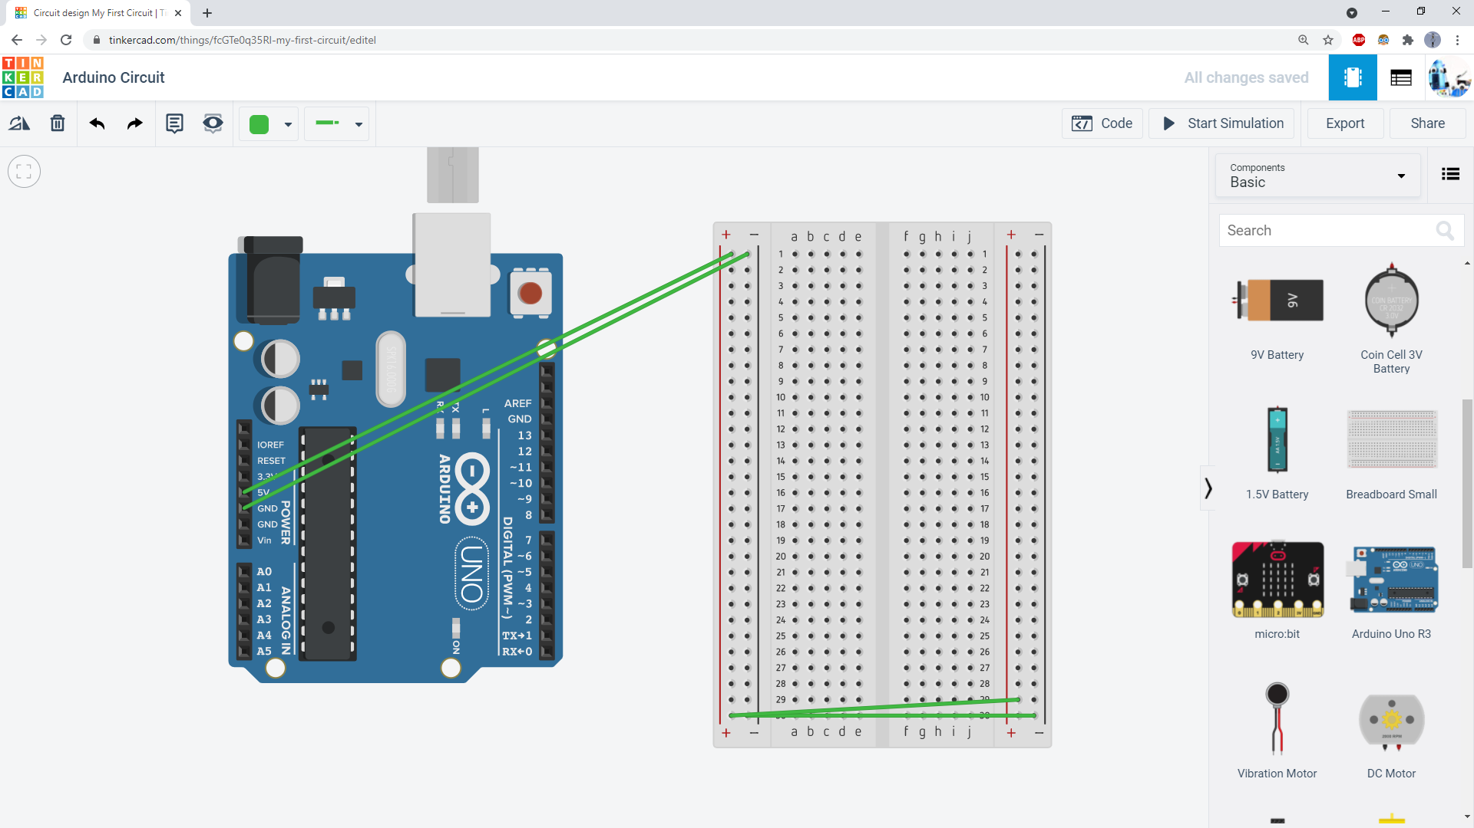
Important: don’t do this!
Make sure you color-code your wires and click to route the wires so you can easily tell them apart.

