Slide 1
Gravity vector at
T=0
Gravity vector at
T=1
Projected onto edge:
Projected Gravity vector at
T=0
Projected Gravity vector at
T=0

Slide 2
t=0
v₀
Integration
X₀
a
t>0

Slide 3
t=0
v₀
Integration
x₀
t>0
y
y
x
x

Slide 4
t₂
t₁
r
v₀
C
x₀
y
x

Slide 5
t₁
v
t₂
d
p
a
s
y
y
x
x
α
d
d
s
s
y
y
x
x

Slide 6
t=0
v
Integration
p
a
t>0
y
x

Slide 7
Robot
N rows
Goal
M columns

Slide 8
a_{projected}
a
a_{perp}
Projection
a_{projected}
a
workpiece

Slide 10
Free-Fall
Sliding
Transition
Transition
Sliding
Free-Fall

Slide 11
Turn:
a_{t=2.0}
a_{t=1.0}
t=1.0
v₀
X₀
Integration
a_{t=1}
t=2.0

Slide 12

Turn:
t=1.0
a_{projected}
a_{t=2.0}
a
a_{t=1.0}
a_{perp}
t=2.0
a_{projected}
a
workpiece
a_{perp}
Projection

Slide 13
e₂
V_{cc}
e₁

Slide 14
V_{cc}
e₂
e₁
g_{start}
g_{end}

Slide 15
V_{cc}
e₂
e₁
e^{p}₂
e^{p}₁
e^{p}₂
g_{start}
g_{end}
e^{p}₁

Slide 16
V_{cc}
e₂
e₁
e₂
e₁
e^{p}₂
e^{p}₂
e^{p}₁
e^{p}₁
e^{p}₂
g_{start}
g_{end}
e^{p}₁

Slide 17
V_{cc}
e₂
e₁
e^{p}
e^{p}₂
g_{start}
g^{t=2}
g_{end}
e^{p}₁
g^{t=1}
e^{p}

Slide 18
t = 1.0s
g_{end}
g_{start}

Slide 19
Turn₁
Turn₂
Turn₃

Slide 20
V_{cc}
V¹
g_{start}
g_{end}
V_{cc}
V²
g_{start}
g_{end}

Slide 21
V_{cc}
V¹
g_{start}
V_{cc}
V²
g_{start}

Slide 22
V_{cc}
V¹
g_{start}
V_{cc}
V²
g_{start}

Slide 23
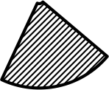
V_{cc}
V¹
V_{cc}
V²
g_{start}

Slide 24
V_{cc}
V¹
V_{cc}
V²
g_{start}

Slide 25
V_{cc}
V¹
V_{cc}
V²
g_{start}
g_{end}

Slide 26

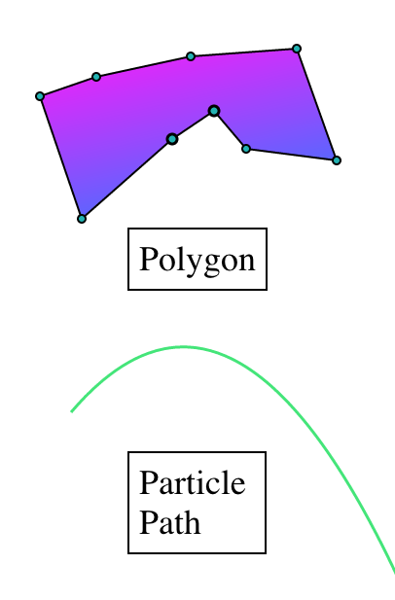
Legend

