Slide 1

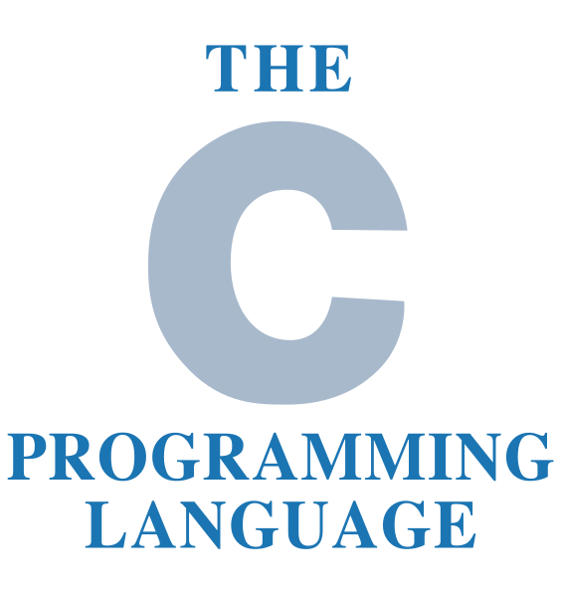
C Language Programming
by Oscar Priego Verdugo
Linux Kernel Software Engineer ASV @Intel

Slide 2
About the Instructor
Experience working in Linux operative systems since 2008.
14 years of experience developing applications for Linux OS’s.
7 years of experience in developing device drivers for Linux and embedded systems in C and C++.
Main responsible of Linux Kernel debugging in ASV Cluster at Intel GDC.
4 years of experience as Embedded Systems Architect.
Worked in Continental, Caterpillar, PARR Inst. Company & HCL tecnologies before joining Intel in October 2021.
Certified C programmer from CPP institute (CLA).

Slide 3
Agenda for today
C Language programming
    Basics (Introduction)
    Data types
    Variables
    I/O Operations

Slide 4
Tools needed for the training
A Linux distribution workstation (any distro of our choice) with the following tools installed:
  GCC
  GDB
  GIT
  Vim or any editor of our choice
And the most important:
  Patience, enthusiasm and the will to learn something new

Slide 5
Bibliography
The C Programming Language, by Brian W. Kernighan & Dennis M. Ritchie, ISBN-13 978-0131103627, ISBN-10 0131103628, https://www.pearson.com/us/higher-education/program/Kernighan-C-Programming-Language-2nd-Edition/PGM54487.html
Expert C Programming: Deep Secrets, by Peter van der Linden, ISBN-13 978-0-13-177429-2
Any book in: https://www.iso-9899.info/wiki/Books

Slide 6
C Basics
C it’s a general-purpose programming language.
Developed between 1972 & 1973 by Dennis Ritchie @ Bell Labs, initially intended to be a system programming language.
Standarized by ANSI (ANSI C) and the ISO since 1989.
It’s highly portable.
Provides low level access to memory.
Structured programming paradigm.
Used to develop Operative Systems like UNIX, Linux and Windows.

Slide 7
C Basics
Let’s do some coding!!

Slide 8
C Data Types
The set of general attributes & behavior that will define our variables and functions in C language.
Types in C could be classified as follows:
  Basic types (integers and floating-point types)
  Enumerated types (arithmetic types for certain discrete integer values)
  Void (no value available)
  Derived types (pointers, arrays, structures, unions and functions)

Slide 9
C Data Types
Integer Types in C:
Type | Storage size | Value range
char | 1 byte | -128 to 127 or 0 to 255
unsigned char | 1 byte | 0 to 255
signed char | 1 byte | -128 to 127
int | 2 or 4 bytes | -32,768 to 32,767 or -2,147,483,648 to 2,147,483,647
unsigned int | 2 or 4 bytes | 0 to 65,535 or 0 to 4,294,967,295
short | 2 bytes | -32,768 to 32,767
unsigned short | 2 bytes | 0 to 65,535
long | 8 bytes (4 bytes for 32 bit OS) | -9223372036854775808 to 9223372036854775807
unsigned long | 8 bytes | 0 to 18446744073709551615

Slide 10
C Data Types
Floating Types in C:
Type | Storage size | Value range | Precision
float | 4 bytes | 1.2E-38 to 3.4E+38 | 6 decimal places
double | 8 bytes | 2.3E-308 to 1.7E+308 | 15 decimal places
long double | 10 bytes | 3.4E-4932 to 1.1E+4932 | 19 decimal places

Slide 11
C Data Types
Void type could be used in:
  Function return type (the function doesn’t return anything) “void function()”
  Function arguments or parameters as void “int function(void)”
  Pointers to void *
*for instance “void *malloc(size_t size);” returns a pointer to void which can be casted to any data type for later use.

Slide 12
C Data Types
Let’s do some coding!!

Slide 13
C Variables
A name given to a storage area that our programs can manipulate, it has its definition conventions.
  It has a specific type.
  Can be char, int, float, double or void* (all of these in the most basic C types)
  To define it in source code: “type variable_name;”
  The names should start with an alphabetic char [a-z][A-Z] or ‘_’ (underscore)
  C programming keywords are out of boundaries for naming variables

Slide 14
C Variables
Let’s do some coding!!

Slide 15
C I/O Operations
Operations to interact with our C programs, these operations will be in charge of processing and writing data through the Input and output interfaces of the system where it will be running, in this case our operative system.
I/O operations are useful for a program to interact with users. the standard C library <stdlib.h> is the library used for input-output operations in C language, two important streams play this main role:
    Standard Input (stdin)
    Standard Output (stdout)

Slide 16
C I/O Operations
Let’s do some coding!!

Slide 17
Questions & Answers
Let’s solve the queries

Slide 18
That’s all for today folks!
Thank you for your attention!

