Slide 1

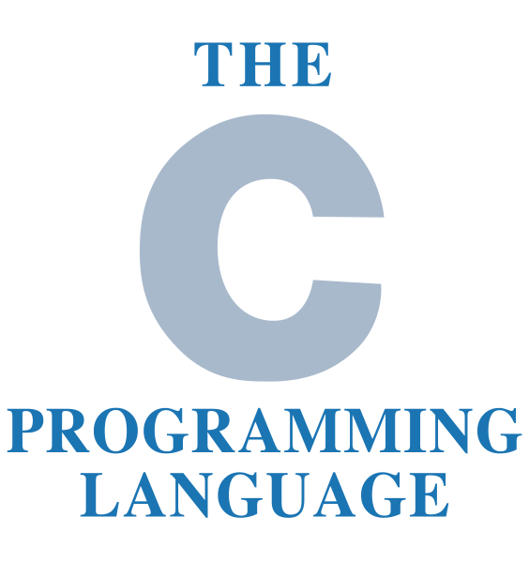
C Language Programming
by Oscar Priego Verdugo
Linux Kernel Software Engineer ASV @Intel

Slide 2
Agenda for today
C Language programming
    Operators

Slide 3
Tools needed for the training
A Linux distribution workstation (any distro of our choice) with the following tools installed:
  GCC
  GDB
  GIT
  Vim or any editor of our choice
And the most important:
  Patience, enthusiasm and the will to learn something new

Slide 4
Bibliography
The C Programming Language, by Brian W. Kernighan & Dennis M. Ritchie, ISBN-13 978-0131103627, ISBN-10 0131103628, https://www.pearson.com/us/higher-education/program/Kernighan-C-Programming-Language-2nd-Edition/PGM54487.html
Expert C Programming: Deep Secrets, by Peter van der Linden, ISBN-13 978-0-13-177429-2
Any book in: https://www.iso-9899.info/wiki/Books

Slide 5
C Operators
An operator is a symbol of the programming language which is able to operate on the values. C language provides the following types of operators:
  Arithmetic Operators
  Relational Operators
  Logical Operators
  Bitwise Operators
  Assignment Operators
  Misc Operators

Slide 6
C Arithmetic Operators
The Arithmetic Operators in C provide features to execute arithmetical operations to defined values. The main arithmetical operators in C are the following:
  ‘+’ (addition)
  ‘-’ (subtraction)
  ‘/’ (division)
  ‘*’ (multiplication)
  ‘%’ (modulus)

Slide 7
C Multiplication & Division
An asterisk (*) is a multiplication operator in, which the order of the factors does not affect the result, in the case of the division* we have the slash (/) as the operator, the value in front of the slash is a dividend, the value behind the slash, the divisor. On which indeed the order of the factors affects the result.
Multiplication “(m = x * y) == (m = y * x)”
Division “(d = x / y) != (d = y / x)”
*it is important to note that division by zero, is strictly forbidden!!

Slide 8
C Addition & Subtraction
A plus (+) is an Addition operator, in the case of the subtraction we have the minus (-) as the operator, in these operations only in the subtraction the order of the factors does affect the result.
Addition “(a = x + y) == (a = y + x)”
Subtraction “(s = x - y) != (s = y - x)”

Slide 9
C Modulus (remainder)
A percent (%)* is the Modulus operator in, which the order of the factors does affect the result.
Modulus “(md = x % y) != (md = y % x)”
*it is important to note that division by zero, is strictly forbidden, same applies to modulus!!

Slide 10
C Unary, Binary & Ternary
The Unary, Binary & Ternary operators are just definitions of how many operands they require to perform any action. Here are some examples of them:
  Unary “int a = sizeof(int);”, “ a++; a--; int s = -(a);”
  Binary “ int a = x + b;”
  Ternary “ (a == 1)? 20 :30);” // just an example of an elegant simplified if else statement.

Slide 11
C Relational Operators
The Relational Operators are used for logic evaluation and comparative between two values. Here are some examples, and how we read them:
  x == y reads x equal to y.
  x != y reads x not equal to y.
  x > y reads x greater than y.
  x < y reads x lesser than y.
  x >= y reads x greater equal to y.
  x <= y reads x lesser equal to y

Slide 12
C Logical Operators
The Logical Operators are used for logic evaluation between two values, which the logical condition could result in a true or false. Here are some examples, and how we read them:
  ‘&&’ AND operand.
  ‘||’ OR operand.
  ‘!’ NOT operand.

Slide 13
C Bitwise Operators
The Bitwise Operators are used for operations in bits, bit-by-bit mode. Bitwise operations are very useful for flags and bit displacement, also for evaluating on bit level certain operations.
  ‘&’ AND operand.
  ‘|’ OR operand.
  ‘^’ XOR operand.
  ‘~’ one complement operand.
  ‘<<’ Left shift operand.
  ‘>>’ right shift operand.

Slide 14
C Assignment Operators
The Bitwise Operators are used for operations in bits, bit-by-bit mode. Bitwise operations are very useful for flags and bit displacement, also for evaluating on bit level certain operations.
  ‘=’ simple assignment.
  ‘+=’ add and assign.
  ‘-=’ sub and assign.
  ‘*=’ multiply and assign.
  ‘/=’ divide and assign.
  ‘%=’ mod and assign.
  ‘<<=’ left shift and assign.
  ‘>>=’ right shift and assign.
  ‘&=’ bitwise AND and assign.
  ‘^=’ bitwise xor and assign.
  ‘|=’ bitwise or and assign.

Slide 15
C Misc Operators
The Misc Operators are used for several functions, mostly related to memory management and conditional expressions. Examples are the following:
  sizeof() which returns the size of a variable in bytes.
  ‘&’ which returns the address of a variable ‘&a’.
  ‘*’ which returns the pointer to a variable ‘*a’.
  ‘? :’ which represents a conditional expression, if condition cond is true ? Then value x : otherwise value y (cond ? path x : path y).

Slide 16
C Operators
Let’s do some coding!!

Slide 17
Questions & Answers
Let’s solve the queries

Slide 18
That’s all for today folks!
Thank you for your attention!

