Slide 1


C Language Programming
by Oscar Priego Verdugo
Linux Kernel Software Engineer ASV @Intel

Slide 2
Agenda for today
C Language programming
    Preprocessor

Slide 3
Tools needed for the training
A Linux distribution workstation (any distro of our choice) with the following tools installed:
  GCC
  GDB
  GIT
  Vim or any editor of our choice
And the most important:
  Patience, enthusiasm and the will to learn something new

Slide 4
Bibliography
The C Programming Language, by Brian W. Kernighan & Dennis M. Ritchie, ISBN-13 978-0131103627, ISBN-10 0131103628, https://www.pearson.com/us/higher-education/program/Kernighan-C-Programming-Language-2nd-Edition/PGM54487.html
Expert C Programming: Deep Secrets, by Peter van der Linden, ISBN-13 978-0-13-177429-2
Any book in: https://www.iso-9899.info/wiki/Books

Slide 5
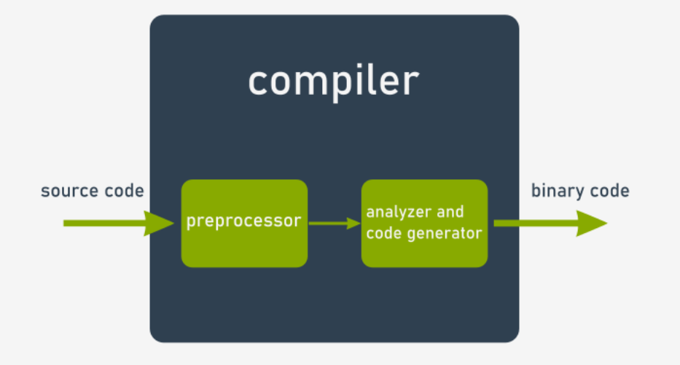
C Preprocessor
The C preprocessor is responsible for the initial processing of the C program. This process occurs before the compiler starts to analyze source code. The effects of preprocessing are visible only to the compiler, it is important to note, that the preprocessed source code is not stored in any way.

Slide 6
C Preprocessor
The preprocessor inserts various information into the code. The markings are ignored during the verification and translation of the program. The recognizable characteristic of a preprocessor directive is that they’re preceded by the # character. If the preprocessor directive doesn’t fit on one line and needs to be split, you must put the \ characer in the place where the directive should be broken, for instance:
    #include \
    <stdio.h>

Slide 7
C Preprocessor
Key directives of the C Preprocessor:
#define Substitutes a preprocessor macro | #else The alternative path for #if
#include Inserts a particular header from another file | #elif #else and #if in one statement
#undef Undefines a preprocessor macro | #endif Ends the preprocessor conditional
#ifdef Returns true if the referenced macro is defined | #error Prints error message on stderr
#ifndef Returns true if the referenced macro is not defined | #pragma Issues special commands to the compiler, in a standarized way
#if Tests if a compile time condition is true

Slide 8
C Preprocessor
Let’s do some coding!!

Slide 9
Questions & Answers
Let’s solve the queries

Slide 10
That’s all for today folks!
Thank you for your attention!

