Slide 1

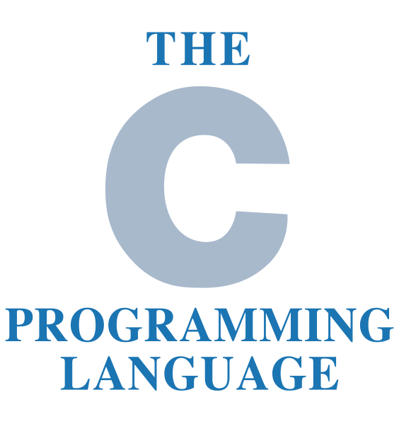
C Language Programming
by Oscar Priego Verdugo
Linux Kernel Software Engineer ASV @Intel

Slide 2
Agenda for today
C Language programming
    Arrays & Strings

Slide 3
Tools needed for the training
A Linux distribution workstation (any distro of our choice) with the following tools installed:
  GCC
  GDB
  GIT
  Vim or any editor of our choice
And the most important:
  Patience, enthusiasm and the will to learn something new

Slide 4
Bibliography
The C Programming Language, by Brian W. Kernighan & Dennis M. Ritchie, ISBN-13 978-0131103627, ISBN-10 0131103628, https://www.pearson.com/us/higher-education/program/Kernighan-C-Programming-Language-2nd-Edition/PGM54487.html
Expert C Programming: Deep Secrets, by Peter van der Linden, ISBN-13 978-0-13-177429-2
Any book in: https://www.iso-9899.info/wiki/Books

Slide 5
C Arrays
In C language, there might be a time where you would need to read, store, process and print dozens, even thousands of numbers and values. For this special purpose we use vectors which are multi-value variables that are of the same type stored inside the same data collection known as Array.
To define them we will use the following instantiation:
        type name[size1][size2]...[sizeN];

Slide 6
C Strings
In the C language, there’s a special case for one dimension char type arrays, which are terminated by a null character ‘\0’, thus a null-terminated string contains the characters that comprise the string followed by a null.
To declare these so called ‘strings’ in C language we will make use of the following implementation:
      char name[sizeN] = { ‘*’, ‘*’, … ‘*’} ;
      char name[sizeN] = “**….*”;
Note*.- where the * character represents any valid character to be stored.

Slide 7
C Arrays & Strings
Let’s do some coding!!

Slide 8
Questions & Answers
Let’s solve the queries

Slide 9
That’s all for today folks!
Thank you for your attention!

