Slide 1
IT5002
Tutorial #2
MIPS Assembly
(Prepared by: Aaron Tan)

Slide 2
Q1.
(a) Set bits 2, 8, 9, 14 and 16 of b to 1. Leave the other bits unchanged.
Recall:
  x OR 0 = x
  x OR 1 = 1
Example: Before
b = 00110000011100000110110100100001.
(Bits 2, 8, 9, 14 and 16 are underlined.)
After
b = 00110000011100010110111100100101.
lui $t0, 1 # set bit 16
ori $t0, $t0, 0b0100001100000100 # set bits 14,9,8,2.
or $s1, $s1, $t0

Slide 3
Q1.
(b) Copy over bits 1, 3 and 7 of b into a, without changing any other bits of a.
Recall:
  x AND 0 = 0
  x AND 1 = x
Recall:
  x OR 0 = x
  x OR 1 = 1
Example: Before (assume that the most significant 24 bits are all zeroes)
a = 0 0 … 0 0 0 0 1 0 1 0 1 0.
b = 0 0 … 0 0 1 1 0 1 1 1 0 0.
andi $t0, $s1, 0b0000000010001010
lui $t1, 0b1111111111111111
ori $t1, $t1, 0b1111111101110101
and $s0, $s0, $t1
or $s0, $s0, $t0
After
a = 0 0 … 0 0 1 0 1 0 1 0 0 0.
b = 0 0 … 0 0 1 1 0 1 1 1 0 0.

Slide 4
Q1.
(c) Make bits 2, 4 and 8 of c the inverse of bits 1, 3 and 7 of b.
Recall:
  x XOR 0 = x
  x XOR 1 = x'
Example: Before (assume that the … part are all zeroes)
b = 0 0 … 0 0 1 1 0 1 1 1 0 0.
c = 0 0 … 0 1 0 0 1 0 1 0 1 0.
xori $t0, $s1, 0b10001010
andi $t0, $t0, 0b10001010
sll $t0, $t0, 1
lui $t1, $t1, 0b1111111111111111
ori $t1, $t1 0b1111111011101011
and $s2, $s2, $t1
or $s2, $s2, $t0
After
b = 0 0 … 0 0 1 1 0 1 1 1 0 0.
c = 0 0 … 0 0 0 0 1 0 1 1 1 0.

Slide 5
Q2.
$s0 is a 31-bit binary sequence with MSB=0.
add $t0, $s0, $zero
lui $t1, 0x8000
lp: beq $t0, $zero, e
andi $t2, $t0, 1
beq $t2, $zero, s
xor $s0, $s0, $t1
s: srl $t0, $t0, 1
j lp
e:
Need to trace the MIPS code with an example to find out what it does.

Slide 6
Example: $s0 = 31
Q2.
$s0 is a 31-bit binary sequence with MSB=0.
add $t0, $s0, $zero
lui $t1, 0x8000
lp: beq $t0, $zero, e
andi $t2, $t0, 1
beq $t2, $zero, s
xor $s0, $s0, $t1
s: srl $t0, $t0, 1
j lp
e:
MSB
Q: What is the final value of $s0 (in hexadecimal)?
$s0 =
0 0 … 0 0 0 1 1 1 1 1
1
$t0 =
0 0 … 0 0 0 1 1 1 1 1
0 0 … 0 0 0 0 1 1 1 1
$t1 =
1000 0000 0000 0000 0000 0000 0000 0000
$t2 =
0 0 … 0 0 0 0 0 0 0 1
What does andi do?
Extracts the LSB of $t0 into $t2
31
Q: At most how many iterations?
Q: What happens in each iteration?
What does xor do?
It toggles the MSB of $s0 (why?)
Toggle the MSB of $s0 if $t2 = 1.

Slide 7
Q2.
$s0 is a 31-bit binary sequence with MSB=0.
Example:
$s0 = 0x0AAAAAAA
add $t0, $s0, $zero
lui $t1, 0x8000
lp: beq $t0, $zero, e
andi $t2, $t0, 1
beq $t2, $zero, s
xor $s0, $s0, $t1
s: srl $t0, $t0, 1
j lp
e:
MSB
$s0 =
0 0001010101010101010101010101010
$t0 =
0 0001010101010101010101010101010
$t1 =
1000 0000 0000 0000 0000 0000 0000 0000
Q: What is the final value of $s0 (in hexadecimal)?

Slide 8
Q2.
$s0 is a 31-bit binary sequence with MSB=0.
Summary
add $t0, $s0, $zero
lui $t1, 0x8000
lp: beq $t0, $zero, e
andi $t2, $t0, 1
beq $t2, $zero, s
xor $s0, $s0, $t1
s: srl $t0, $t0, 1
j lp
e:
$s0 = 31
Before:
Odd number of 1’s in $s0: MSB → 1
MSB
$s0 = 0 0000000000000000000000000011111
After:
$s0 = 1 0000000000000000000000000011111
$s0 = 0x0AAAAAAA
This is known as odd parity bit scheme.
(Even parity bit scheme defined similarly.)
Before:
Even number of 1’s in $s0: MSB → 0.
$s0 = 0 0001010101010101010101010101010
After:
$s0 = 0 0001010101010101010101010101010

Slide 9
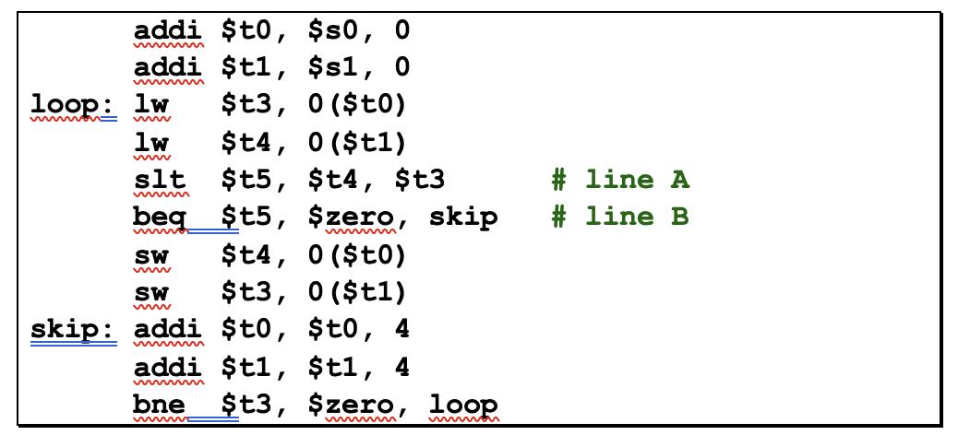
Q3.
Given two integer arrays A and B with unknown number of elements, and their base addresses stored in registers $s0 and $s1 respectively, study the MIPS code below. Note that an integer takes up 32 bits of memory.
a. What is the purpose of register $t1 in this code?
Ans: $t1 is the address of the B[] element to be read

Slide 10
Q3.
Given two integer arrays A and B with unknown number of elements, and their base addresses stored in registers $s0 and $s1 respectively, study the MIPS code below. Note that an integer takes up 32 bits of memory.
b. If array A = {7, 4, 1, 6, 0, 5, 9, 0} and array B = {3, 4, 5, 2, 1, 0, 0, 9}, give the final content of these two arrays.
Ans: A = {3, 4, 1, 2, 0, 5, 9, 0}
B = {7, 4, 5, 6, 1, 0, 0, 9}

Slide 11
Q3.
Given two integer arrays A and B with unknown number of elements, and their base addresses stored in registers $s0 and $s1 respectively, study the MIPS code below. Note that an integer takes up 32 bits of memory.
c. How many store word operations are performed given the contents of the arrays in part (b)?
Ans: 4

Slide 12
Q3.
Given two integer arrays A and B with unknown number of elements, and their base addresses stored in registers $s0 and $s1 respectively, study the MIPS code below. Note that an integer takes up 32 bits of memory.
d. What is the value (in decimal) of the immediate field in the machine code representation of the bne instruction?
Ans: -9

Slide 13
Q3.
Given two integer arrays A and B with unknown number of elements, and their base addresses stored in registers $s0 and $s1 respectively, study the MIPS code below. Note that an integer takes up 32 bits of memory.
e. The two lines indicated as “line A” and “line B” represent the translation of a MIPS pseudo-instruction. Give the corresponding pseudo-instruction.
Ans: bge $t4, $t3, skip

Slide 14
Q4.
(a)
Instruction encoding | MIPS code
 | # $s1 stores the results; $t0 stores a non-negative number
 | addi $s1, $zero, 0 #inst addr is 0x00400028
0x00084042 | Loop: srl $t0, $t0, 1
0x11000002
0x22310001
 | j loop
 | exit:
?
?
?
?

Slide 15
Q4.
(a) addi $s1, $zero, 0
Look up MIPS Reference Data sheet!
Name | Mnemonic | Format | Operation | Opcode/Funct
Add Immediate | addi | I | R[rt] = R[rs] + SignextImm | 8_{hex}
I format:
opcode | rs | rt | immediate
rt =
Which is rs (source) and which is rt (target)?
$s1 = $17; $zero = $0
rs =
0 0 1 0 0 0
0 0 0 0 0
1 0 0 0 1
0 0 0 0 0 0 0 0 0 0 0 0 0 0 0 0
(2 0 1 1 0 0 0 0)₁₆

Slide 16
Q4.
(a) 0x11000002
0x11000002 = 0001 0001 0000 0000 0000 0000 0000 0010
Opcode = 4
Look up MIPS Reference Data sheet!
Name | Mnemonic | Format | Operation | Opcode/Funct
Branch On Equal | beq | I | If R[rs] == R[rt] PC = PC + 4 + BranchAddr | 4_{hex}
I format:
opcode | rs | rt | immediate
$8 = $t0
 | MIPS code
 | addi $s1, $zero, 0
0x00084042 | Loop: srl $t0, $t0, 1
0x11000002
0x22310001
 | j loop
 | exit:
beq
$t0,
$zero,
2
exit
Next instr.
+2 instr.

Slide 17
Q4.
(a) 0x22310001
0x22310001 = 0010 0010 0011 0001 0000 0000 0000 0001
Opcode = 8
Look up MIPS Reference Data sheet!
Name | Mnemonic | Format | Operation | Opcode/Funct
Add Immediate | addi | I | R[rt] = R[rs] + SignextImm | 8_{hex}
I format:
opcode | rs | rt | immediate
$17 = $s1
addi
$s1
$s1
1
____, ____,

Slide 18
Q4.
(a) j loop
Look up MIPS Reference Data sheet!
Name | Mnemonic | Format | Operation | Opcode/Funct
Jump | j | J | PC = JumpAddr | 2_{hex}
J format:
opcode | address
MIPS code | Address
addi $s1, $zero, 0 | 0x00400028
Loop: srl $t0, $t0, 1
j loop
exit:
What is the address of the srl instruction?
0x00400028 + 4 = 0x0040002C
?
Remove the first 4 bits and last 2 bits:
0000 0000 0100 0000 0000 0000 0010 1100
0 0 0 0 1 0
0 0 0 0 0 1 0 0 0 0 0 0 0 0 0 0 0 0 0 0 0 0 1 0 1 1
(0 8 1 0 0 0 0 B)₁₆

Slide 19
Q4.
(a)
Instruction encoding | MIPS code
 | # $s1 stores the results; $t0 stores a non-negative number
 | addi $s1, $zero, 0 #inst addr is 0x00400028
0x00084042 | Loop: srl $t0, $t0, 1
0x11000002
0x22310001
 | j loop
 | exit:
?
0x20110000
?
beq $t0, $zero, exit
?
addi $s1, $s1, 1
0x0810000B
?

Slide 20

Q4.
(b)
Give a simple mathematic expression for the relationship between $s1 and $t0.
addi $s1, $zero, 0
loop: srl $t0, $t0, 1
beq $t0, $zero, exit
addi $s1, $s1, 1
j loop
exit:
$$\$s1=\left\lfloor \log_{2}(\$t0)\right\rfloor$$

