Slide 1

Searching for Medical Information on the Internet
Hong Kao
Bsc, BscPhm, BCPS
Clinical Pharmacist
HSICT Professional Practice Day
Sept 14, 2011

Slide 2
Objectives
Internet and Medical Information search
History of iMedisearch Development
The Advantages of iMedisearch vs Google
How to use iMedisearch

Slide 3
A Little about Me
Graduated from U of T Pharmacy in 2000
Worked as community pharmacist x 2 years
Worked as Long Term Care pharmacist x 1 year
Work as clinical pharmacist at Trillium Health Centre x 8 years
  Specializing in Stroke and Spine
  Involved with research studies in stroke prevention (1)

Slide 4
Internet and Medical Information
There are countless medical information websites on the Internet
These sites vary enormously with regards to credibility, reliability and intended audience
Anyone can post anything on the Internet including about health
Millions consumers use Internet to get medical information (2)
Clinicians also regularly use the Internet for references
Most use Google to search for these information
Most don’t go past the first couple of pages of search results

Slide 5


The Internet Challenge

Slide 6
Weaknesses of Google
Google uses complex mathematical formula to determining the ranking of each page on the Internet based on the number of other websites linking to it.
When a user searches for medical information on the Internet, site with the most number of other sites linking to it will show up at the top of Google results for a specific keyword containing in that site.
Problems when searching for medical information:
Context - Google does not know who is doing the search
  For a search term, Google presents results that are mixtures of materials meant for the general public and those meant for medical professional
Quality - Google cannot distinguish between reputable and non-reputable web resources
  Search results presented tend to be mixture of reputable & non-reputable sources
  The user would have to determine which is which.

Slide 7
A little History
Before Google was popular, it was common practice to collect links of useful, credible and reliable sites for references
Hospital pharmacists including myself had our own ways of saving URL (bookmark, sheet of paper, notebooks…)
Problems - not easy to retrieve website when needed, hard to remember which site is for what
RPhWorld.com was created in 2003
The website serves as a descriptive link repository for useful sites for pharmacists. Websites are organized in easy to use manner.
This site was shared and became popular among pharmacists around the world

Slide 8
RPhWorld.com
More and more useful links were added to RPhWorld over time
Eventually, it became harder to find a website to answer particular clinical question. There were too many useful websites.
Need for a search capability
Google Custom Search became available
  Allows customization of Google engine to search selected websites instead of the entire Internet
URL’s from RPhworld were added to Google Custom Search to create a new search engine
The search engine were tweaked to return results that pharmacists would find useful e.g. clinical guidelines, CE, renal dosing…
Search results were quite reliable as they were from reputable sources
The search engine also “seems” to know that the searcher is a pharmacist

Slide 9
iMedisearch.com
Feedbacks for the new search engine were overwhelmingly positive
This lead to further development of the search engine to allow for searches by other health professionals and the general public.
iMedisearch.com was created and went online in 2008
Over the years, it has been fine-tuned and improved with more websites entry
Currently it searches from over 40,000 reliable websites.
Each URL entered into iMedisearch engine is carefully selected based on criteria developed by US FDA (2) and HON (Health On Net)

Slide 10
Inclusion Criteria for iMedisearch
To be included in iMedisearch engine, a website has to be:
  Government site
  Military site
  Educational institution site (e.g. university, college, continuing education)
  Professional regulatory site
  Professional association site
  HON-accredited site
  Hospital or medical clinic site
  Medical reference publisher site

Slide 11
Inclusion Criteria for iMedisearch
  Medical journal site
  Drug information site
  Poison control site
  Site authored by an MD or pharmacist with referenced contents (e.g. Globalrph.com)
  Pharmaceutical manufacturer (e.g. Merck.com)
  Support group society site
  Expert site (e.g. Naturaldatabase.com, WebMD)
  Critic site (e.g. Quackwatch.org)

Slide 12
Exclusion Criteria for iMedisearch
  The following type of websites are excluded from iMedisearch:
  Sites with unknown or unlisted author/editor
  Sites which anyone can freely write or edit articles
  Sites which contain bogus miracle cure claims
  Sites with too many ads that obscure the actual contents

Slide 13
iMedisearch and HON
  iMedisearch complies with HON code standard for trustworthy health information
  iMedisearch collaborates with HON to offer users plug in for web browser, so that iMedisearch can be accessed directly from Firefox browser search box(3)

Slide 14
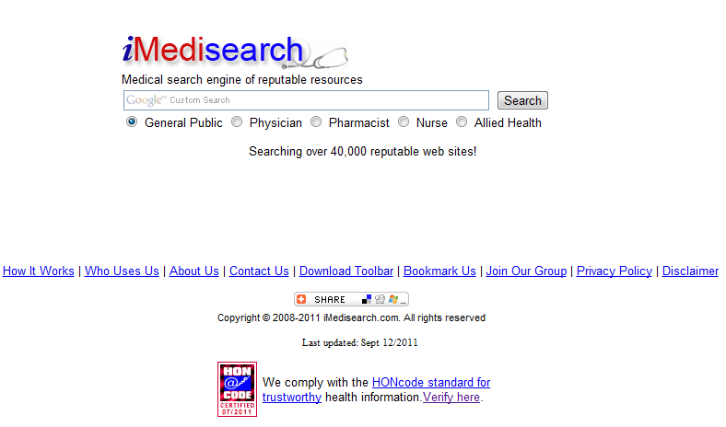
Features of iMedisearch

Slide 15
Advantages of iMedisearch
  In contrast to regular Google, iMedisearch:
  Search only from reputable sites (Quality)
  Targeted search results based on who the searchers are (Context):
    General Public
    Physician
    Pharmacist
    Nurse
    Allied Health
  Customized Search Refinements (Targeted Fine-tuning)
    Further refines the search results to find the right article

Slide 16
How to Use iMedisearch
  www.imedisearch.com

Slide 17
Future Development
  Websites are added on regular basis
  Synonym function will be added where a search for a brand name drug will also search for the generic equivalent (e.g. enter Flagyl, will search for metronidazole as well)
  Option to search from entire Internet with the current searcher definition and search refinements

Slide 18
Thank You
for your attention!
?

Slide 19
References
1. Kao et al, Pharmacist’s Intervention Significantly Increases Usage of Angiotensin-Converting Enzyme Inhibitors/Angiotensin Receptor Blockers and HMG-CoA Reductase Inhibitors in Stroke Patient, http://stroke.ahajournals.org/content/38/2/453.full.pdf
2. How to Evaluate Health Information on the Internet, http://www.fda.gov/Drugs/ResourcesForYou/Consumers/BuyingUsingMedicineSafely/BuyingMedicinesOvertheInternet/ucm202863.htm
2. http://www.imedisearch.com/download.html

