Slide 1

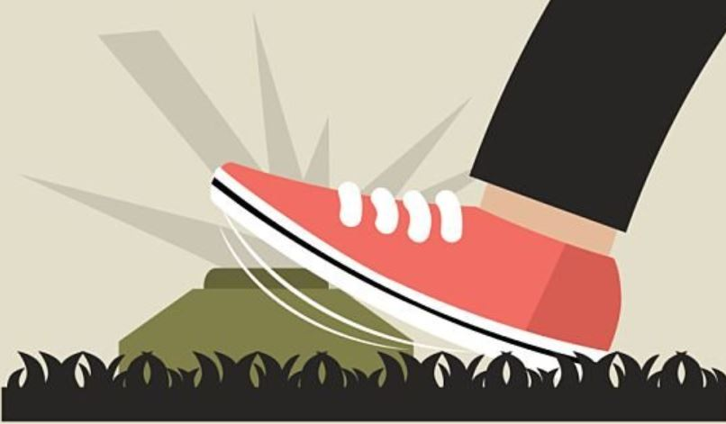
Aggregate Mines are MINES!
Aggregate Land Mines in Rocky View County
DANGER! LAND MINES AHEAD
Notes:
Is there an environmental problem that is festering in the aggregate mining industry under the nose of the Alberta Ministry of Environment and Protected Areas (MEPA)?
Is MEPA ignoring this issue in the hopes it will be diluted with water, time, and distance?
In this presentation, we outline arguments and evidence that seems to indicate that the answer to both these questions is YES.

Slide 2
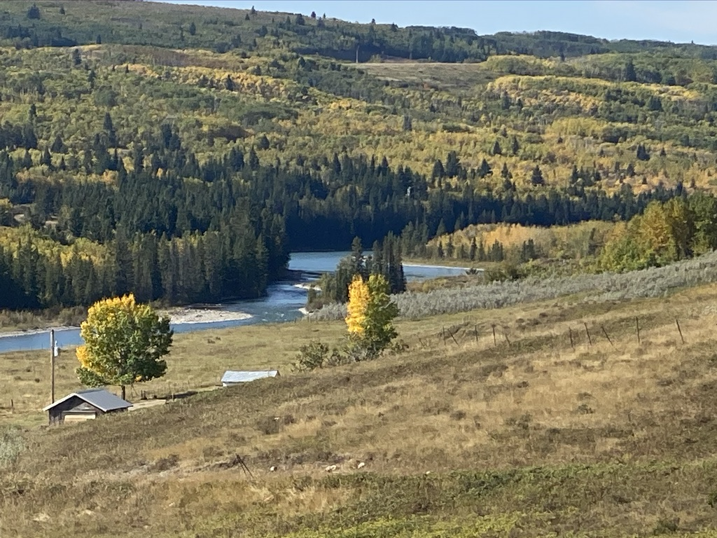
Typical Lands Affected by Aggregate Mining
Notes:
Aggregate mines are often located in the most pristine areas of Alberta. Is legislation that should be used to protect these areas being ignored?
We report, you decide.

Slide 3
Objectives
Aggregate Mines are MINES! They Should Be Treated as Such
Create Recognition:
  Need for Aggregate Production
  Market Externalities
  Potential Impacts
  Opposition to Irresponsible Expansion/Production
Suggest:
  Reduce Scale and Promote Slow, Monitored, Phased Approach
  Implement Proactive Pre/During/Post Mine Monitoring
  Address Holes in Legislation/System where Aggregate Issues Fall Through
Help Define a Responsible, Go Forward Plan
Ambitious? Yes. Necessary? Absolutely.
Notes:
Aggregate is the literally a key component of the foundation that our society is built on.
We are not opposed to aggregate mines, we are opposed to irresponsible expansion of aggregate mines w/o adequate protection for the environment, adjacent lands, Waters, residents and wildlife.
In fact, many of us supported RVC’s initial plan to allow a single quarter (150 acre) expansion to Burnco’s current mine. We felt this was a reasonable and responsible approach. That said,
Aggregate mines are MINES! They should be treated as such. Current legislation and SOP governing aggregate mines are inadequate, especially for mining below the water table and/or close to major water sources, parks, etc.
One objective of this presentation is to illustrate some of the market externalizes and issues in aggregate mining and the proposed Burnco West Cochrane expansion.
Another objective is to make a case for reducing the scale of the proposed expansion and/or implementing a slower, phased approach w/ a significantly improved monitoring program to determine the effects of a limited expansion on the environment, Cochrane, wildlife, and the surrounding landholders, thereby recognizing and hopefully mitigating any impacts.
We would also like to see earlier, more extensive, and more proactive monitoring of aquifers and environmental impacts to determine what impacts there will be from expansion, and where those impacts will be found over time.
With the above in place, we would be more likely to help define and support a RESPONSIBLE go forward plan to meet the aggregate needs of the county.

Slide 4
Agenda
General Aggregate Mining
Aggregate Mining in RVC
General Issues
Issues Specific to RVC
Questions
  Interrupt at Will
Notes:
The agenda for this meeting/presentation is:

Slide 5
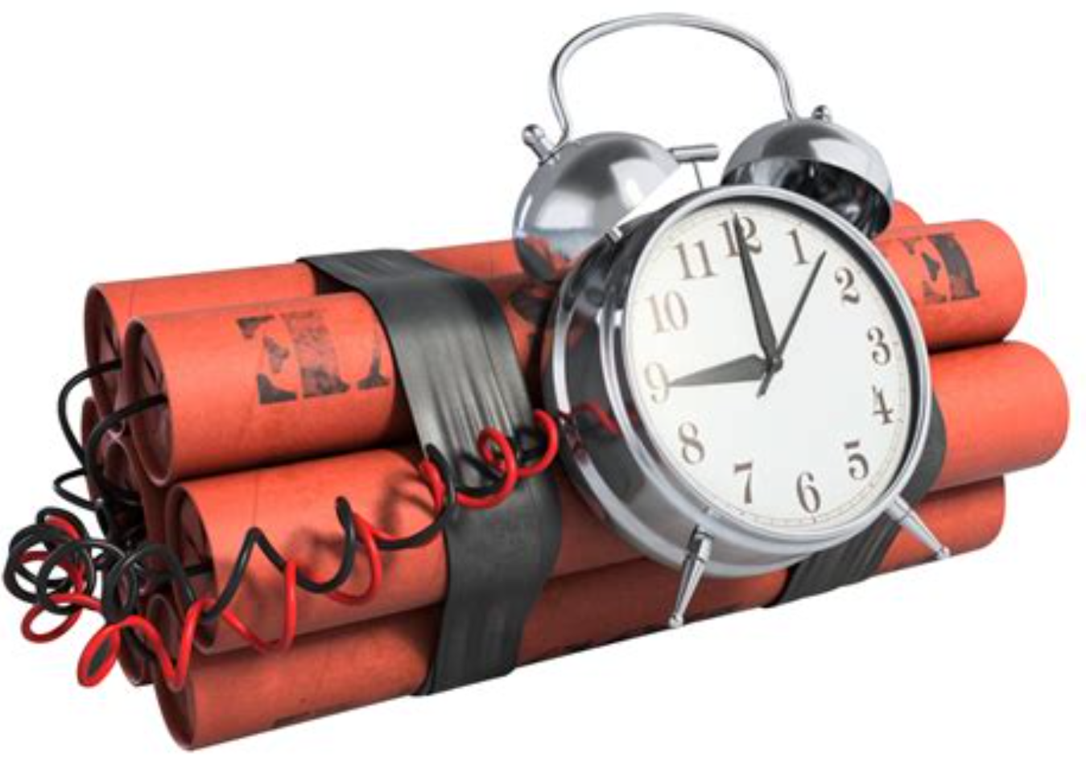
Land Mine or Time Bomb?
Concentrations & Negative Impacts Accumulate Over Decades
Potential Contaminants in Gravels
  Metals: Lead, Arsenic, Aluminum, Zinc, Etc.
  Mobilized Organic Chemicals
Crushing, Washing, Dewatering
  Free Captured Contaminants
    Airborne Dust
    Suspended Solids in Water
    Dissolved Solids in Water
    Mobilized Organic Chemicals
Cumulative Health and Environmental Impacts Over Time
Notes:
Is the proposed Burnco Mine a potential time bomb environmentally? Perhaps. Are we well advised to raise an alarm BEFORE the law of unintended consequences, and its annoying siblings, kick Albertans in...the plumbing? ABSOLUTELY.
Many mining operations in Canada started with the assumption that they would not cause environmental problems, only to teach us that time, concentration of pollutants, human error, hubris, greed, wishful thinking, and the law of unintended consequences are all inexorable laws of nature.
Most of these, non-aggregate mining operations are now under strict legislation that has resulted from the, often disastrous, consequences of recognizing the effects of these laws after years or decades of operation.
Aggregate Mines are MINES! We ignore that at our own and the environment’s peril.
This lesson has been learned the hard way many times. We would like to avoid repeating those lessons.
Rock scoured by glaciers from Rockies and Canadian Shield over hundreds of thousands of years form the gravels in RVC. They contain highly varied, potentially dangerous contaminants like arsenic, uranium, lead, zinc, silica, ????, etc.
Hydrocarbons and organic chemicals can be mobilized. Examples follow.
Removing overburden and most of the water table can mobilize hydrocarbons and chemicals from anthropogenic, petrogenic, biogenic, pyrogenic sources. This also removes much of the natural filtering and treatment capability that the soil provides.
Crushing and washing frees contaminants captured in the rocks. This suspends solids in the air and water. Silca is ground in fine silica power and the dust can cause silicosis.
These chemicals and solids accumulate in the water and soil over time...a time bomb waiting to go off?
Health effects from these contaminants also accumulate over years, further pushing the impact to future generations...The aggregate time bomb. It may go off in five years, or five decades, or we defuse it now, and it may not go off at all.
If experience with mines has taught us anything, it has taught those of us paying attention, to approach them with an abundance of caution. Has Alberta Environment learned this lesson or are they being “schooled” by aggregate companies with a huge conflict of interest?
Aggregate Mines are MINES! They should be treated as such.
Environmental Protection and Enhancement Act
Alberta Water for Life

Slide 6
Historical Mine Time Bombs
Yes Burny, Aggregate Mines are MINES
Elk Valley Coal
Gibraltar
Copper Mountain
Mount Polley
Quinette
Bonanza Ledge
Cariboo Gold
Tulsequah Chief
Yellow Giant
Anyox
KSM
Telkwa Coal
Wiliston Lake
Sudbury
Notes:
Aggregate mine are MINES. Mines are historically a major polluter of air, ground water, lakes, rivers, and streams.
Issues are often not recognized until the damage is done.
Lakes in a large area around Sudbury, Ontario, Canada, which historically received very high deposition of both acid and metal particulates from surrounding mines, were severely affected.
“Teck Resources’ Elk Valley coal mines have created one of the most serious pollution problems in North America2 “
“Taseko’s Gibraltar mine, on the banks of the Fraser River, is the fourth largest open-pit mine in North America... While Gibraltar’s previously underfunded reclamation bonding has recently improved, the mine still has major risks associated with both tailings and water “
“Straddling the Similkameen River, Copper Mountain mine, has a bad track record for causing damage to fish-bearing waters—including unauthorized wastewater discharges directly to the Similkameen (where local Indigenous communities now feel unsafe accessing traditional foods), and repeated copper and nitrate contamination of local creeks.
“Mount Polley is the site of the most significant environmental mining disaster in Canadian history, in which a tailings dam collapse released 25 billion litres of tailings and contaminated water into salmon habitat in Quesnel Lake and surrounding creeks.”
https://miningwatch.ca/news/2021/1/19/new-map-shows-dozens-mine-pollution-threats-bc
https://reformbcmining.ca/wp-content/uploads/2023/05/BCMLR-Dirty-Dozen-report-2023-web.pdf?utm_source=business%20in%20vancouver&utm_campaign=business%20in%20vancouver%3A%20outbound&utm_medium=referral

Slide 7
Aggregate Mines v. Other Mines
Aggregate Mines:
Free heavy metals
Mobilize Contaminants
Damage Aquifers
Damage Land Forms
Change Hydrology
Other Mines:
Free heavy metals
Mobilize Contaminants
Damage Aquifers
Damage Land Forms
Change Hydrology
Under Strict Legislation
Hmmmmmm....?
Notes:
Aggregate mining activities have many of the same outputs and issues as other mining activities.
Some of these output/issues are either more, or less, damaging.
Significant historical contamination issues have resulted in strict legislation governing other mining operations, but aggregate mines have been flying below the radar.
We are not opposed to aggregate mines, we are opposed to irresponsible expansion of aggregate mines w/o adequate study and protection for the environment and the adjacent lands waters, residents and wildlife.

Slide 8
Aggregate Mine Market Externalities
Market Externality:
An indirect cost or benefit to an uninvolved third party caused by another party's activities.
Aggregate Mines have Many Market Externalities
  Unrecognized, Unmonitored, and/or Uncontrolled
Legislative Bodies are Responsible for Minimizing Negative Effects of Market Externalities
Is AB Ministry of Environment and Protected Areas (MEPA) Ignoring these Externalities?
Notes:
Explain market externalities.
This is important because aggregate mines create many market externalities
While we are not a fans of government regulation, it is the responsibility of the government to protect the public from companies that ignore market externalities at the expense of their neighbours or the general public.
Is AB Ministry of Environment and Protected Areas (MEPA) Ignoring these Externalities?

Slide 9
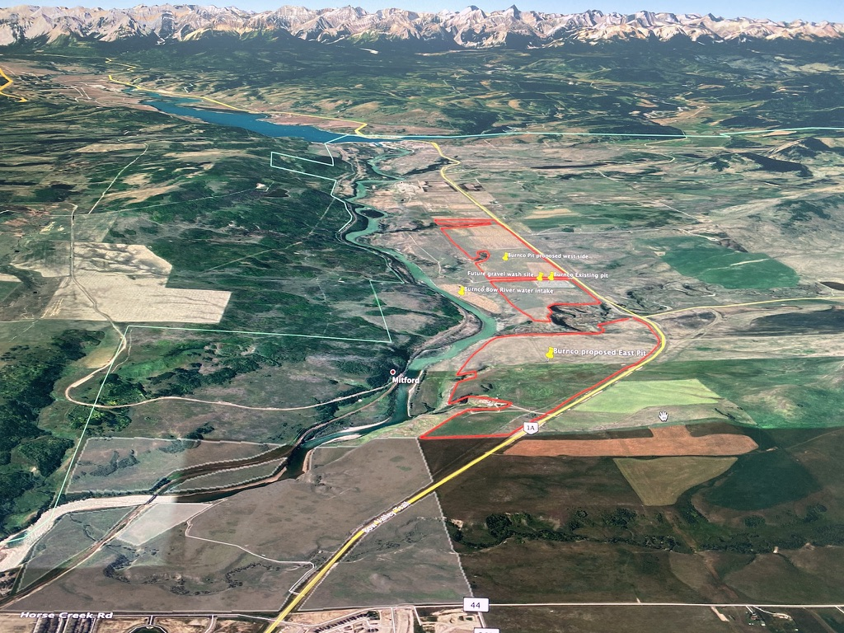
Aerial View of the Proposed Burnco Expansion
Notes:
This is an aerial view showing the extent of the proposed Burnco expansion along the Bow River West of Cochrane.

Slide 10
Proposed Mine Expansion Plan Along Bow River
Notes:
A1, A2, A3, and A4 are the existing pilot mine project.
The rest is the proposed expansion plan, most of which MEPA has already approved.

Slide 11
Springs Disturbed (Destroyed?)
Notes:
There are numerous springs in the proposed expansion area that highlight the fact that the areas aquifers discharge into the Bow. The degree to which these springs and aquifers will be affected by the proposed expansion has not be sufficiently characterized by MEPA or Burnco.

Slide 12
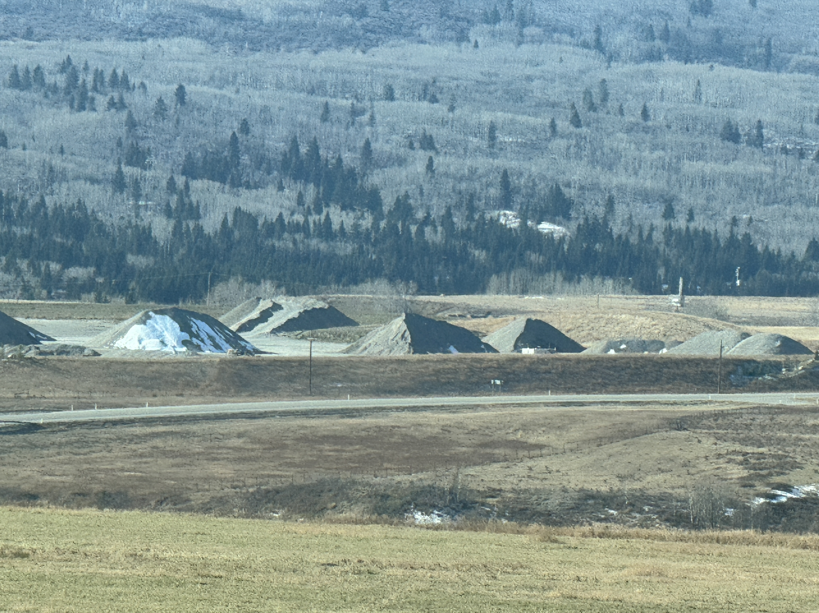
Existing Mine Aggregate Piles
Notes:
This picture shows SOME of the massive aggregate piles on the existing mine site. Image 6 kilometres of this w/ a crusher, a washing plant, an asphalt plant, and a concrete batch plant, all along the (formerly) picturesque Bow River valley.

Slide 13
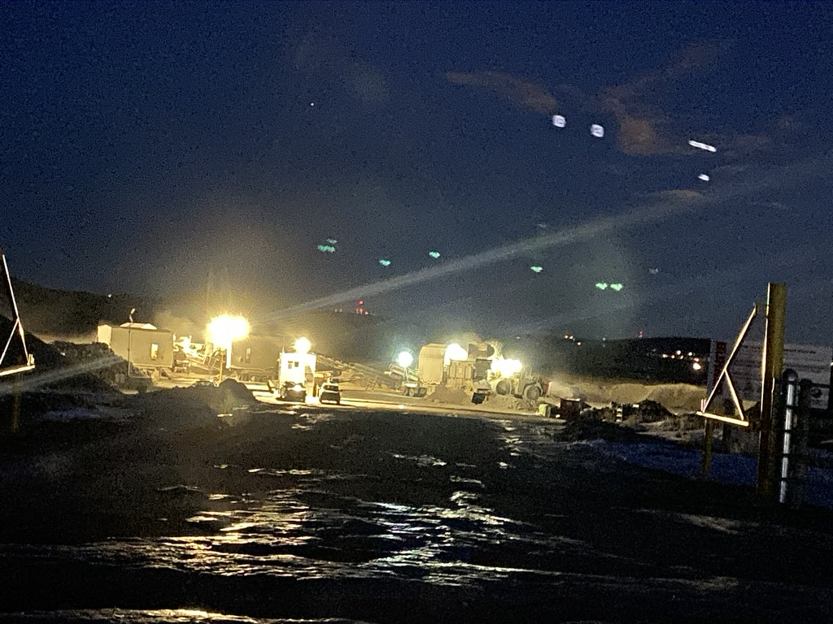
24/7 Mining Operation
Notes:
24/7 operations will exacerbate/accelerate the environmental impact.

Slide 14
Burnco West Mine Status
Burnco West Cochrane Mine
  Pilot
  RVC Approved Small (1/2 klic) Expansion
    Acting in the Interests of the County and Residents
  Burnco End Run to Alberta Environment
    6 Kilometre Proposed Expansion
    On Banks of the Bow River
    1 Kilometre Upstream and Upwind of Cochrane
    Upstream of Major Water Users
    APPROVED
    In Whose Interest is Alberta Environment Acting?
  Reclamation
    Remove 30’ to 50’ of Overburden, Gravel, and Water
    Replace w/ 1 FOOT of Soil
    Destroys 6 Kilometres of Gravel Aquifers Draining into Bow
Notes:
We could not believe that Alberta Environment approved the massive expansion of the Burnco mine even though RVC only approved an additional 1/4 section (150 acres).
Is environmental stewardship just a buzzword for the Provincial government?
Does the proposed dam five kilometres from the proposed aggregate mine affect the approval and/or pace of development?
How much money does Burnco stand to make supplying aggregate over the life of the project: 1 Billion? 2 Billion? Probably more.

Slide 15
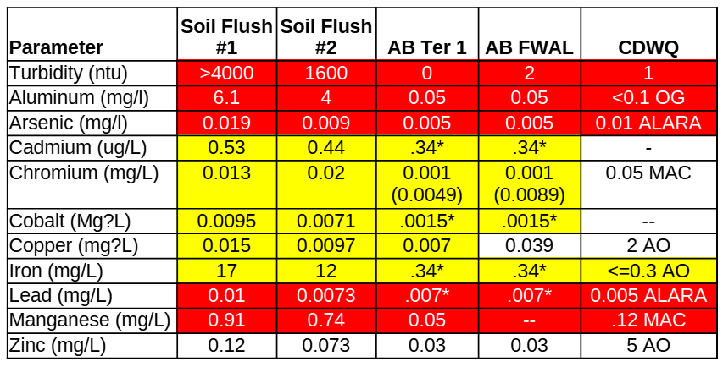
Aggregate Percolation Test Results
Yellow = Over Limit
Red = WTH???
Note:
  1.25 m Test Column
  Avg Pile 12 m?
  Reality 10x Worse?
Tests performed by Dr. Jon Fennell
* Assumes a groundwater hardness of 250 mg/L (as CaCO3).
AB Tier 1 and FWAL limits are presented as bivalent (trivalent)
MAC = maximum acceptable value
ALARA = as low as reasonably achievable
AO = aesthetic value
OG = operational guidance value
The Solution to Pollution is Dilution?
Notes:
Results from a 1.25 m column percolation test of sand/gravel aggregate from existing mine performed by Dr. Jon Fennell.
AB Tier 1: Alberta limit to protect the environment
AB FWAL: Limit to protect freshwater aquatic life
CDWQ: Canadian Drinking Water Quality Guidelines
NOTE: This is for a 1.25 m column of sand and gravel from the current mine. What is the average height of the typical aggregate pile in the mine pit? If we assume 10 m, are the values at the bottom of the pile 10x these values?
Two, one meter column tests are anecdotal, but why is it left to the public to do this testing at all? Obviously because Aggregate Mines are not treated as Mines?
The attitude of Burnco and Alberta Environment seems to be:
“The solution to pollution is dilution.” This was a disastrous refrain from the industry in the 50’s and, over time, created serious environmental damage. I effluent that now exits pulp mills
This negligent and short sighted environmental outlook saddled the public w/ the impacts and much of the cleanup cost, and is another crack in the system that significant problems can fall through.
Where are all the independent university studies of this issue funded by the Alberta government and environmental groups and not influenced by the aggregate industry?
https://www.earthisland.org/journal/index.php/magazine/entry/the_solution_to_pollution_is_still_dilution

Slide 16
The Solution to Pollution is Dilution?
US Clean Water Act (1972)
  Basic Structure for Regulating Pollutant Discharge
  Set Standards for Wastewater Treatment
  Amended to Force Industry to Protect Water Quality
Environmental Protection and Enhancement Act (EPEA)
  Alberta Passed in 1992
  EPEA Outlaws Using Dilution to Hide Pollution
  Severe Penalties for Using Dilution to Hide Pollution
  Pollutants Diluted in Groundwater, Streams, Rivers, Lakes
  AB Environment Ignoring Dilution Abuse in Aggregate Mines?
Notes:
US Clean Water Act (1972):
This is the most significant piece of legislation directly addressing the dilution issue. Originally enacted as an amendment to the Federal Water Pollution Control Act of 1948, the Clean Water Act:
- Established the basic structure for regulating pollutant discharges into navigable waters.
- Introduced the National Pollutant Discharge Elimination System (NPDES), which requires permits for discharging pollutants into waters of the United States.
- This system effectively made dilution as a pollution control strategy less viable since discharges had to meet specific standards, regardless of dilution in the receiving waters.
- Set standards for industrial and municipal wastewater treatment, pushing for treatment at the source rather than relying on dilution.
1972 Amendments to the Clean Water Act:
- These amendments were crucial in setting up the framework where industries had to treat pollutants to a level that protected water quality, moving away from the previous assumption that natural water bodies could handle waste through dilution.
Subsequent Amendments and Regulations:
- Over the years, amendments and regulations under the Clean Water Act have further refined the approach, with increasing emphasis on reduction at the source, better treatment technologies, and stricter standards for discharges.
The Alberta Environmental Protection and Enhancement Act was passed in 1992. It specifically outlaws the use of dilution as a solution to pollution. Anyone knowingly allowing dilution to be used to HIDE polluting activities is joint and severally liable for the effects of hiding that pollution.
- Is water percolating through Aggregate piles in RVC high in heavy metals and other toxic contaminants? The evidence says that this is very likely.
- Over time, are these toxins being collected and concentrated in the sediments on the bottom of our lakes, rivers, streams, and ground water aquifers? Again, this is a like result.
- If this is the case, why is the Alberta Government not concern?
- Is the Alberta Environmental Protection Agency Ignoring the abuse of dilution in the aggregate mines?

Slide 17
Percolation Through Mine Aggregate Piles
Notes:
Water percolates through aggregate piles, into the water table, and eventually into the Bow River.

Slide 18
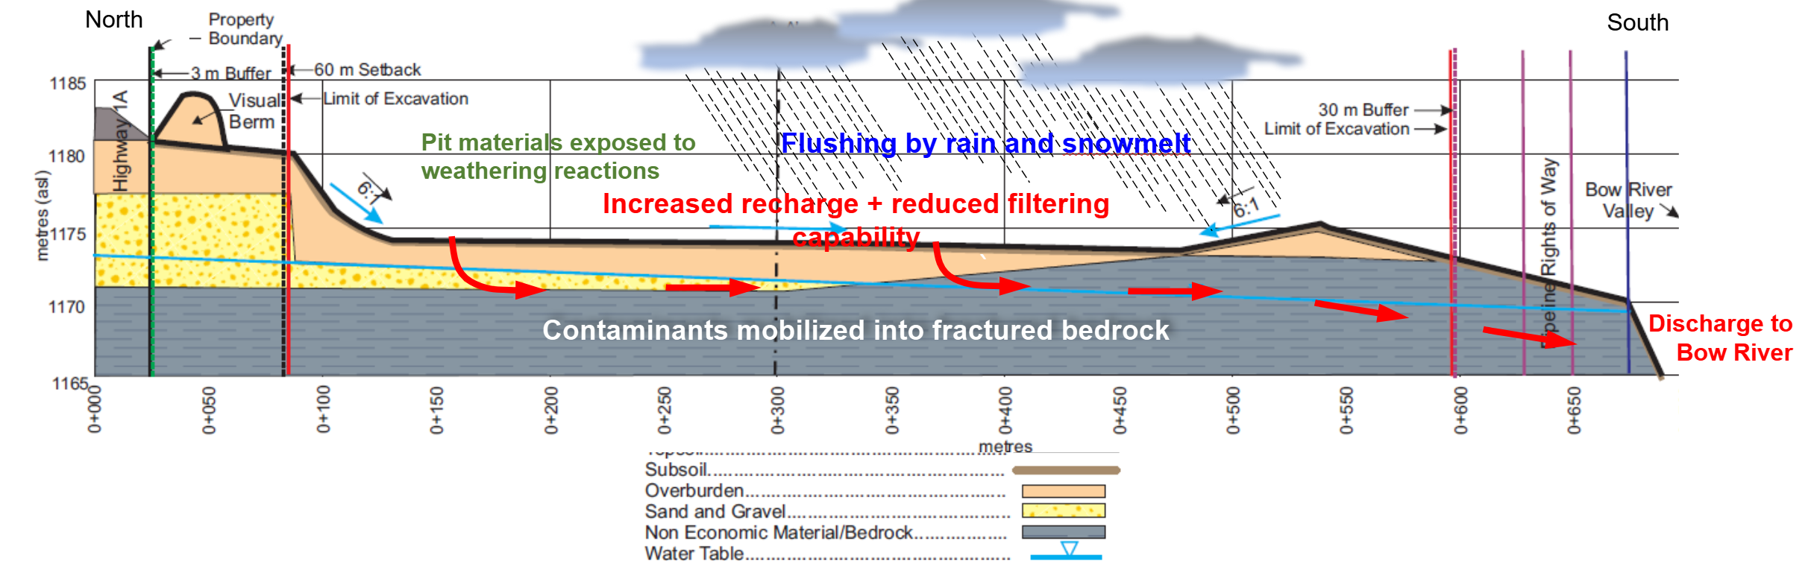
Mine Cross Section/Water Flow
Notes:
Precipitation and dust control water percolates through aggregate piles, into the water table, and eventually into the Bow River.
Discuss the Young drill profile here...Clay/Boulders/Sandstone/Boulders/Clay/Gravel...obvious ancient cliff face.
Do mining companies count on dilution, transport, and time to hide the negative effects of their activities on ground and surface waters? Historically yes, as evidenced by all the lakes in Canada with levels of heavy metals that make their fish dangerous for human consumption. Regulations have been enacted to counter this for most mining industries, but aggregate mining is flying under the radar, and legislation has not been updated since Jesus was a boy...actually the 1980’s.
Does the aggregate mining industry count on the environmentally responsible not recognizing the effects of aggregate mining due to, “it’s just gravel,” dilution, and transport to distance waters?
Do aggregate companies push the boundaries of what is legal in the interest of profit, even though the regulations are lax?. Stupid question?
Ancient, fractured sandstone cliffs border the North side of the proposed 6 kilometre mine expansion.
Fractures in cliffs provide some of the recharge for the aquifers in the existing and proposed excavation.
The significant hydrostatic draw from the dredging may also have mobilized contaminants from the excavation and the land about the excavation. We’ll look at some anecdotal evidence for that this may have occurred later.

Slide 19
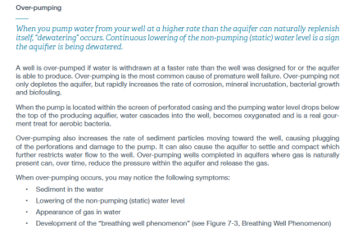
Dewatering/Dredging: Ultimate Over-pumping
Alberta Environment 2019 “Guide for Private Well Owners in Alberta” Chapter 7
Notes:
Before we go on, let’s take a detour into Alberta Environment’s Guide for Private Well Owners in Alberta” Chapter 7
Alberta Environment says that over pumping mobilizes hydrocarbons.
Explain dewatering and dredging
Dewatering and dredging are the ultimate example of over pumping.
- One tandem truckload of dredged gravel removes as much water from the water table as 100 cows drink in a day.
- One 4” trash pump dewatering removes that amount of water in 4 minutes.
“pump water...at a higher rate than the aquifer can...replenish..., ‘dewatering’ occurs...Over-pumping not only depletes the aquifer, but rapidly increases the rate of corrosion, mineral incrustation, bacterial growth and biofouling...
Over-pumping ...increases the rate of sediment particles moving...can also cause the aquifer to settle and compact which further restricts water flow...Over-pumping in aquifers where gas is naturally present can... reduce the pressure within the aquifer and release the gas...
Increased dissolved solids and chemical contamination can occur over a wide area, including upstream. Over-pumping can also initiate mobilization of hydrocarbons from anthropogenic, biogenic, and petrogenic sources over a wide area even upstream of the over-pumping operation. Mobilization of such contaminants can permanently damage an aquifer.
Both dredging and dewatering constitute "over-pumping" the aquifer, so Alberta Environment’s well guidelines against over-pumping argue against AE's approval of dewatering 6 kilometers along the Bow. In fact, such activities are MUCH more likely to negatively affect the aquifer, and hence be considered over-pumping, than a farmer pumping to water a few cows.
To illustrate the difference in scale between pumping for cattle and dredging/dewatering, assume a single steer drinks an average of 10 to 15 gallons a day, and a lactating cow w/ calf requires about 25 to 30 gallons a day, so 50 cow/calf pairs would require 1,250 to 1,500 gallons, or approximately 6 to 7 cubic meters per day. This is equivalent to less than 1 tandem load of wet gravel in a dredging operation or 3 minutes of pumping for a 4" trash pump in a dewatering operation. Note, a 4" trash pump is TINY in the context of Burnco's proposed operation.

Slide 20
Hydrocarbon Mobilization
Hydrocarbons in Two Wells Around Pilot Mine
Burnco Explanation: Rancher Over-pumped Well
  Well Was Not In Use! No Cows Were Drinking!
No Explanation for Hydrocarbons in Burnco Monitor Well
Dredging/Dewatering: The Ultimate Over-pumping
Burnco: “Not Our Fault”
  i.e., Take Us to Court and Prove It – Impossible Now
Exposed a Gaping Hole in Provincial Environmental Protection
  Alberta Environment: Not OUR Problem
  Alberta Energy: Not Our Problem
  Then WHOSE PROBLEM IS IT?
Root Cause:
  Aquifers NOT Characterized BEFORE Excavation
Notes:
Mobilized from contaminants in Mine, or from historical, perched hydrocarbons in water tables affected.
One landowner well and one Burnco monitor well showed hydrocarbons around the time of dredging
No explanation has been provided for either
Bunco has taken the position that this has nothing to do with the excavation
Dredging appears to have been backfilled
Has fractured aquifer above pit been damaged, drained, or contaminated by perched hydrocarbons?
Aquifers were NOT characterized before excavation
Aquifers on South side of Hwy 1A were dewatered and destroyed by dredging.
Impossible to prove/disprove connectivity to well now that aquifers are destroyed
Alberta Environment says not our problem, Alberta Energy says not our problem.
Who’s problem is it?

Slide 21
Contaminant Mobilization
Water Percolates Through Aggregate Piles
Contaminant Mobilization Proven in Perc Tests
  Actual Contamination ~10x Perc Test?
“Will be diluted by ground water and Bow”
“The solution to pollution is dilution.”
“Not a problem” – Alberta Environment
Reality:
  Mead 1995 Shows Turbidity Plume 1.83 km frm Mine (Skagit County USA)
  Heavy Metals Accumulate and Concentrate in Surface Water Bodies Over Time
“Two things are infinite: the universe and human stupidity, and I’m not sure about the former.” – Albert Einstein
Notes:
“The Solution to Pollution is Dilution.
“heavy metals...are characterized by high density and toxicity even at low concentrations (HELCOM, 2022). Although heavy metals enter aquatic ecosystems from both natural and anthropogenic sources, natural processes such as leaching and weathering of rocks, soil erosion or volcanic activity contribute relatively little (Dixit et al., 2015; Paul,2017). In contrast, anthropogenic emissions of heavy metals into the environment intensified in the nineteenth and twentieth centuries” --A global perspective on the nature and fate of heavy metals polluting water ecosystems, and their impact and remediation, Dominika Piwowarskaa,b,c , Edyta Kiedrzyńskaa,b andKatarzyna Jaszczyszyn
How much do Aggregate Mines with crushing and washing operations contribute to the release of heavy metals into the environment? Is there a serious effort on the part of the industry or Alberta Environment to find out? What is the long term impact?
How many millennia would it take natural processes to crush the gravel in a 6 kilometre x 600 meters x 10 meter (36 million cu m) stretch along the Bow River? A million years? More? and nature would require at least one glacial cycle.
Burnco’s plan is to do this in a period of between 25 and 100 years...at least a 10,000 times increase in the rate of natural weathering and the attendant release of heavy metals.
Humans are nothing if not efficient in their....well....I’ll just let Einstein complete that thought.
(Mead 1995) that shows a turbidity plume 6000 ft (1.83 km) downgradient of an operating gravel pit in Skagit County USA.

Slide 22

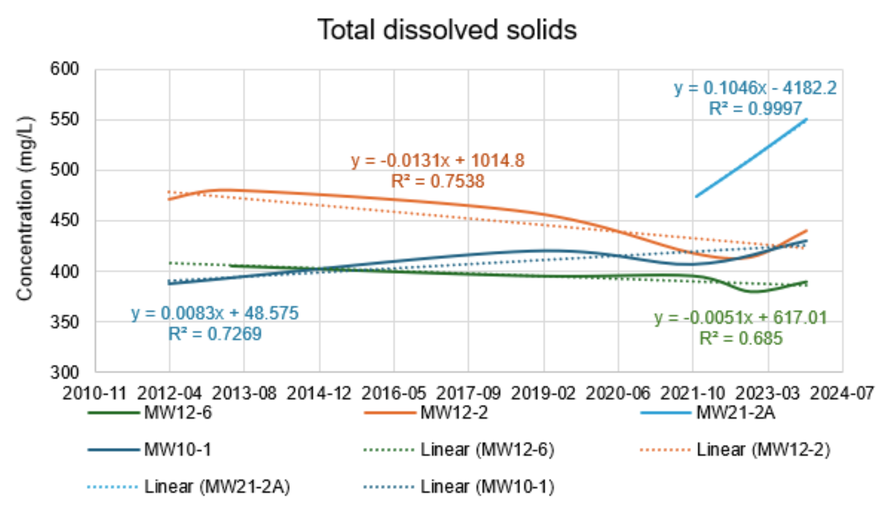
Total Dissolved Solids Increasing
Following Slides are supporting points or in process
Notes:
This shows the TDS in four of Burnco’s monitoring wells around the current mine.
Both of the down gradient wells (21-2A and 10-1) show a distinct increase in TDS.
The upgradient wells are showing a slight decrease in TDS, indicating that the downgradient increase
Is most likely due to something happening in the mine.
Where heavy metals are present in the lithology (as in the Burnco mine), an increase in TDS usually also indicates an increase in
dissolved heavy metals, so TDS can be used as an approximate proxy for heavy metal contamination.
Burnco is only monitoring 4 wells, with infrequent testing intervals (1 yr), so the testing in not frequent enough in time or
space to get an accurate picture of the heavy metal concentrations in the down-gradient aquifers.
As piles are moved, precipitation changes,

Slide 23
Kick the Can-taminants Down the River
Do Aggregate Companies Count On?:
Dilution Hiding Problems in the Short Term
Bow and Its Tributaries Flow to Hudson Bay
No Local Lakes Act to Concentrate Contaminants
However:
Toxins Concentrate in the River Bottom and Bay
Is this Environmentally Responsible?
“The Solution to Pollution is Dilution?”
Notes:
Do mining companies count on dilution, transport, and time to hide the negative effects of their activities on ground and surface waters? Historically yes, as evidenced by all the lakes in Canada with levels of heavy metals that make their fish dangerous for human consumption. Regulations have been enacted to counter this for most mining industries, but aggregate mining is flying under the radar, and legislation has not been updated since Jesus was a boy.
Do they count on the environmentally responsible not recognizing the effects of aggregate mining due to, “it’s just gravel,” dilution, and transport to distance waters? Same answer.
Do aggregate companies push the boundaries of what is legal in the interest of profit, even though regulations are lax?. Is that a stupid question?
Also, Husdon’s bay is BIG and it’s connected to the Atlantic, which is even BIGGER. It will take a long time for those diluted contaminants to get to dangerous levels.
And OBVIOUSLY, Hudson Bay is not in Alberta, so why would ALBERTA environment be concerned about it anyway?

Slide 24
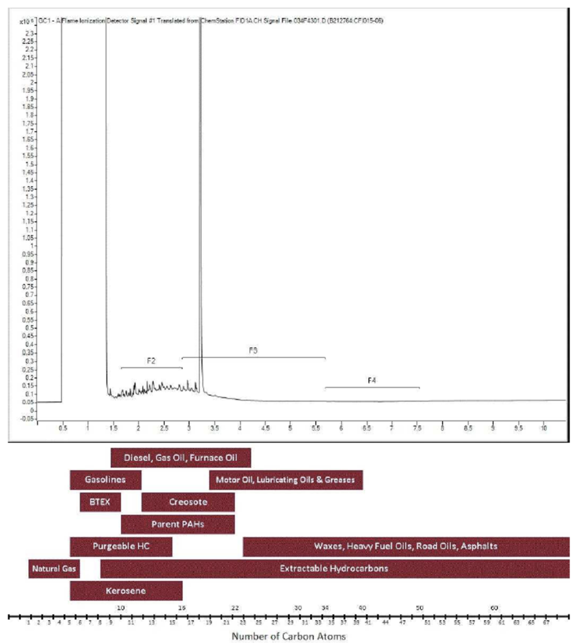
GCFID Profile
Likely Source
  Indeterminate
  Character of:
    Diesel
    Kerosense
    Furnace Oil
Notes:
Two wells tested positive for hydrocarbon contaminants in the area around the Burnco mine after Burnco started dredging.
The source of these hydrocarbon shows has not be definitely determined.
Burnco and MEPA both say it has nothing to do w/ the mine, w/o evidence to prove that.

Slide 25
Continuing Hydrocarbon Shows
Notes:
The toluene and F2 concentrations detected in June confirmed present in 2023-11 in SE23-26-5W5 water well.
• Toluene concentrations were 0.0044 and 0.0042 mg/L in the two samples collected in November. In June both samples were 0.014 mg/L. The Alberta guideline for livestock water is 4.9 mg/L.
• F2 concentrations were 1.5 mg/L in in the two samples collected in November. In June both samples were 1.6 mg/L. There is no Alberta guideline for F2 for livestock as the concentration that puts livestock at risk is greater than can be dissolved in water.

Slide 26
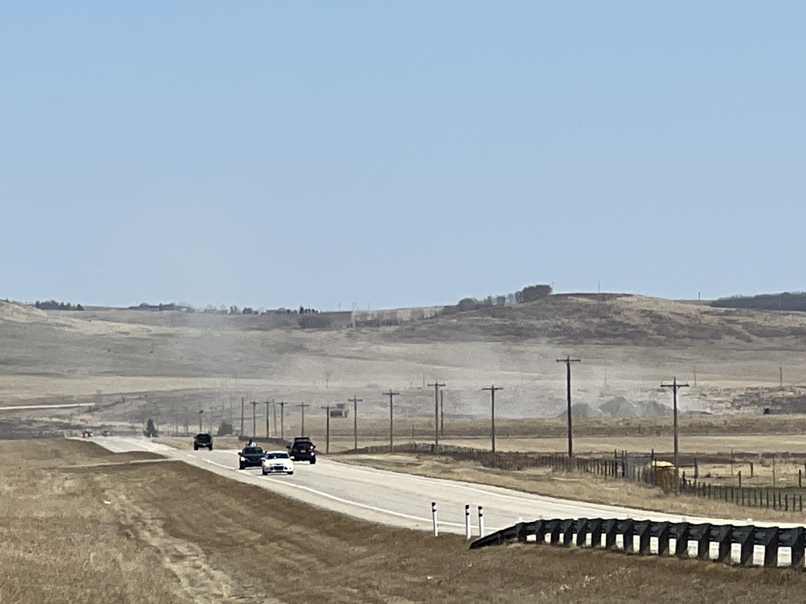
Crusher Dust: The Movie
Notes:
Play the Crusher Dust movie here.
This is from a 100 acre mine site. The proposed mine site is 1,200+ acres.
This illustrates the dust that will be affecting local land owners and Cochrane for the 25 to 100 year life of the proposed mine.

Slide 27
Burnco West Pilot Unresolved Issues
Dust
Turbidity
Elevated Heavy Metals in Samples
Hydrocarbon Contamination in 2 Wells
Reduced Water Table In Mine
Reclamation? Plan
Notes:
Pilot: Existing pit 1 quarter ~ 3 k West of Cochrane
Burnco applied to RVC for 6 kilometer expansion
~1 k West of Cochrane to ~7k West of Cochrane
RVC approved 1 quarter expansion West of pilot
(when?)
Limited due to proximity to Cochrane and the Bow River
Burnco applied to Alberta Environment (AE) for dewatering rights for 6k
AE Approved (when?)

Slide 28
Hydrology and Aquifer Issues
Land Form Modification
Dredging and Dewatering
Aquifer
  Drainage
  Damage
  Contamination
Notes:
The hydrology of the area under and around the proposed mine will be altered permanently.
The potential short and long-term effects of this have not been sufficiently studied.
There has already been aquifer damage, drainage, and contamination with the small pilot mine.

Slide 29
Wildlife and Habitat Issues
Burnco Proposed Mine:
  Affects 12 Sections of Bow River Wildlife Habitat
  Blocks Historical Elk Migration Path
  May further Pollute World Famous Bow Fishery
Notes:
Proposal:
100 acre pilot mine to be expanded to 1,200+ acres will affect wildlife and Bow fishery as well.

Slide 30
Summary of Potential Impacts
Water and Air Contamination
  Silicosis, Cancer, Heavy Metal Poisoning, ect.
Water Availability
  Mining Drains/Damages Aquifers
  Pollutes Major Water Sources
Wildlife and Fishery Disruption
Land Form Modification/Disruption
Notes:
Water and air pollution WILL occur.
Water availability WILL be affected.
Wildlife WILL be affected.
Burnco and MEPA do not have a sufficient understanding of the short and long term effects, and they seem to have no interest in developing that understanding.

Slide 31
Court Says EIA* is Required
2020: Alberta Court of Appeal: Pit > 45,000 Tonnes/yr Requires EIA
  Held up 500 Pit Applications
Alberta Sand and Gravel Association (ASGA) Lobbied to Circumvent
From June 12, 2020 ASGA Letter to Environment Minister:
“EIA’s are typically reserved for large resource projects, not sand and gravel pits. Regulation and policy on a modified EIA process for gravel pits would take significant time to develop and adversely affect the industry.
1,200+ Acres of Aggregate Mine on Bow River w/ Crushing, Washing, Asphalt, and Bulk Cement IS a LARGE RESOURCE PROJECT.
*EIA = Environmental Impact Assessment
Notes:
The Alberta Sand and Gravel Association (ASGA) have done their best to ensure they are not subject to the delay and expense of an EIA.
In 2020, the Alberta Court of Appeal found that a pit of greater than 45,000 Tonnes/yr was a quarry and subject to an EIA. That case held up 500 pit applications when the court stated:
“Having concluded that the only reasonable interpretation is that sand is a mineral under the EPEA, I would remit this decision to the Director for reconsideration as to whether Wayfinder’s Project goes beyond the mere removal of sand and therefore cannot be classified as a pit, but must be a quarry.”
Alexis v Alberta (Environment and Parks), 2020 ABCA 188 (CanLII), at para 193
As a result of the case, the ASGA lobbied (see attached letter written by John Ashton Executive Director of the Society and President of Burnco) the then Minister of the Environment Nixon, for the appropriate amendments to various acts to ensure a pit is not subject to the same regime as a quarry.
Alberta Sand and Gravel Assoc. letter to Minister Nixon re EIA exemption June 12 2020.pdf" for your review.
https://acrobat.adobe.com/id/urn:aaid:sc:VA6C2:dc0a235f-1d65-450d-9cac-a663489c93a7
“EIA’s are typically reserved for large resource projects, not sand and gravel pits. Regulation and policy on a modified EIA process for gravel pits would take significant time to develop and adversely affect the industry.”

Slide 32
Suggestions
Recognition
  Aggregate Mines are MINES!
  Environmental Impact
  Eventual Concentration
  Community/Landowner Impact
Monitoring and Mitigation
  DETAILED Impact Studies (EIA+)
  Phased Implementation
  Responsible Reclamation
  Wash Water Treatment?
  Wash Silt Treatment?
Court Ruling Requires EIA
Aggregate Mine Management
  Detailed Characterization of:
    Geology
    Lithology
    Hydrology and Aquifers
    Chemistry
    Impacts
  Long-term Monitoring of 3, 4, 5
  Aggregate Mine Monitoring System
    Open-source
    Wireless
    Auditable
    Backed by Legislation, Training, and SOP
Notes:
Those of us who are concerned about the Burnco expansion would like to suggest the following:
Burnco and MEPA recognize that:
aggregate mines are mines, and they should be treated as such
there could be a significant environmental impact from the mine
pollutants eventuality concentrate somewhere...it is a law of nature
the proposed mine expansion has a significant impact of the surrounding landowners and communities
Burnco and MEPA commit to:
Comprehensive monitoring and mitigation
Phased implementation
Proactive and detailed monitoring and impact studies
Wash water and silt treatment
Responsible and comprehensive reclamation

Slide 33
Conclusions
Aggregate Mines are MINES!
  They should be Treated as Such.
Counting on Dilution to Hide Pollution?
Serious, Long-term Environmental Impact?
Is AB Environment Ignoring these Issues?
Notes:
1. Aggregate mines are MINES! Treat Them as Such
2. Are aggregate mines are counting on dilution to hide pollution? It appears that they are.
3. This could have serious, long-term environmental and health impacts.
4. Alberta Environment appears to be ignoring these issues in contravention of EPEA. WHY?

Slide 34
End of Presentation
Following Slides are supporting points or in process

Slide 35
Existing Mine Elevation Profile

Slide 36
The Percolation Process?
Notes:
Fact: Water percolates through aggregate piles, into the water table, and eventually into surface water.
Hypothesis:
Plumes of high TDS water will be found in the area of the piles, and will move around with the piles and with precipitation events.
The high TDS water will enter the aquifer and travel down-gradient as a bolus.
The bolus will be progressively diluted as it flows down-gradient and diluted again as it enters surface water resources (e.g. the Bow River or Big Hill Springs creek).
Precipitation will flow down the sides of the piles, and percolate to a depth dependant on the permeability of the aggregate.
As it flows down the pile and percolates, it will pick up solids and dissolved solids.
Permeability depends on a number of factors including, but not limited to, the size distribution of the aggregate elements, and the shape of those elements.
For crushed, unscreened gravel, it is likely that a simple conical shape will probably experience the least percolation with a concentration ring around the outer diameter.
For crushed, screened gravel, the precipitation will percolate to a much greater depth, so the concentration of dissolved solids will probably be higher, and may well be found over the entire base of the pile.

Slide 37
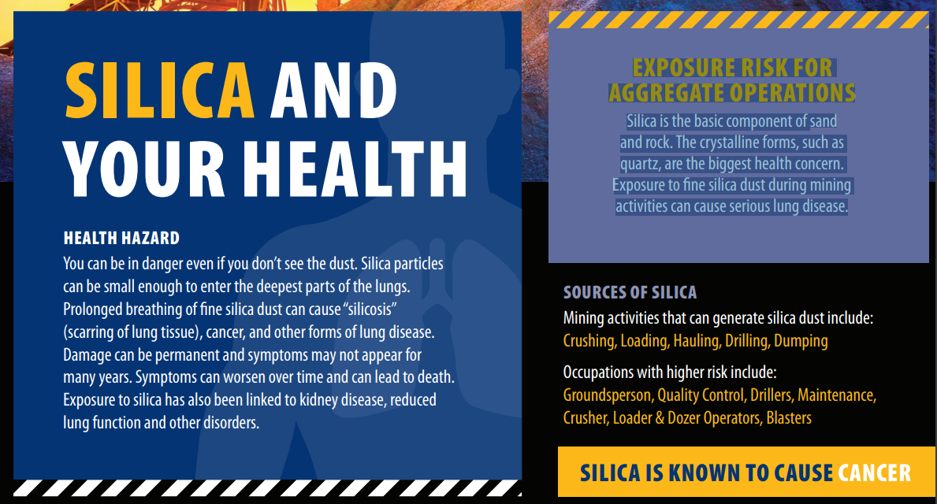
Silica Dust, Silicosis and Cancer
Notes:
The surrounding landowners and residents of Cochrane are the most likely to be affected by dust from the pit.
The Bow River valley West of Cochrane is a wind tunnel with prevailing West winds that often exceed 100 kph

Slide 38
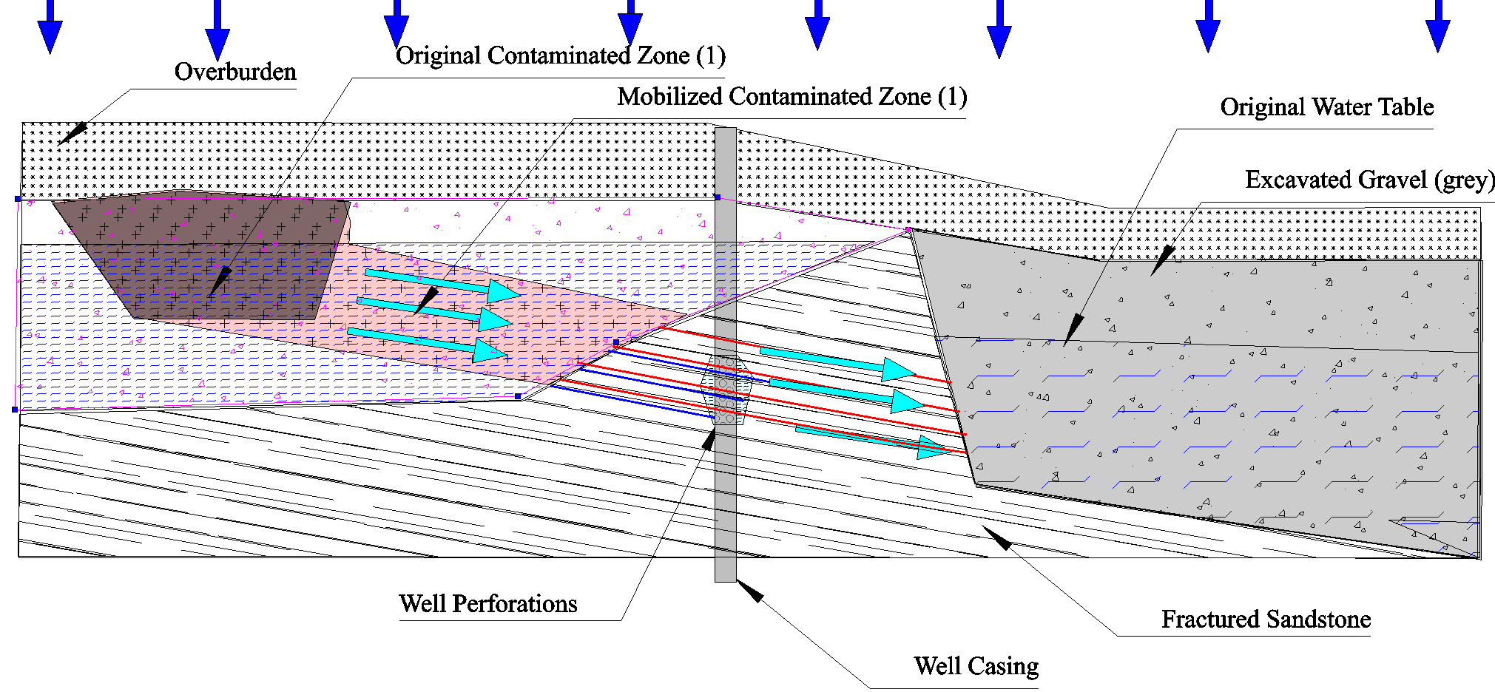
Mobilization of Perched Hydrocarbons
Notes:
Contaminated zone (e.g. an ancient peat bog, modern drill sump, etc).
With low flow from agricultural use, scoured fractured sandstone does not draw contaminants to well.
Flow from the dewatering/dredging can be 1,000 times the flow for animal/human consumption.
Aquifer below the sandstone is partially recharged from springs that originate in the zone to the left and above.
Under normal conditions, the hydrocarbons from the contaminated zone is not be mobilized, but with dewatering/dredging the high flow through fractures mobilizes the hydrocarbons.
Water table in the dredged/dewatered zone drops, flow through fractures increases dramatically and draws perched hydrocarbons into fractures feeding the well and the recharge springs.

Slide 39
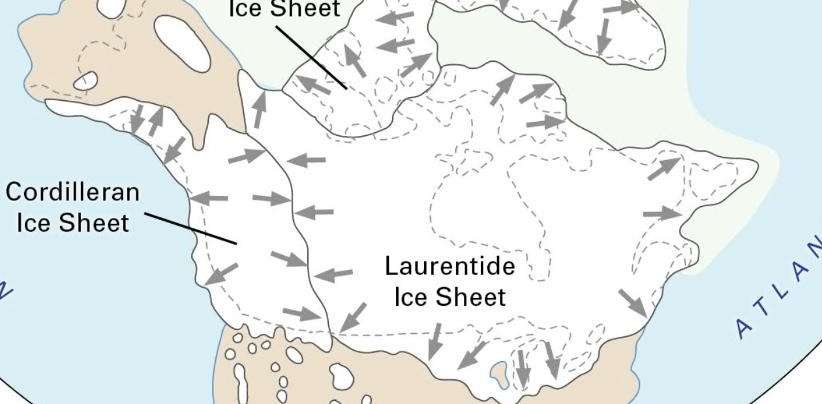
RVC Gravel: Genisis?
Notes:
Depositional Environment
Glaciofluvial, glaciolacustrian
Glacial transport frm rockies and canadian shield over long distances and 100,000+ years
Terminal and Lateral (Side) Moraines
The Ice Free Corridor
Modified by Water Flow over 15,000 Years
Extremely Complex Lithology, Geology, Hydrology
Lithology – Igneous, Sedimentary, Metamorphic
Toxins, Organic, Heavy Metals
Hydrology – Complex Channels
Chemical Composition – Potential Toxins

Slide 40
RVC Gravel: Genesis?
Depositional Environment
  Glaciofluvial, Glaciolacustrian
    Glacial Transport Over Long Distances and 100,000+ Years
      Rocky Mountain and Canadian Shield Rocks
    Terminal and Lateral (Side) Moraines
    The Ice Free Corridor
    Modified by Water Flow over 15,000 Years
    Extremely Complex
      Lithology – Igneous, Sedimentary, Metamorphic
        Toxins, Hydrocarbons, Radioactive Isotopes
      Hydrology –
      Chemical Composition – Potential Toxins

Slide 41
Complex Aquifer Management
Pre-excavation Aquifer Characterization
  Confined, Unconfined, Connected, Semi-connected, Unconnected, Permeability, Porosity, Composition, etc
  Impulse Testing to Predetermine Connectivity to Surrounding Properties, Wells, Wetlands, Aquifers, etc
Excavation Progress and Impact Monitoring
  Water Levels
  Water Draws
  Excavated Aggregate Volumes
  Turbidity
  Suspended and Dissolved Solids
  Toxicity, etc.
Post Excavation and Reclamation
  Above less Water Draws and Excavated Volumes

Slide 42
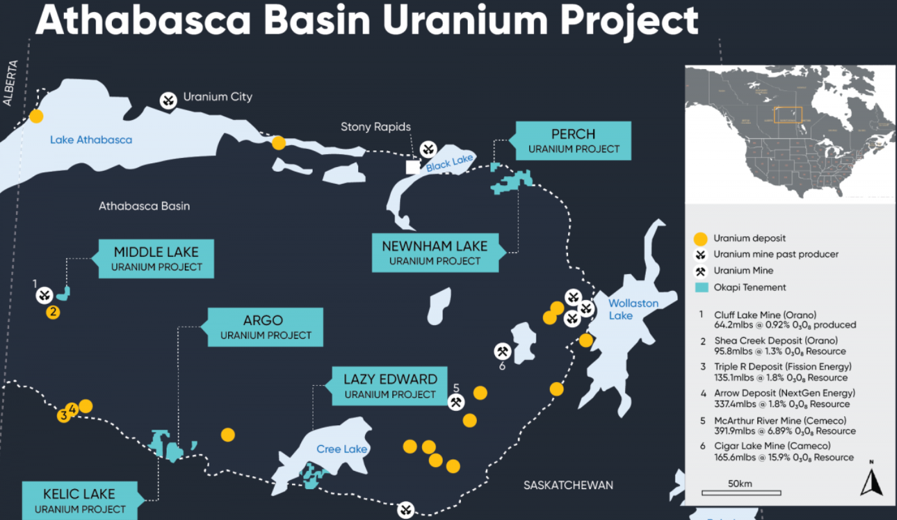
Example: Uranium
Scoured from Canadian Shield by Glaciers
  Sask/Alta Leading Suppliers of High-grade Uranium (~20% of Supply)
Notes:
Uranium is a heavy metal and it is very toxic.
Uranium has a long half life, so not a significant radiological threat but it’s decay products have shorter half lives and can be cancer causing.
Radon is a decay product of Uranium and its prevalence in the area are direct evidence of widespread presence of Uranium and its decay products in the rock and soils in RVC

Slide 43
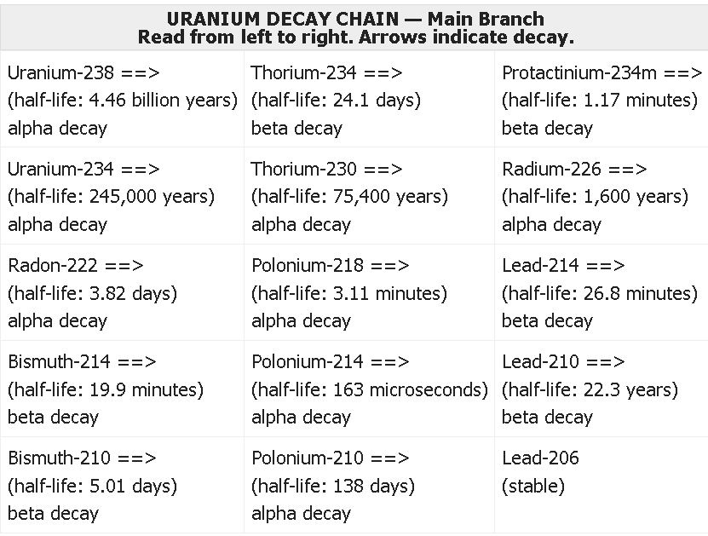
Uranium Decay Products

Slide 44
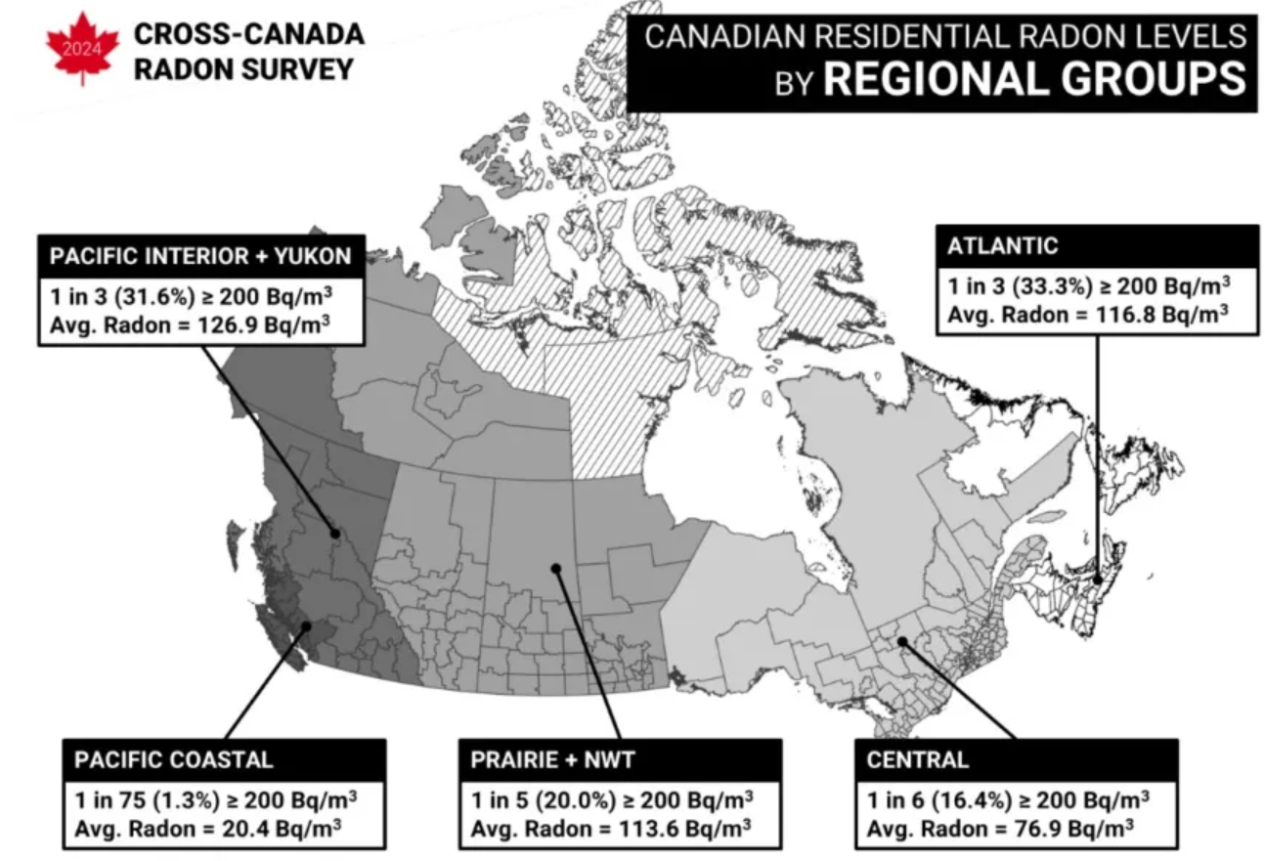
Residential Radon Problem
1 in 5 Prairie Homes are Above Limit
Second-leading Cause of Lung Cancer in Canadians
Major Factor: Levels of Radium, Thorium, and Uranium in Rock and Soil
Notes:
Uranium is a heavy metal and it is very toxic.
Radon is a decay product of Uranium and the prevalence of Radon issues in Alberta and BC are direct evidence of widespread presence of Uranium and its decay products in the rock and soils in RVC

Slide 45
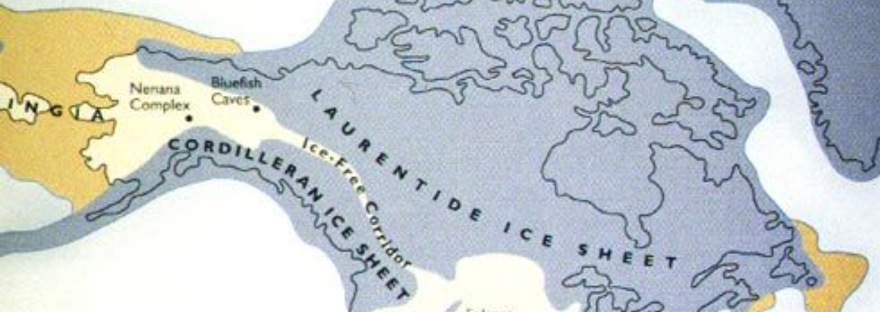
RVC Gravel: Ice Free Corridor
Notes:
Depositional Environment
Glaciofluvial, glaciolacustrian
Glacial transport from Rockies and Canadian shield over long distances and 100,000+ years
Ice left terminal and lateral (side) moraines as glaciers receded with lithology/geology/hydrology modified by water flows under and around receding ice starting around 15k to 20k years ago
The Bow River valley was formed, in large part, by these moraines and massive glacial melt water flows at the end of the Pleistocene
Summary: Extremely complex lithology, geology, hydrology
Lithology – Igneous, sedimentary, metamorphic
Toxins – Organics, heavy metals, salts, radio isotopes
Hydrology – Complex channels/aquifers formed by moraines, river channels, tributaries, river backwaters, and glacial lakes

Slide 46
RVC Aggregate Mine Explosion
List all Existing and Proposed Mines Here
Notes:
Click to add Notes

Slide 47
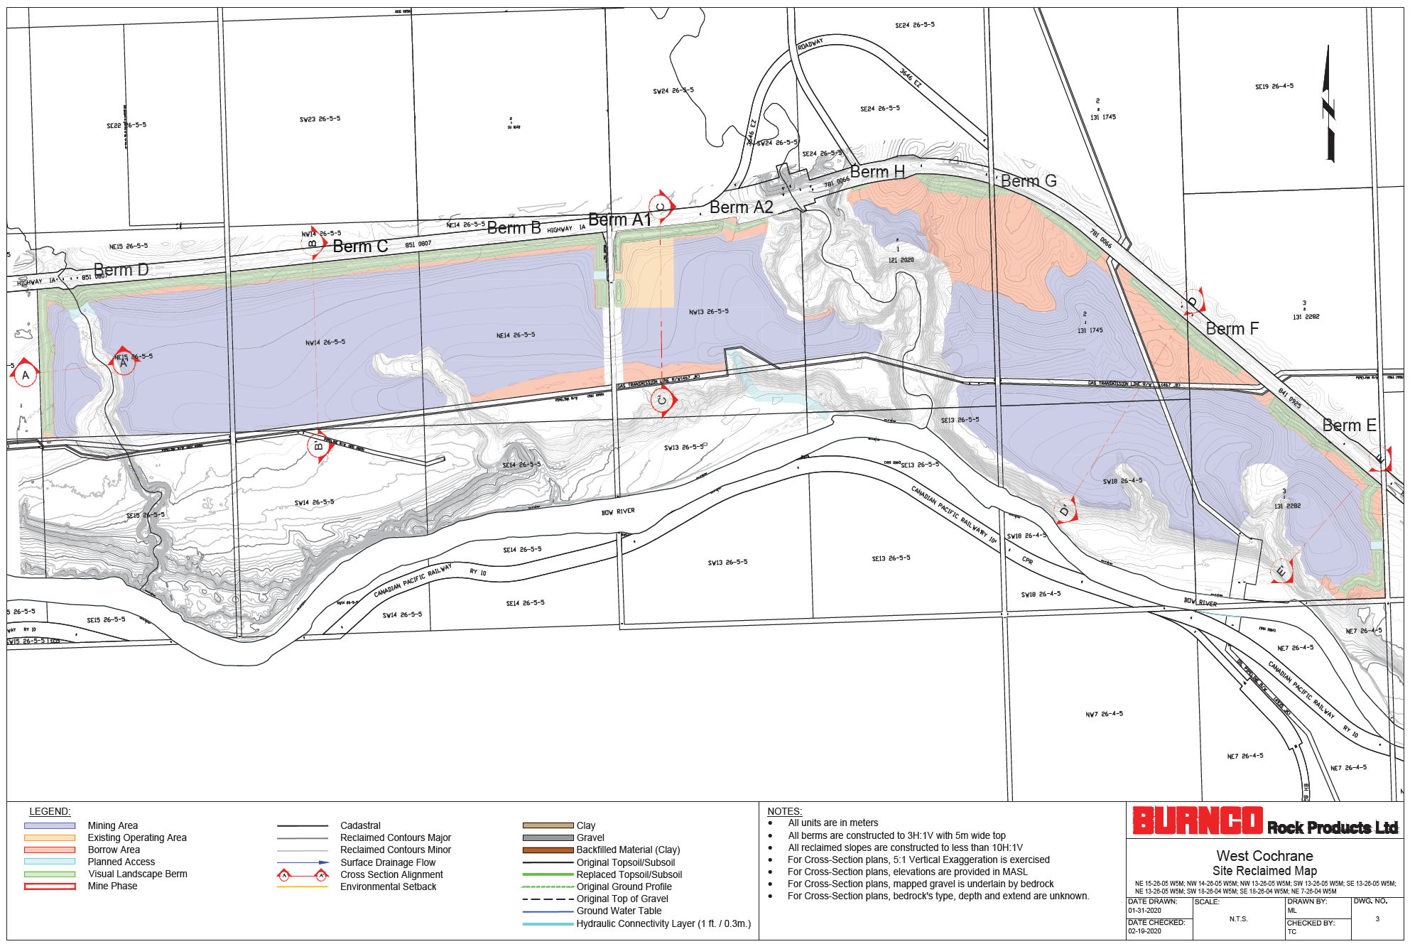
Burnco West Proposed Site

